Slide 1
SSIO Enhanced Communications Taskforce Report
01/2017

Slide 2
Announcement (July 2016)
Enhanced Communication Task Force was formed in July 2016
The new system will aid the SSIO in effective communication between the Prasanthi Council, Zones, Committees, Countries, Centres and Groups, and the SSIO members.

Slide 3
Taskforce Team
Anupom Ganguli (Chair of Media Committee)
Deviesh Tankharia (Chair of Sathya Sai International Youth Leadership Program)
Jenny Monson (Senior Member, Australia)
Krishna Srinivasan (Member, IT Committee)
Manfred Muller-Gransee (Central Coordinator, Zone 7)
Srinivas Raghavan (Member, Education Committee) – Task force lead
Suri Metla (Co-Chair, Parent Council, Sathya Sai School, Canada)
Tomas Bures (Member, IT Committee)

Slide 4
Pilot Test : Holiday Message
Holiday Message from Dr. Narendranath Reddy, Chairman, Prasanthi Council
Message Distribution
  Zone Chairs, Central Coordinators, Deputy Central Coordinators, Committee Chairs, International Youth Coordinator
  National Council Presidents – Mailing List @ sathyasai.org
  NCP’s asked to forward the message and BCC sairam@sathyasai.org

Slide 5
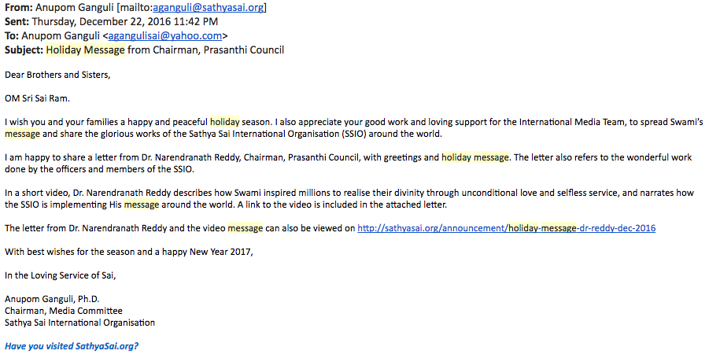
Holiday Message from Chairman, Prasanthi Council

Slide 6
Distribution Summary Across Zones
Zone | # NCPs | # FWD | %
1 | 12 | 6 | 50%
2A | 12 | 1 | 8%
2B | 11 | 2 | 18%
3 | 3 | 2 | 67%
4 | 12 | 3 | 25%
5 | 4 | 1 | 25%
6 | 12 | 6 | 50%
7 | 16 | 9 | 56%
8 | 6 | 0 | 0%
9A | 19 | 4 | 21%
9B | 12 | 2 | 17%
Total | 119 | 36 | 30%

Slide 7
Next Steps
SSIO Individual Email Accounts
  Prasanthi Council, SSWF, Zone Chairs, Central Coordinators, Deputy Central Coordinators, SSIO Committee Chairs
SSIO Placeholder Email Accounts
  National Council Presidents (One per country)
  Others as needed
Communications Delivery Team
  Translation & Diffusion teams across zones with non-English speaking countries
  Work to improve outreach to all English speaking countries
  Resolve issues and offer training and support to SSIO officers

