Slide 1


Slide 2

WHAT IS A CAREER
Includes all work-related positions
Consists of the positions involved in jobs

Slide 3


ACTIVITY
“Üntil you know who you are, you will not know what you will become”

Slide 4

List of careers
Technician
Dietician
Food technologist
Advertiser
Shop keeper
Salesman entrepreneur
Quality controller
Tree feller
Researcher
supervisor
Packer
Artist
Innovator
Farmer
Marketing manager
Editor
Bag maker
Chip maker
Machinist
accountant

Slide 5
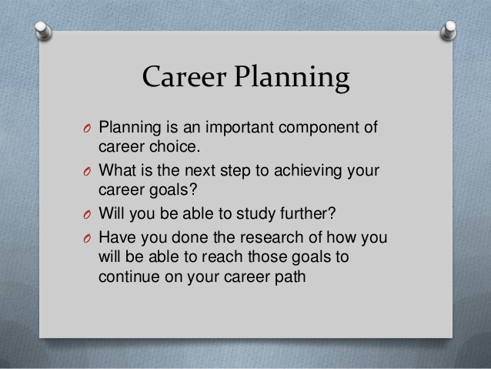

Slide 6


Slide 7

BARRIERS TO CAREER CHOICE
WHAT ARE THE BARRIERS FACING YOUNG PEOPLE TODAY?
IN GROUPS YOU MAY RESEARCH THAT.

Slide 8
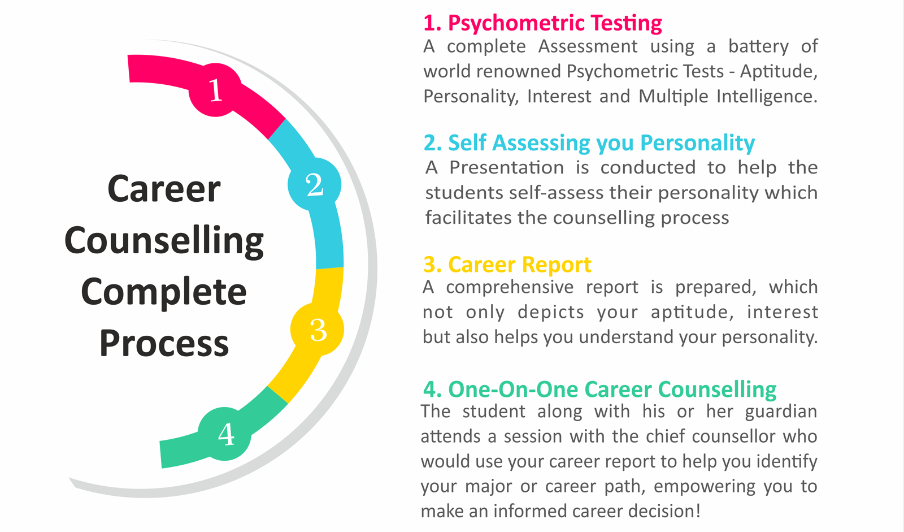

Slide 9
LEARNING JOURNAL
Knowledge on career counselling, personal and community support
Career guidance, self assessment tools, world of work
Skills-CV writing, letter writing, networking for a job, Bursary application
Self confidence, honesty, integrity, self realization ,faith,

Slide 10
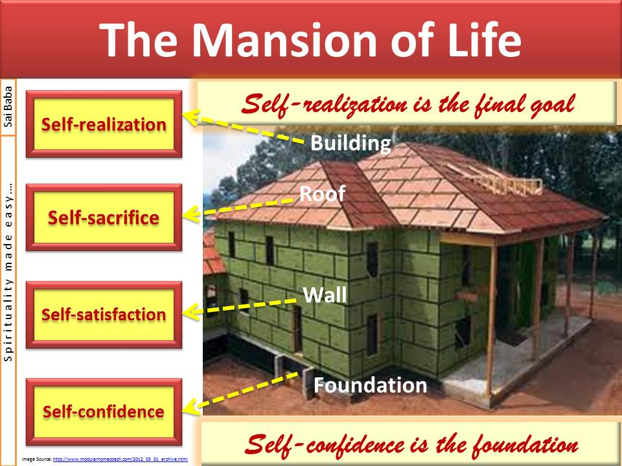

Slide 11


STORY:TURN OF THE TIDE
ARTHUR GORDON

