Slide 1
Introduction to WebEx
A Tutorial

Slide 2
Objective
Understand the benefits of WebEx
Learn how to sign on to a meeting
Learn how to host a meeting

Slide 3
Benefits of WebEx
WebEx allows you to host online meetings with Audio, Video and Desktop Sharing
WebEx is a very good choice for online meetings that will include sharing of documents, presentation and/or your desktop screen
It is very easy to switch presenters and to control who is sharing
Ability to schedule and send out meeting invites in advance

Slide 4
When to Use Other Technologies
For Audio only Conference calls for a small number of individuals Skype may be a better option.
Video Conferences, WebEx does provide the ability for Video Conferences, but other tools may be better suited for this.
WebEx is only free for 3 attendees.

Slide 5
Joining a Meeting
In most cases the host of the meeting will send you and email invitation.
Email will contain a link taking you directly to the meeting.
You will have to enter your Name and Email Address to join the Online Meeting
Once you have joined the meeting you will have to select how you want to join the audio conference

Slide 6
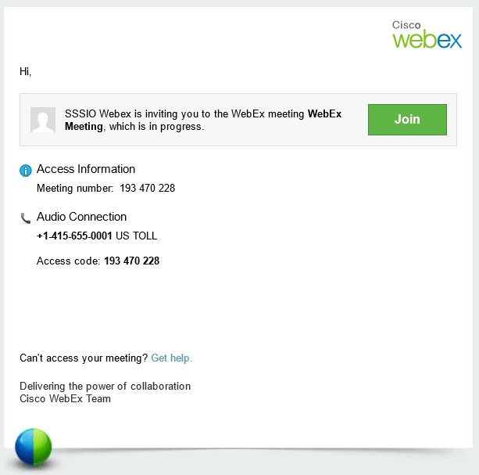
Email Invitation

Slide 7
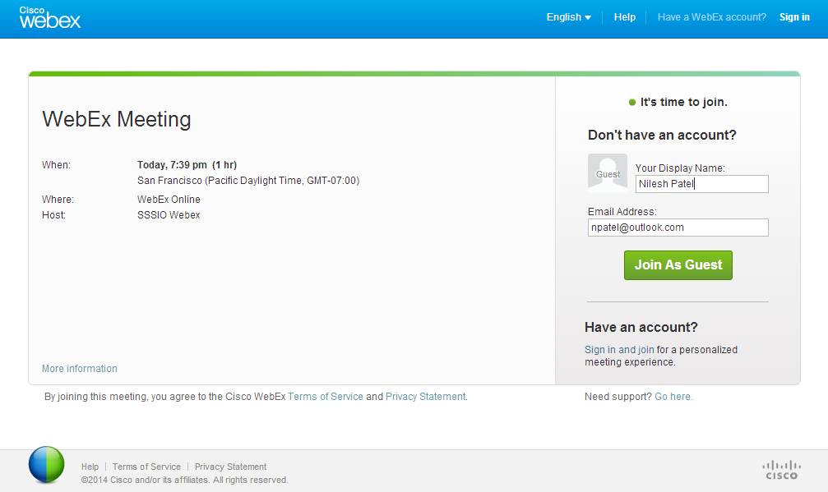
Joining a meeting

Slide 8
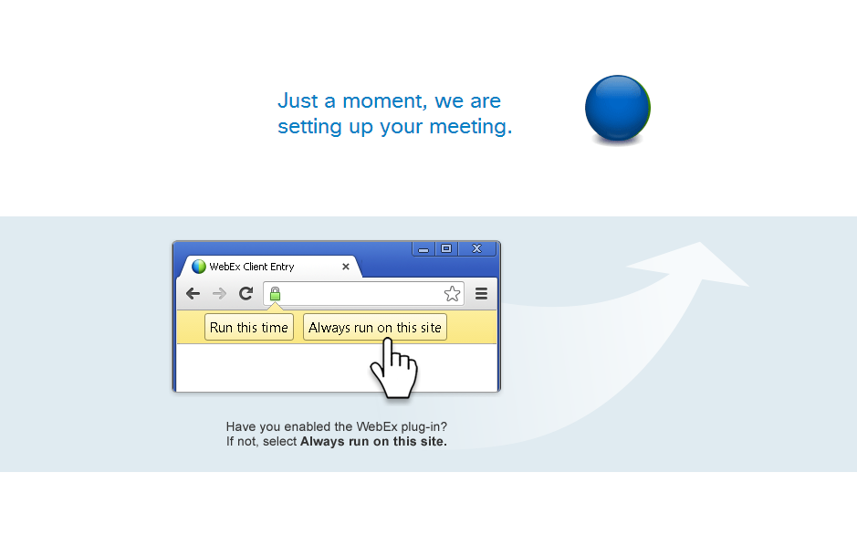
Joining

Slide 9
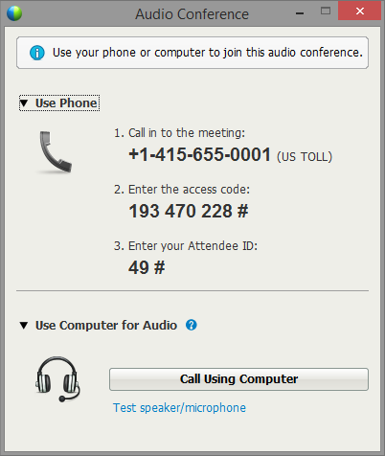
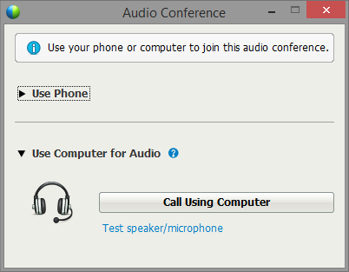
Joining Audio

Slide 10
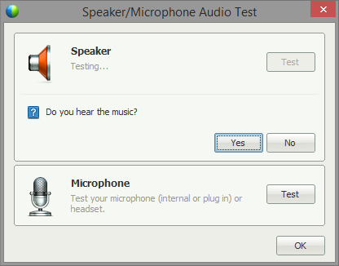
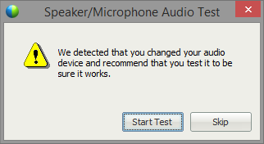
Call Using Computer

Slide 11
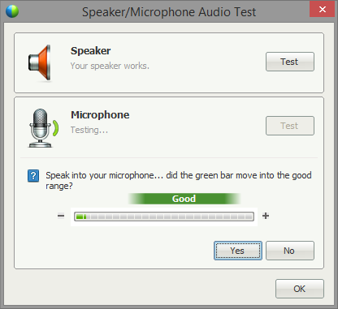
Call Using Computer

Slide 12
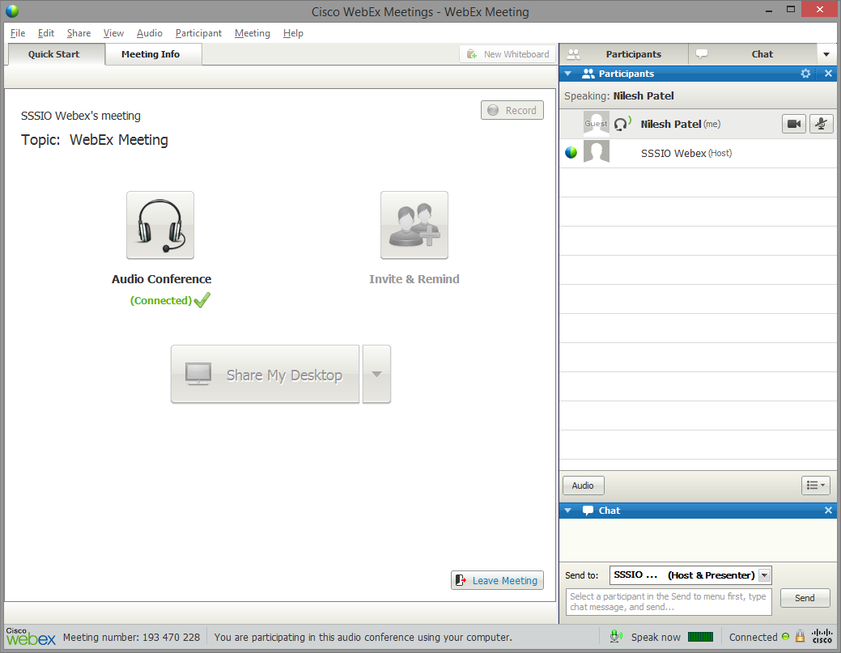
Successfully Connected

Slide 13
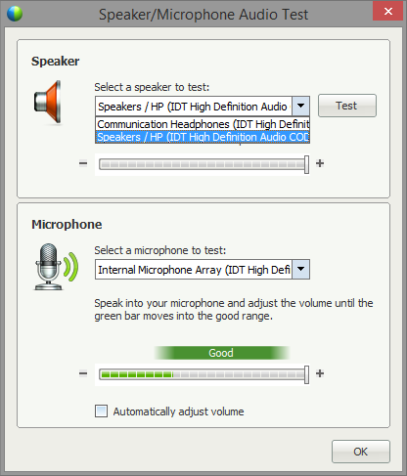
How to Troubleshoot Audio Issues
Click on the Audio Conference Button
Click “Test speaker/microphone”
Uncheck “Automatically adjust volume”
Select correct speaker and microphone

Slide 14
Hosting a Meeting
Hosting a meeting requires a WebEx Account.
Free for 3 Attendees
Account can be setup by going to http://www.webex.com
Instructions on hosting a meeting can be found here: http://www.wbximg.com/includes/documents/GSG_MC_0111_final.pdf
How To Videos on using WebEx: http://www.webex.com/howto/index.html

Slide 15
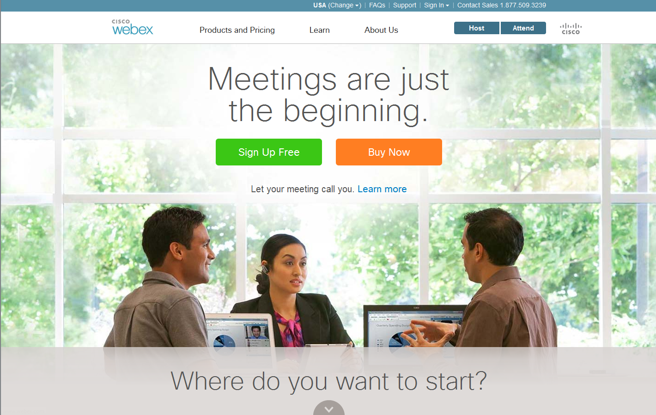
WebEx Home Page

Slide 16
Questions
?

