Slide 1
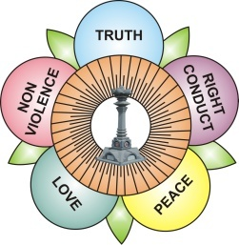

South Africa
Report of Activities – July to October 2014

Slide 2
Background
14 Regions
96 Centres
23 Groups
Regular attendees in excess of 7,500
SSE Students : +/- 2,100
SSE Teachers : +/- 300

Slide 3
Regular Activities
Devotional
  Devotional Group Singing
Education
  SSE Classes
Service
  Regular Medical Programmes
  Support to Sathya Sai Schools
  Blood Camps
Youth
  Youth Programmes
Ladies Forum
  19th of the month observed

Slide 4
Theme for 2014
Love and Unity in Action
Same theme for National Conference
Promoted throughout the year

Slide 5
National Conference
July 2014
Attended by 1,000 delegates
Theme : Love and Unity in Action
All Entities Participated
Conference Probed the Question : “Who am I, Where do I come from, Where am I going, and How do I get there?”
Swami’s Ex-Students Shared – Divine Personal Experiences

Slide 6
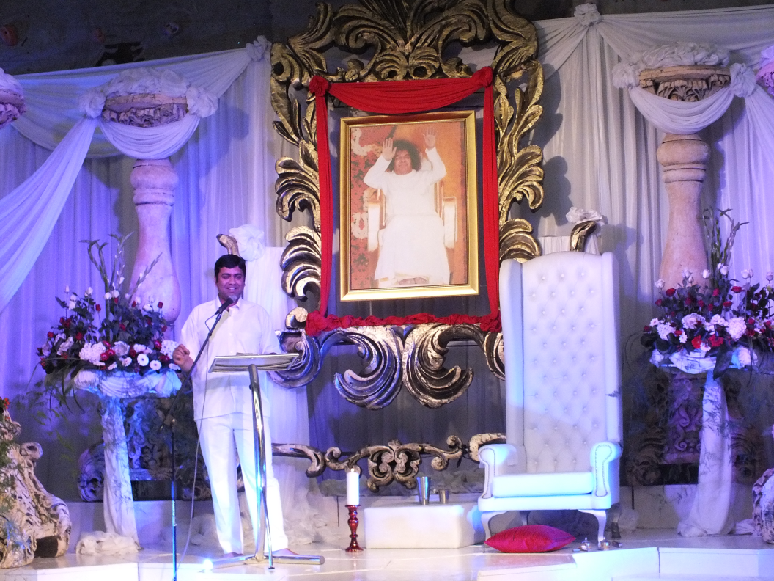

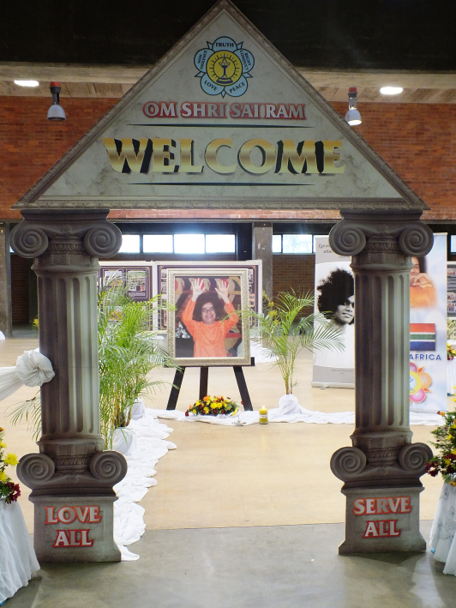
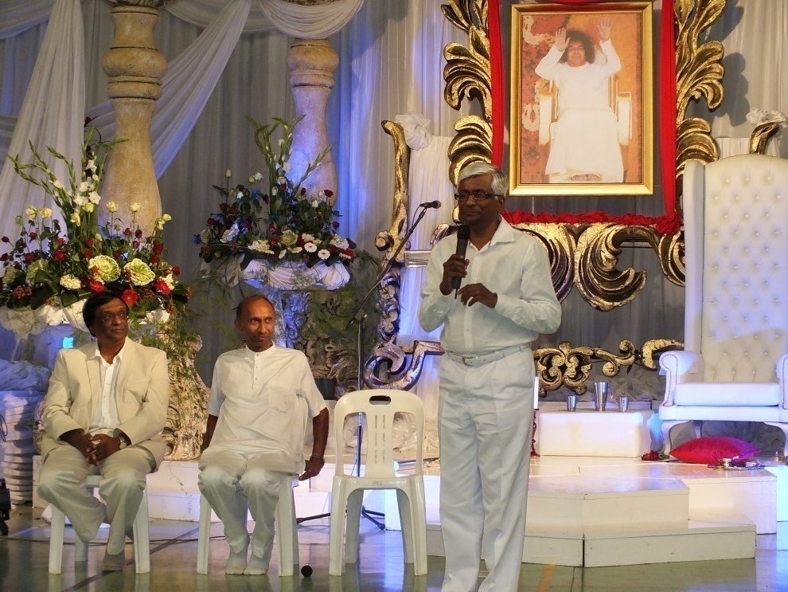
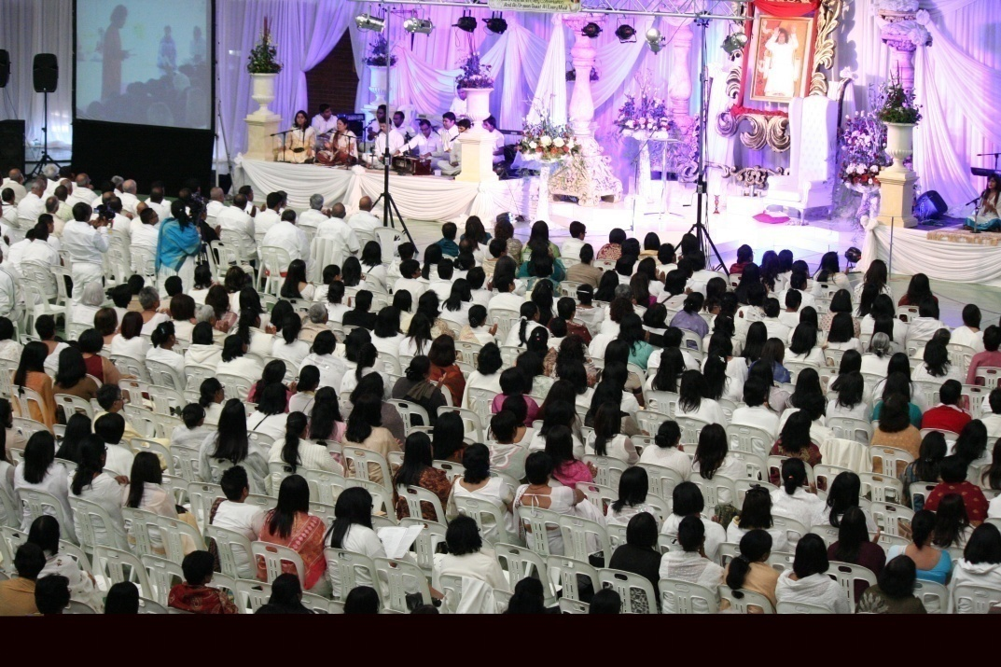
National Conference

Slide 7
Human Values Walk
Conducted on the same day throughout the Country
In excess of 2,000 Participated
Common Banners and Placards Printed and Distributed Throughout the Country
Awareness Raised
Midlands Region – Memorandum Received by Mayor
2015 – All 14 Regions to Participate on Same day

Slide 8
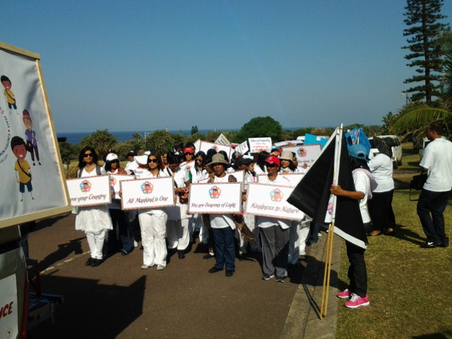
Human Values Walk
Be Simple
& Sincere
Be Simple
& Sincere

Slide 9
Grama Seva and Medical Camp
Grama Seva projects
  In one Province: Grama Seva and Medical Programmes
    Four Per Annum
Four Regions come together
Unity
Well organised

Slide 10
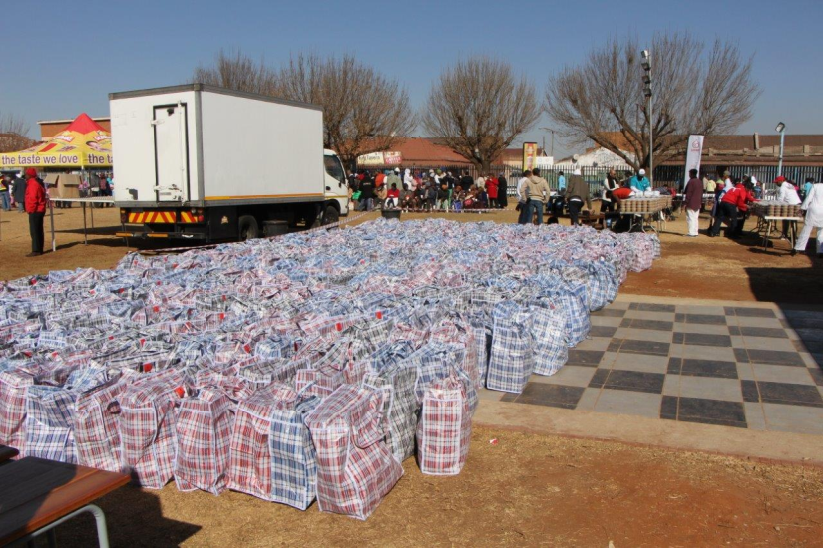
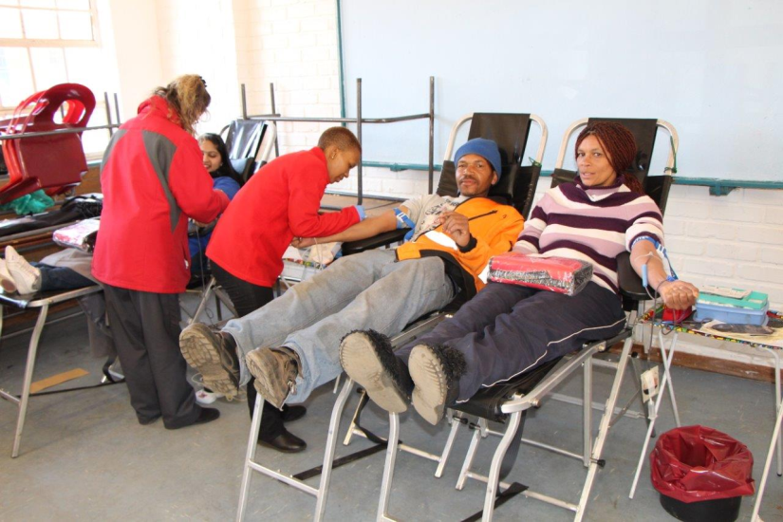
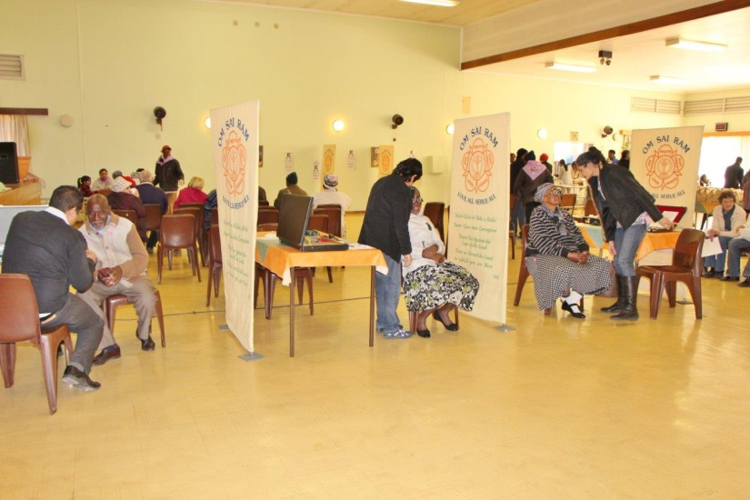
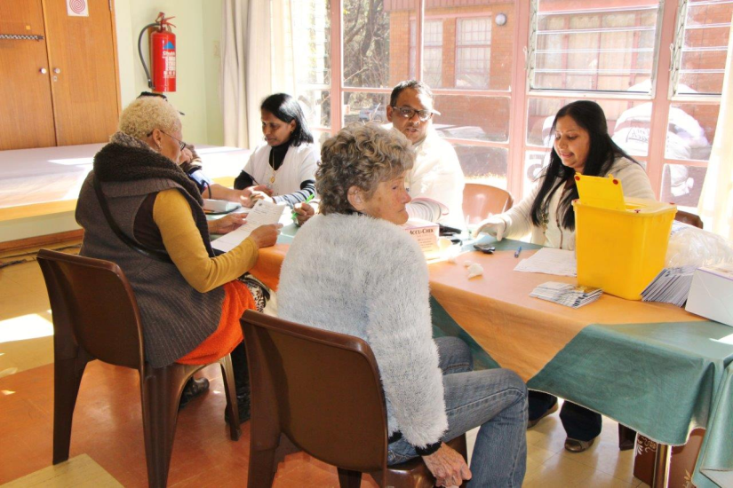
Grama Seva and Medical Camp

Slide 11
Ladies Forum
Active Forum
Recipe Book
  Food Workshops – Recipes provided and Book compiled
  Offering of the Book – Prasanthi Nilayam
  2,000 Books Printed and Being Sold
Part 2 being developed
Will be Published on the Web

Slide 12
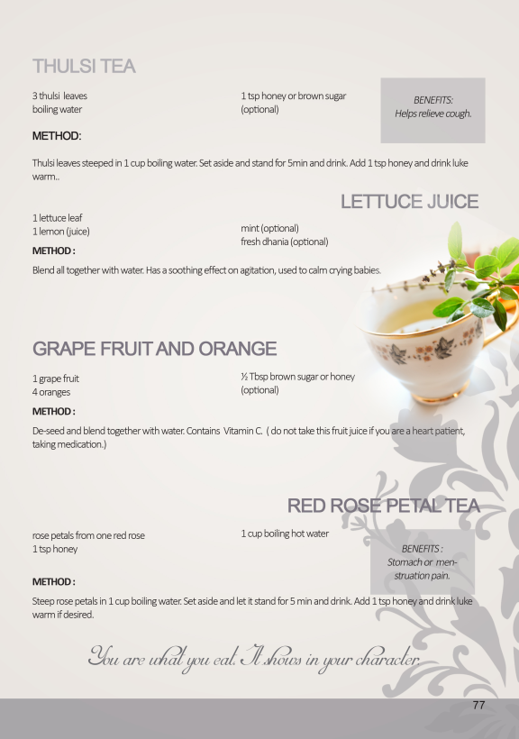


Recipe Book

Slide 13
Youth
Youth Living for Truth Programmes
  Regular Programme
  Held at Large Metropolitan Areas (Provincial Programme)
Youth Day (16 June)
  Programmes throughout the Country
  Theme : Universalism
  Invited Other Religious Groups

Slide 14
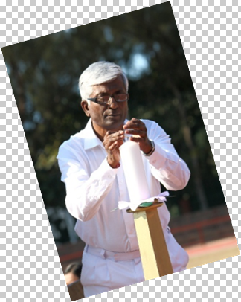
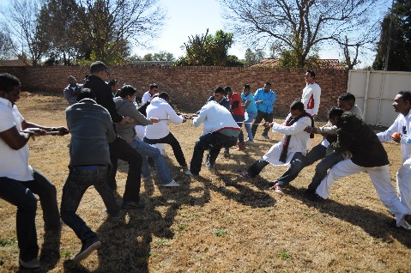
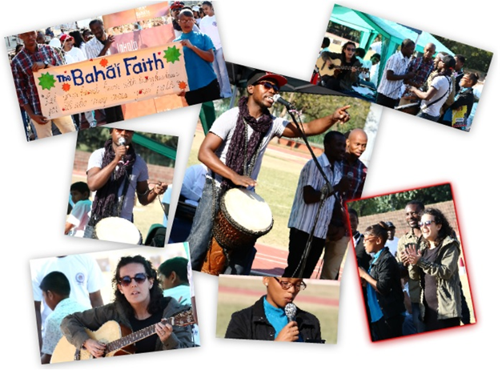
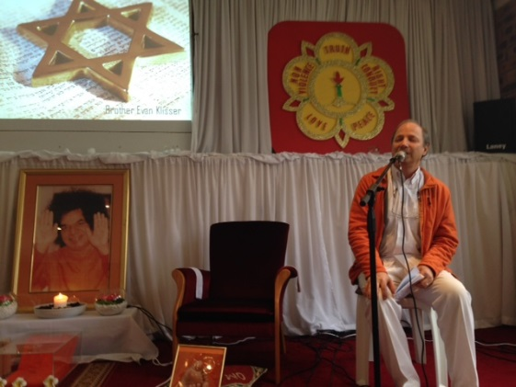
Youth Day Programmes

Slide 15
Serve the Planet Project
Focus on Sathya Sai Schools
  Children in the School
  Children : Our Future
Extreme Makeover – 18/19 October 2014
3 Schools
All Regions, All Centres
Legacy Project (computer lab)
Unity Project

Slide 16
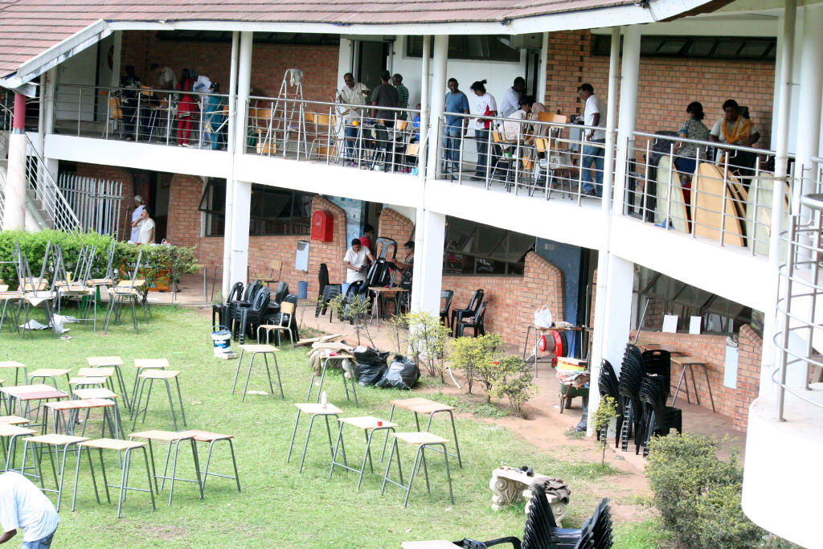
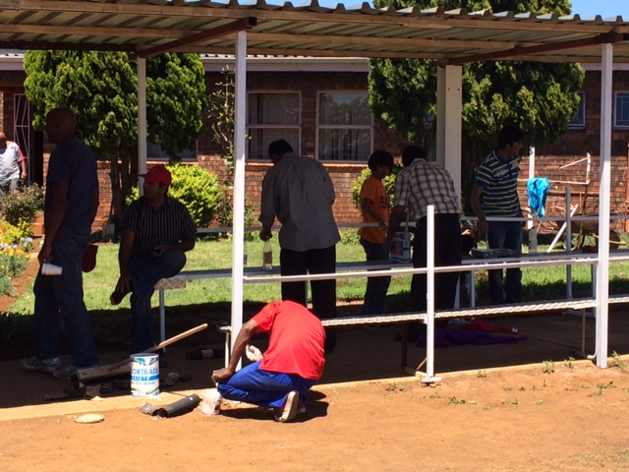
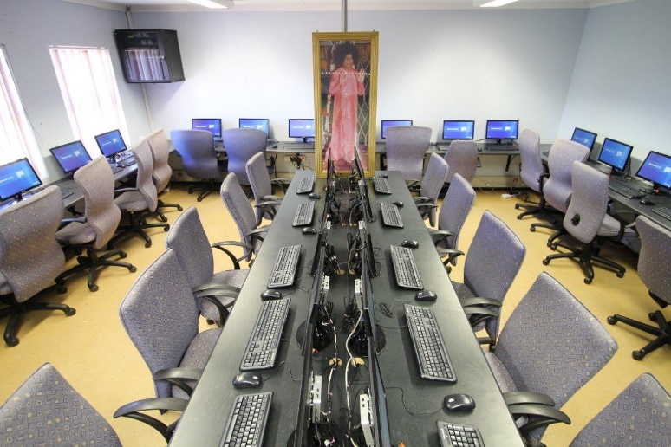
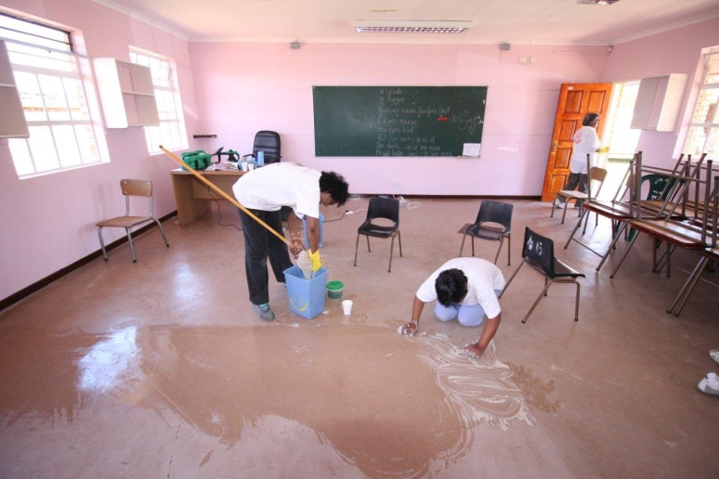
Serve the Planet Project
Legacy Project – Computer Lab

Slide 17
Planning for 2015
Special Planning Meeting – 25/26 October 2014
Preparing for Pre-World Conference
  June/July 2015
Preparing for World Conference
  Registration of Cenference Delegates
  Task Team Being Finalised

Slide 18
MAURITIUS
Report of Activities – July to October 2014

Slide 19
REPORT OF ACTIVITIES IN MAURITIUS FROM 1 JULY TO 30 OCT 2014
Guru Purnima
Ladies Sports Meet
National Conference
National Quiz Contest for Balvikas students
Sathya Sai Leadership Training Programme
Handicapped Day
Serve the Planet

Slide 20
Guru Poornima Celebrations
Guru Poornima was celebrated in Centres
National cultural programme was held on 20th July at Wooton Sai Centre
The Youth presented a special programme together with the National Spiritual Coordinator.

Slide 21
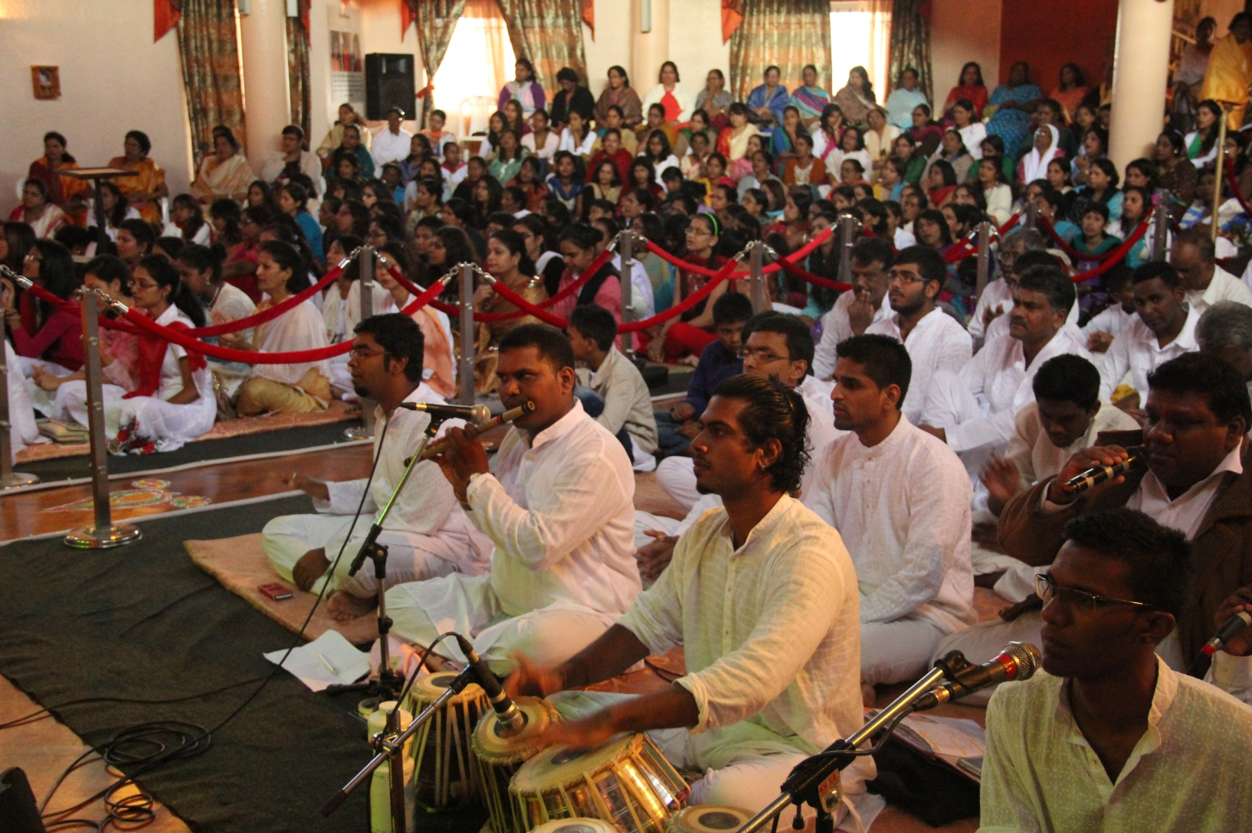

Slide 22
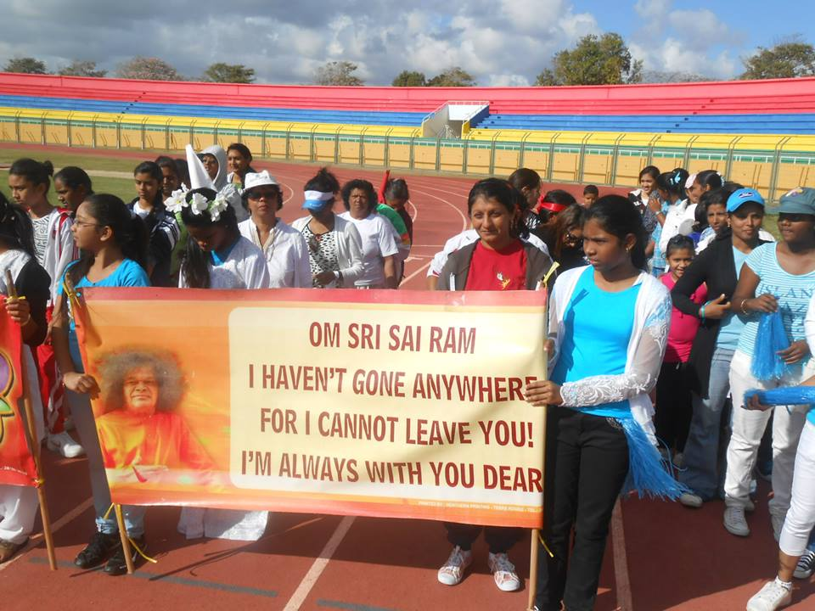
Ladies sports meet held at Anjaley Stadium on 15 August 2014

Slide 23
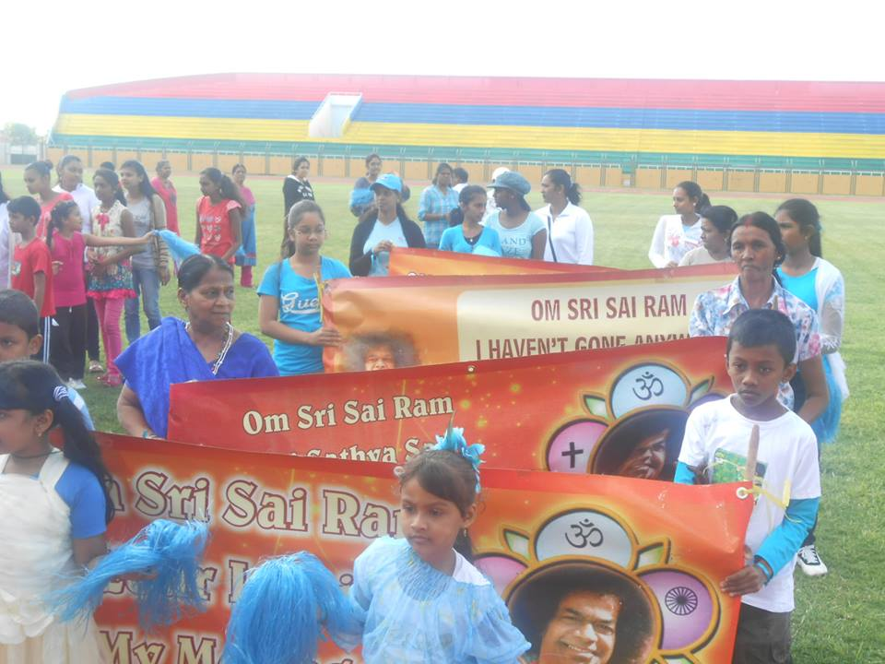
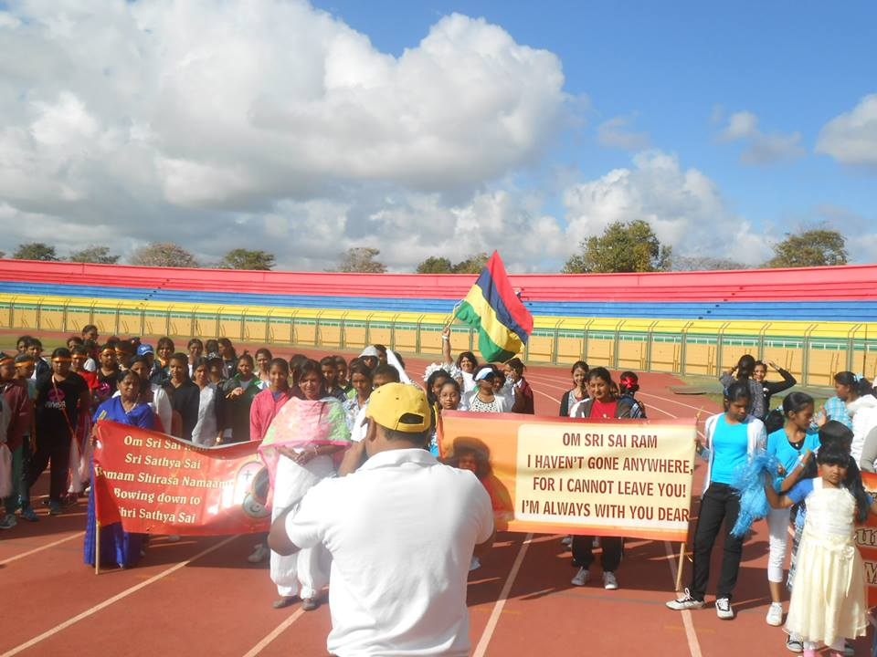
Sri Sathya Sai Service Organisation of Mauritius
Report July 2014 to October 2014

Slide 24
National Conference
The National Conference on the theme ‘Unity and love in Action’ was held on 6th September 2014, at the Rabindranath Tagore Auditorium.
The guest speakers were Prof. Art-Ong Jumsai and Sister Lorraine Burrows.

Slide 25
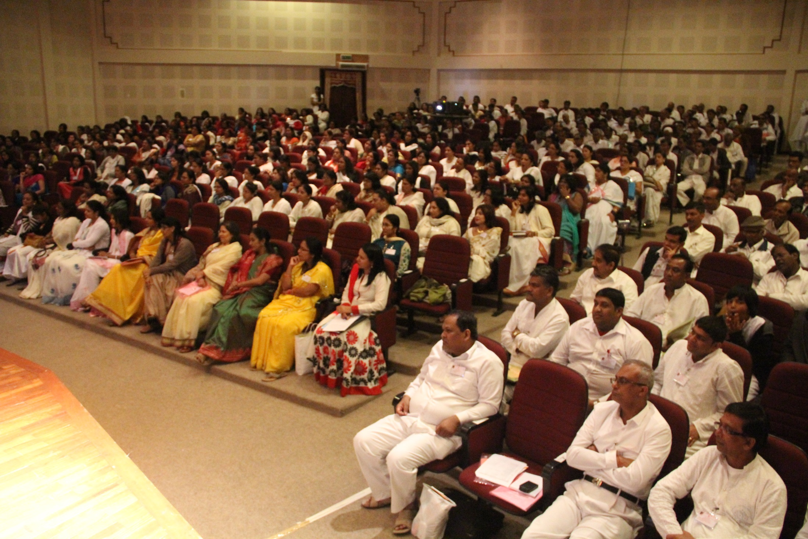

Slide 26
Sathya Sai Leadership Training Programme
The first SSLTP in Mauritius started on 26 July with 90 enrollments.
The course had six modules and the Youth were blessed with an additional session by Sister Lorraine Burrows from the Sathya Sai School of Thailand.
A first cohort of 70 Youth who successfully completed the SSLTP programme were awarded certificates on 11th October 2014.

Slide 27
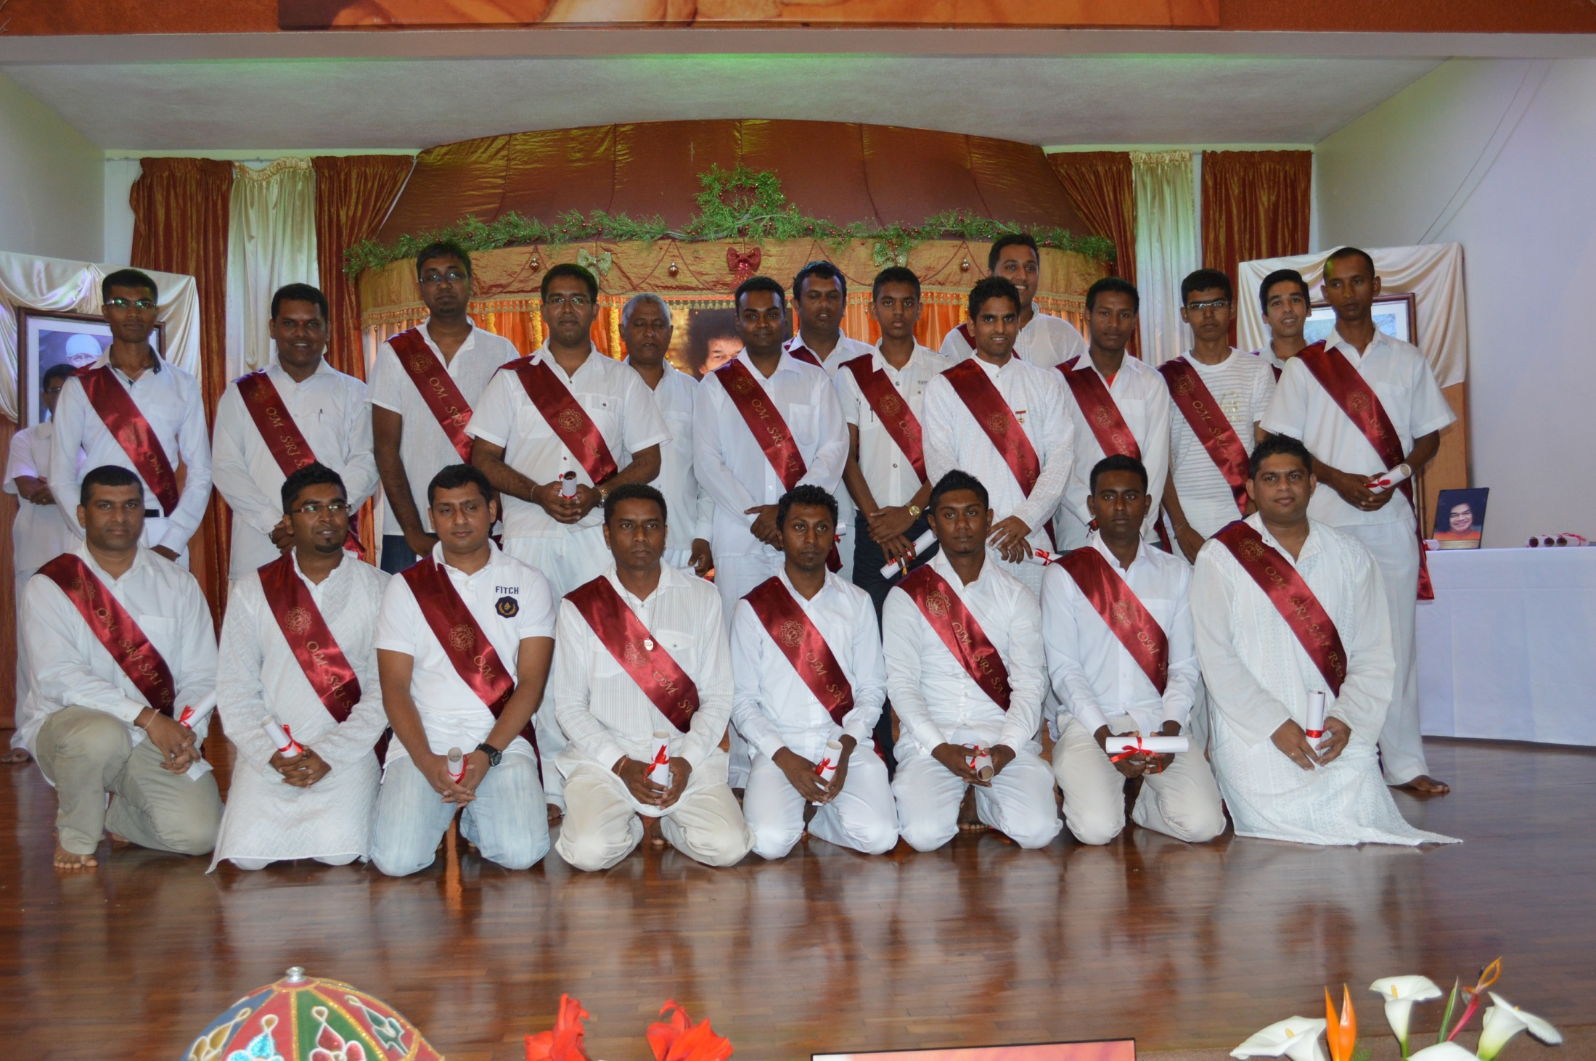

Slide 28
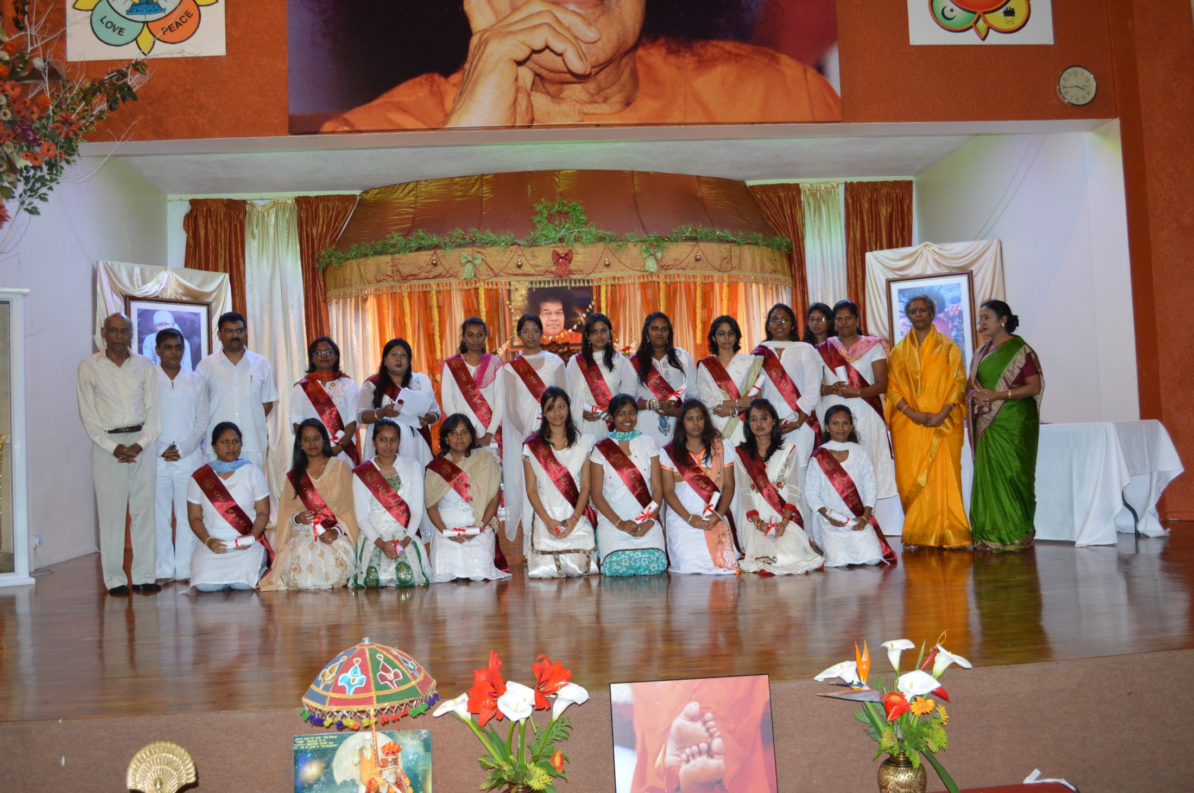

Slide 29
Handicapped Day
The SSIO of Mauritius organised a series of activities in all 8 regions.
Physically challenged persons from all over the region were brought together for a day out.
Popular programme; organised every year - homes, specialised schools and institutions taking care of physically challenged persons are invited for an outing, mostly by the seaside.
Tents are erected to host the event and ambulance services, life savers, and fire services are arranged for safety.

Slide 30
Serve the Planet
The Youth in Mauritius organised various activities in Centres:
Taking care of children who are victims of domestic violence and who have been taken away from their parents.
Child development activities, karaoke and dances with live music were organised.
Lunch was served.

Slide 31
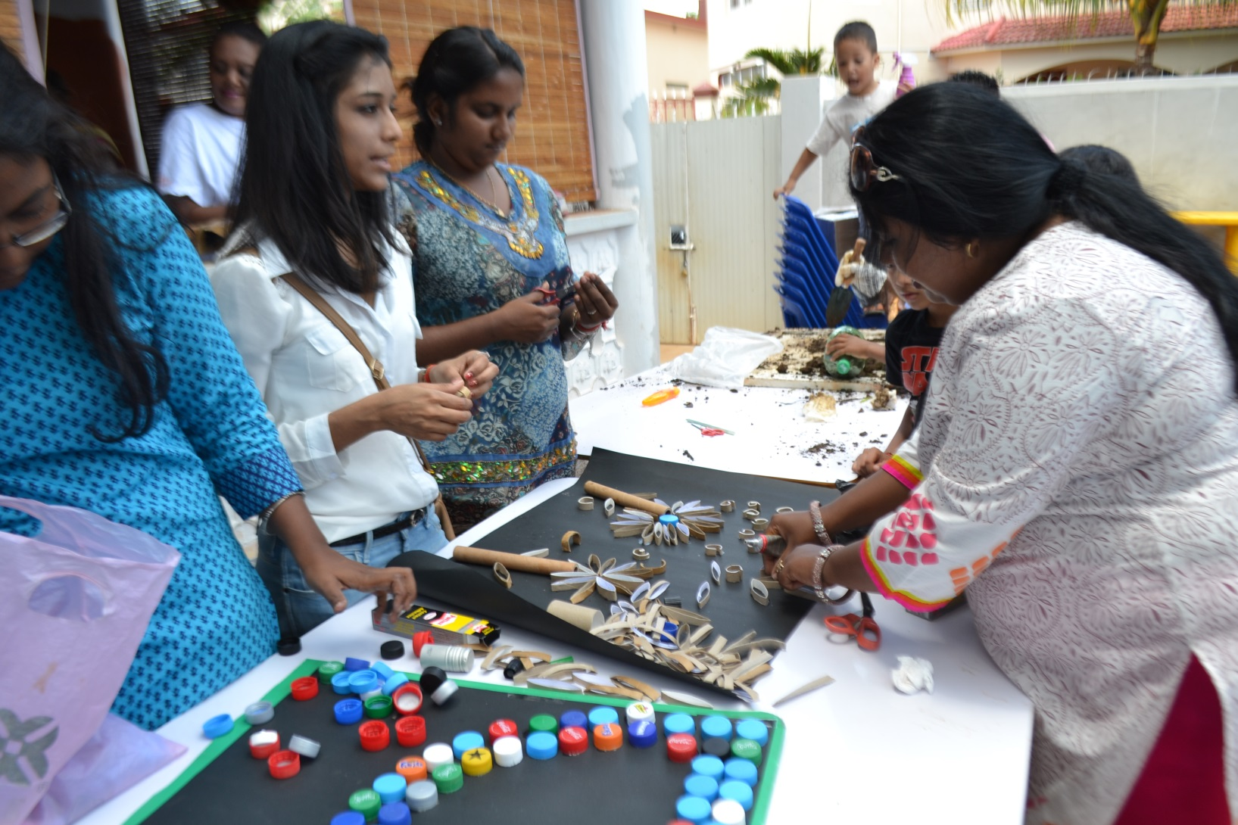
Serve the Planet –Special Care for Children

Slide 32
BOTSWANA

Slide 33
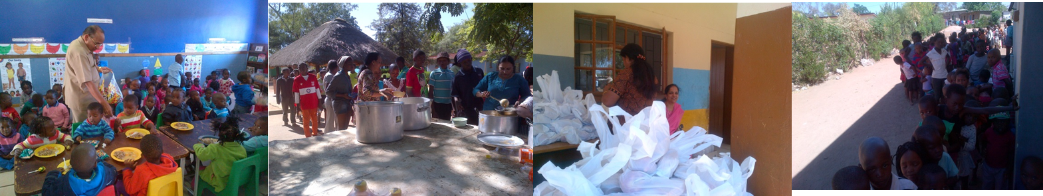

GABORONE
400 underprivileged children - 1st Sunday of every month at Naledi Day care Centre
150 children - Save Our Souls Village- Gaborone - last Sunday /month
Ladies Forum – cooking of meals
Youth packed food hampers (40 babies & 90 children)
Seva done for Avatar Declaration Day 20th October 2014

Slide 34
GABORONE - MEDICAL SEVA
TYPES OF TREATMENT
1. Eyes : Spectacles
2. Skin : Dermatitis, Tania, scabies, Allergic Rash
3. ENT : Sinusitis, Upper Respiratory , infections, Tonsillitis, Flu,
4. Cardiovascular: Hypertension.
5. Metabolic : Diabetes Mellitus, Musculo skeletal pams, Arthritis.
6. Females: Pelvic Inflammatory Diseases,
7. Respiratory: Common Cold ,Flu, Bronchitis, TB
8. Dental: Extraction, filling and general cleaning

Slide 35
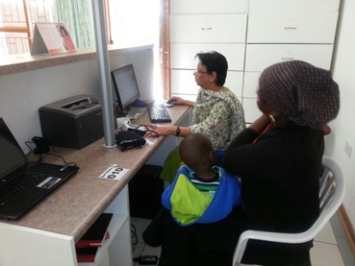
GABORONE - MEDICAL SEVA

Slide 36
Francistown Sai Centre
Narayan Seva for physically challenged kids from deaf & dumb and blind kids from Lephoi centre on 5th October 2014

