Slide 1
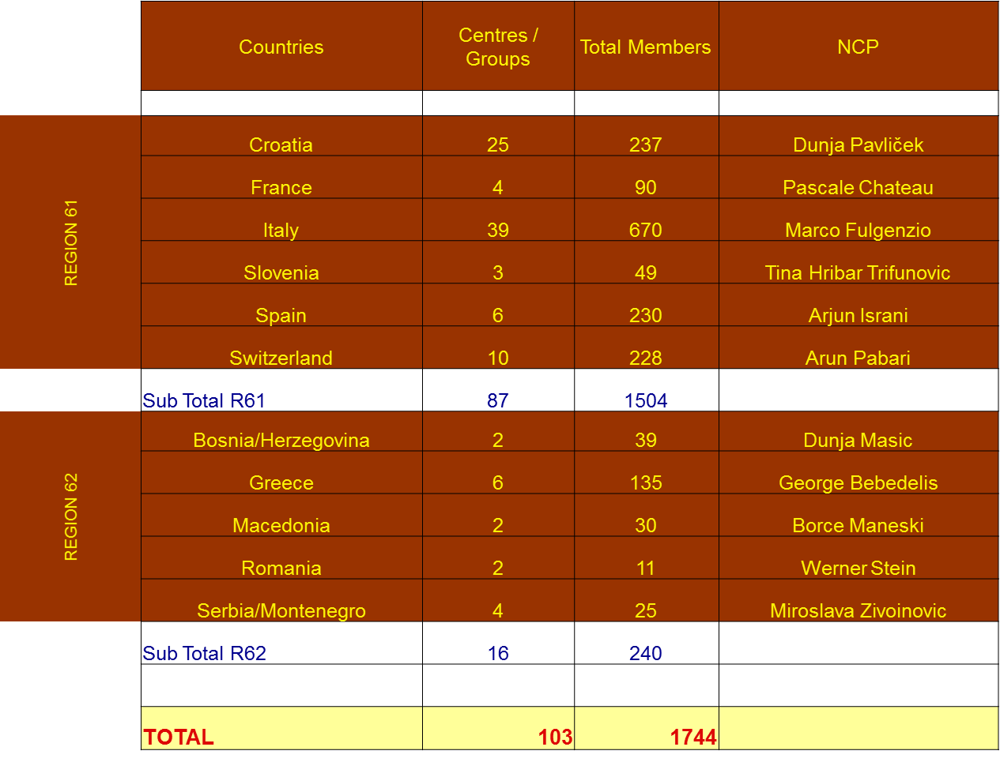
ZONE 6

Slide 2
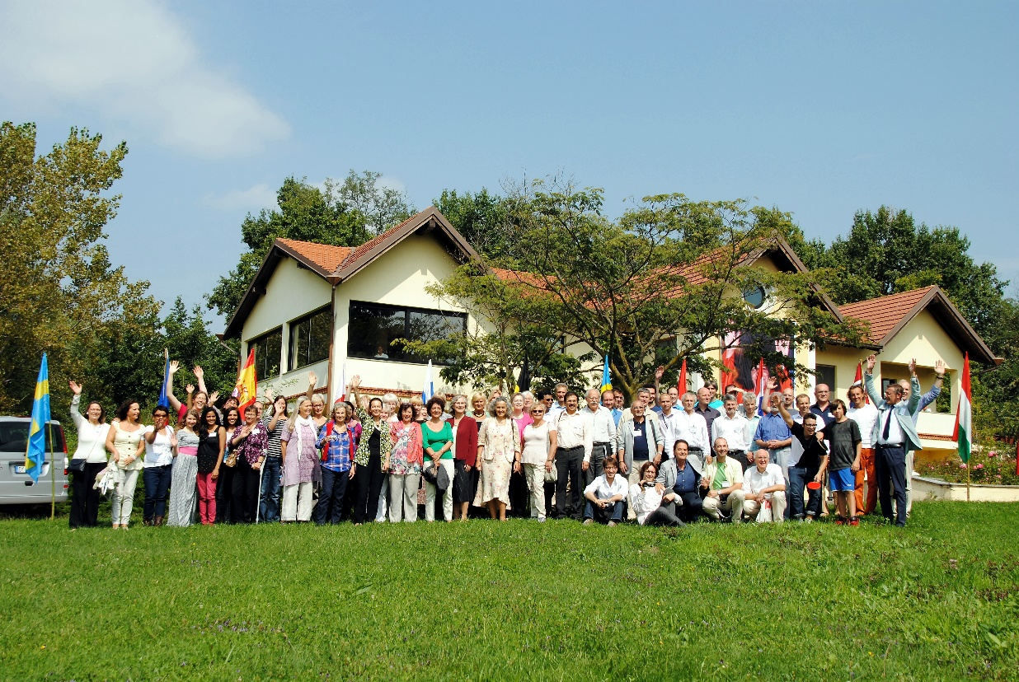
EUROPEAN SSIO AND ISSE SE / ESSE MEETING HELD IN MOTHER SAI HOUSE, ITALY
Zones 6, 7 and 8 Annual Meeting held on the first weekend of September 2014.
Venue: Mother Sai House, Italy.
77 officers from 23 Countries actively participated - 32 Italian volunteers took care of everyone’s needs.
General session held on Saturday morning to communicate deliberations by PC, followed by separated Zone meetings and presentations by ZCs and CCs.
Marianne Meyer, member of SSWF and PC, was present.

Slide 3
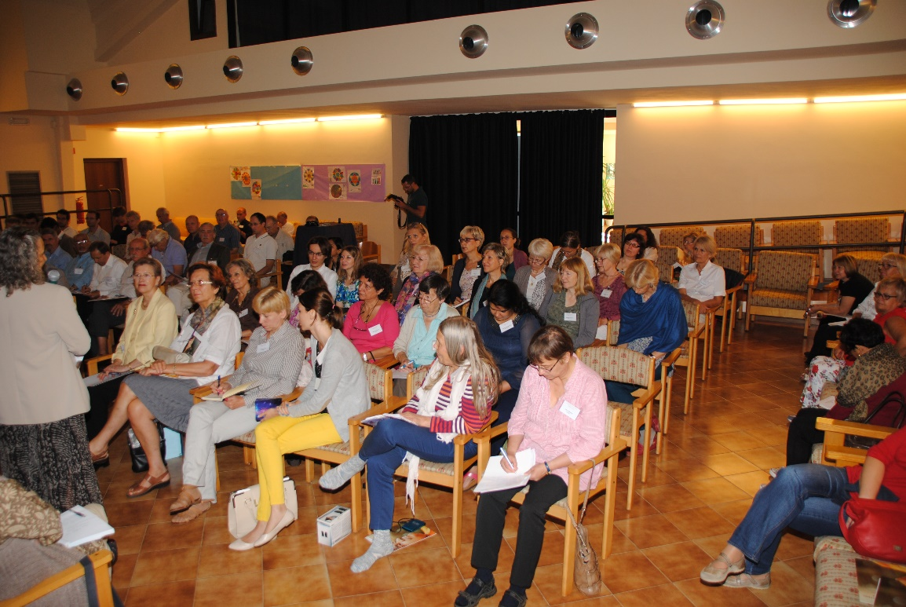
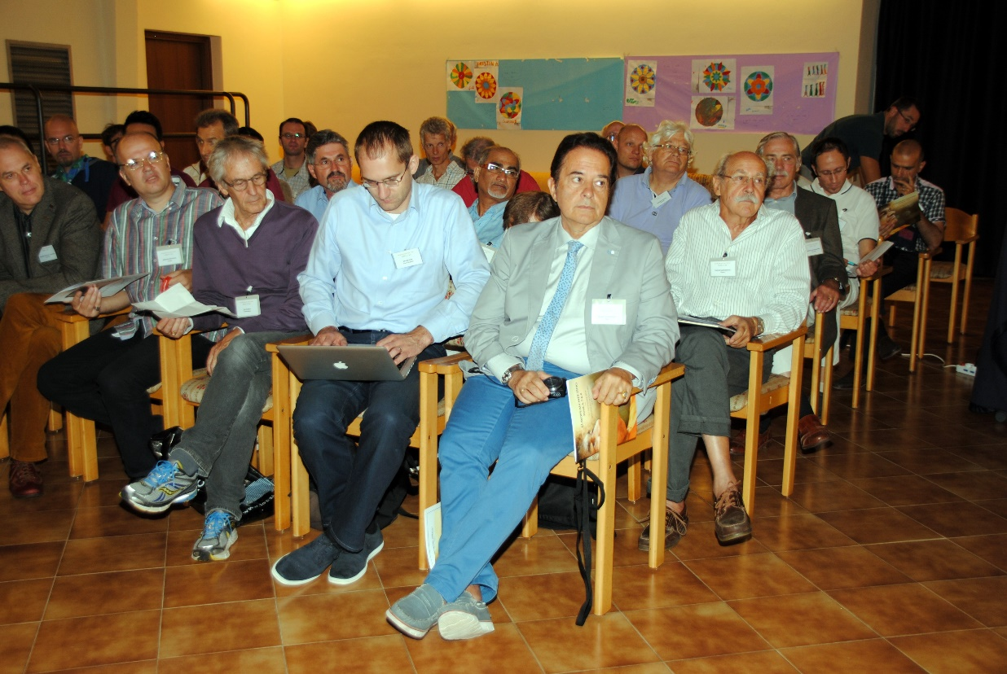

Slide 4
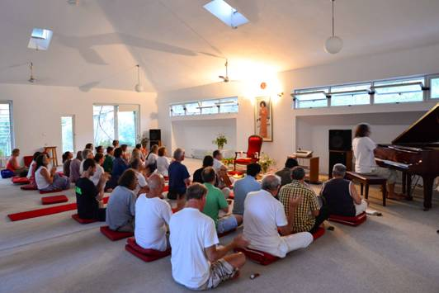
EUROPEAN SADHANA CAMP IN
SAI PREMA, GREECE
31 participants from 7 countries: Italy, Germany, Austria, Switzerland, Slovenia, Finland, and Greece.
Daily programme started with Omkara, bhajans and physical exercises.
Afternoon study circle theme: “Work, Worship, Wisdom” – Bhagawan’s quotations, to be inspired and implement His teachings in daily life.
Amazing experience unfolded day by day, a play was presented, and the mind was crowned by the profound stillness of meditation.
“Samasta lokah sukhino bhavantu” was heard daily in different languages spoken by multinational group.
Camp was great success!
Scheduled for next year again.

Slide 5
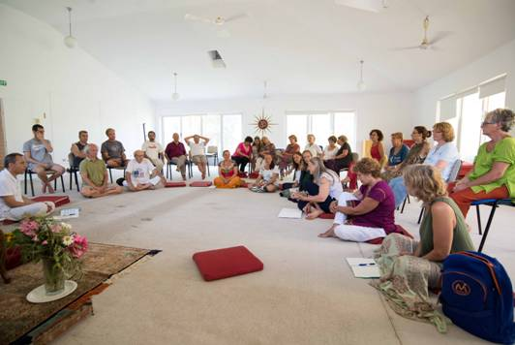
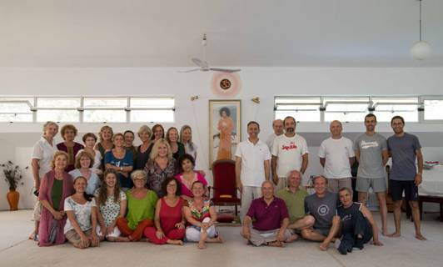
”

Slide 6
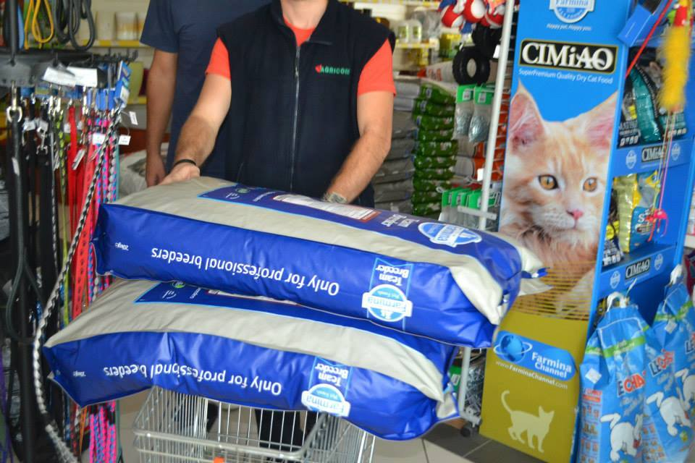
FLOODS IN THE BALKAN AREAS
As anticipated, now that summer is over, families and individuals need different kinds of support (food, furniture, etc.).
The donations received are now being used in parallel for Bosnia, Serbia, and Croatia.
Separate report to follow shortly.
Photos of last service project in Bosnia:
- essential food supplies
- help and food given to animal shelters

Slide 7
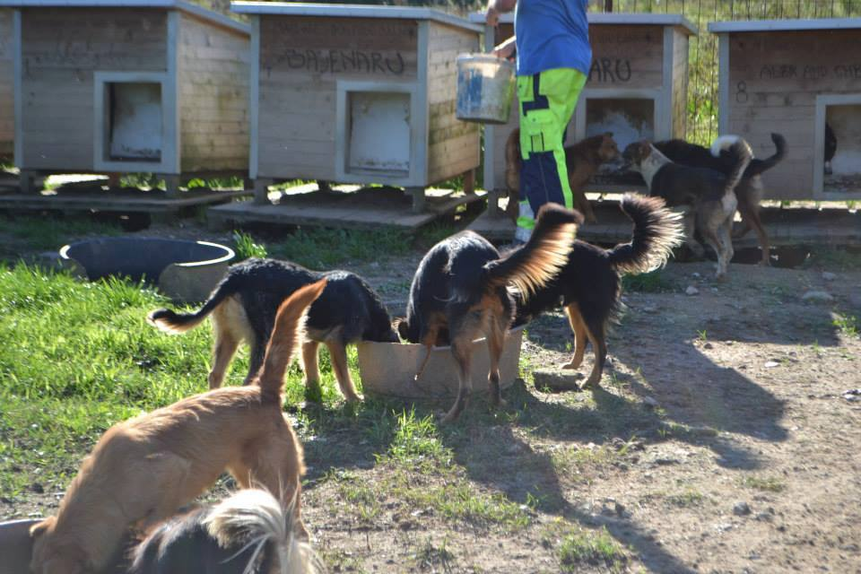
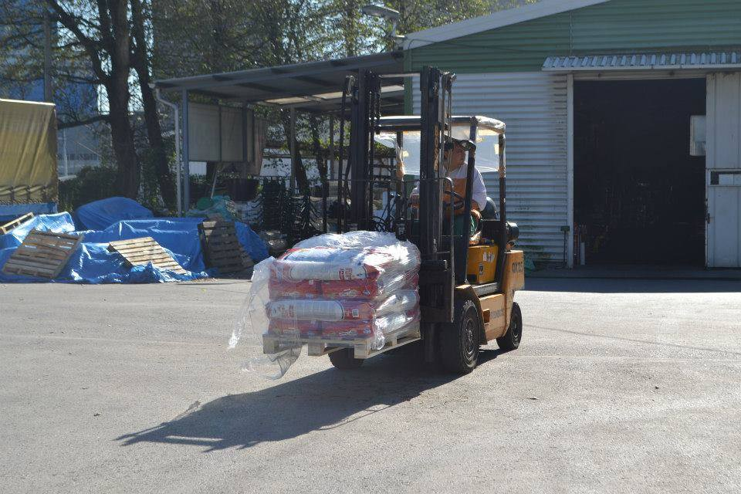

Slide 8
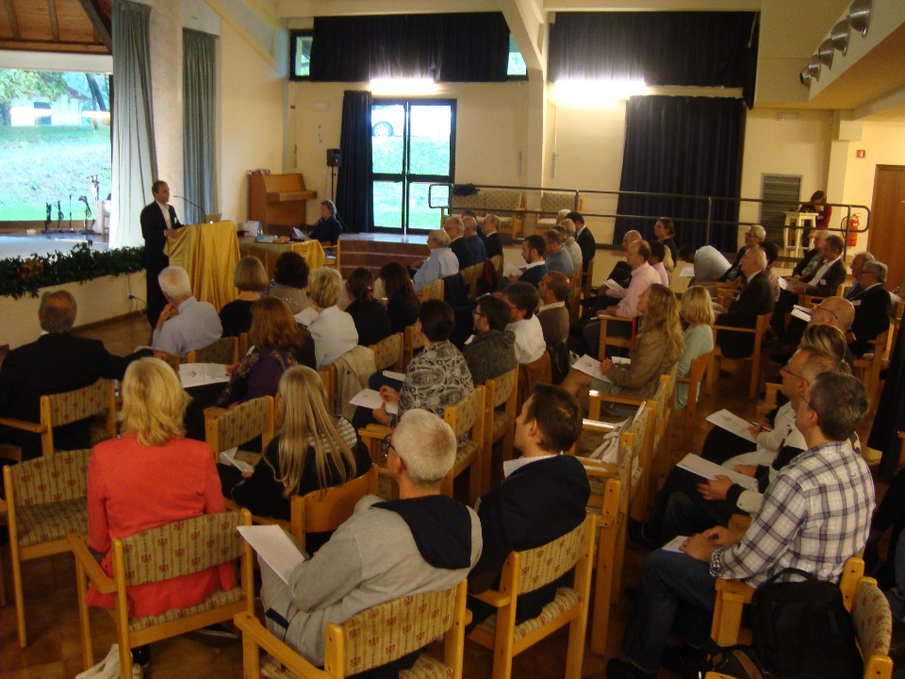
Managing Change and Growth through Human Values”
ISSE SE - Values Leadearship Public Conference
Mother Sai, Divignano - Oct 11 and 12, 2014
66 managers and businessmen participated from all over Europe (Denmark, Holland, Switzerland, Germany, Greece, Romania, Croatia, Serbia, Italy, Spain, Latvia, Poland, Norway). Topics covered:
Sathya Sai Educare and Management, by George Bebedelis (Greece);
Leading with wisdom: success stories, by Peter and Kirsten Pruzan (Denmark);
Why it seems so difficult to practice HV in business: solutions and tools to use, by Jordi Griera (Spain);
Experience from Public sector, by George Vlacopoulos (Belgium);
HV in business: the ways of clubs of service, by Roberto Micolitti (Italy);
Why the business world has to change to a new paradigm, by Werner Stein (Romania);
Educating Future managers, by Vassiliki Stephanides (Greece).
Different workshops evaluated the relationship between
Human Values and Business areas.
Panel discussion concluded Forum on Sunday morning.

Slide 9
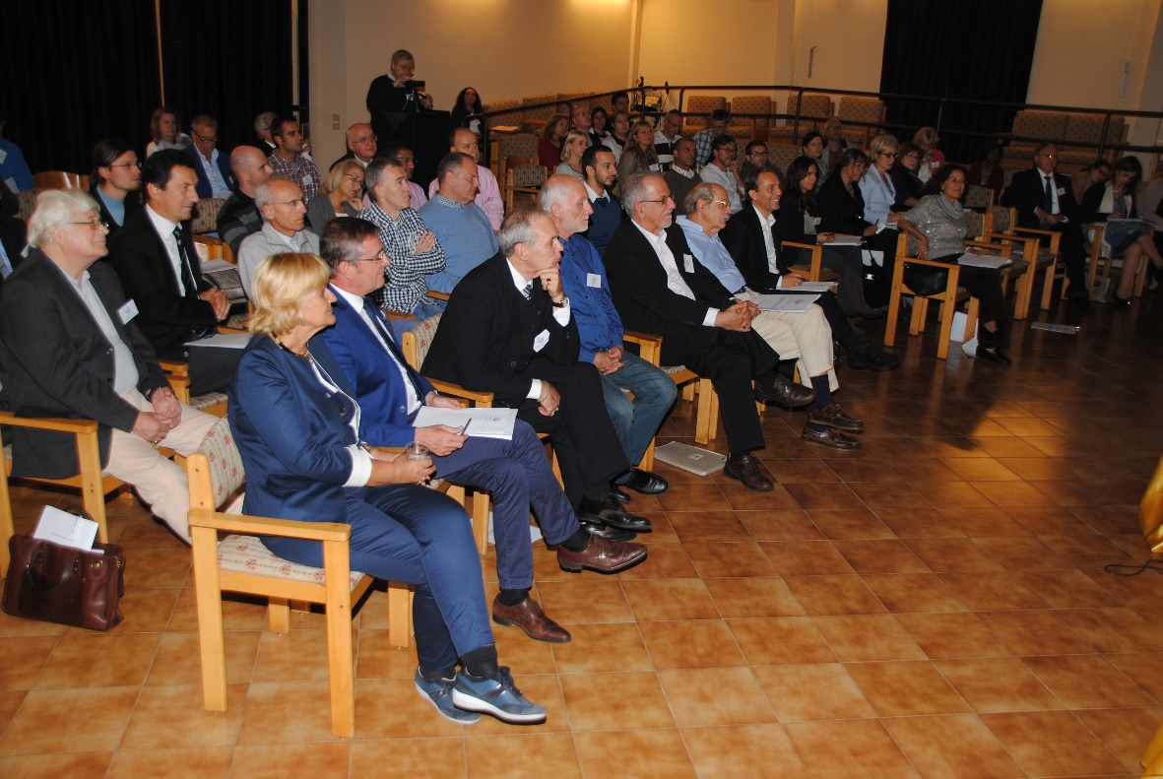

Slide 10
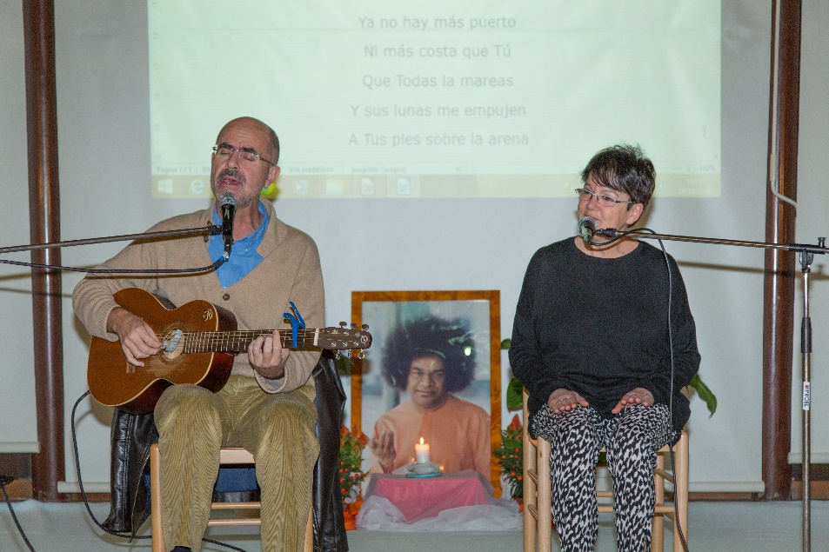
European Devotional Singing Meeting
Mother Sai, Divignano – Oct. 18th and 19th
89 Devotees from 4 European countries, Spain, Switzerland, Italy and Croatia, participated in a Devotional Singing Meeting in Mother Sai.
A part from devotional singing programmes presented by every country, various workshop were organized and presented during the Meeting.
Some of the topics were:
The presence in the voice.
Working with the pure voice.
Lyrics.
Local culture in devotional singing.

Slide 11
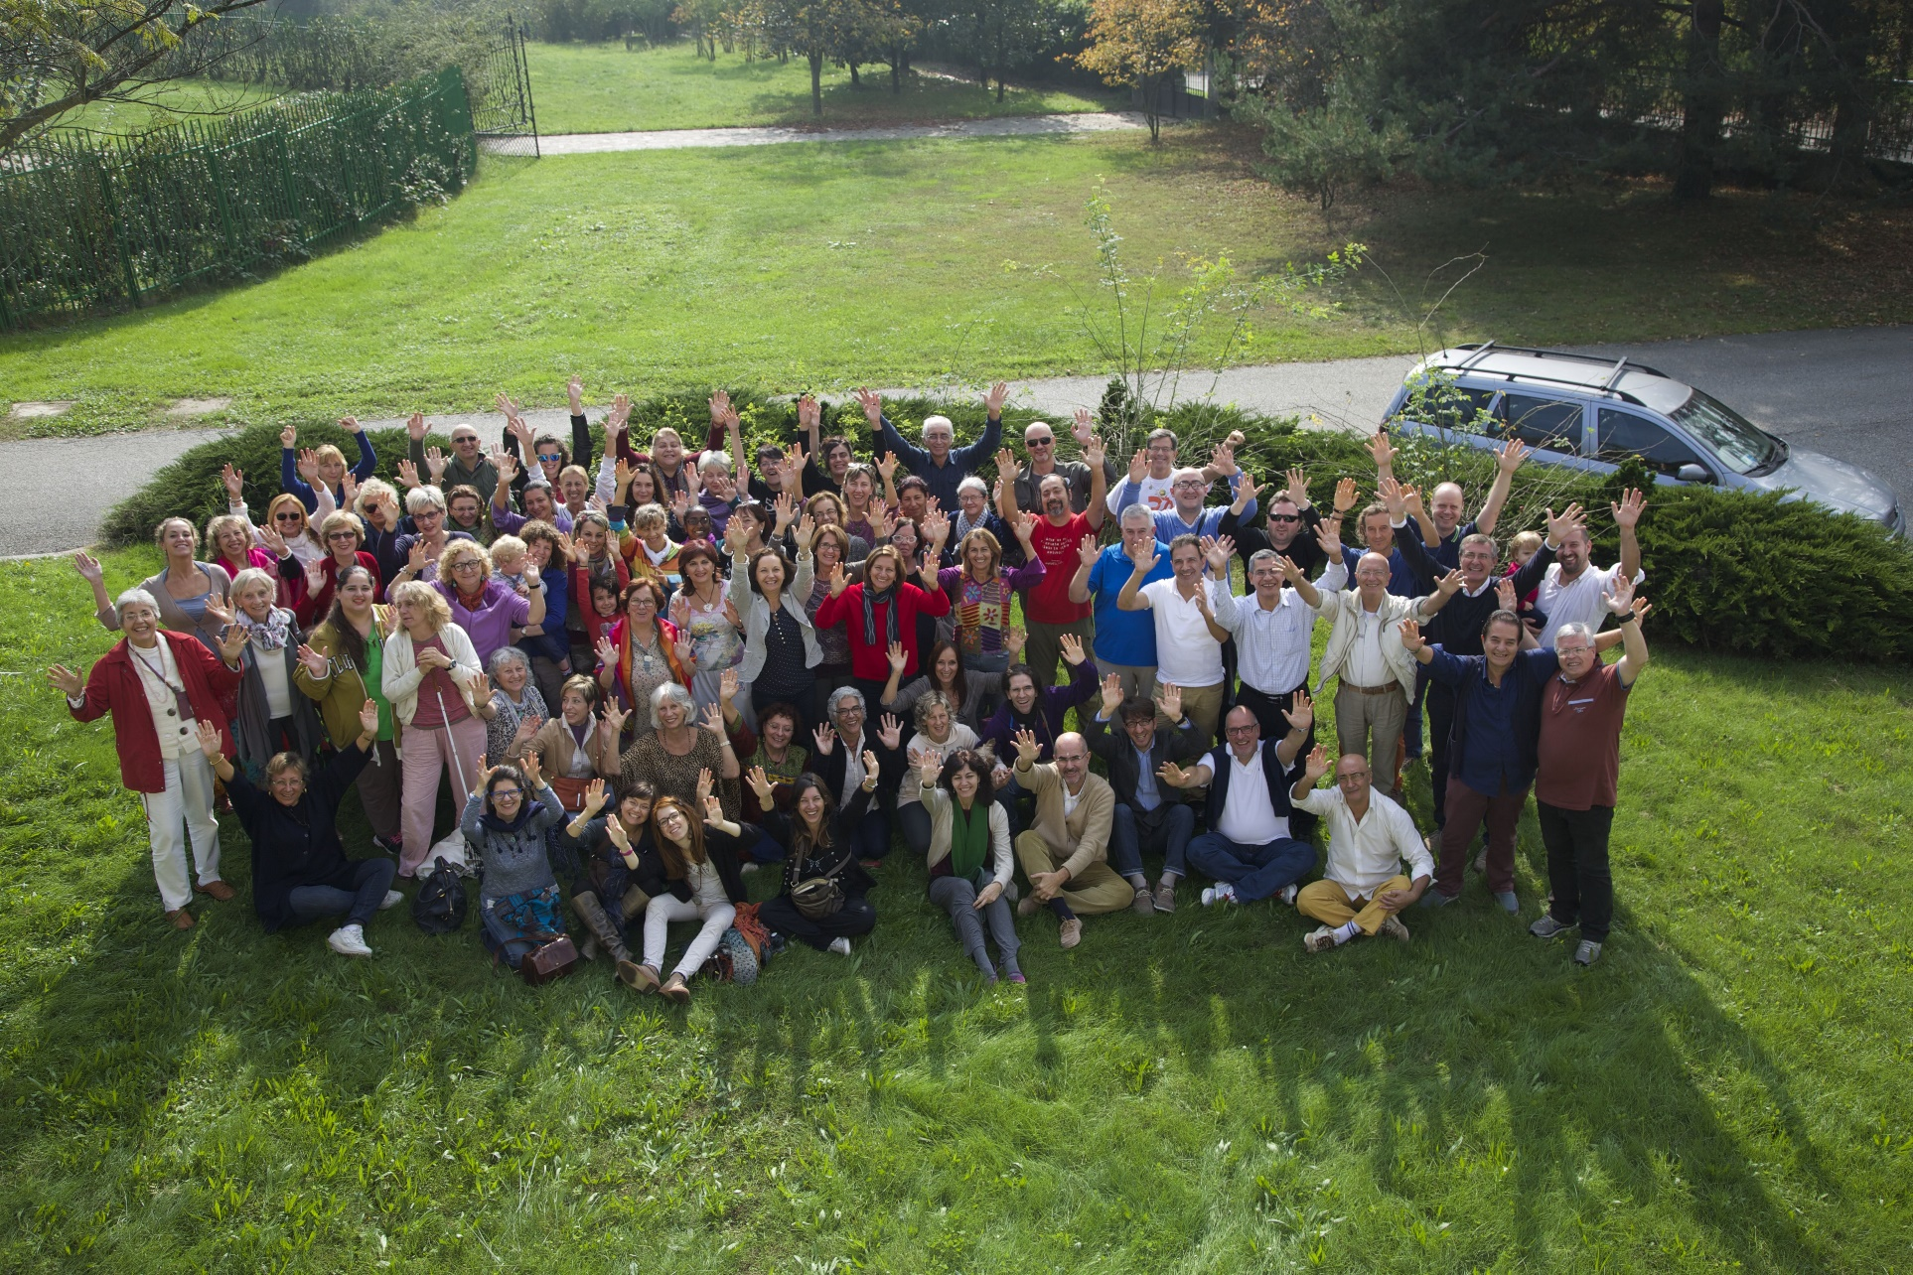

Slide 12
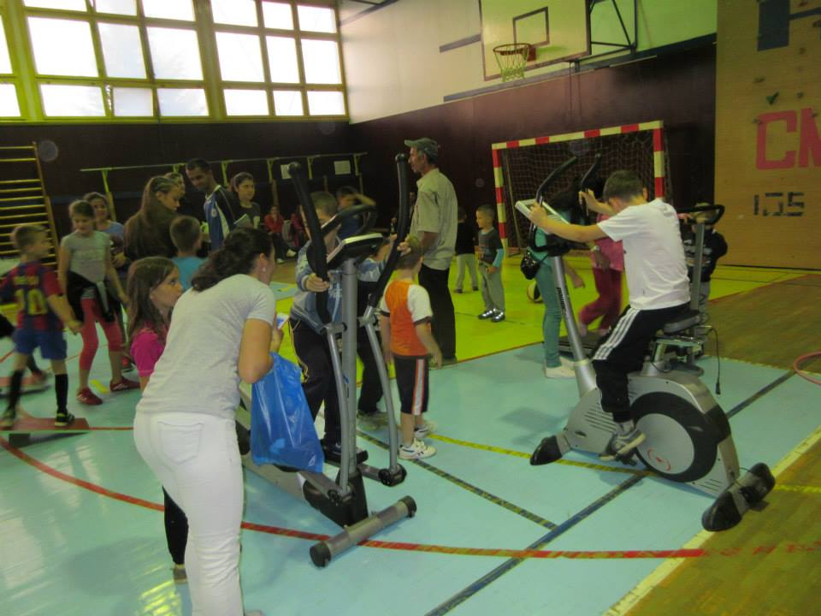
SERVE THE PLANET 20th OCTOBER 2014
Bosnia & Herzegovina, Croatia, France, Greece, Italy, Macedonia, Serbia, Slovenia, Spain and Switzerland participated in this global service project to serve the children.
Notable services activities:
helping children victims of recent floods providing basic needs
visiting children in orphanages and children with special needs
Human Values classes for children
providing food and general provisions to children in needy families
visiting hospitalized children sharing food and entertainment activities
(a separate PP on this global project will include
reports and photos from all countries that participated)

Slide 13
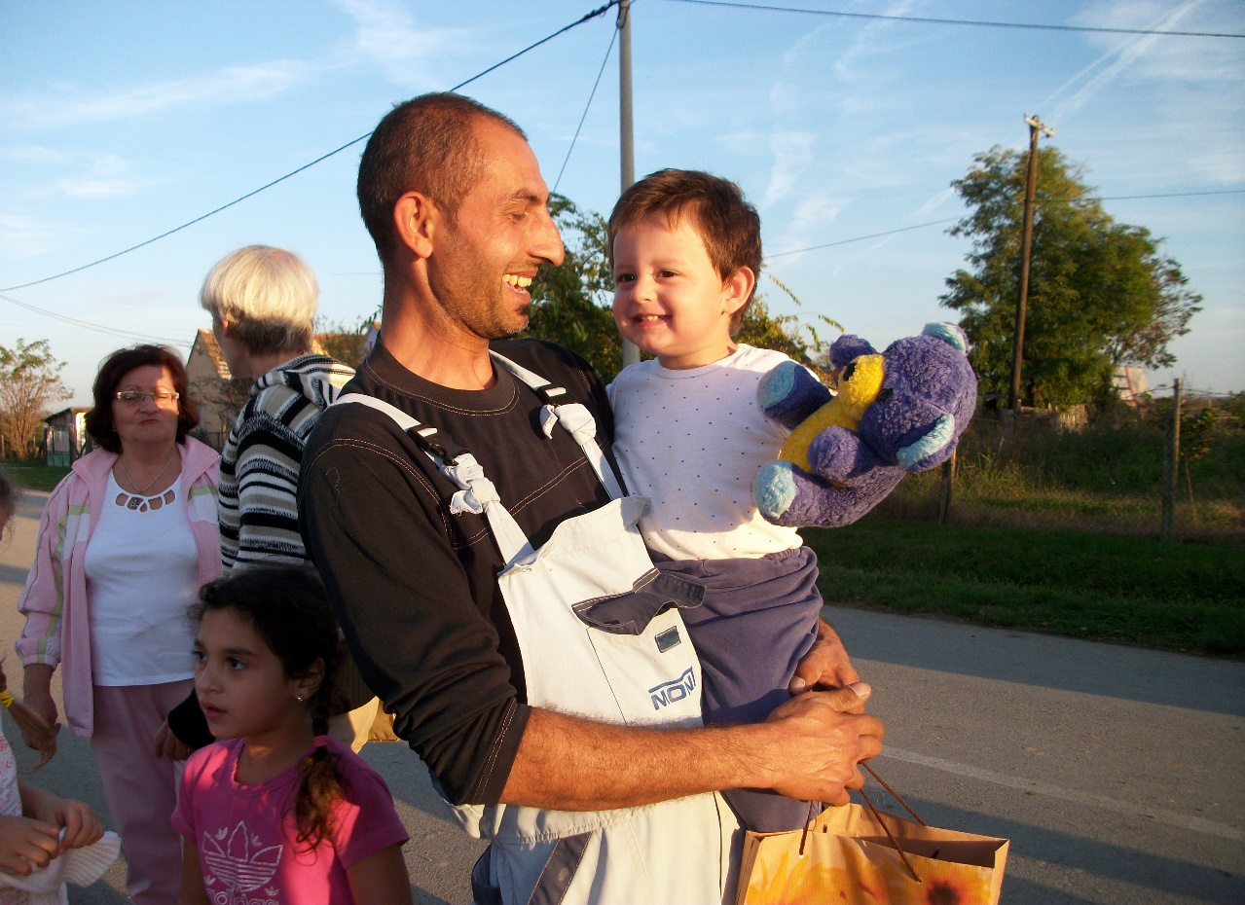
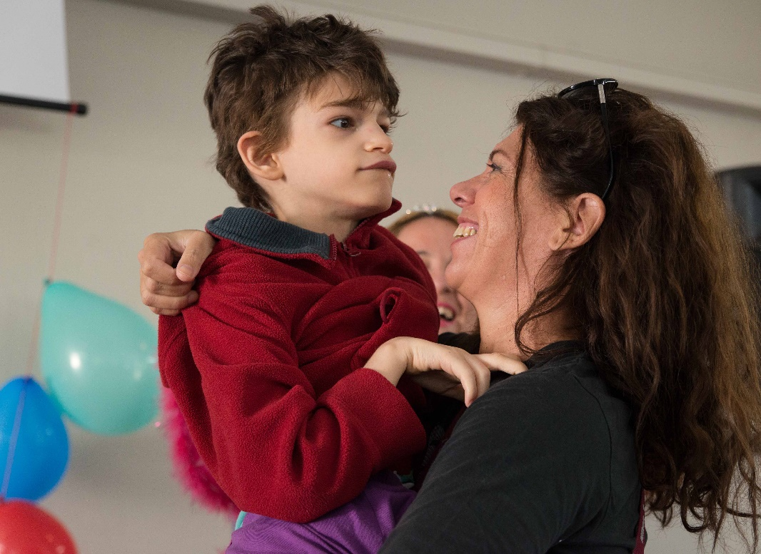
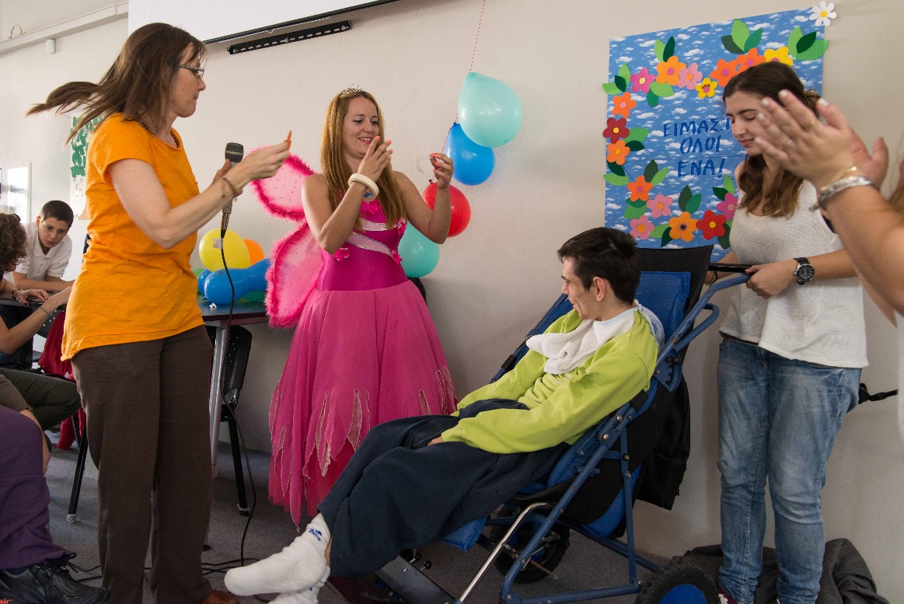

Slide 14
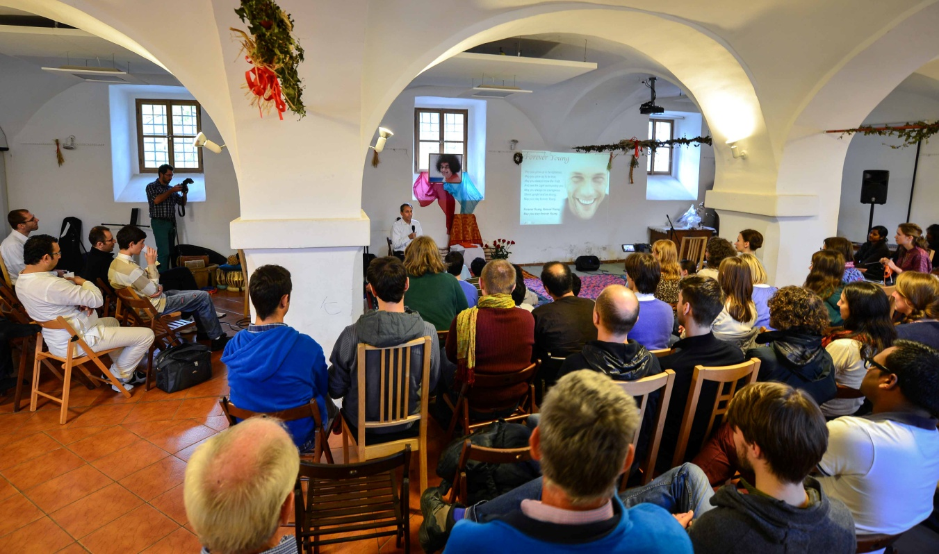
EUROPEAN YOUTH MEETING
1st–2nd NOVEMBER 2014
86 youth from 19 European countries participated in Zone 6 & 7 Youth Meeting in Prague, Czech Republic.
The theme was “Inner Vision: the Joy of Revealing what resides within”. The programme included workshops on how to reveal our inner talents & strengths and the importance of selfless service. A talent show “Europe’s got Talent” with beautiful art, music and dance performances was organised.
George Bebedelis, director of the ISSE SE, was the guest speaker and gave inspiring presentations on being ‘Forever Young’ and discovering our true divine nature. The meeting ended on an uplifting note.

Slide 15
