Slide 1
Zone 5 Report
Hong Kong, Japan, Taiwan & China
November 2014

Slide 2
Hong Kong

Slide 3
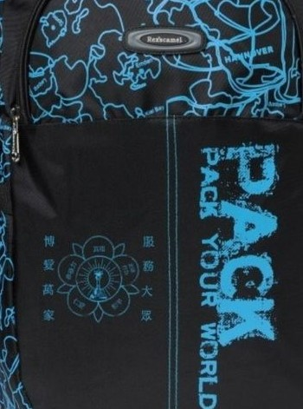
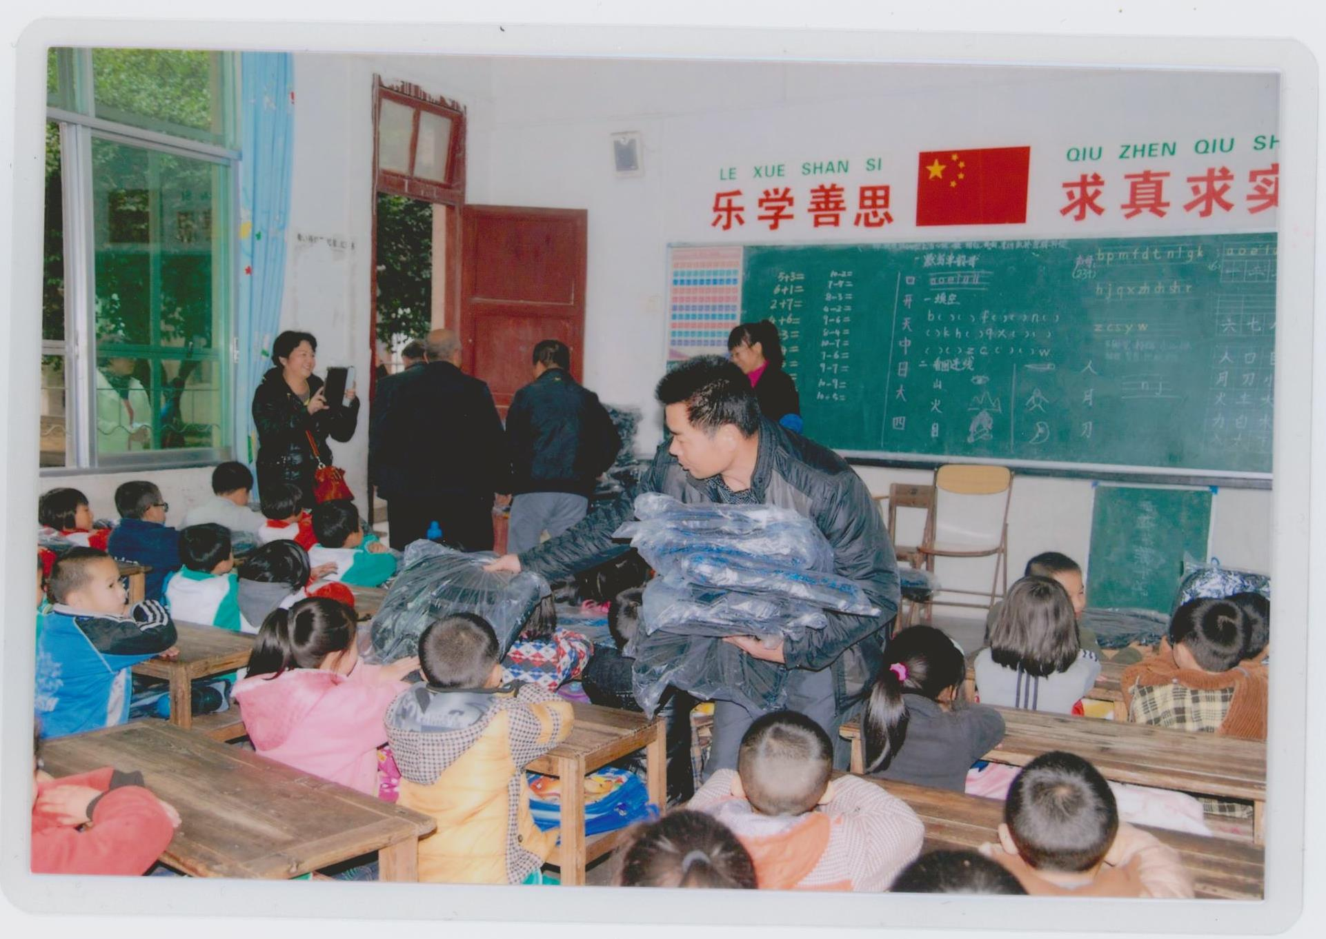
Distribution of 500 school bags with the Sarva Dharma logo in Chinese to a school in Fungshan, China.

Slide 4
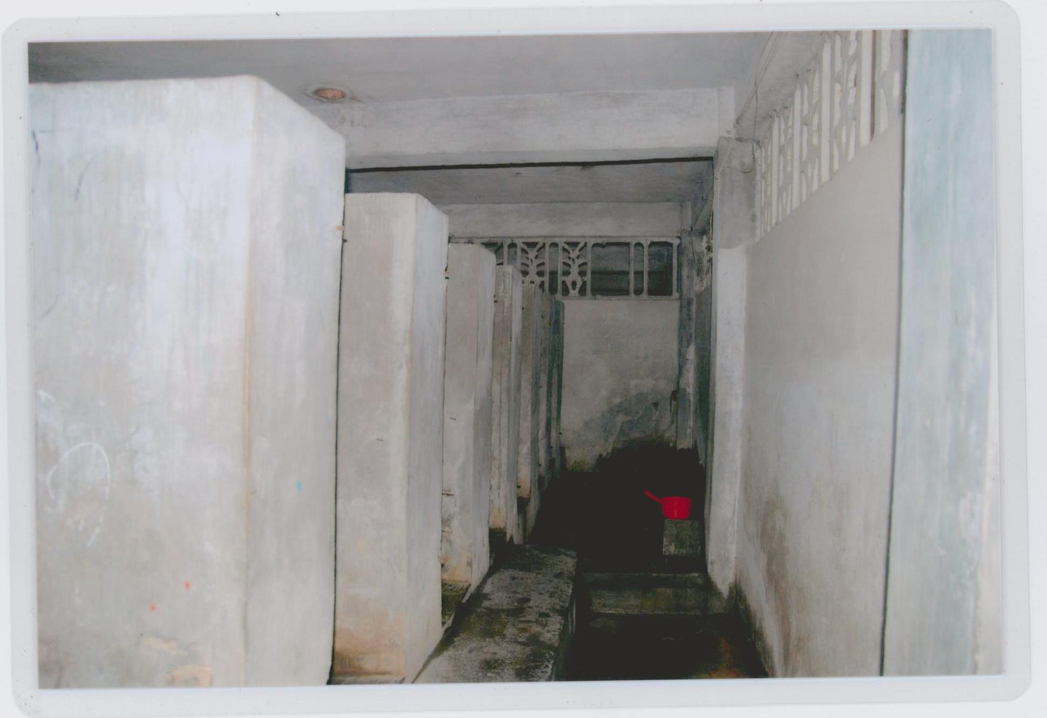
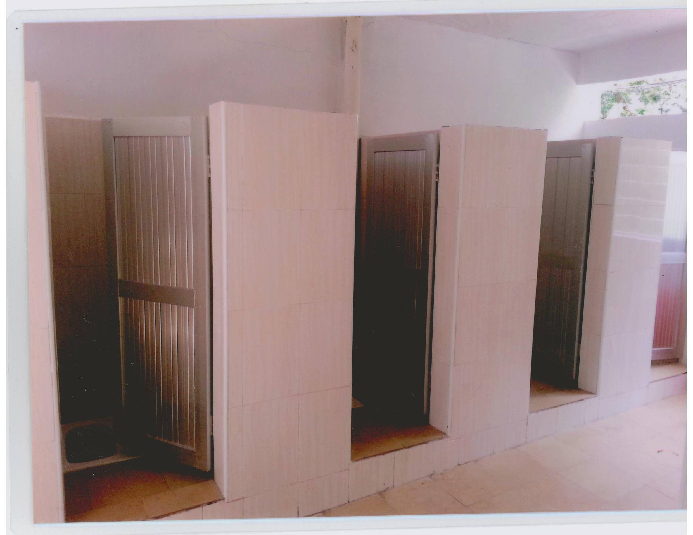
SSIO Hong Kong helped to construct new toilets for students at a local school in Fungshan, China.
Before renovation
After renovation

Slide 5
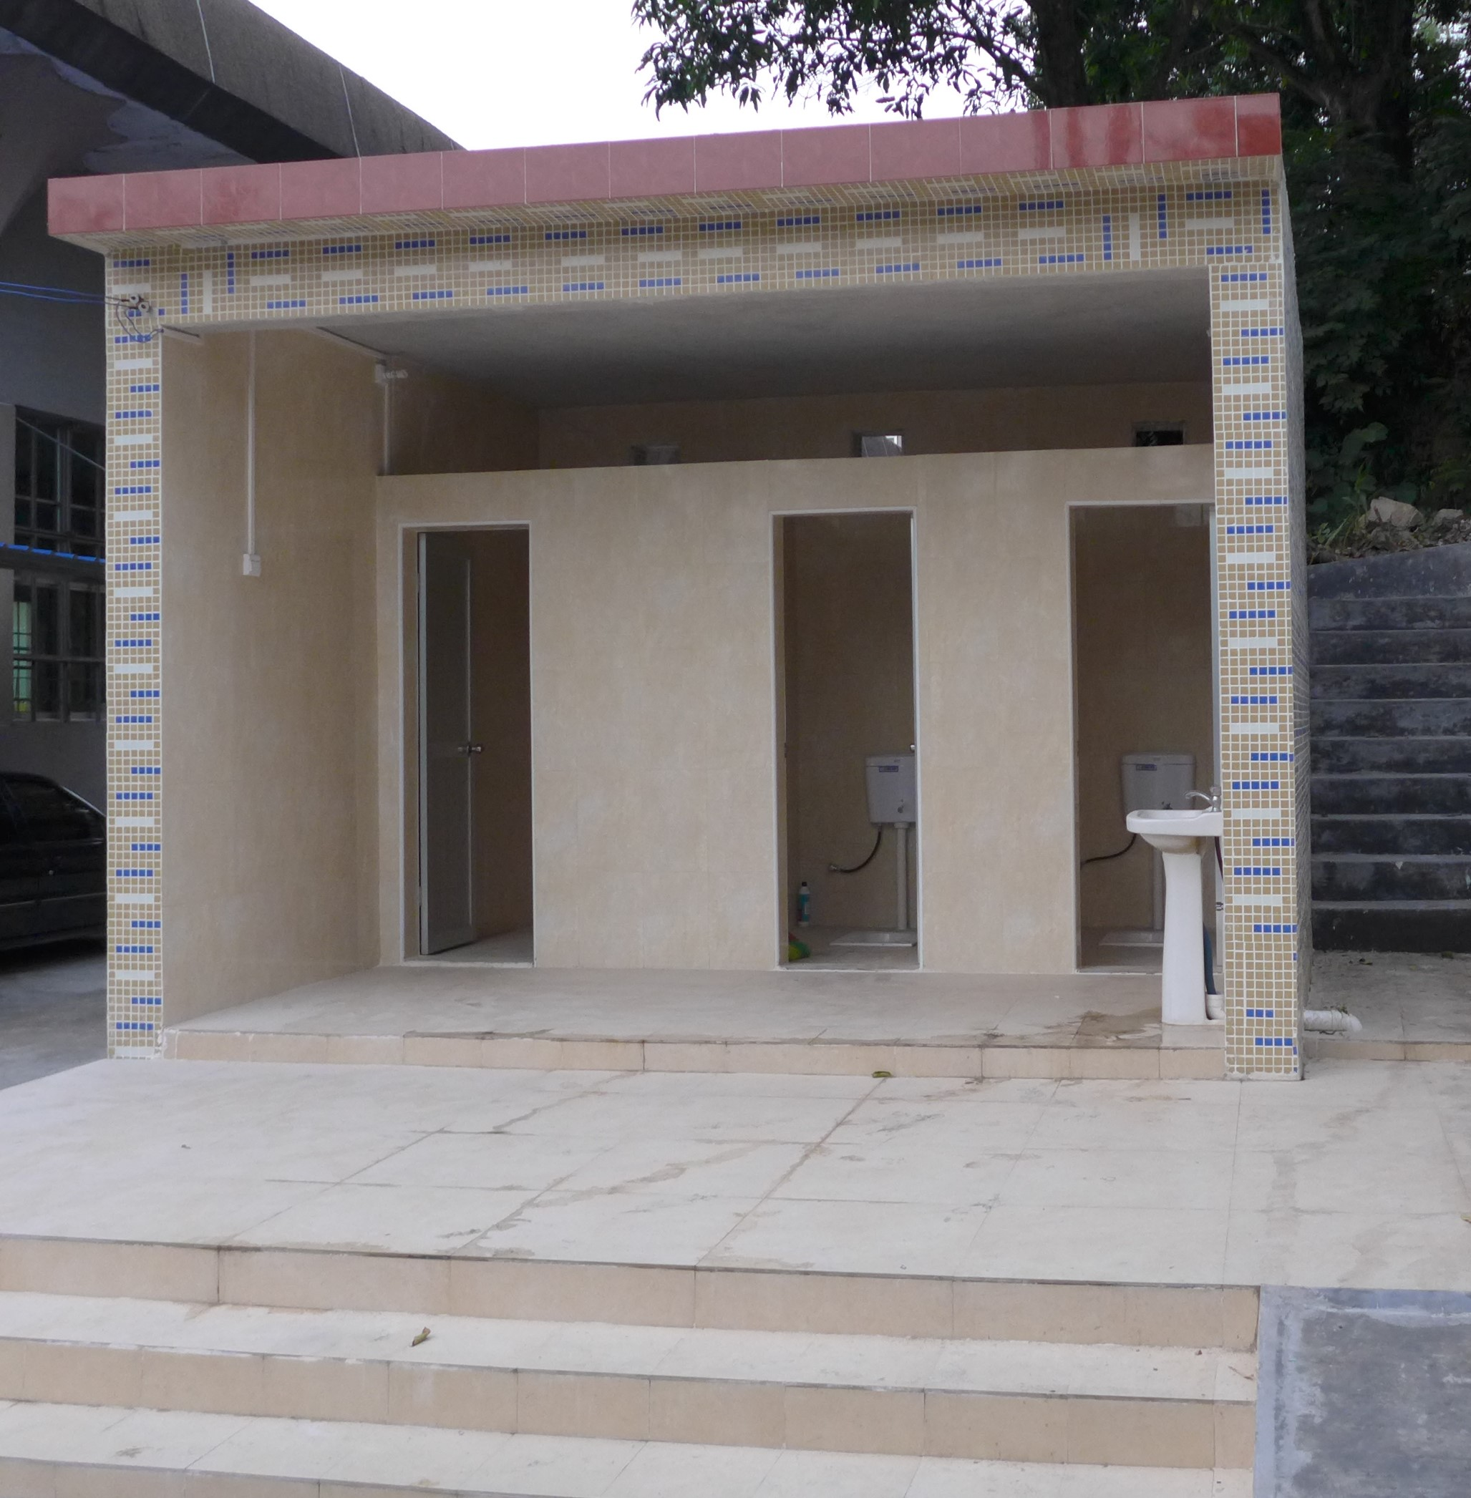
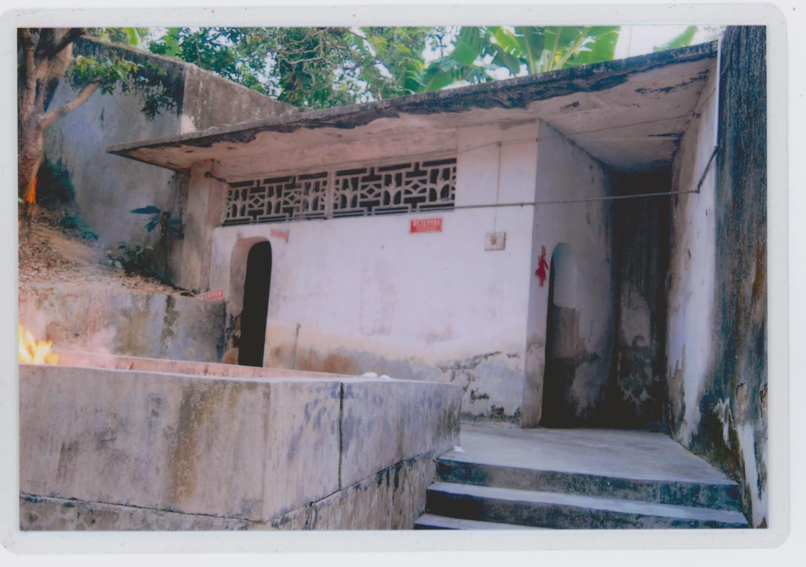
Teachers’ toilet Before renovation
Teachers’ toilet After renovation

Slide 6
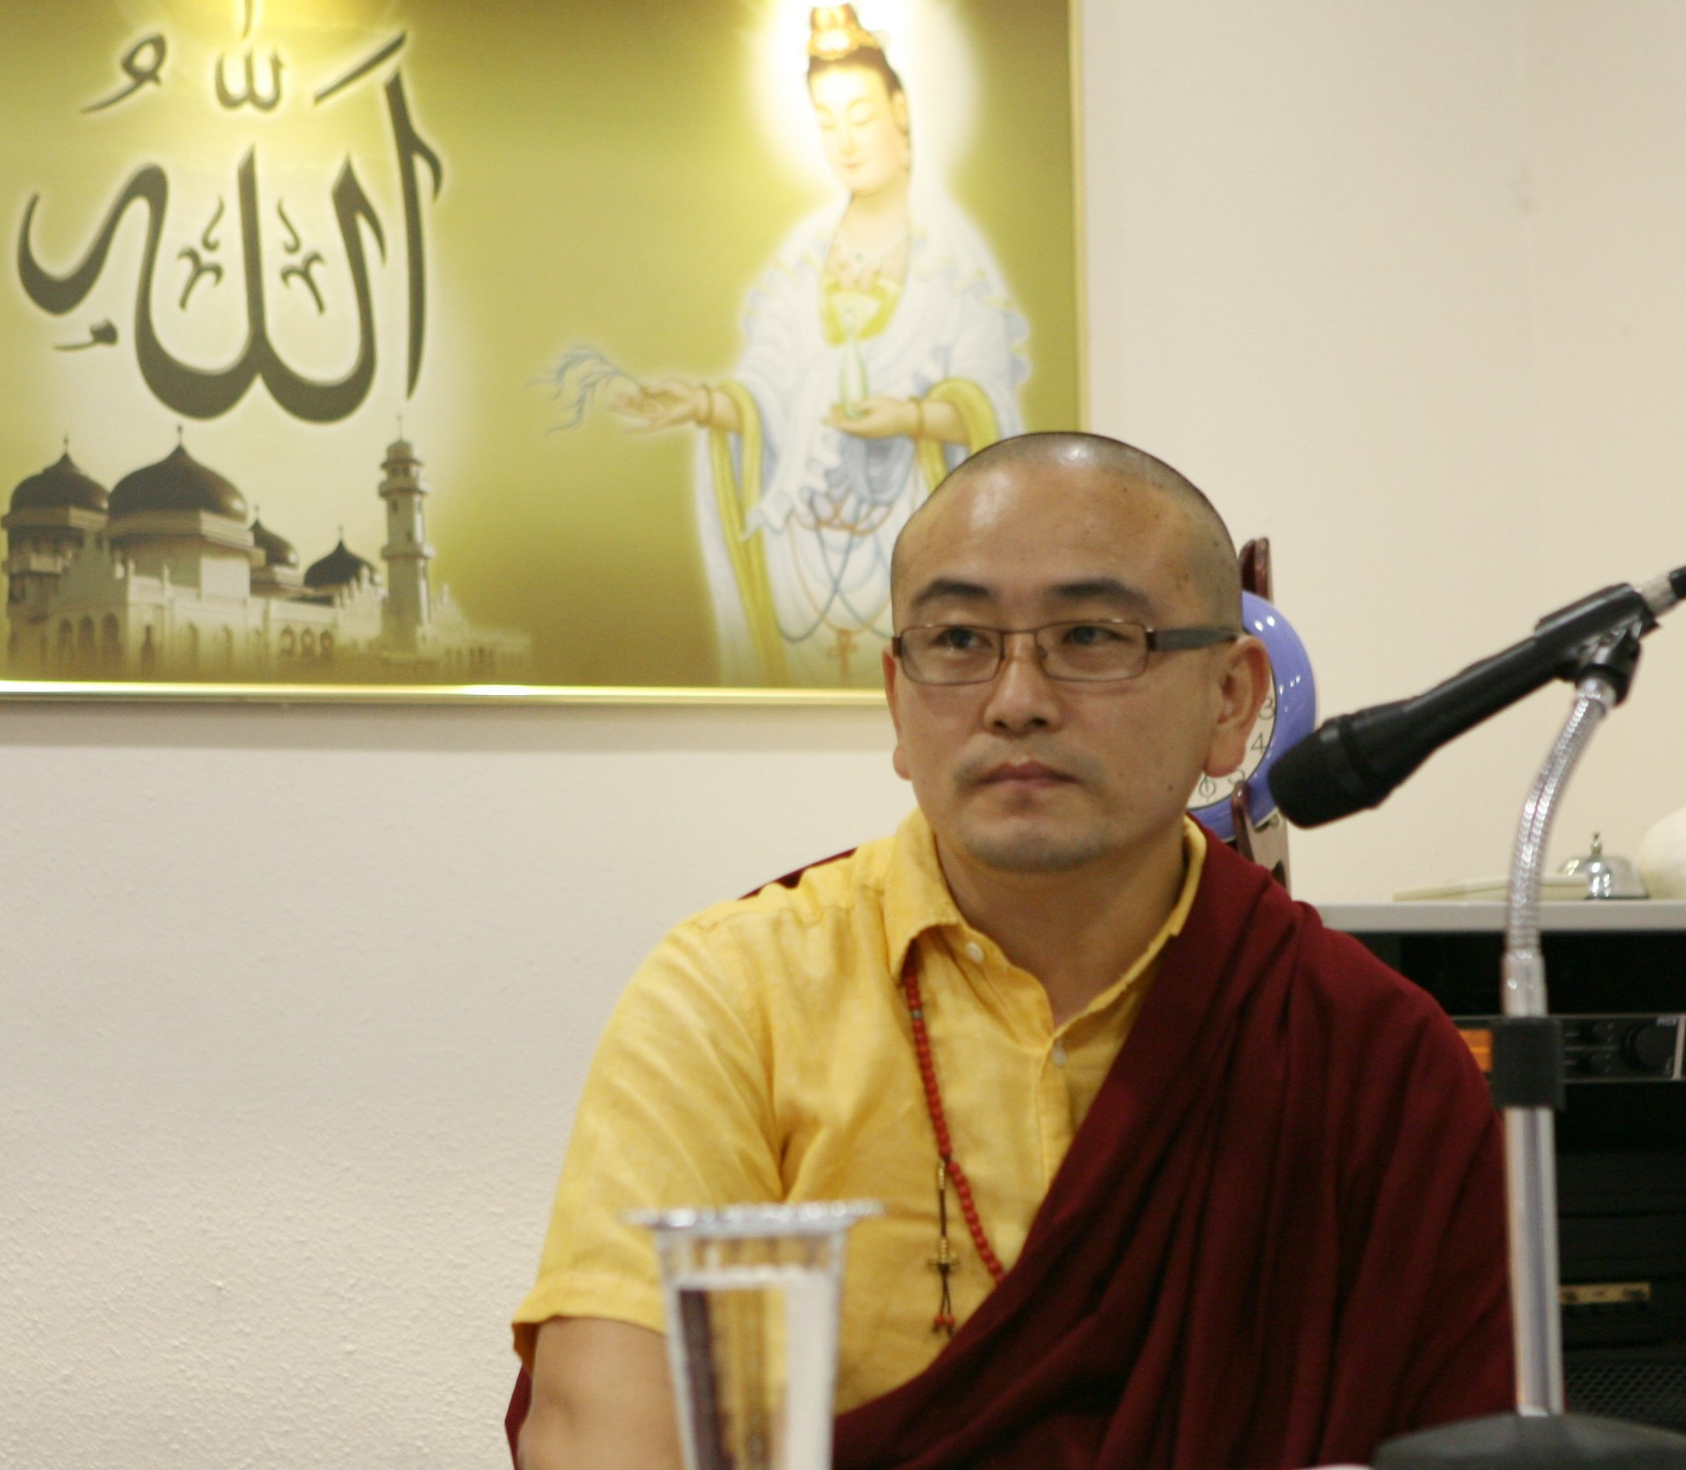
Talks in the TST Sai Centre in June 2014 by Tulku Karma Sonam Gyurme Rinpoche.
Tulkuji had spoken in Swami’s presence during Buddha Poornima 2007 and Swami had a personal conversation with him after his talk.

Slide 7
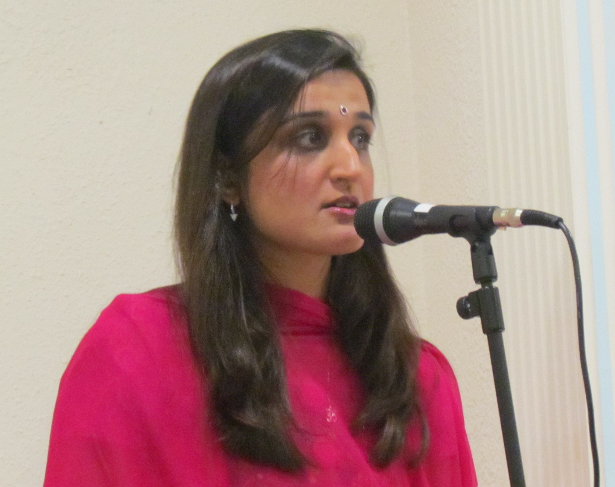
A 6 weeks presentation was held in Sept-Oct, 2014 on the Theme of "The Nature and Importance of Our Daily Sadhana. The introduction to the theme was followed by 5 sub topics:
Importance of a disciplined Life
My Daily Devotion, conquering the six enemies within by implicit faith and devotion
Opening my heart to Swami’s Presence around me
Remembering and Worshiping Sai throughout the Day
My Sadhana of Self-Enquiry - Importance of self enquiry in recognizing our inherent Divinity.

Slide 8
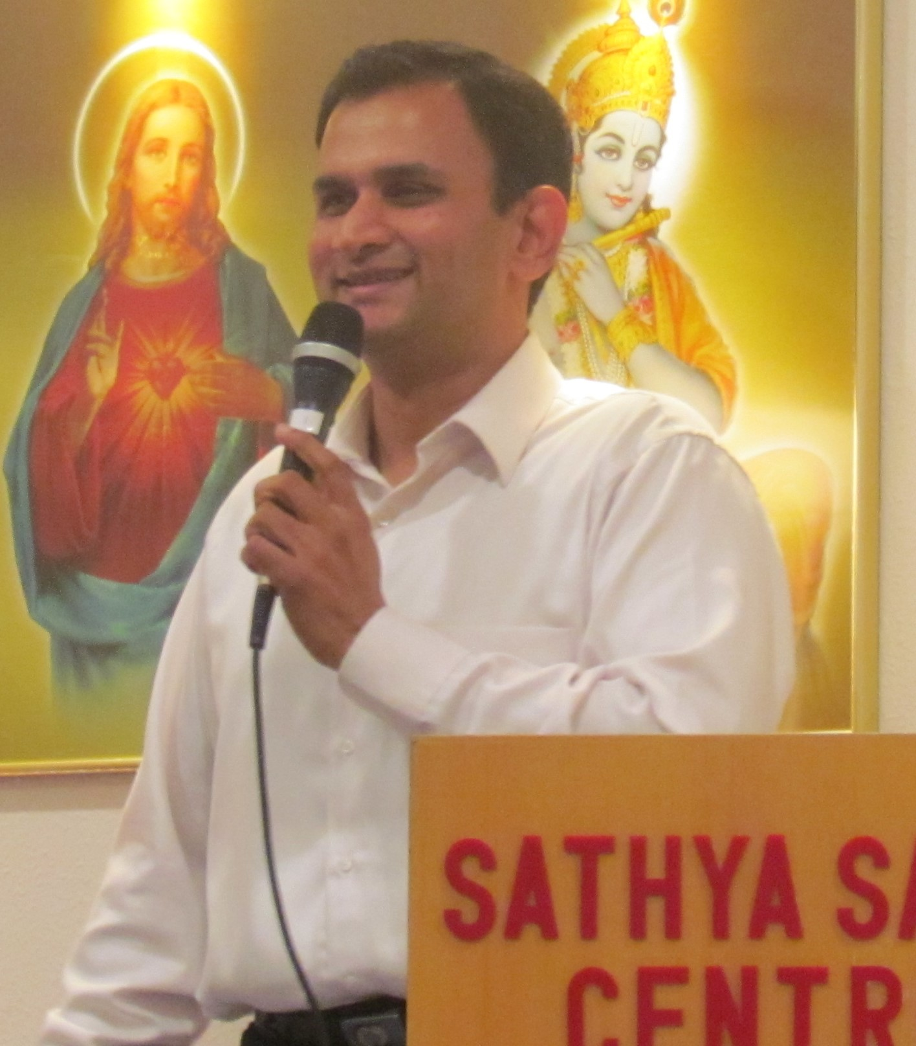
21st & 25th August – one of Swami’s students Raghupathi Rao Karanamu spoke on the topic of “Being a witness through active meditation”.
11th & 12th September - a guest speaker, Sathya Atreyam, President of Region 1, SSIO, USA, shared his personal experiences with Swami and spoke on “The Importance of Discipline in Spiritual Life”.

Slide 9
Bal Vikas Graduation – Class of 2014

Slide 10
Special Educare English enhancement programme conducted by the Youth at a local primary school

Slide 11
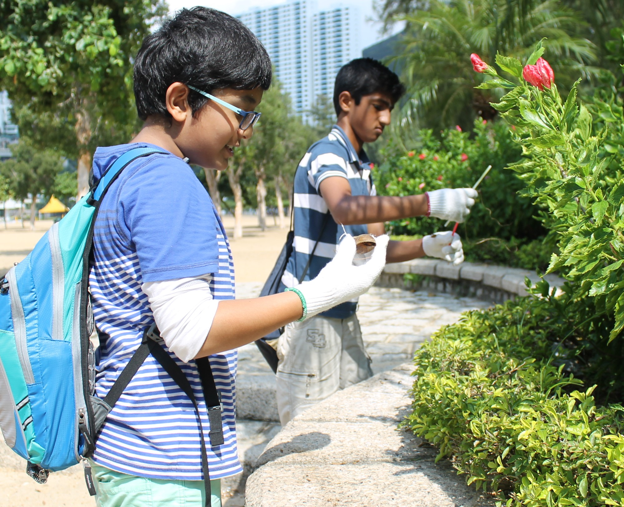
Bal Vikas Beach Cleaning Seva

Slide 12
SERVE THE PLANET 2014
SSEHV class with children of refugees and asylum seekers

Slide 13
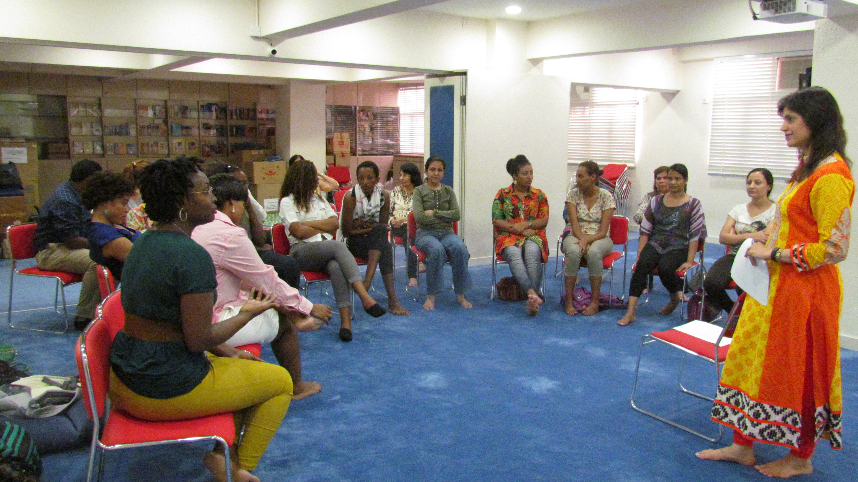
SERVE THE PLANET 2014
Parenting talk with refugees and asylum seekers
SSEHV class with local children and ethnic minority

Slide 14
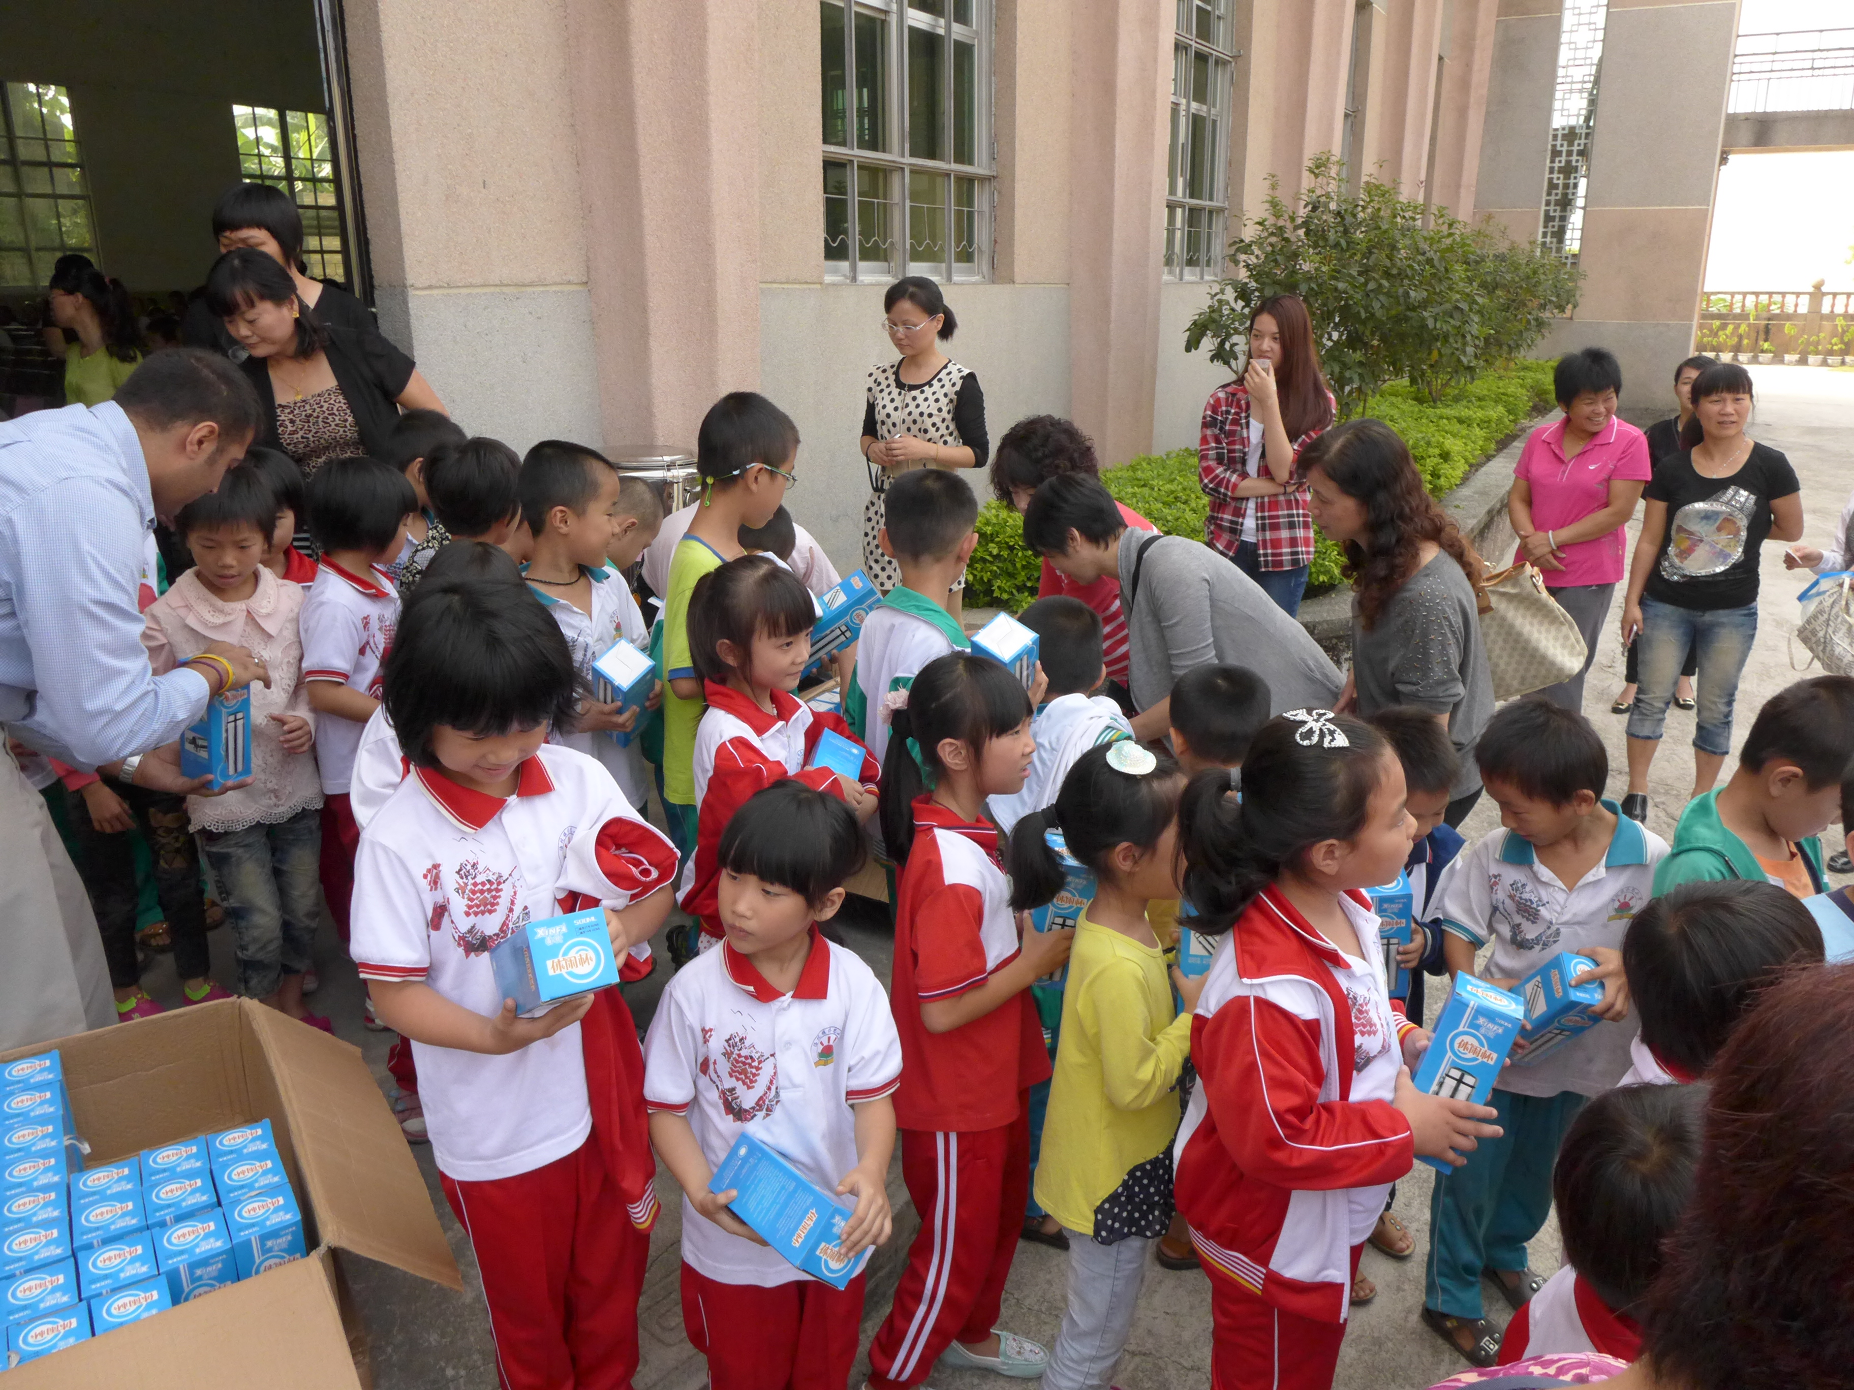
SERVE THE PLANET 2014
Distribution of 450 water bottles to children in a local school in Fungshan, China in October 2014.

Slide 15
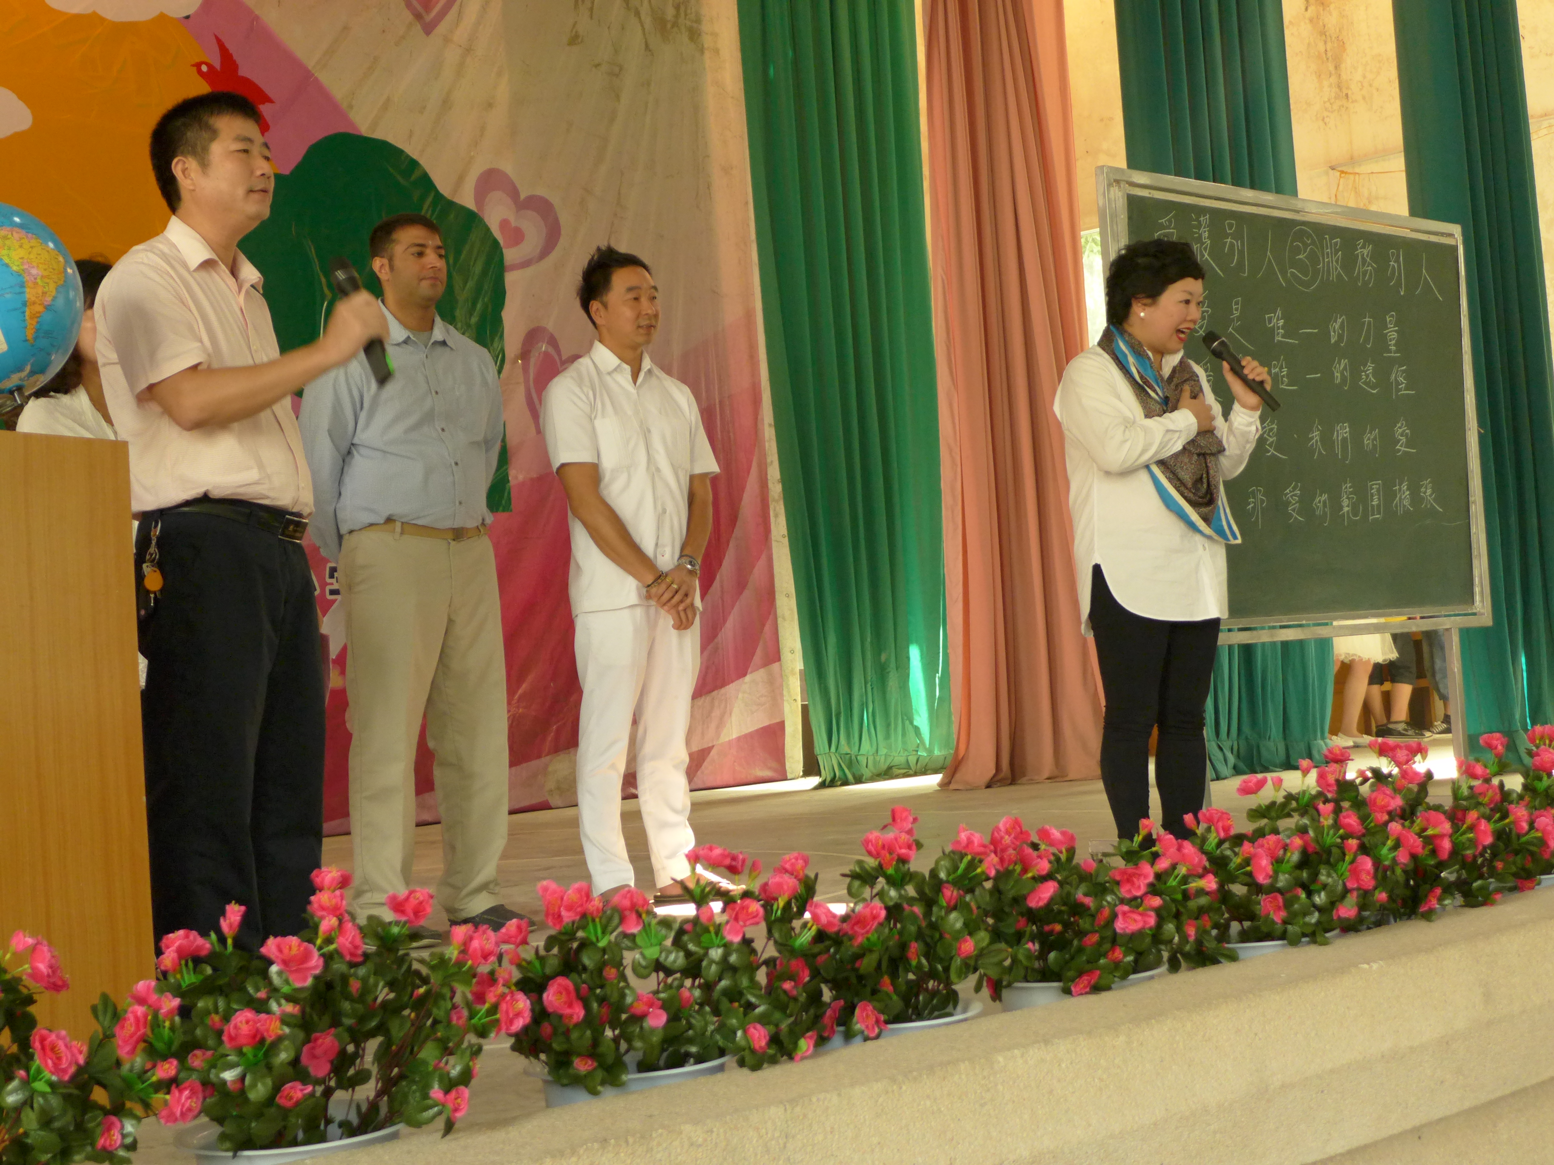
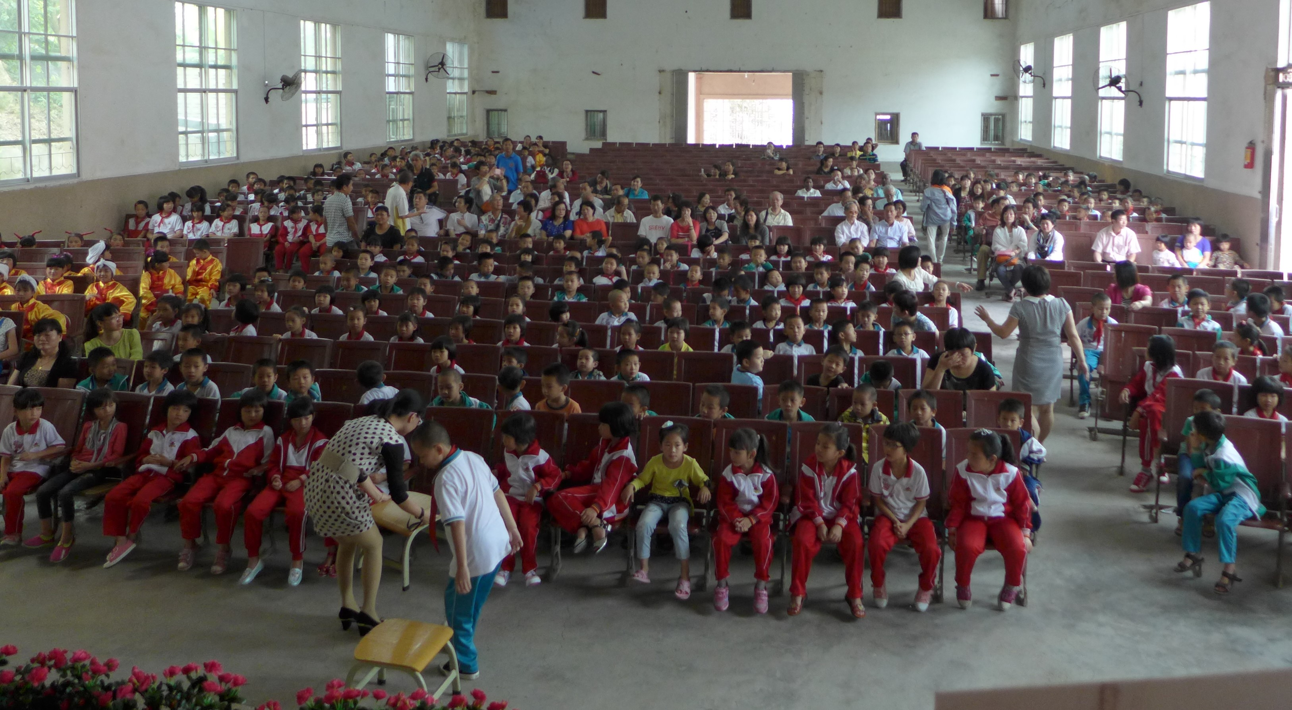
SERVE THE PLANET 2014
SSEHV Talk to children in a local school in Fungshan, China.

Slide 16
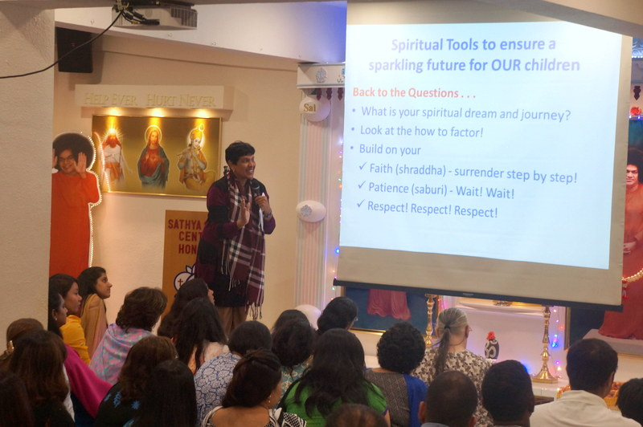
SERVE THE PLANET 2014
19th October motivational talk to the children

Slide 17
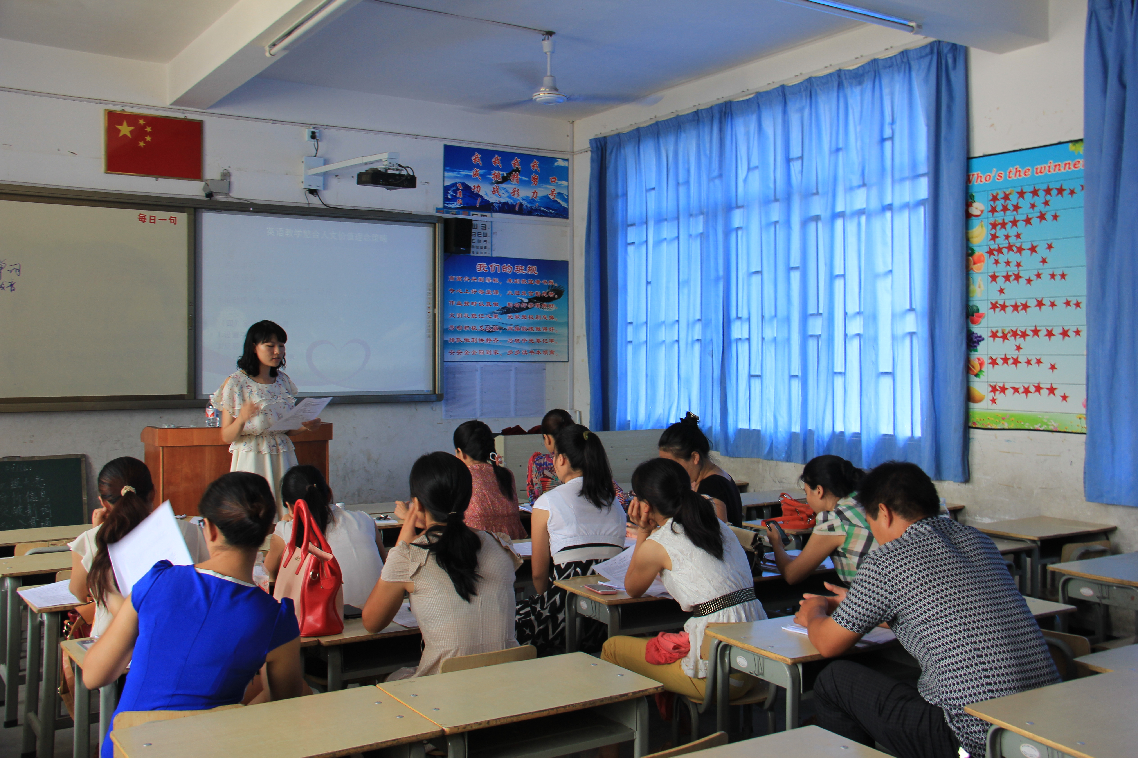
ISSE IN CHINA
Integrating SSEHV into English lessons

Slide 18
ISSE IN CHINA
Playing SSEHV games

Slide 19
ISSE in China
Conducted a major evaluation of the 5th phase of SSEHV in Qinghai Province and made recommendations for future directions.
Conducted a 2-day seminar for 70 teachers and principals in Yangshou District, Gong Cheng Province.
Conducted a 1-day seminar for the staff of Dong Guan No. 1 Primary School, Guandong Province. Several local Education Bureau officials attended and were impressed with concepts of SSEHV.
August, 20 principals/senior teachers, a professor and the Education Bureau Director from Yang Shuo visited Qinghai for an exchange visit, sponsored by the Education Bureau.

Slide 20
Upcoming Events
Bhagawan Sri Sathya Sai Baba’s 89th Birthday celebrations.
Disneyland outing in January 2015 for under-privileged children of refugees/asylum seekers.
Zone 5 Pre-World Conference in Hong Kong at end of January, 2015.

Slide 21
Japan

Slide 22
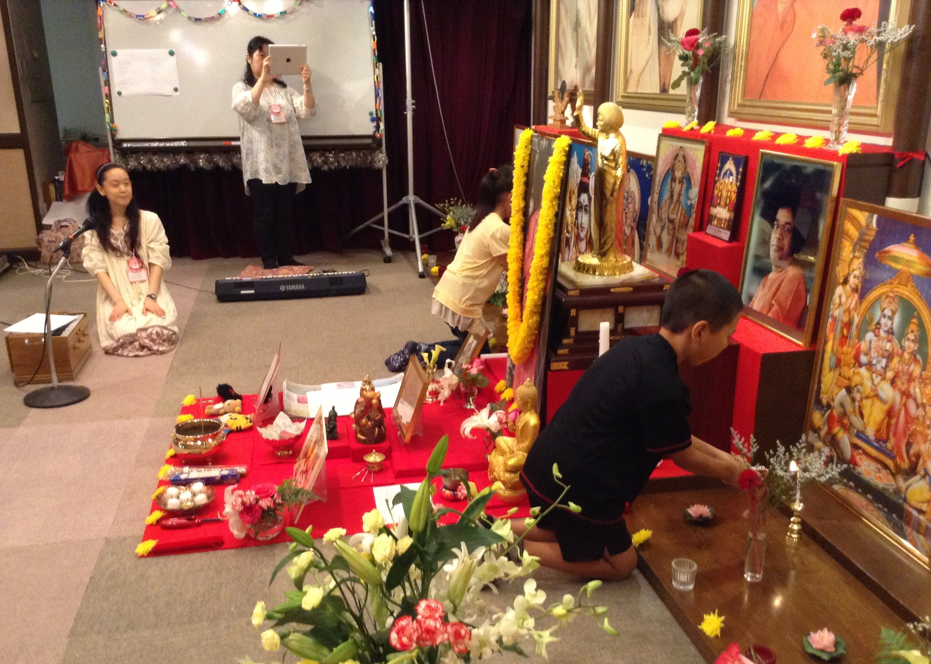
Bal Vikas camp july 2014

Slide 23
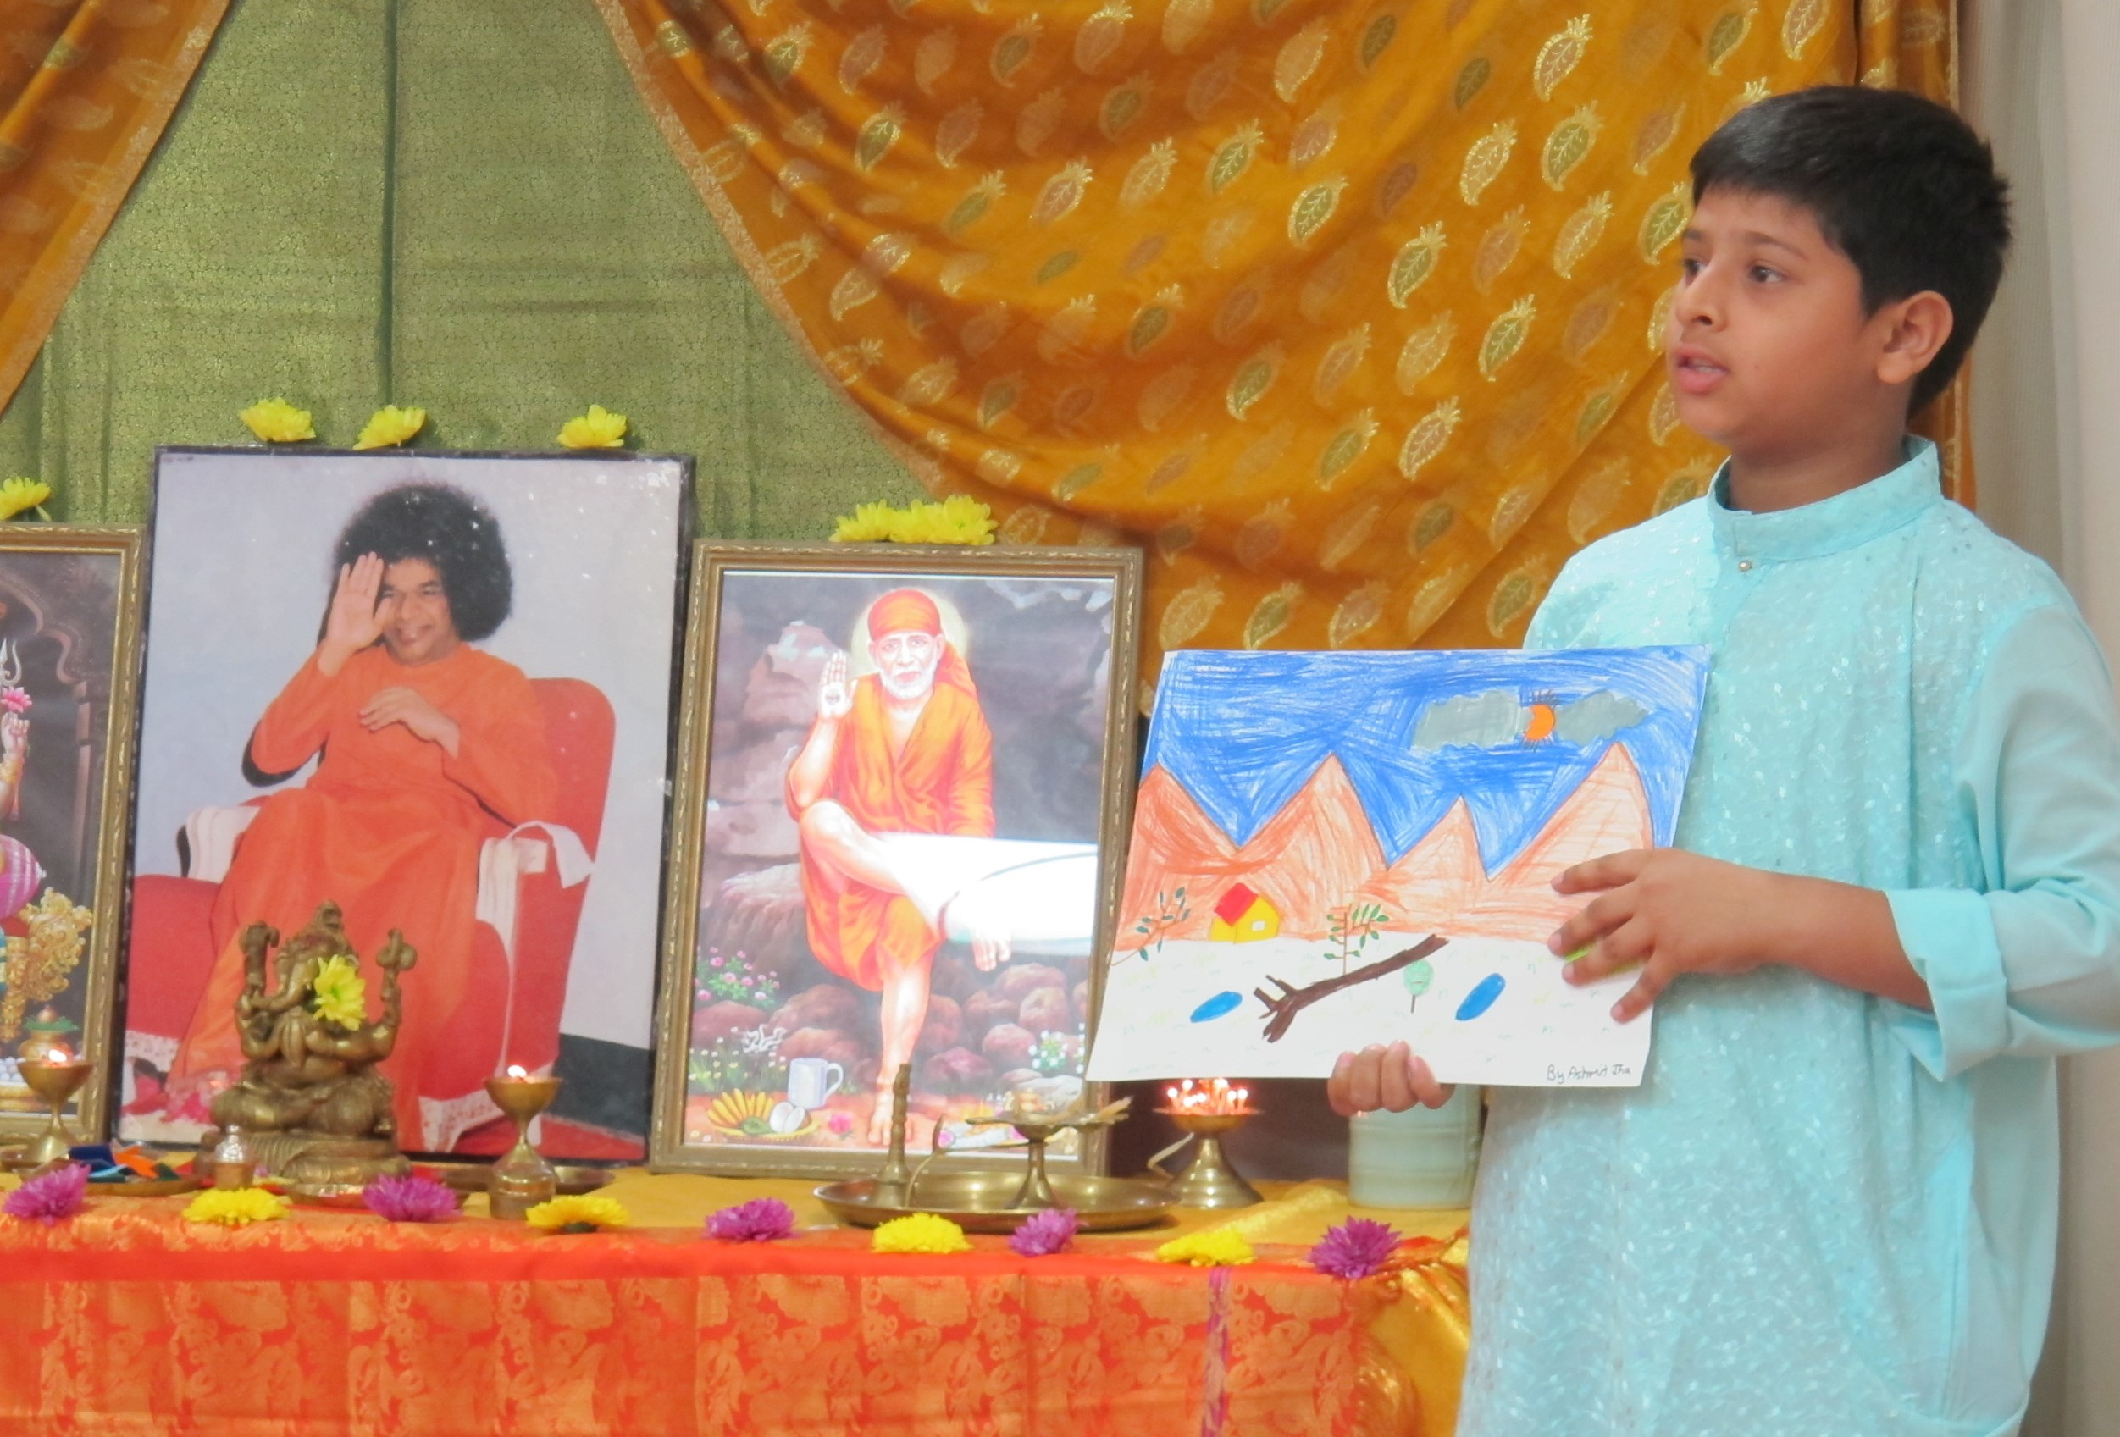
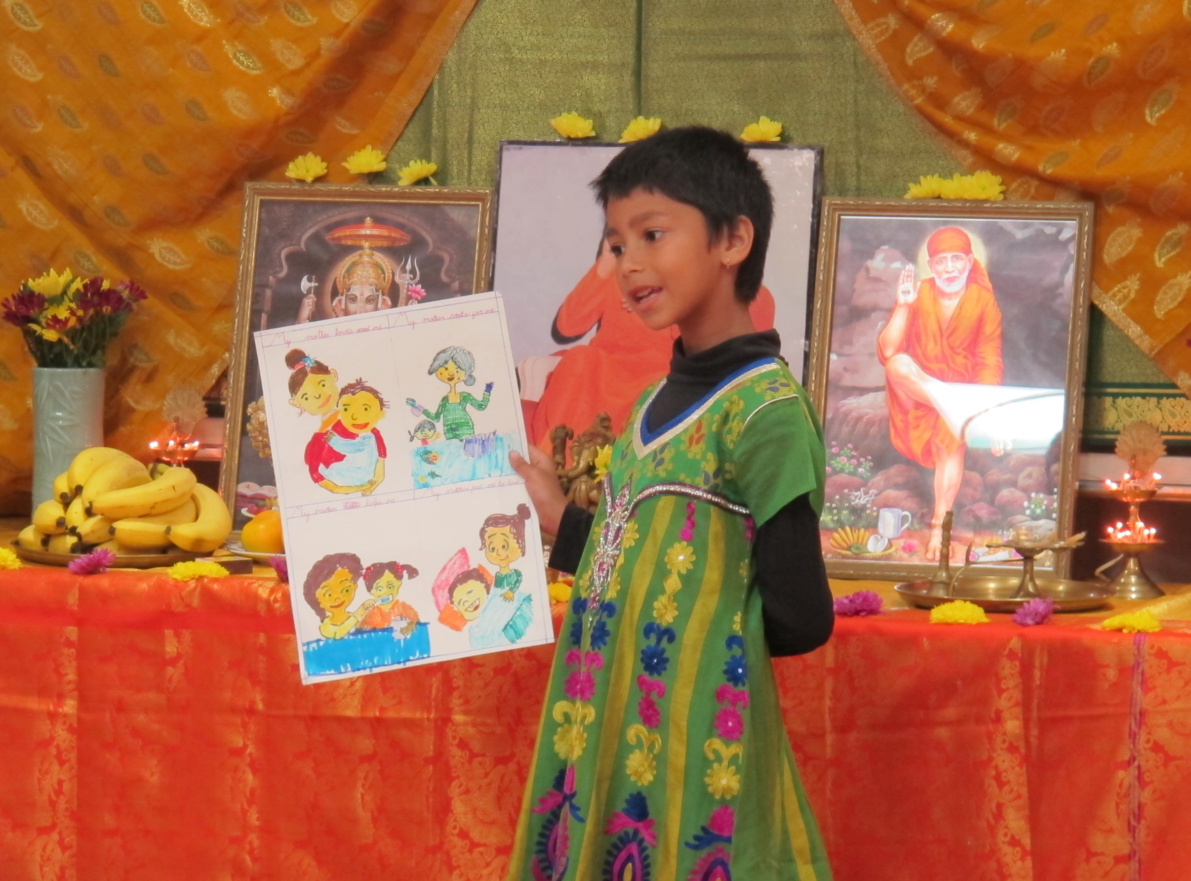
SERVE THE PLANET 2014
Ojima Sai Bhajan Group - `Draw and Tell Story’ competition

Slide 24
Taiwan

Slide 25
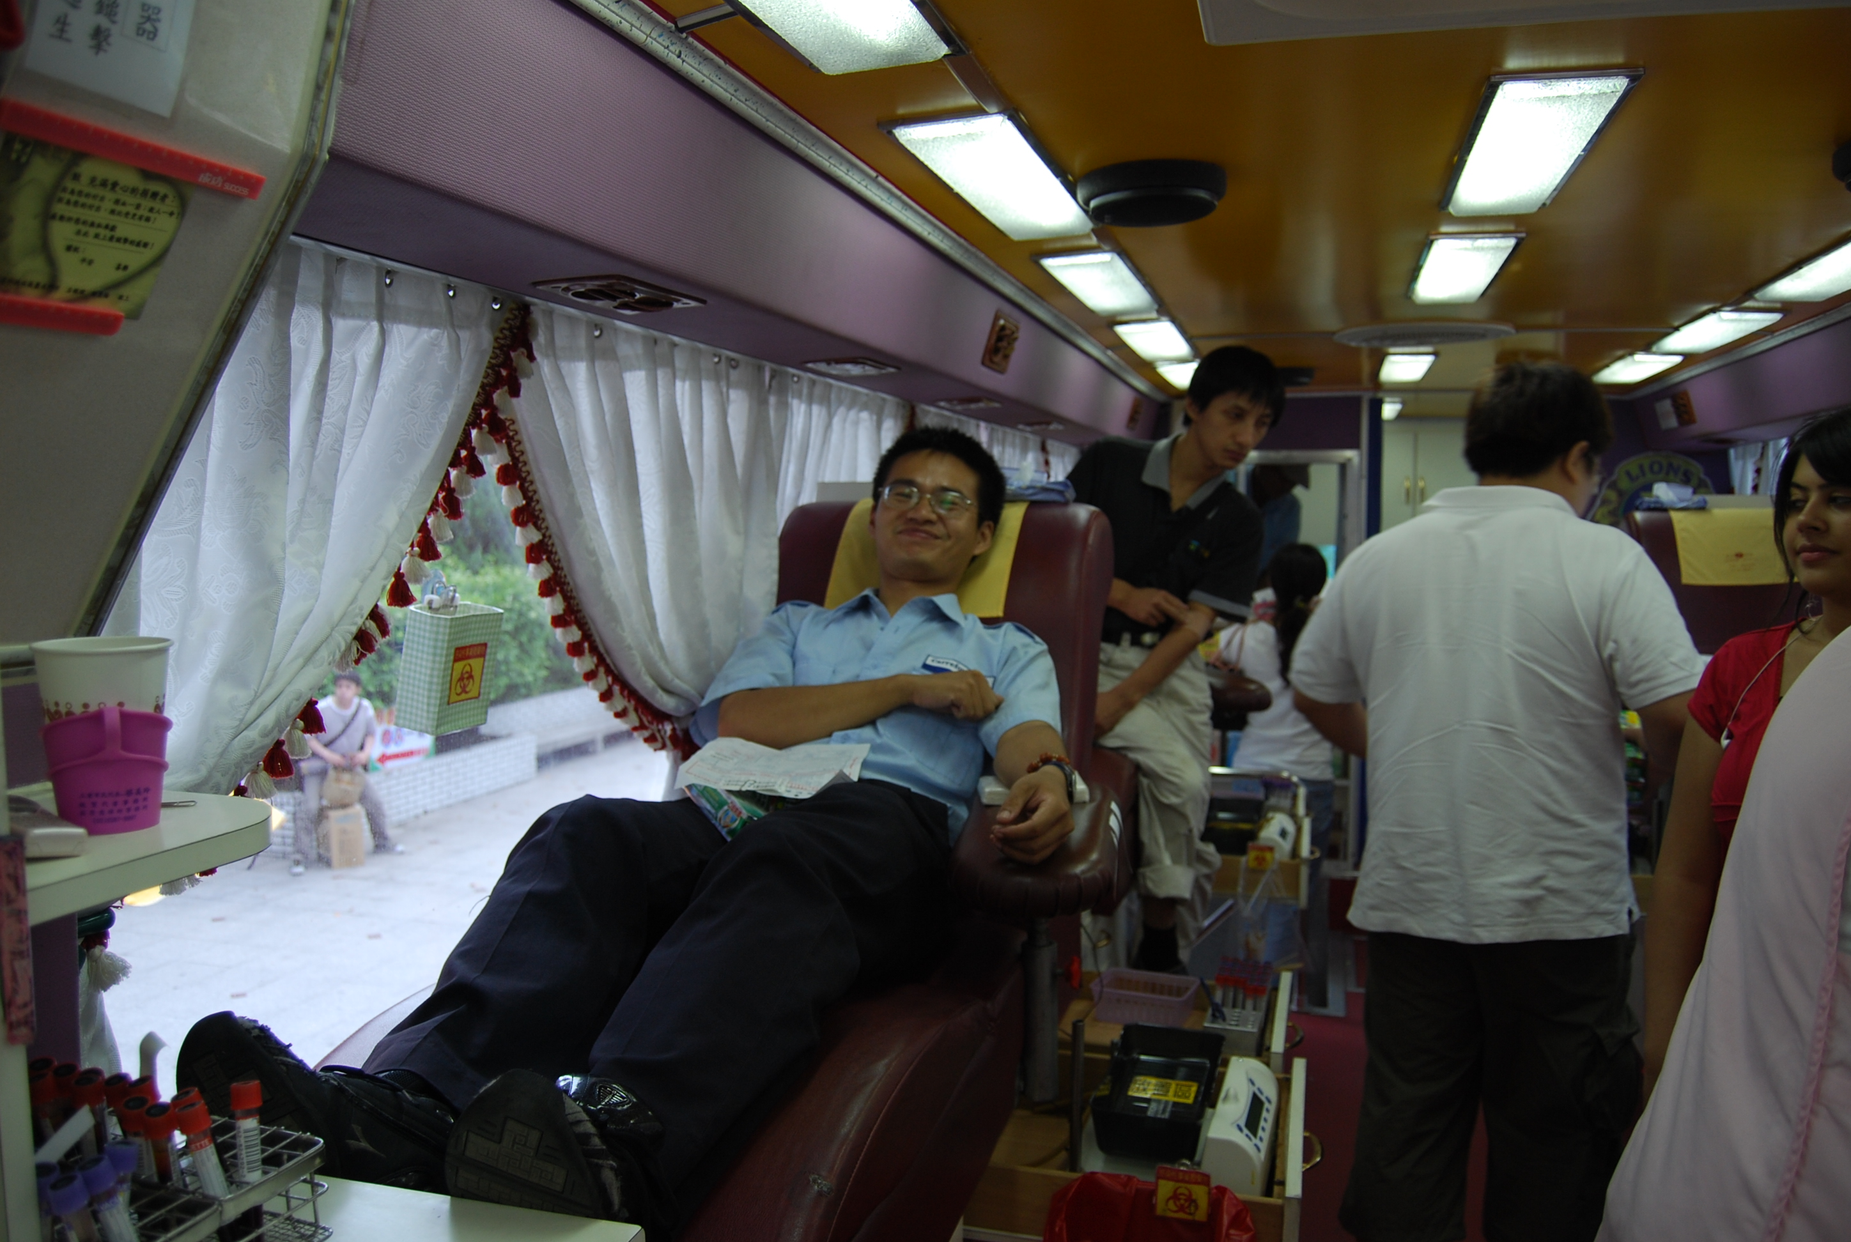
August 2014 blood donation by SSEHV teachers, parents, students and volunteers.

Slide 26
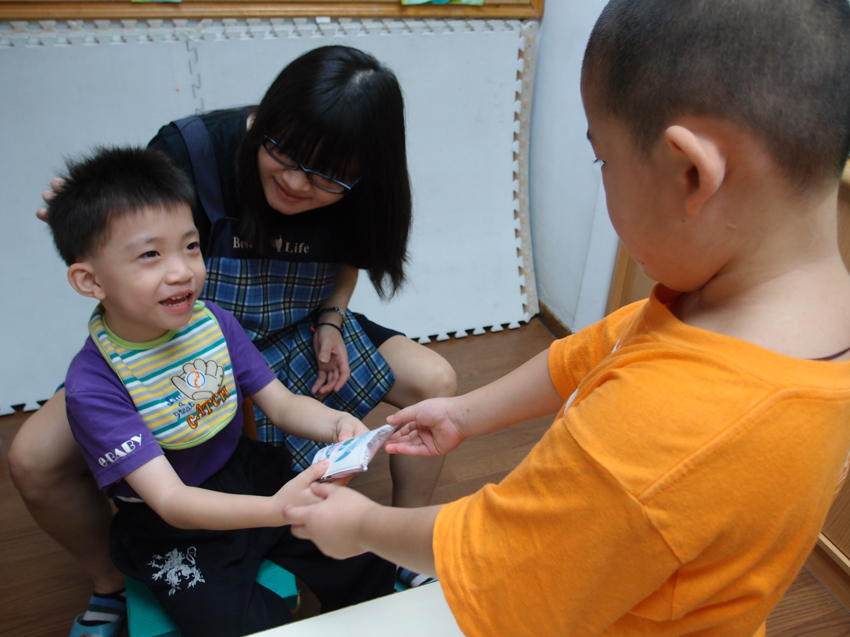
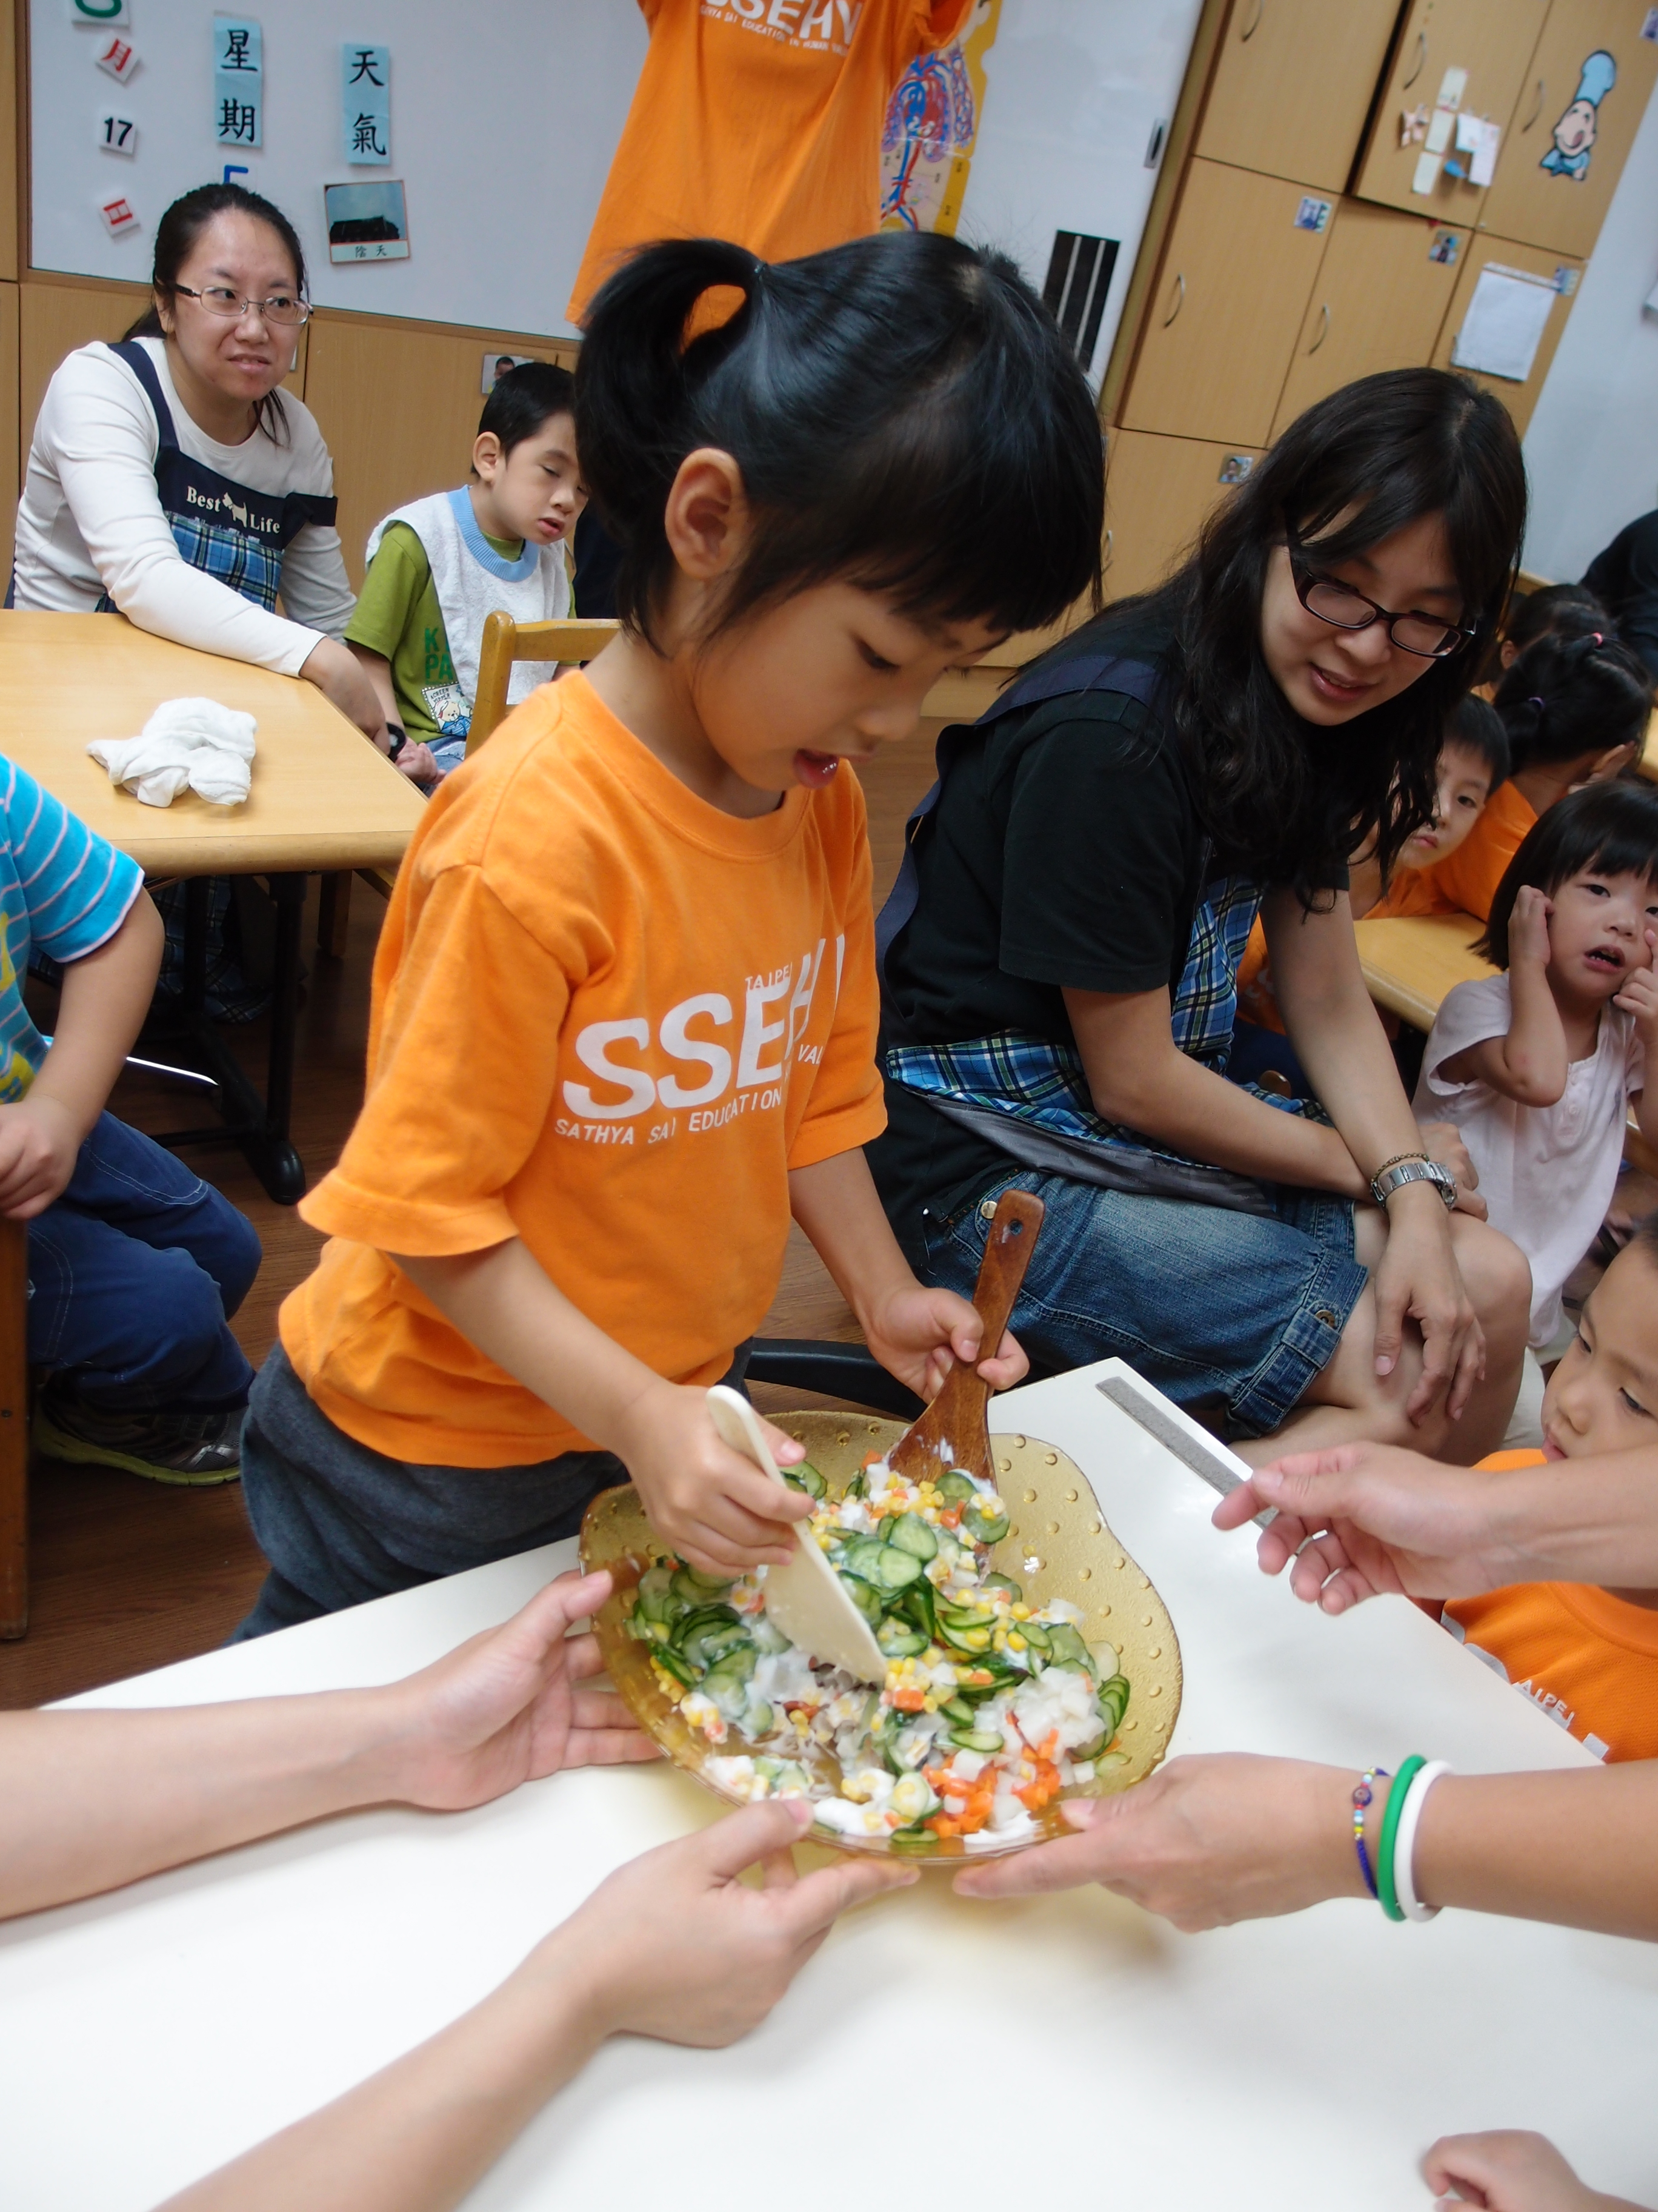
SERVE THE PLANET 2014
Seva at home for mentally and physically challenged children

Slide 27
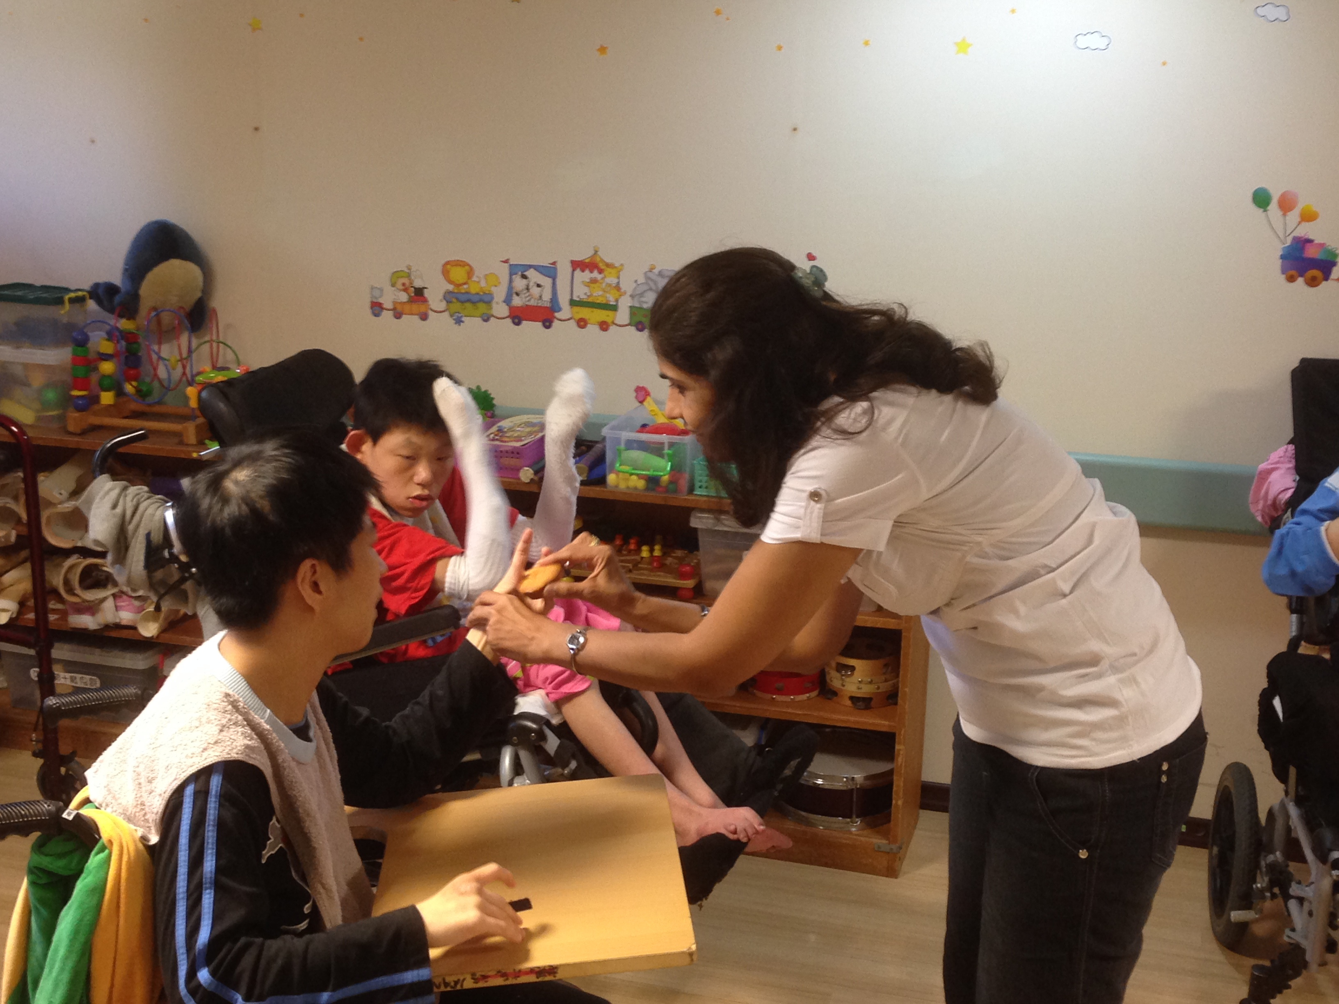
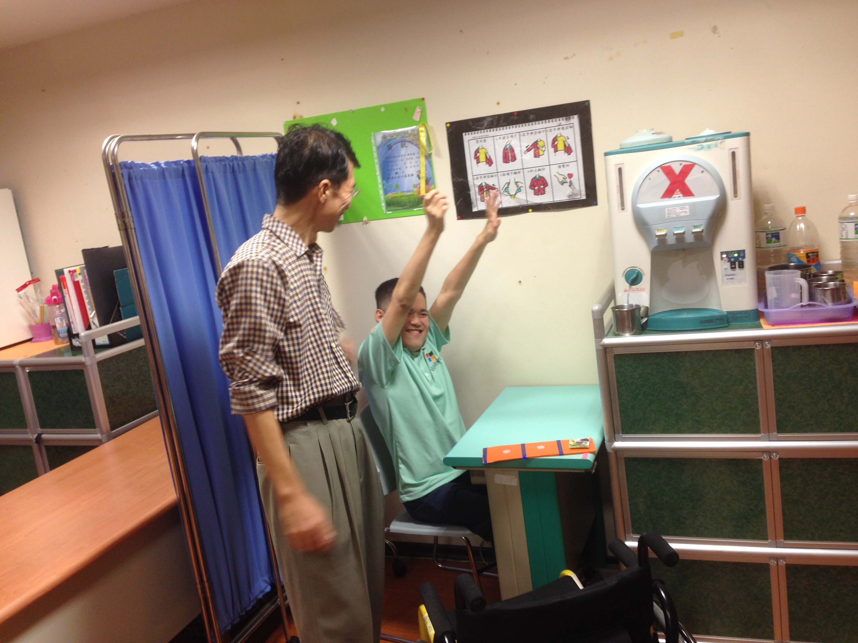
SERVE THE PLANET 2014
Seva in Pali for mentally challenged children.

Slide 28
CHINA

Slide 29
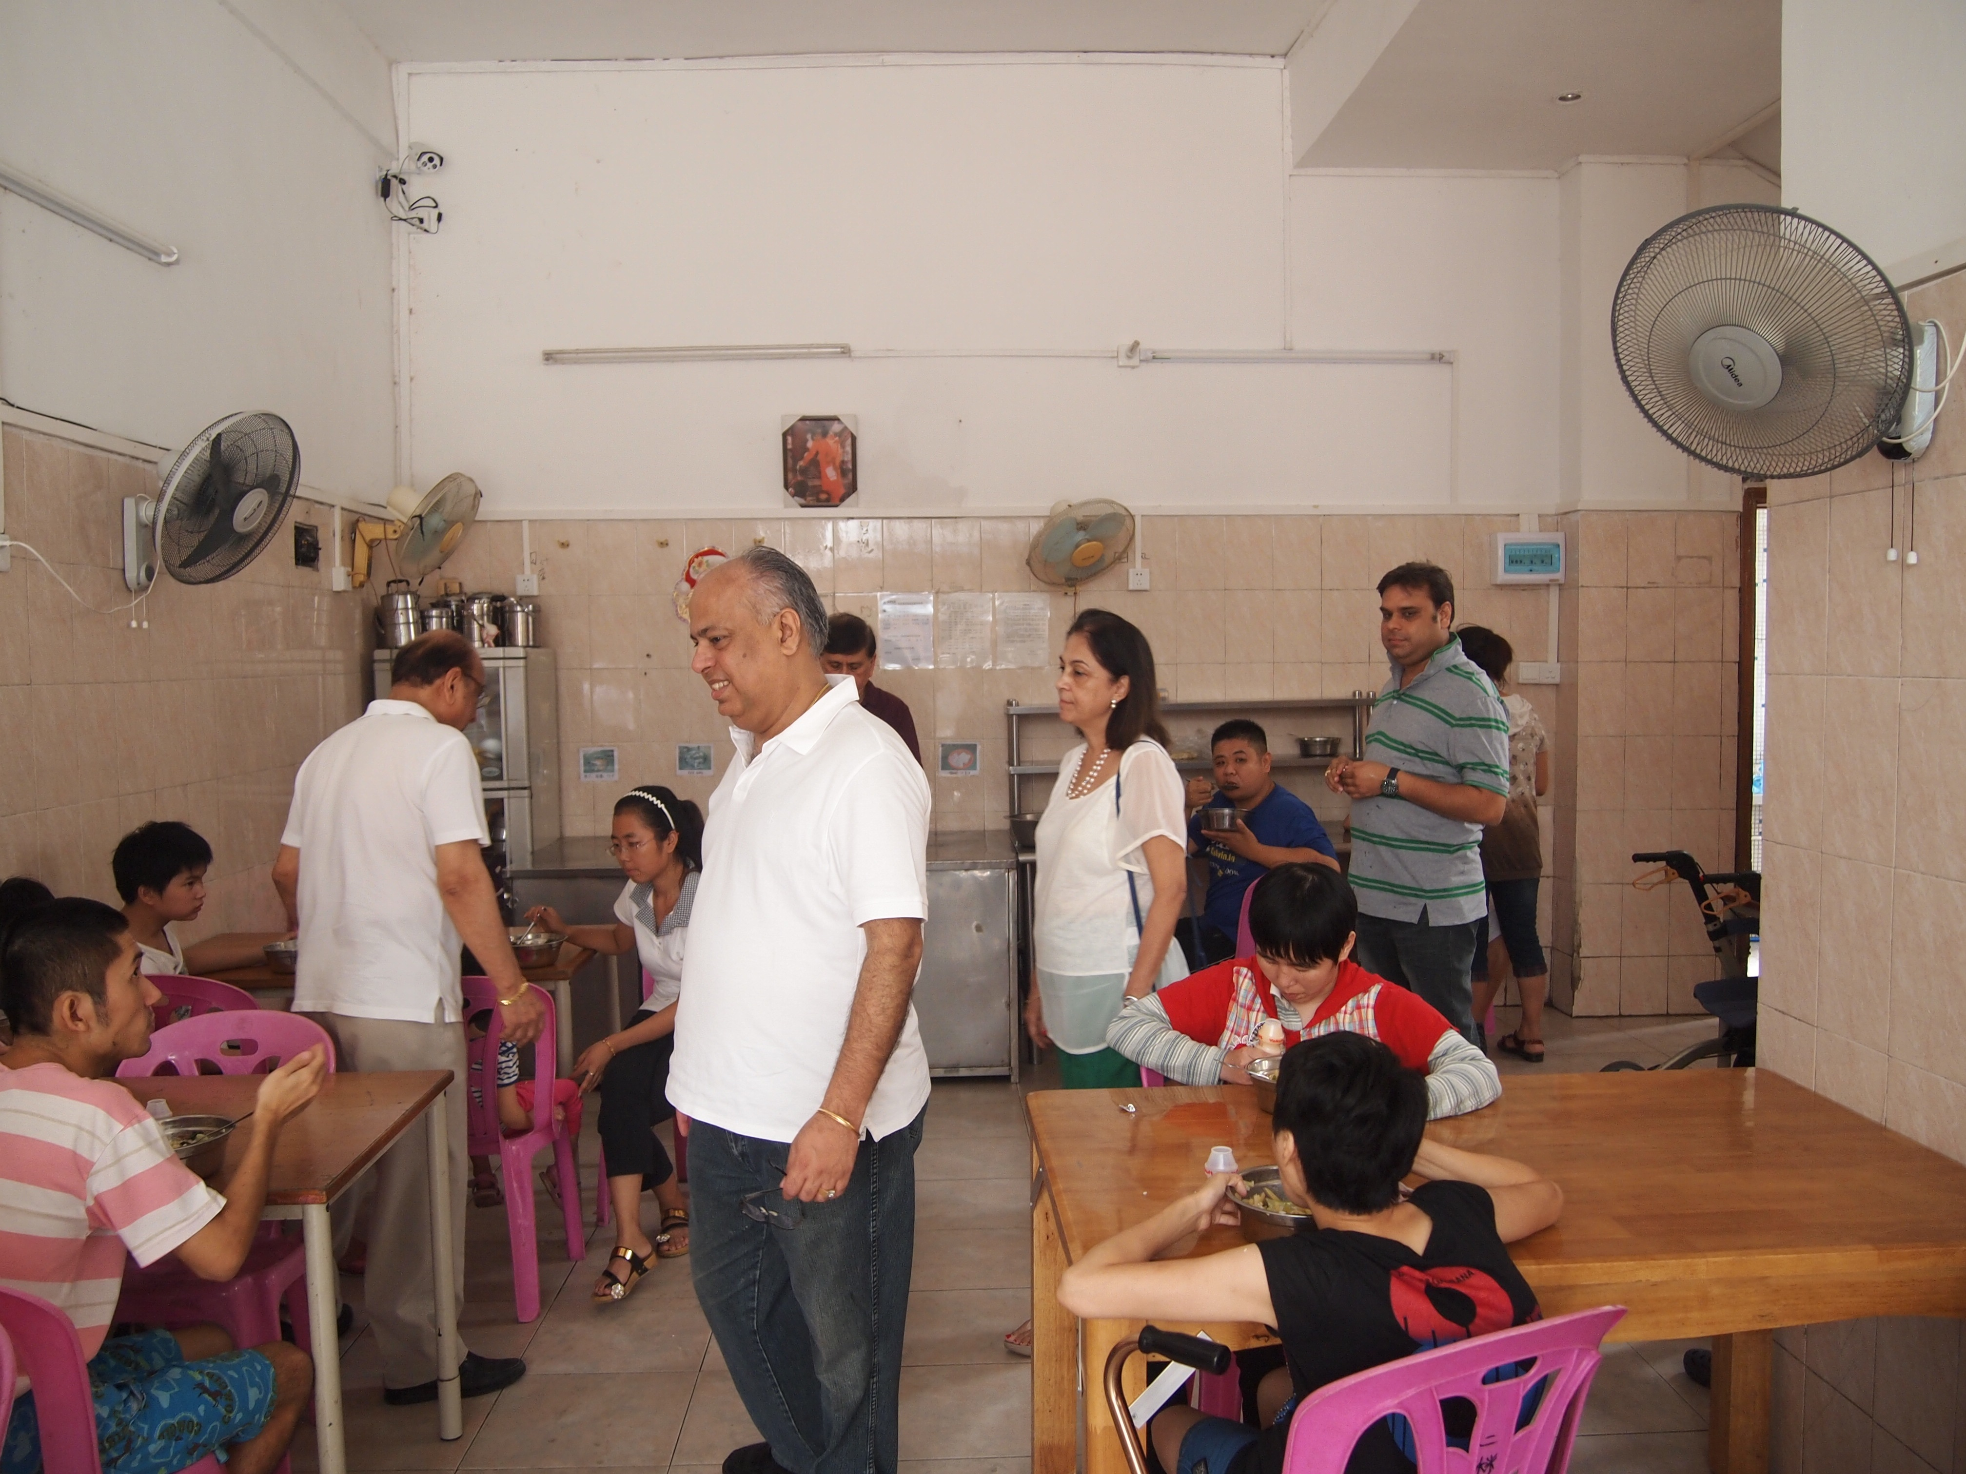
SERVE THE PLANET 2014
Seva at orphanage in Guangzhou for mentally challenged children

Slide 30
JAI SAI RAM

