Slide 1
Zone 4 Report: 2013-2014
Indonesia, Lao PDR, Malaysia, Myanmar,
Nepal, Singapore, Sri Lanka, Thailand
Offered at the divine lotus feet with love and gratitude

Slide 2
INDONESIA

Slide 3
SERVICE
Integrated Seva: Medicare, Educare & Ecocare
20th September 2014
Samosir Island (200 km South of Medan), Northern Sumatra.
A joint-effort Medicare Programe with Police department of the island.
Services Rendered:
Dental screening & treatment (19 dentists served 125 patients).
General healthcare (390 patients).
Seminars on Educare for 112 teachers from 12 districts of the island.
Ecocare: 700 tree seedlings planted to avoid landslides.
Public Kitchen: sevadals (40 members) cooked food for patients, teachers & all.

Slide 4
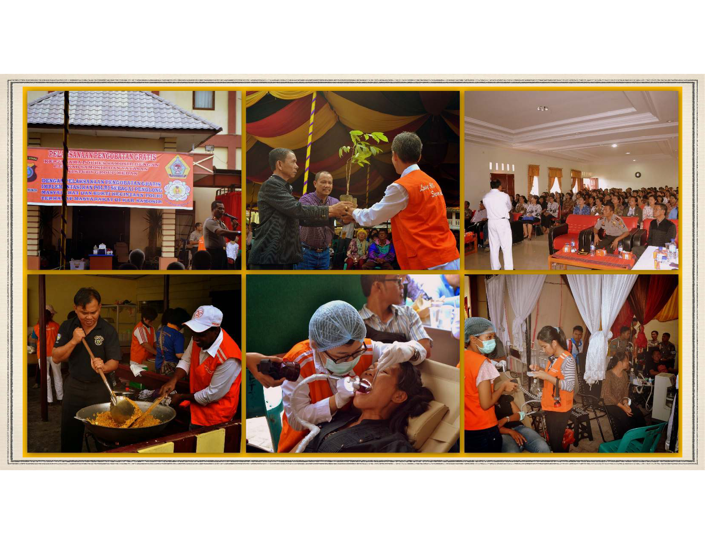

Slide 5
Avatar Declaration Day Celebrations
Medicare: National Blood Donation Campaign throughout Indonesia & Free Cataract Operation (Palembang).
Educare: Visits & Contribution of Educational Tools/Aids to school (Palembang & Jakarta), Computer & EHV Training for children (Jambi).
Sociocare: Narayana Seva (Basic Food Aids) (Medan, Palembang & Lampung)

Slide 6
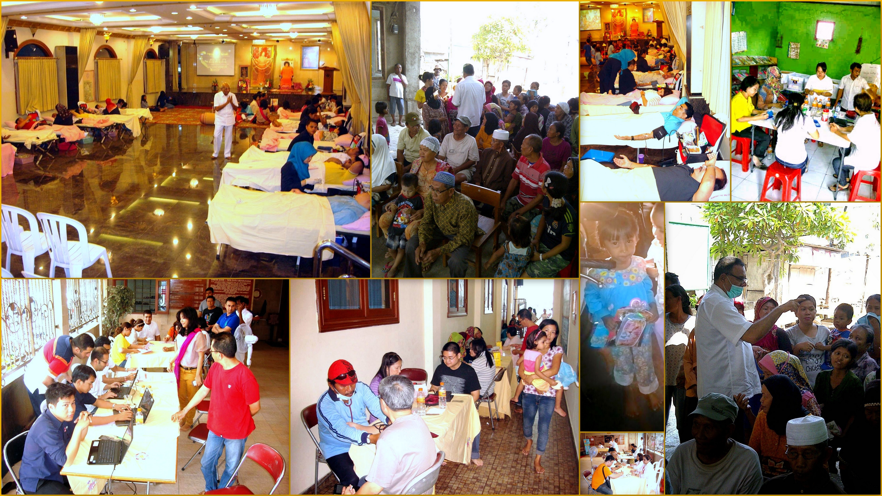

Slide 7
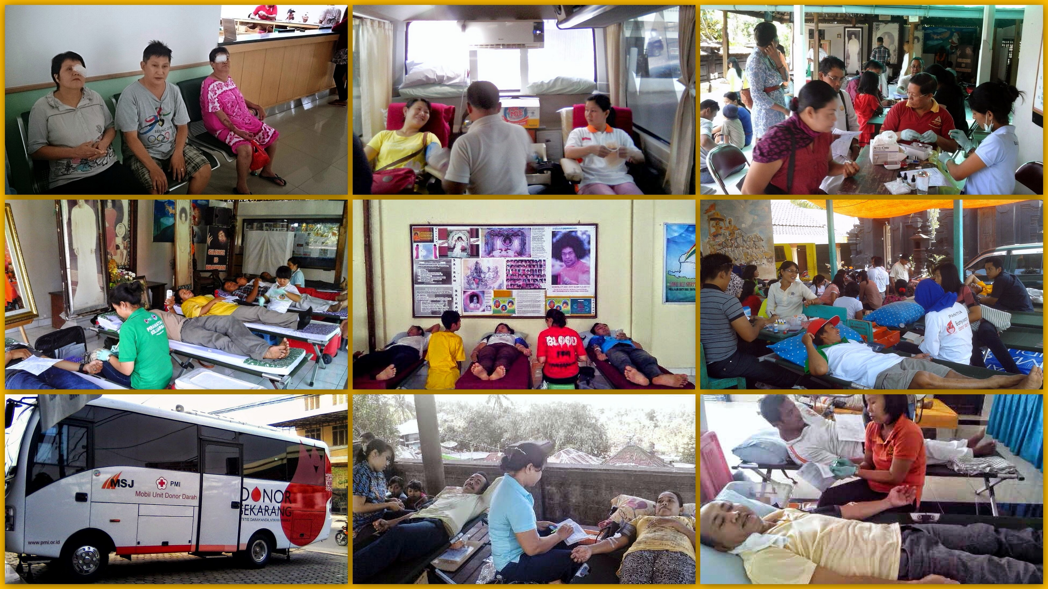

Slide 8
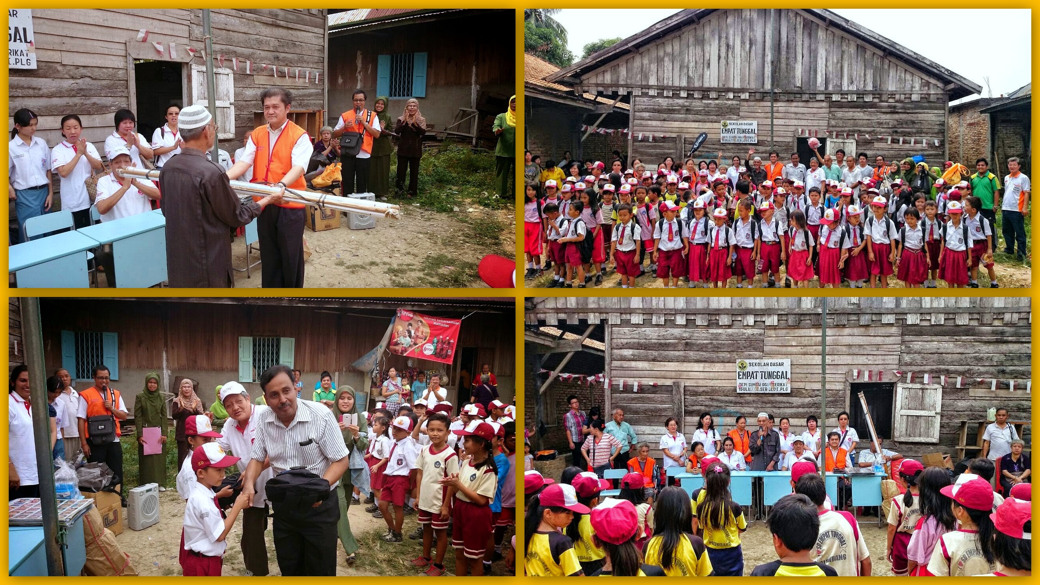

Slide 9
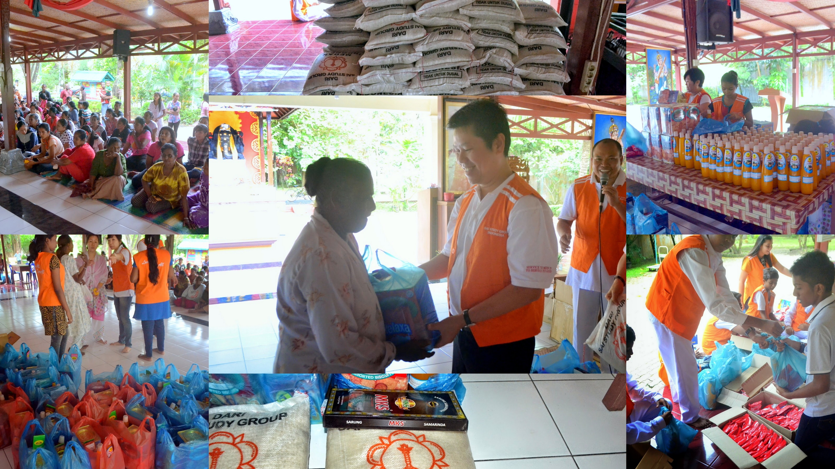

Slide 10
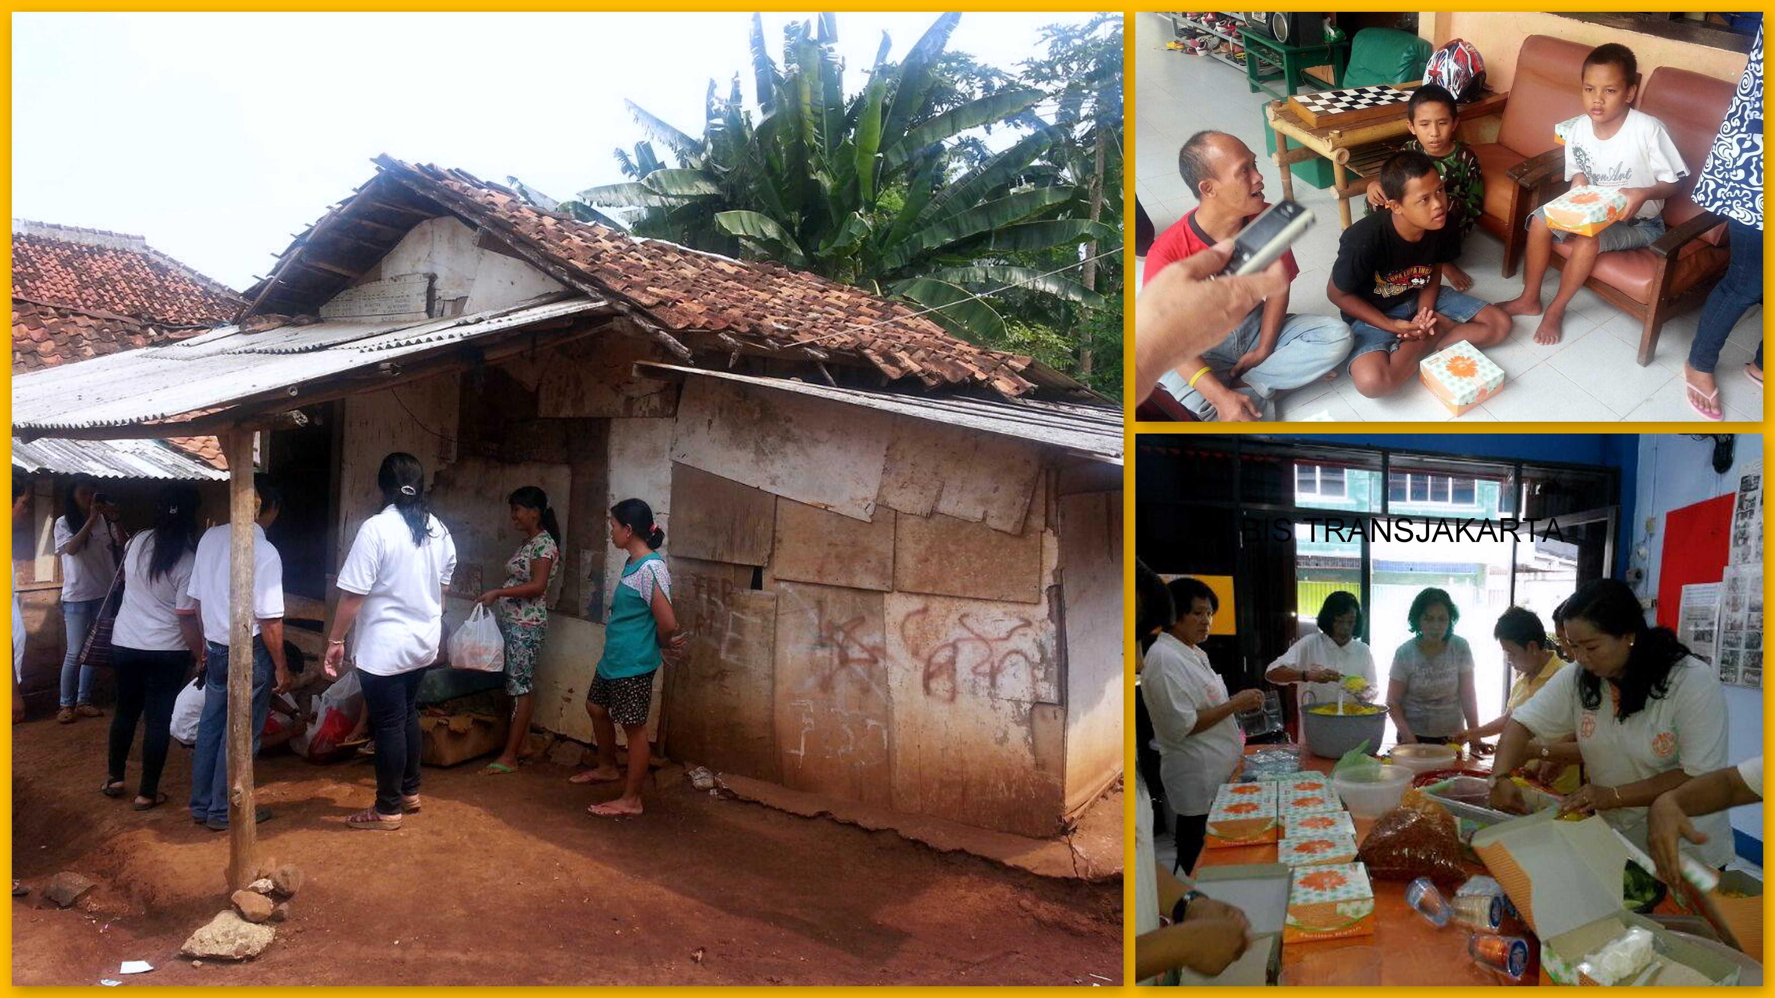

Slide 11
Other Activities:
Regional Youth Camps:
2014-07-19 & 20: Region VII (Bali & Lombok), theme: “HOME - Honor Our Master Every Moment (Becoming Sai Youth) - 84 youths participated.
2014-08-13: Public Lecture at Indonesian Educational University, Bandung - West Java, Dr. Pal Dhall.
2014-08-23 & 24: Sai Rescue Establishment & Training at Lombok.
2014-09-13 & 14: Region I & II (North & South Sumatra), Mahila Camp at Lampung.
Water Project at Klaten, Central Java (Region IV), distribution of clean water & water tank construction (on-going basis).

Slide 12
Lao pdr

Slide 13
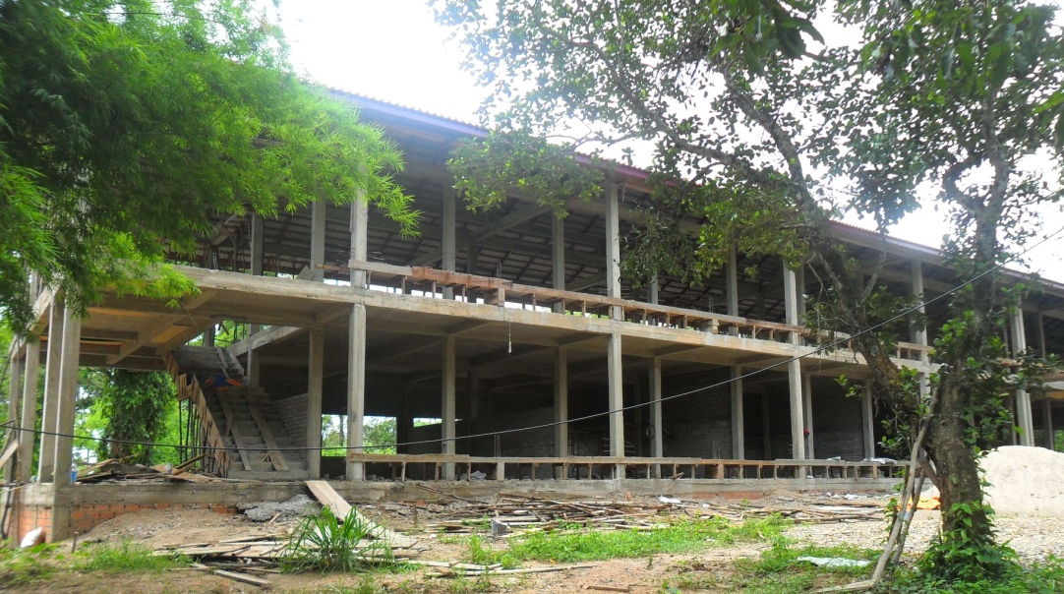
SAI SCHOOL …on-going Sathya Sai School construction
The ground-breaking ceremony was organised on 23rd November 2013
School premises expected to be ready by April 2015
1st academic session planned to commence in October 2015

Slide 14
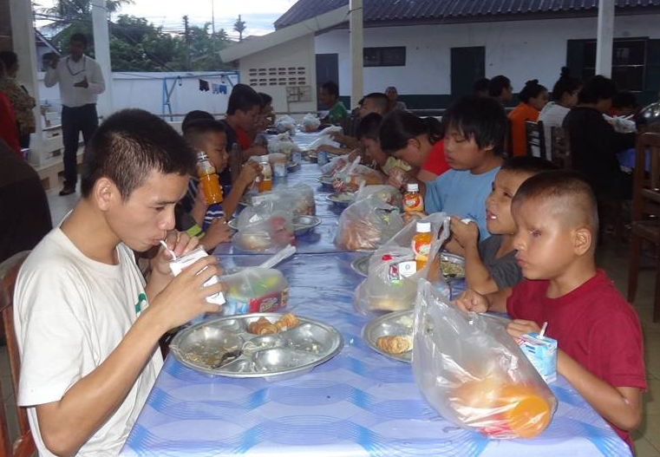
SERVICE United Hearts for Sai’s Children
Serve and care for 40+ blind children
Medical camps planned

Slide 15
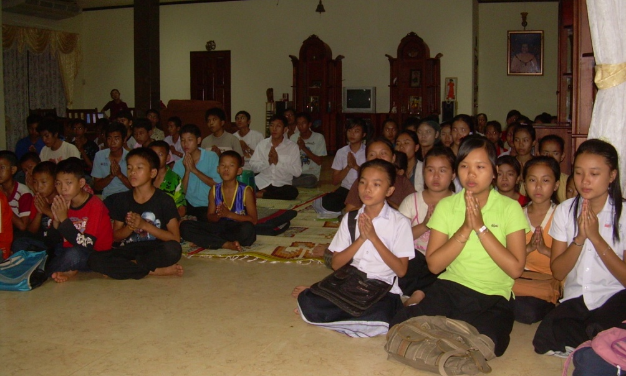
SSEHV
Daily classes
8 Classrooms
250 Students
2 Centres

Slide 16
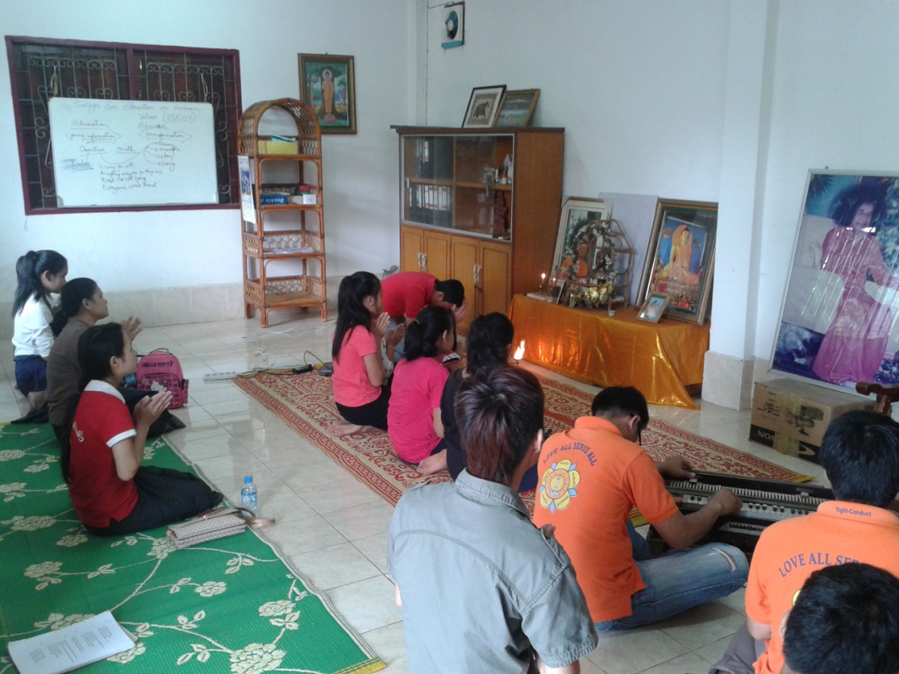
SPIRITUAL Weekly Study Circle and Bhajan
New activities commenced from July 2014
Location: Pho Sai Pagoda

Slide 17
Malaysia

Slide 18
SPIRITUAL
Spiritual Transformation programme – involve more than 90% centers

Slide 19
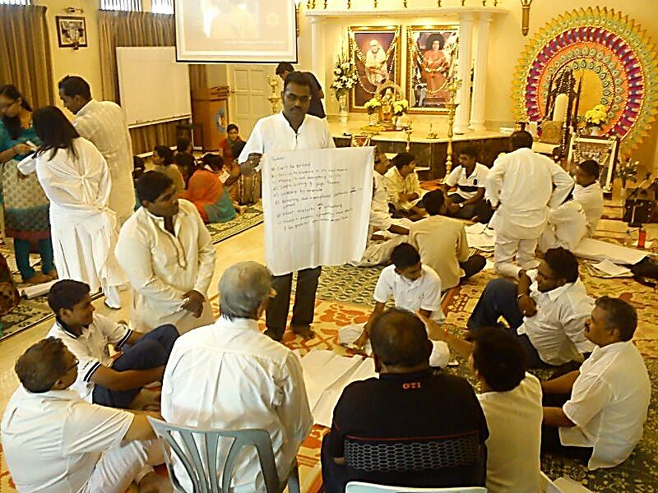
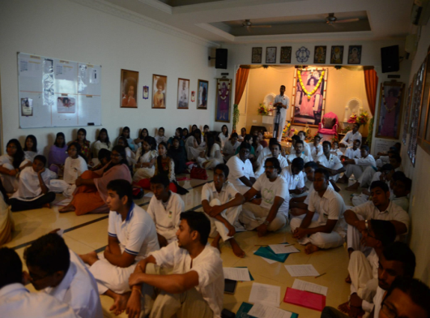
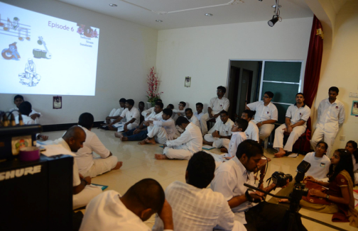
Sathyam Sivam Sundaram
Study circles throughout the nation in almost all regions.
Covering teachings of Swami.
Well attended by youth.

Slide 20
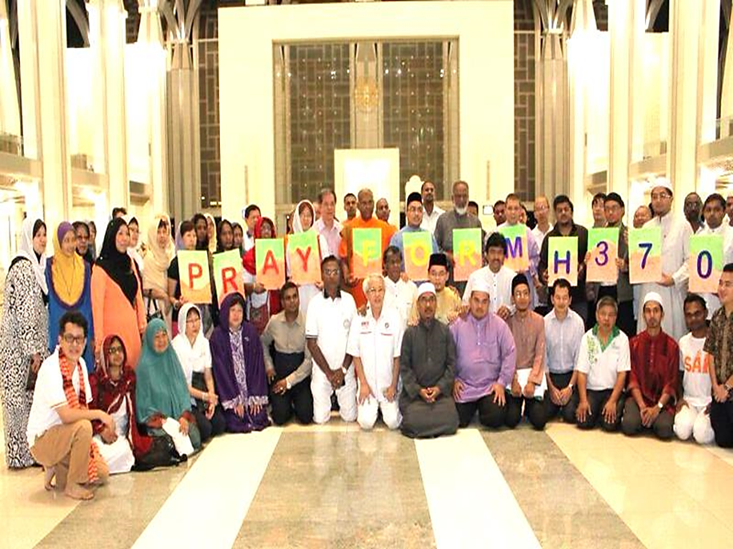
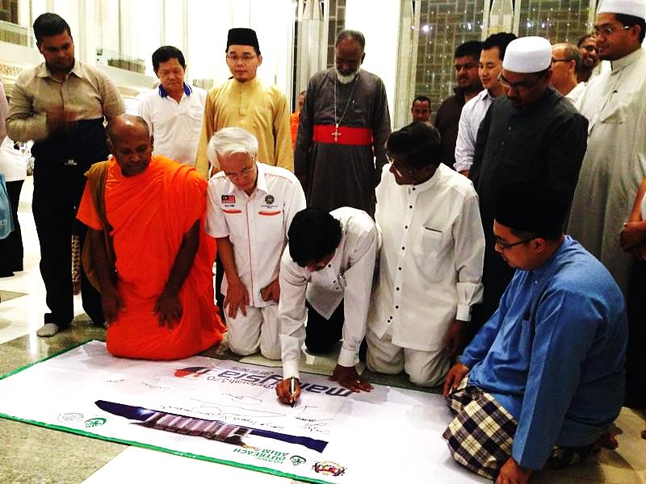
Interfaith prayers for the missing flight in a mosque – historic as this is the first time non Muslims were allowed to enter a mosque

Slide 21
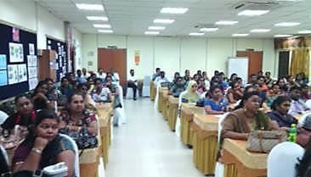
SSEHV
300 teachers and headmasters from Tamil schools agreed to teach SSE in formal classes within school time table.
Major breakthrough allowing SSE into mainstream
schools.

Slide 22
BENCH MARKING PROGRAMMES
Unity promoting programmes - carried out by SSIO Malaysia
Recognised by Ministry as role model examples to be emulated by others

Slide 23
PARENTS APPRECIATION DAY
1,500 parents in 7 communities were brought together. Another inter-ethnic building activity benchmark.

Slide 24
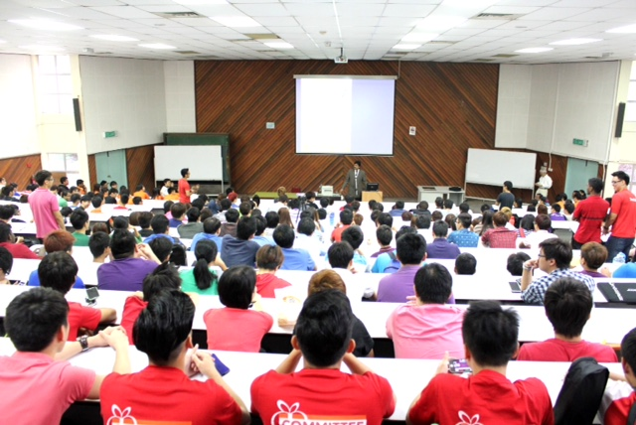
Reaching out to students in colleges for empowerment to do service
TAR college | 430
University Malaya Kuantan colleges | 3,500 300

Slide 25
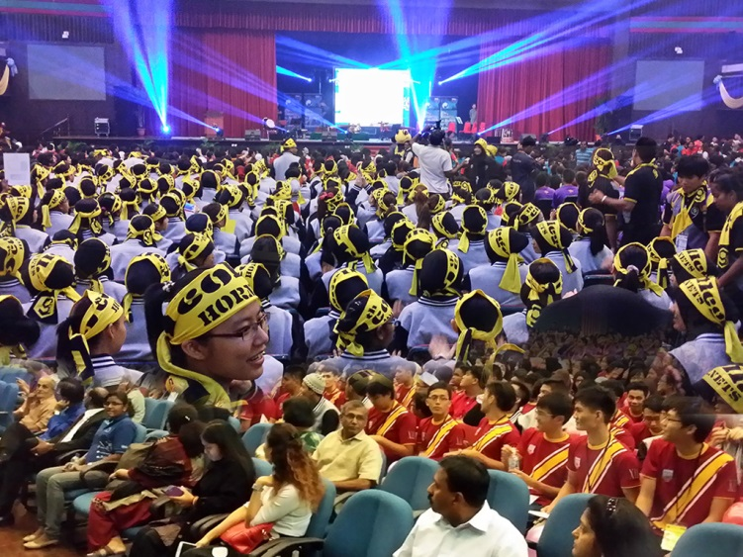
3,500 new students exposed to values through drama and music by inter religious groups, coordinated by SSIO Malaysia

Slide 26
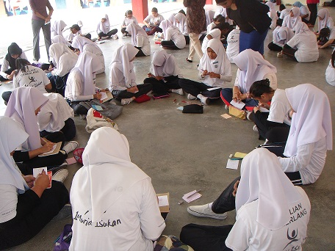
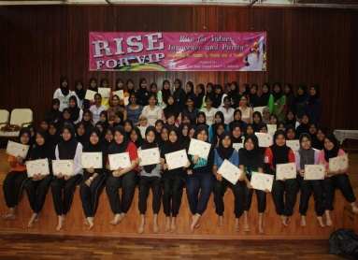
SERVICE
RISE For VIP - Reaching for Inner Strength and Empowerment for Values, Innocence and Purity
Program Preventing Teenage Pregnancy launched in several schools. Target to reach 90 schools by Swami’s 90th birthday
Program by female youth for female students

Slide 27
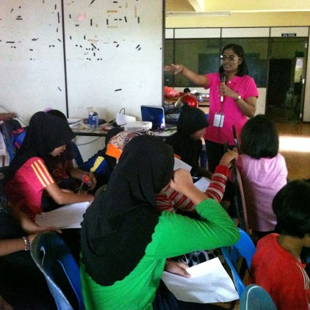
RISE for VIP Programme

Slide 28
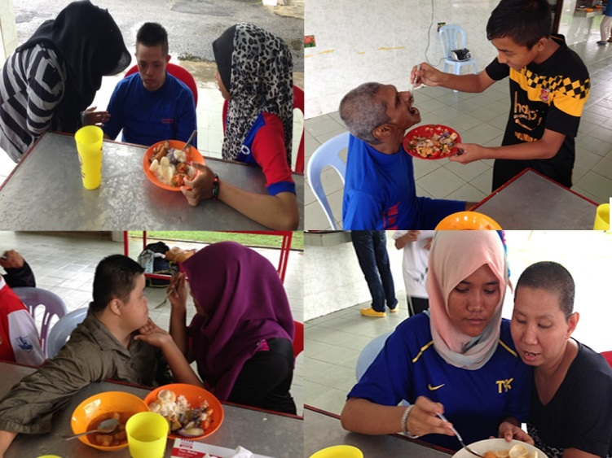
Bringing youth from communities to experience service by feeding elders of other races

Slide 29
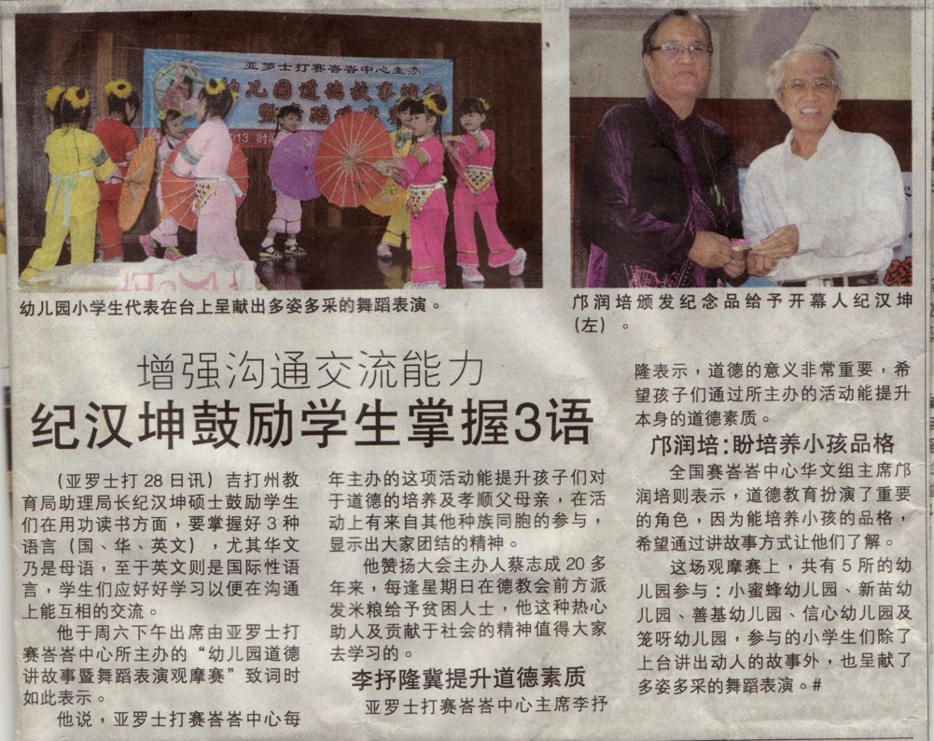
Reaching out to the Chinese community using regular newspaper articles on Swami’s messages

Slide 30
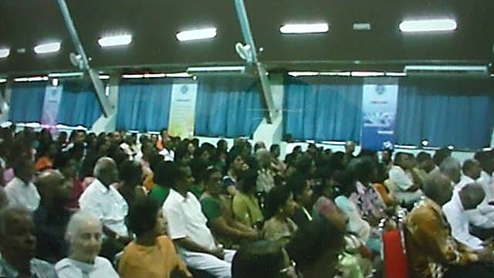
Reaching out to the public through talks -
The Science and Signs of Human Transformation

Slide 31
Interfaith Value Based Music and Drama sponsored by
Prime Minister’s Department

Slide 32
Myanmar

Slide 33
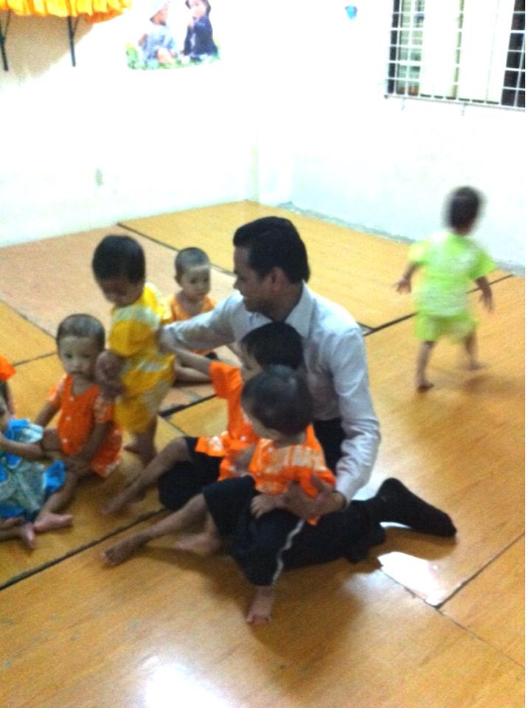
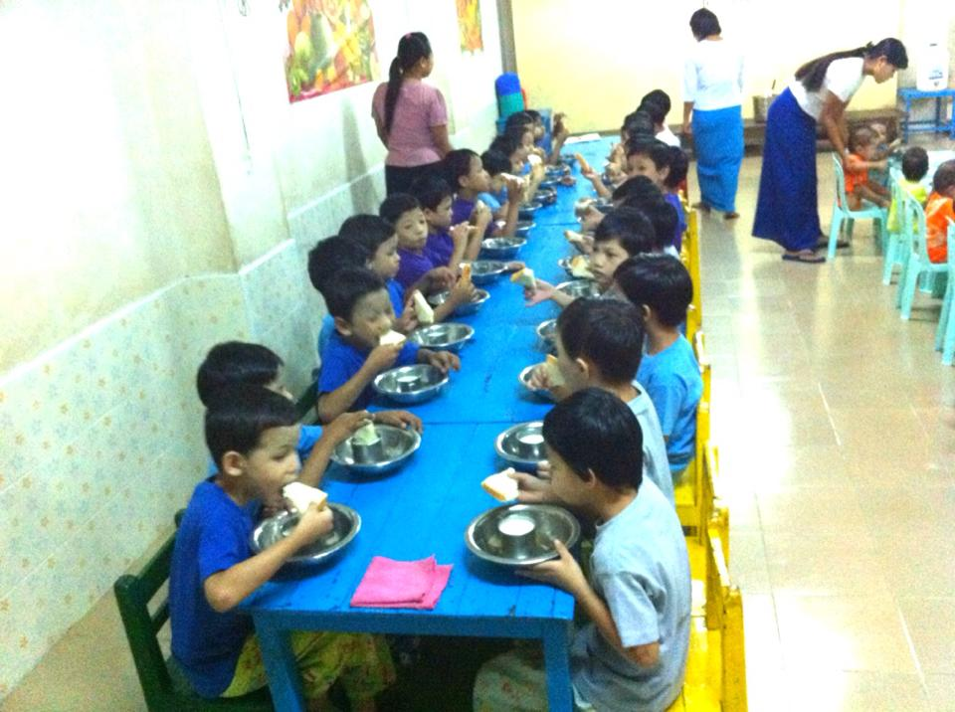
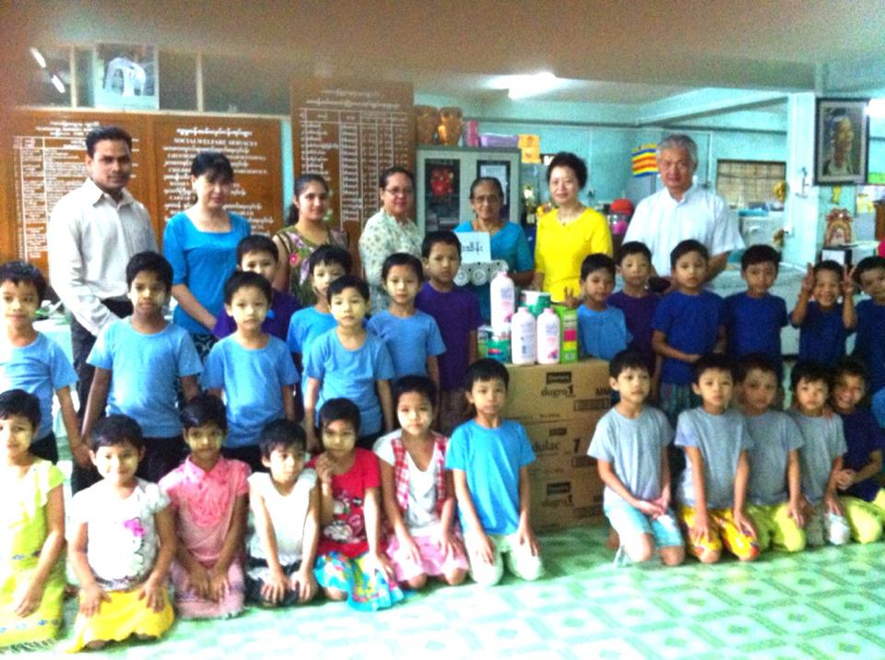
SERVICE: Serve the Planet 2014
20th October 2014
Seva at Department of Social Welfare
Shwe Gon Dine Nursery, Yangon, Myanmar
7 devotees joined and donated items for the nursery
50 orphans served

Slide 34
Nepal

Slide 35
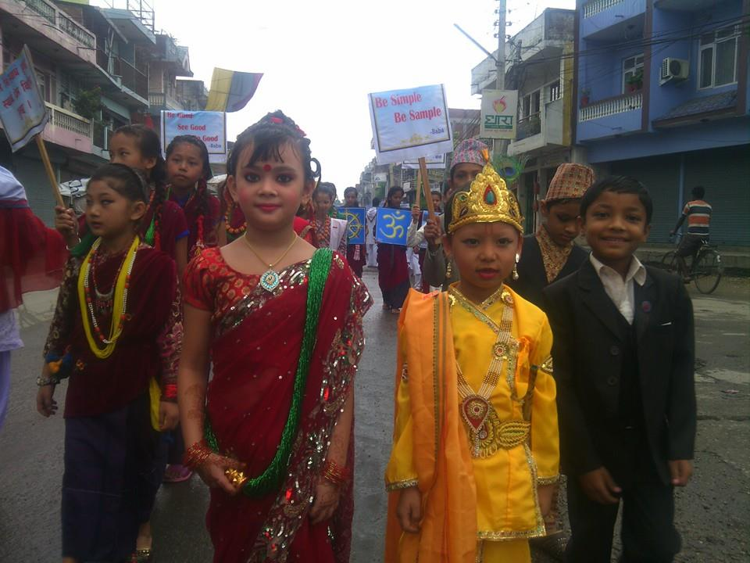
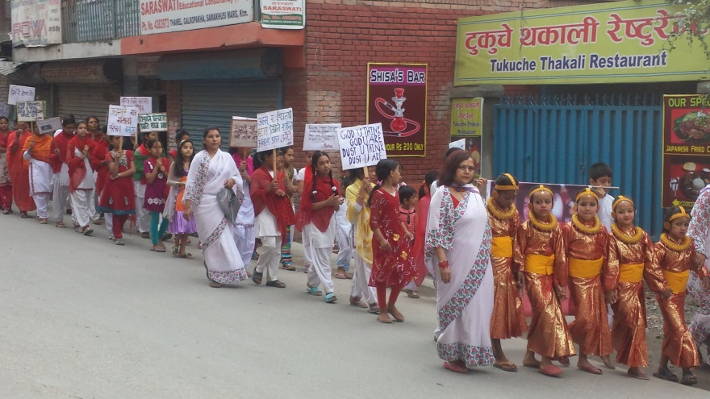
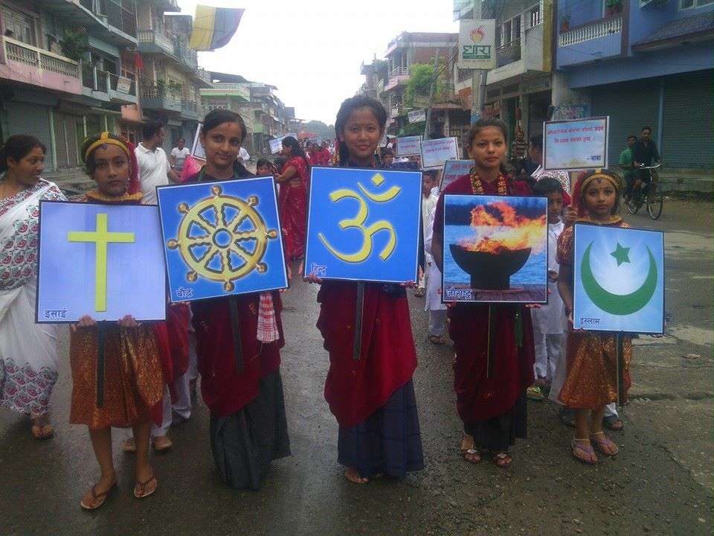
SSEHV – Guru Poornima Bal Vikas Rally
A total of 2013
Bal Vikas Children from 35 Sai Centres took out rallies in different parts of the country

Slide 36
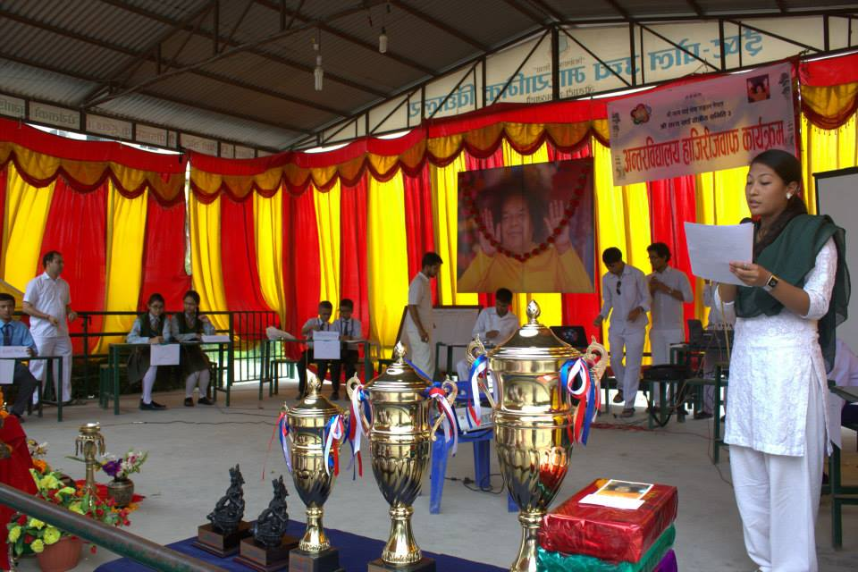
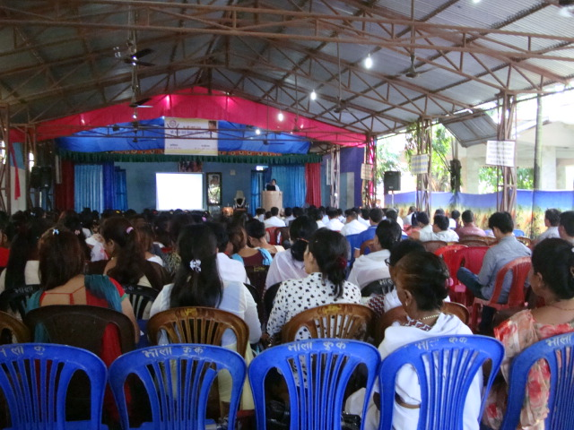
Inter School Quiz Contest on Spirituality and EHV Training
469 students of 34 schools Participated in Inter School Quiz Competition in spirituality
300 teachers of private schools received EHV training
ISSE Nepal has trained 10,690 teachers of private schools and 3,848 master trainers of Department of Education, Nepal
Parenting Talks given to 2,238 parents

Slide 37
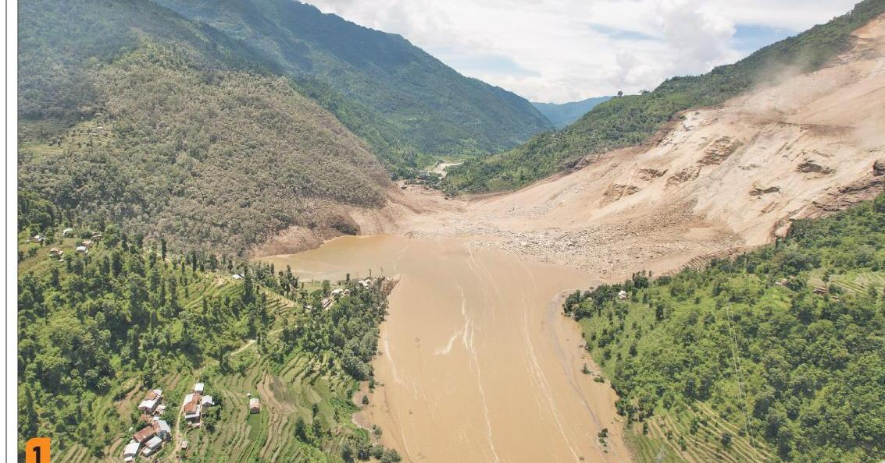
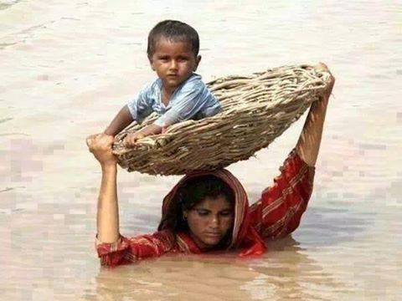
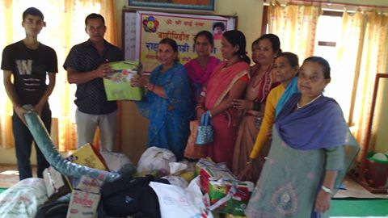
SERVICE -Flood Relief Program
7 Sevadals carried relief materials utensils, blankets and mattresses for the landslide victims in 56 houses in Mankha village
247 victims given food items (Confectionaries, beaten rice, etc) for 9 days with clothes, tents, blankets and daily meals for 50 people sheltered in a school.

Slide 38
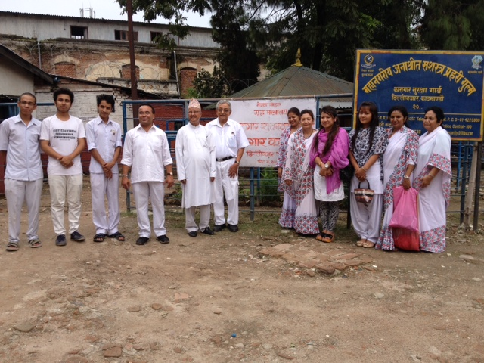
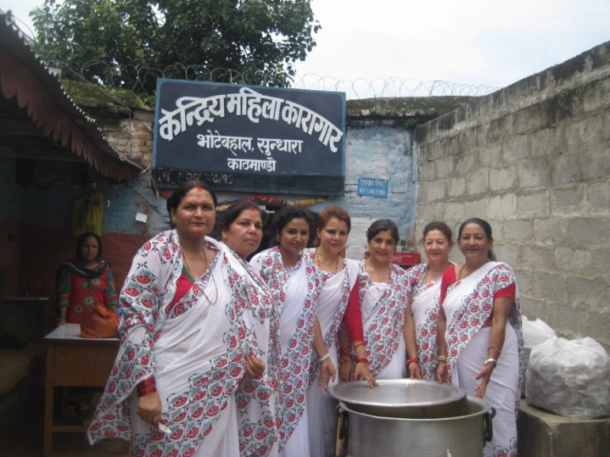
Jail Seva
On Fathers' Day SSSIO Nepal served lunch to 1809 male inmates in 5 jails
On Hari Talika Teej festival 492 female prisoners at 5 different places were served a delicious lunch.
645 inmates patiently attended the melodious Sai Bhajans followed by a brief talk by the director of the ISSEN

Slide 39
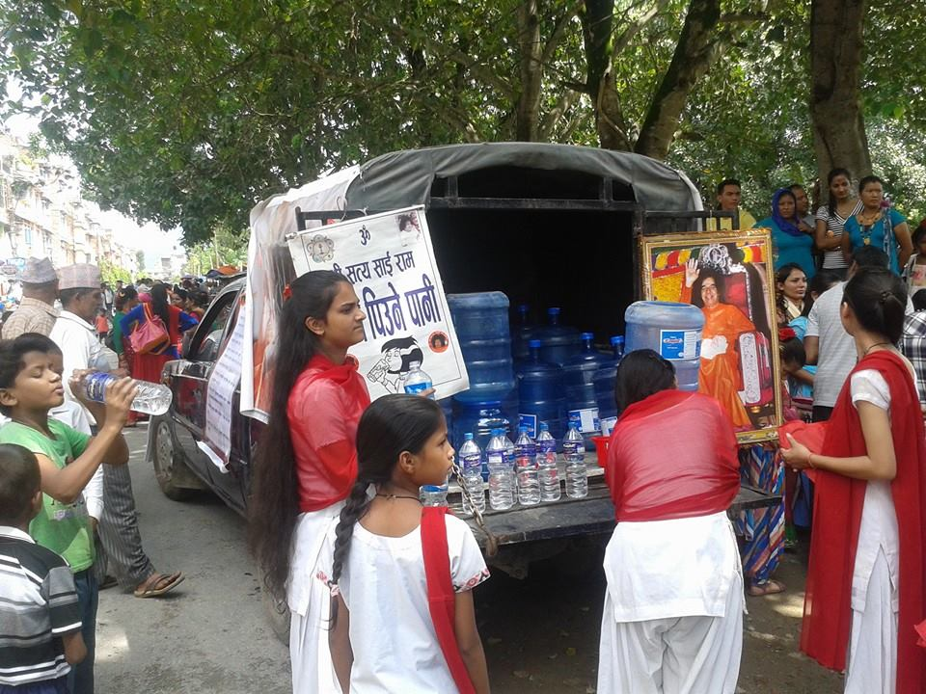
Drinking water served to 2000 pilgrims visiting a Shiva temple.

Slide 40
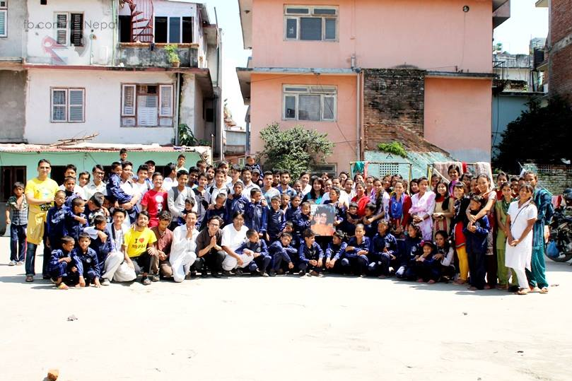
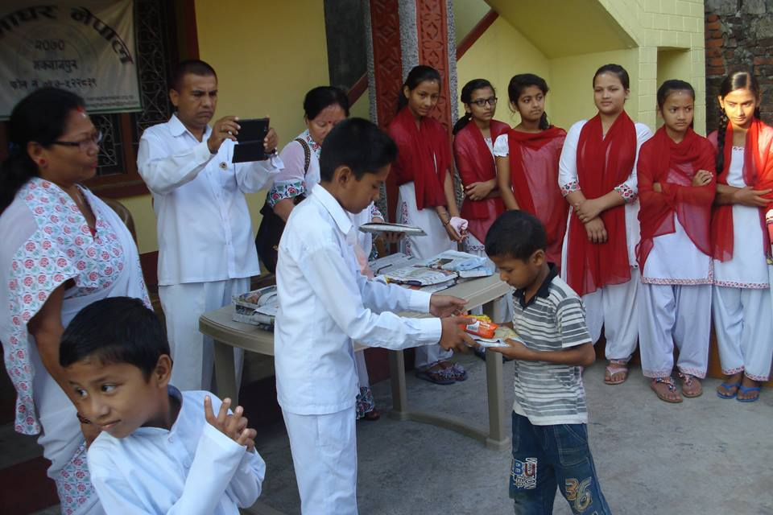
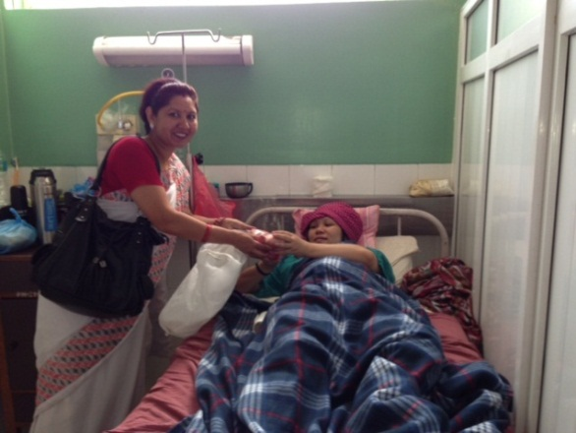
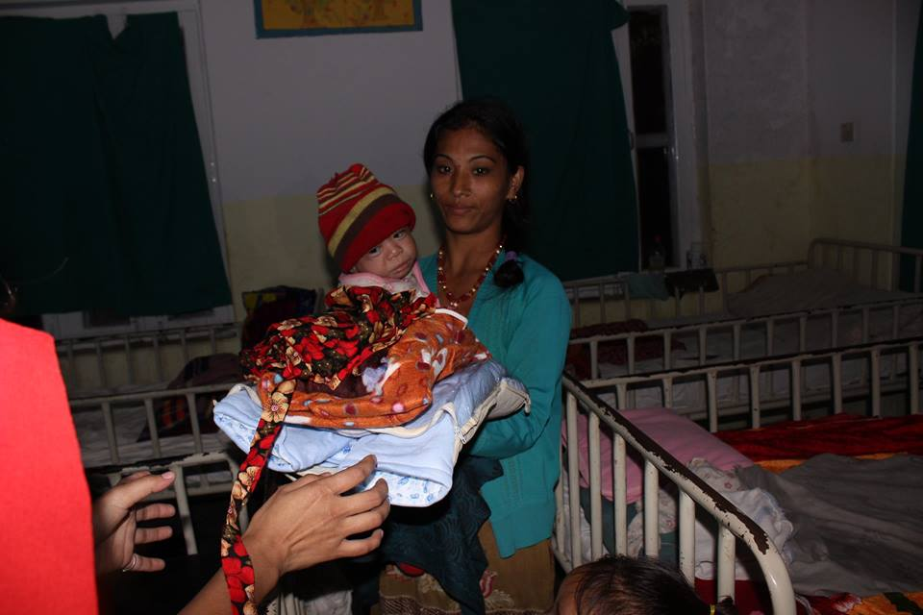
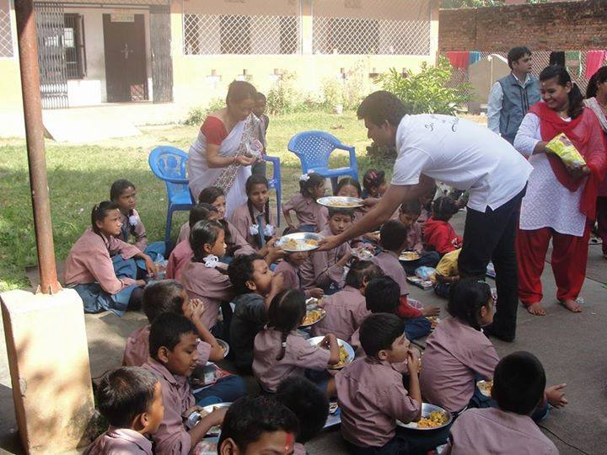
Serve the Planet
SSIO distributed sportswear embossed with photo of Bhagawan Baba to 162 children of an orphanage
Stationeries Distribution
8 children suffering from malnutrition were given nutritional food, fruits, clothes and bedcovers along with financial assistance in 3 different hospitals
Narayan Seva to 300 Children

Slide 41
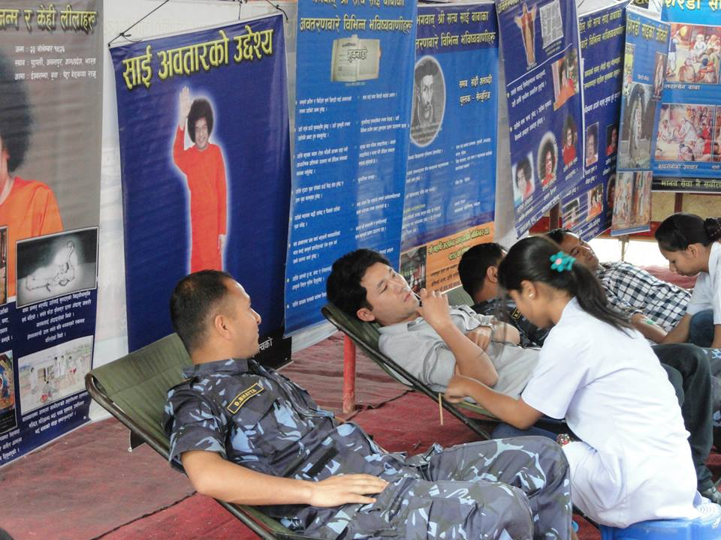
National Award for Blood Donation

Slide 42
Cleaning the Bagmati River

Slide 43
Singapore

Slide 44
SSEHV
Human Values Drama Festival 2014
Organised by the SSIO of Singapore and supported by the National Youth Council and the Lee Foundation.

Slide 45
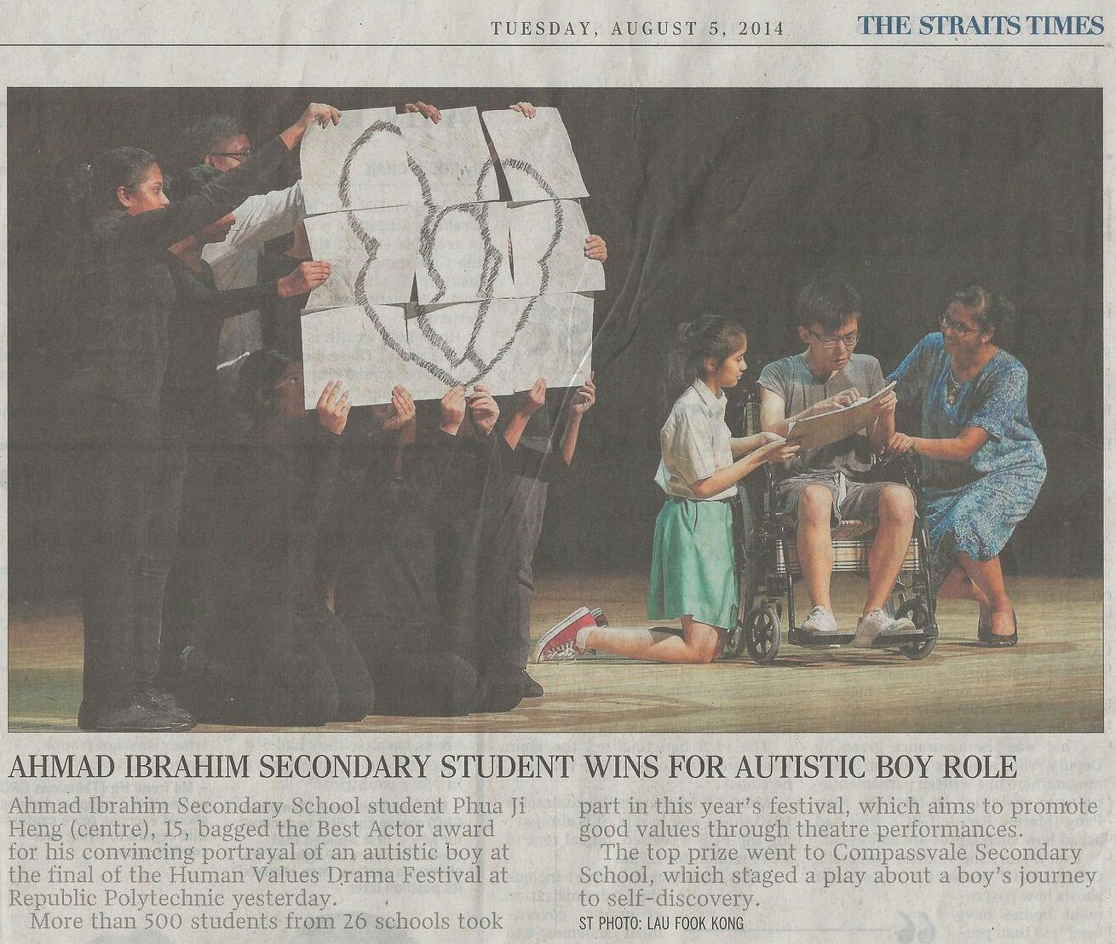

Slide 46
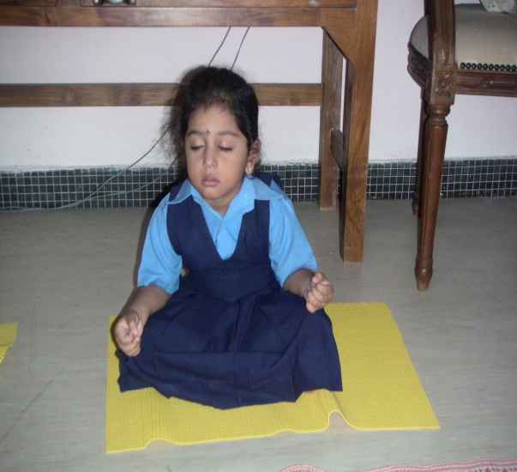
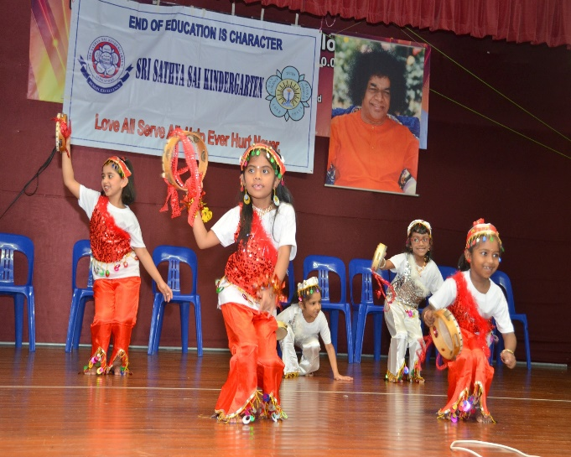
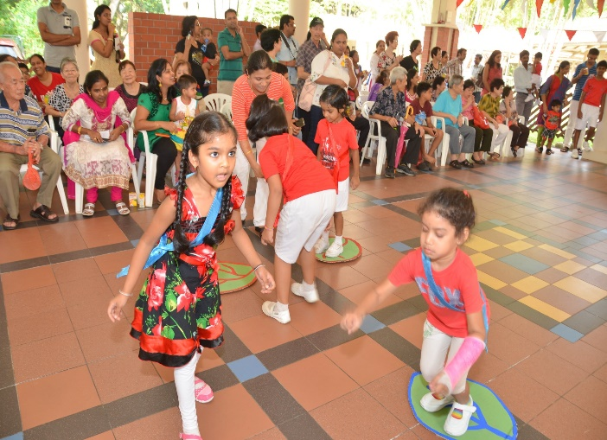
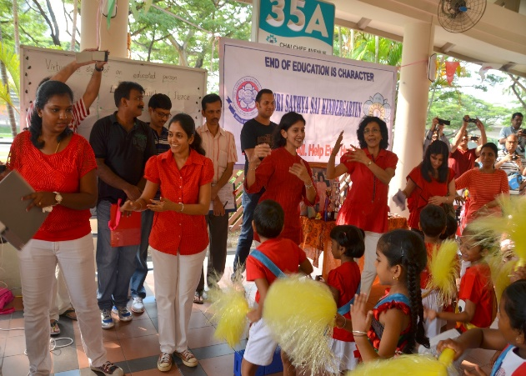
2002 – 2014
Sri Sathya Sai Kindergarten, Singapore
14th Graduation Day
Student doing meditation
Students performing Egyptian dance
Background: VIPs- Seniors from Chai Chee Activity Centre

Slide 47
SERVICE
Home cooked food distribution
Narayana Seva
3rd Sunday of every month from 4:30 pm at worker’s dormitory
Started on 21st sept 2014 – to be continued monthly
Vegetarian food prepared by volunteer families from all over Singapore, along with fruits
Food prepared at home - collected by volunteers & brought to dormitory
Distributed to needy foreign workers
New Year’s day 2015: Plan to distribute 9,000 packets on 4th Jan 2015

Slide 48
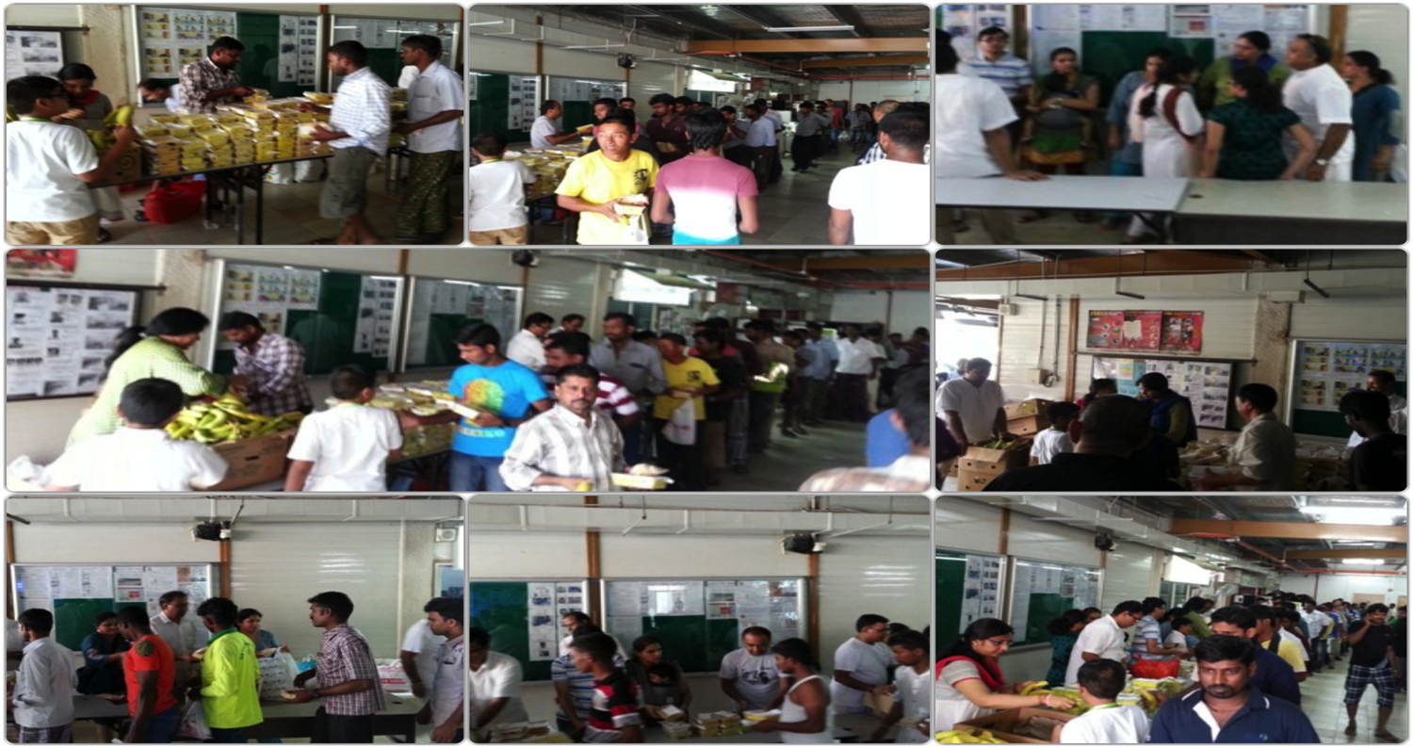
Narayana Seva @ Yishun
21st September 2014

Slide 49
Sai Students entertaining at Chinatown Senior Activity Centre on Mahasamadhi Day 2014
Notes:
Orientation at jan 2013

Slide 50
Sri lanka

Slide 51
Literacy Project: Sinhala & English
SSEHV
100 books donated to a day care centre where the gurus currently conduct EHV classes in a suburb of Colombo.
Mulathivu Centre to start a library and donate books to primary schools around the area to raise literacy.

Slide 52
Sri Sathya Sai Village Integrated Programme
SERVICE
was initiated in two identified villages, Vadamunnai and Uthuchenai where there is lack of basic facilities.
Cataract Surgeries:
Performed for 12 villagers
Cows and calves donated to widows:
Widows support families with income generated from selling milk and manure for farming

Slide 53
Wells constructed to provide drinking water
Villages lacked basic water facilities
Vadamunnai Well - opened on 18/09/2014
Uthuchenai Well - opened on 25/10/2014.
Income for basic needs
To help villagers earn a living, seeds were donated for farming.
No expenses for fertilizer and pesticides.
Villagers trained by experts to make natural fertilizers and pesticides using manure.
Bed sheets donated to 30 elders (above 70)
Importance of Prayer and Cleanliness - Awareness programme by Ladies Wing

Slide 54
Serve the Planet – “Our Children: Our Future”
Youth from Vavuniya conducted the program on 25.10.2014
78 Balvikas children from Vavuniya Sai Children’s home, Vavuniya Sai center balvikas students and Poompugar SDG Balvikas students participated
Drama, Bhajans, Speeches, Swami’s video clips, Cartoons and Children games included in the programme
Finally school exercise books distributed among the children followed by prasadam

Slide 55
Cataract Surgeries
23 patients from Mullaithivu and Kilinochchi district were successfully operated on at Jaffna Teaching Hospital.

Slide 56
Mother and Child: Sustainable Self Employment Project
Gemunupura, an underprivileged area, was badly affected by fire in August, 2013
Mahilas identified expectant mothers and sponsored them for 6 months.
This interfaith group has grown from 4 to 9 women
A parenting programme by the Gurus is going on simultaneously

Slide 57
On Avatar Declaration Day, Mahilas assisted in cooking and distributing 300 food parcels in a poor community.
Provided material to help with a self-employment project teaching them how to sew garments and rugs.

Slide 58
Mathugama – Housing Construction
Relief provided during flooding in June this year
Mahilas supported a family of four
Mahilas undertook a project to complete the construction of their partially built house by Swami’s Birthday 2014
Original state of the house
Three of the family members

Slide 59
Ambulance Service
SSIO Sri Lanka Central Trust bought an ambulance for rural areas:
for medical camps and
to transport patients to hospitals.

Slide 60
Drinking Water Project
Drinking water project completed in Vavuniya
–waiting for water board approval.
Objective: To distribute 10,000 litres of drinking water daily to more than 750 families. Initiated due to various kidney-related diseases, in Vavuniya due to high calcium content in water.

Slide 61
Katharagama Mobile Medical Camp
4–day Medical Camp held in Katharagama in July
1,038 people examined and provided medicines

Slide 62
Blood Donation
“Liquid Love” – 3rd week of September 2014 in many centers
Over 150 devotees donated blood

Slide 63
Thailand

Slide 64
Teachers’ Training at Sai Darshini, Chiangrai,Bandu
SSEHV
On 23–24 August, 12 devotees received 2 days of teacher training at Sai Darshini Center

Slide 65
Annual Parents Teachers Meeting
SSE Parents Teachers Meeting @ Sai Prashanti Center on 14th September.
Talk by National Education Coordinater, followed by bhajans by SSE children and prasadam.
Attended by 49 students, 44 parents and 10 devotees.
Bhajans by SSE Students

Slide 66
Chiangrai, Bandu – Sai Darshini Center
October 16th Chiangrai – Bandu - Sai Darshini Center
4 devotees distributed food and drinks to 500 people in Thai temple

Slide 67
Serve The Planet
On 20th October Chiangrai, Bandu- Sai Darshini Center’s 8 members invited 7 children with families and distributed rice and oil to them
On 19th October, Chiangmai center’s 11 members cooked food for 20 young girls and few caretakers at Wildflower Home.

Slide 68
Serve the Planet
Light meditation
Teaching human values songs
Serving home-made food
On 14th October, 11 ladies from Sai Prashanti Center invited 25 children from an orphanage and served them home-made food

Slide 69
Serve the Planet
Buddhist prayers at Buddhist temple
Bhajans
Carrying fruits & snacks
25 members and 5 others from Sai Prashanti, Rajdamneon, Sukumvit, Nonthaburi Sai Centres visited Wat Srakaew, Ayuthya province, and served food to 360 children, monks and others
Children at the temple

Slide 70
SAI RAM

