Slide 1
Sathya Sai International Organisation
Zone 2B
South America

Slide 2
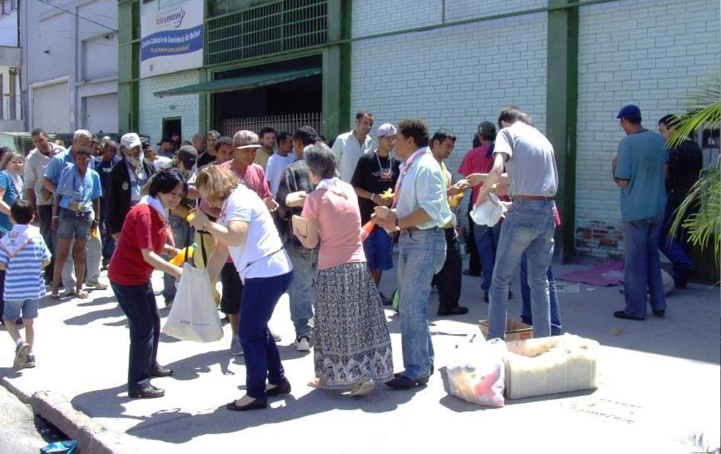
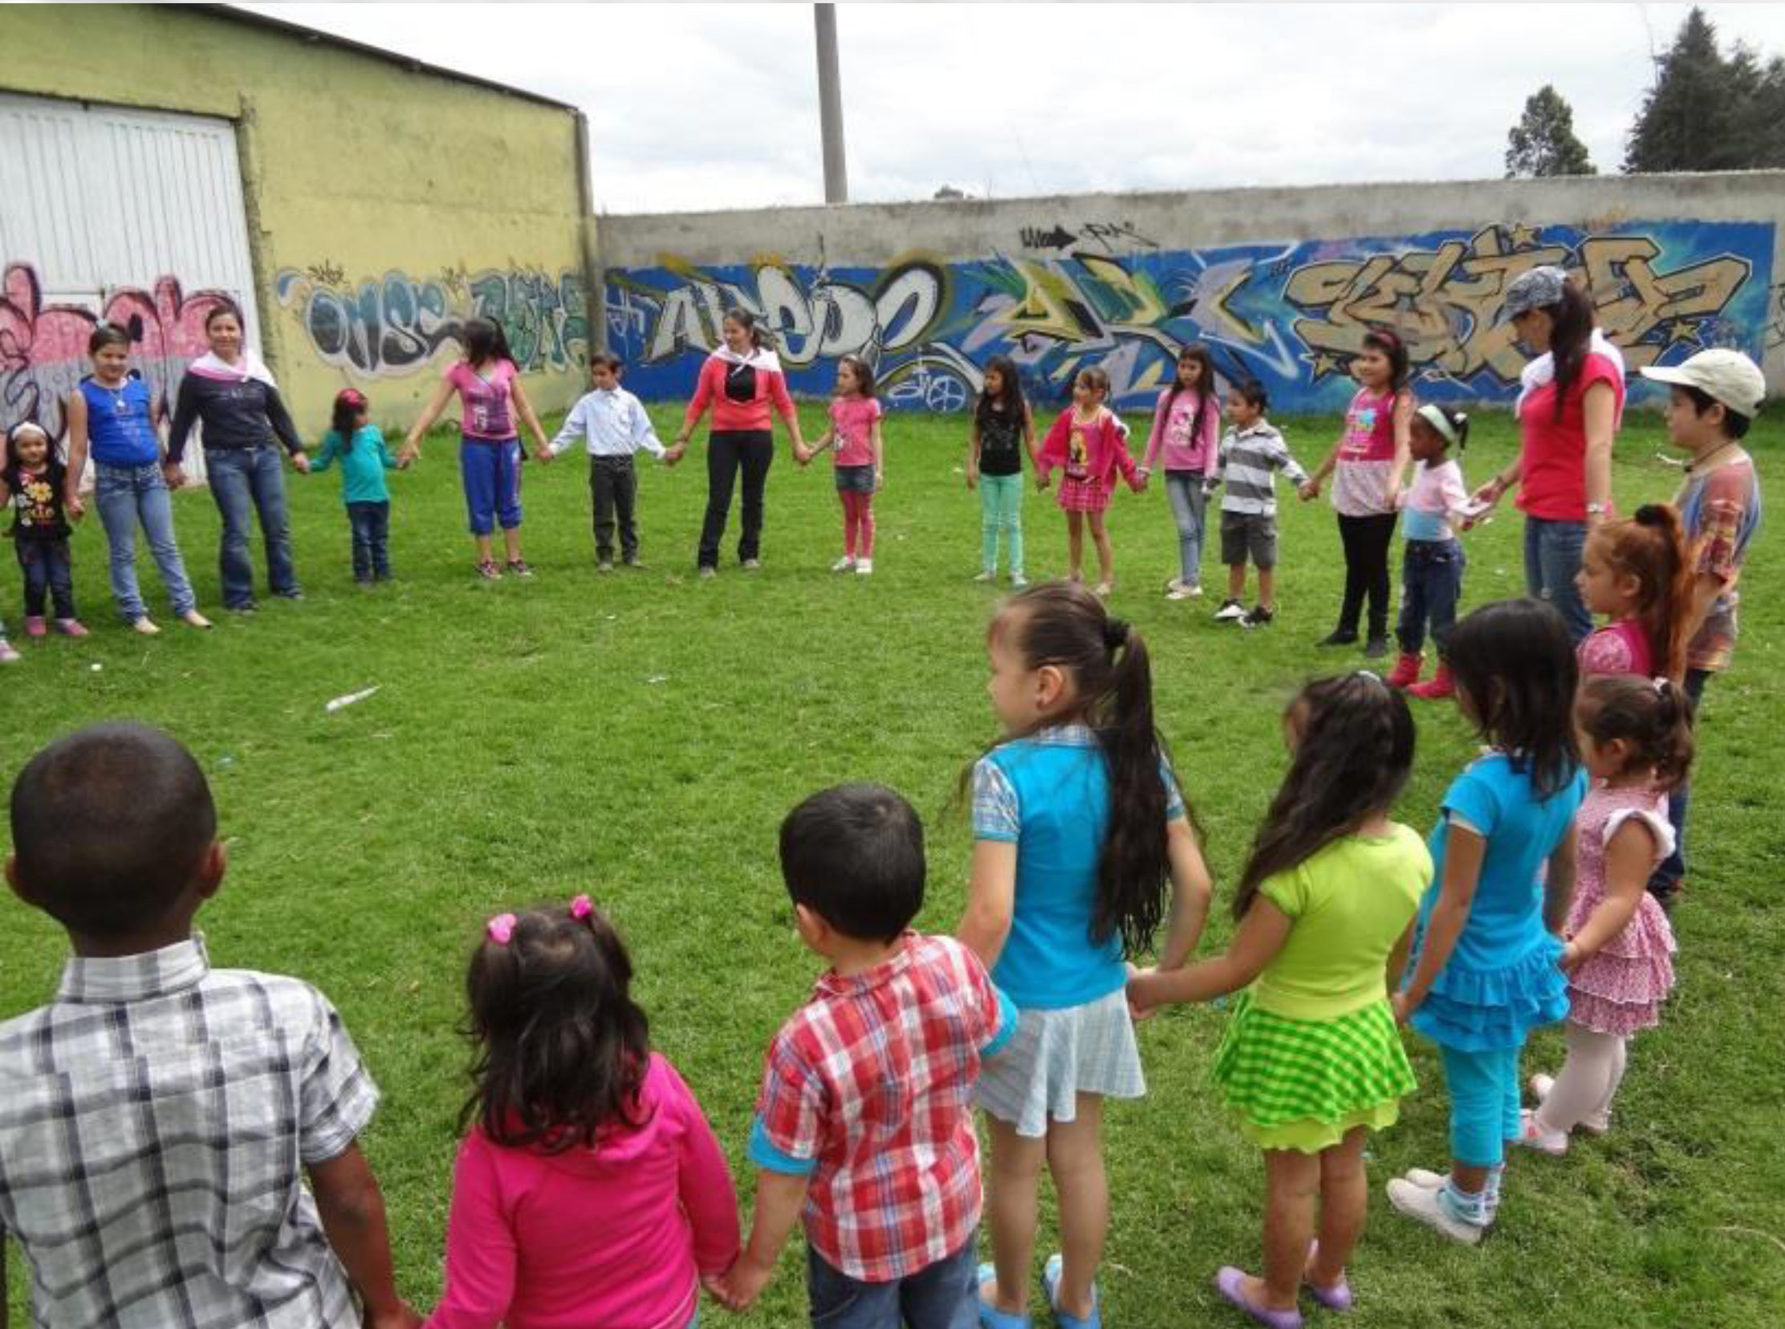
Zone 2B Youth - Serve the Planet
Food for the homeless, Brazil
EHV: children of Prema Sai School, Colombia

Slide 3
Preparation for Pre-World Conference
Colombia, February 2014 (Spanish Speaking countries)
Brazil, March 2014

Slide 4
Activities in Zone 2B Countries

Slide 5
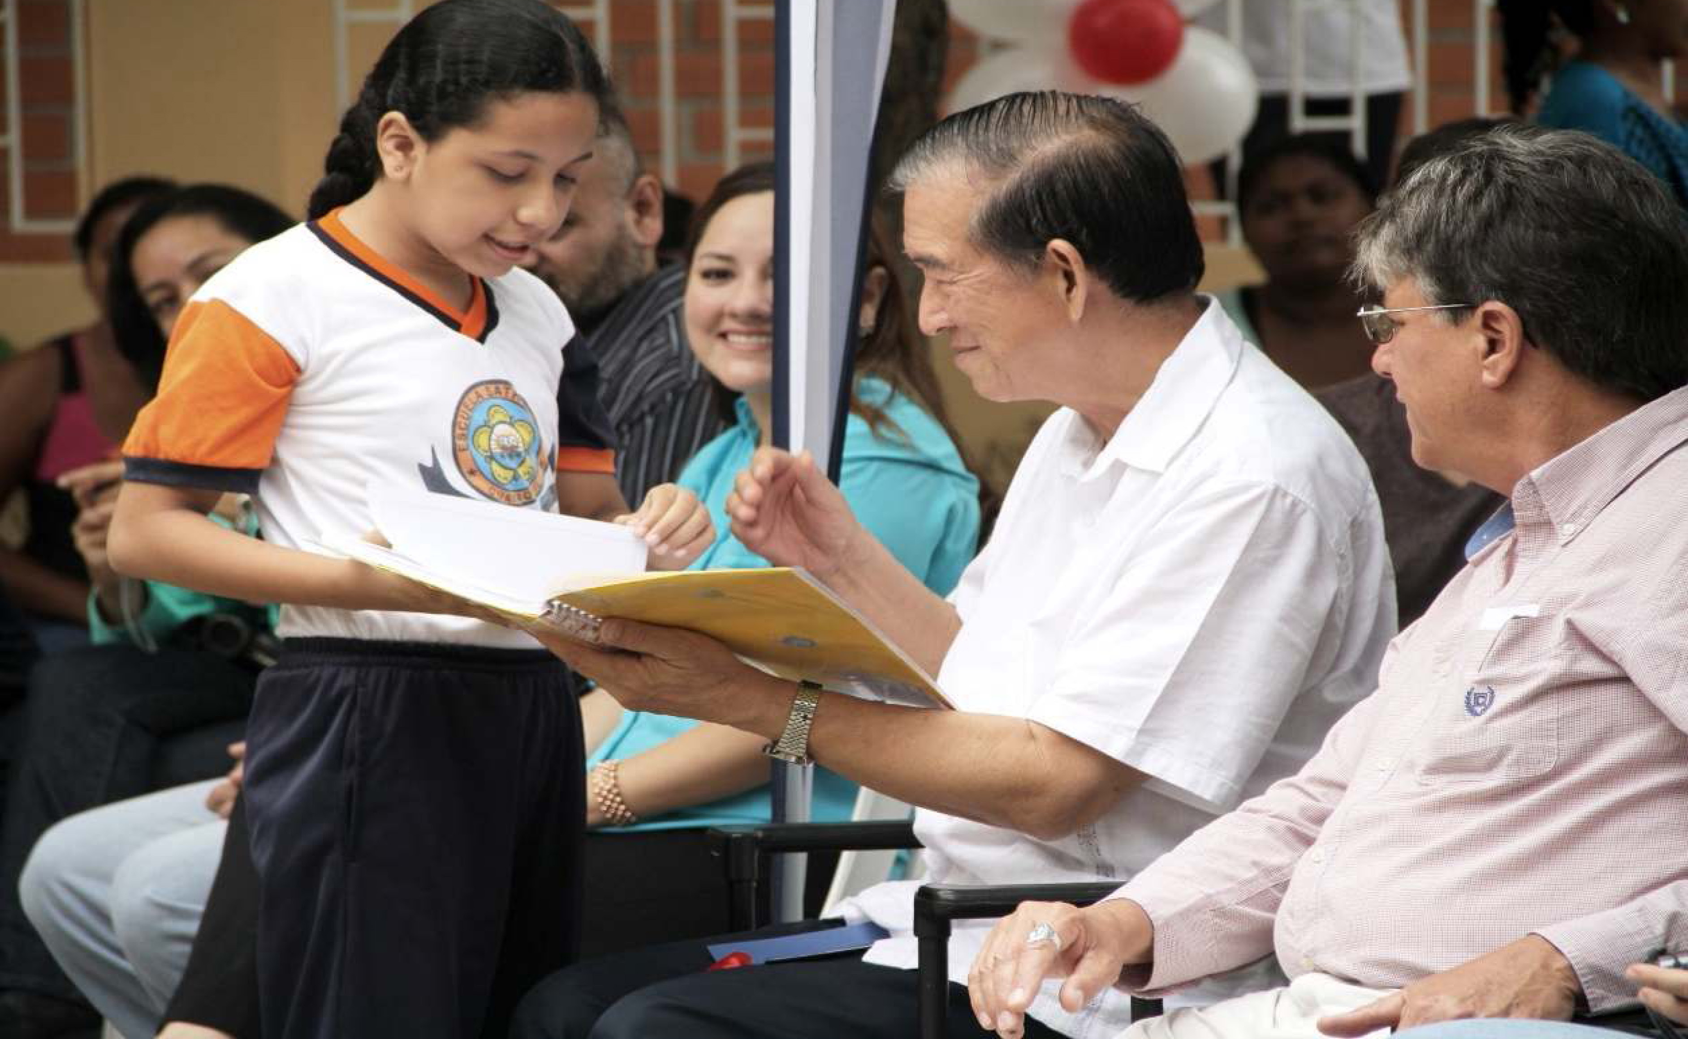
Brother Jumsai’s visit to Ecuador and Peru

Slide 6
Walk for values in Ecuador

Slide 7
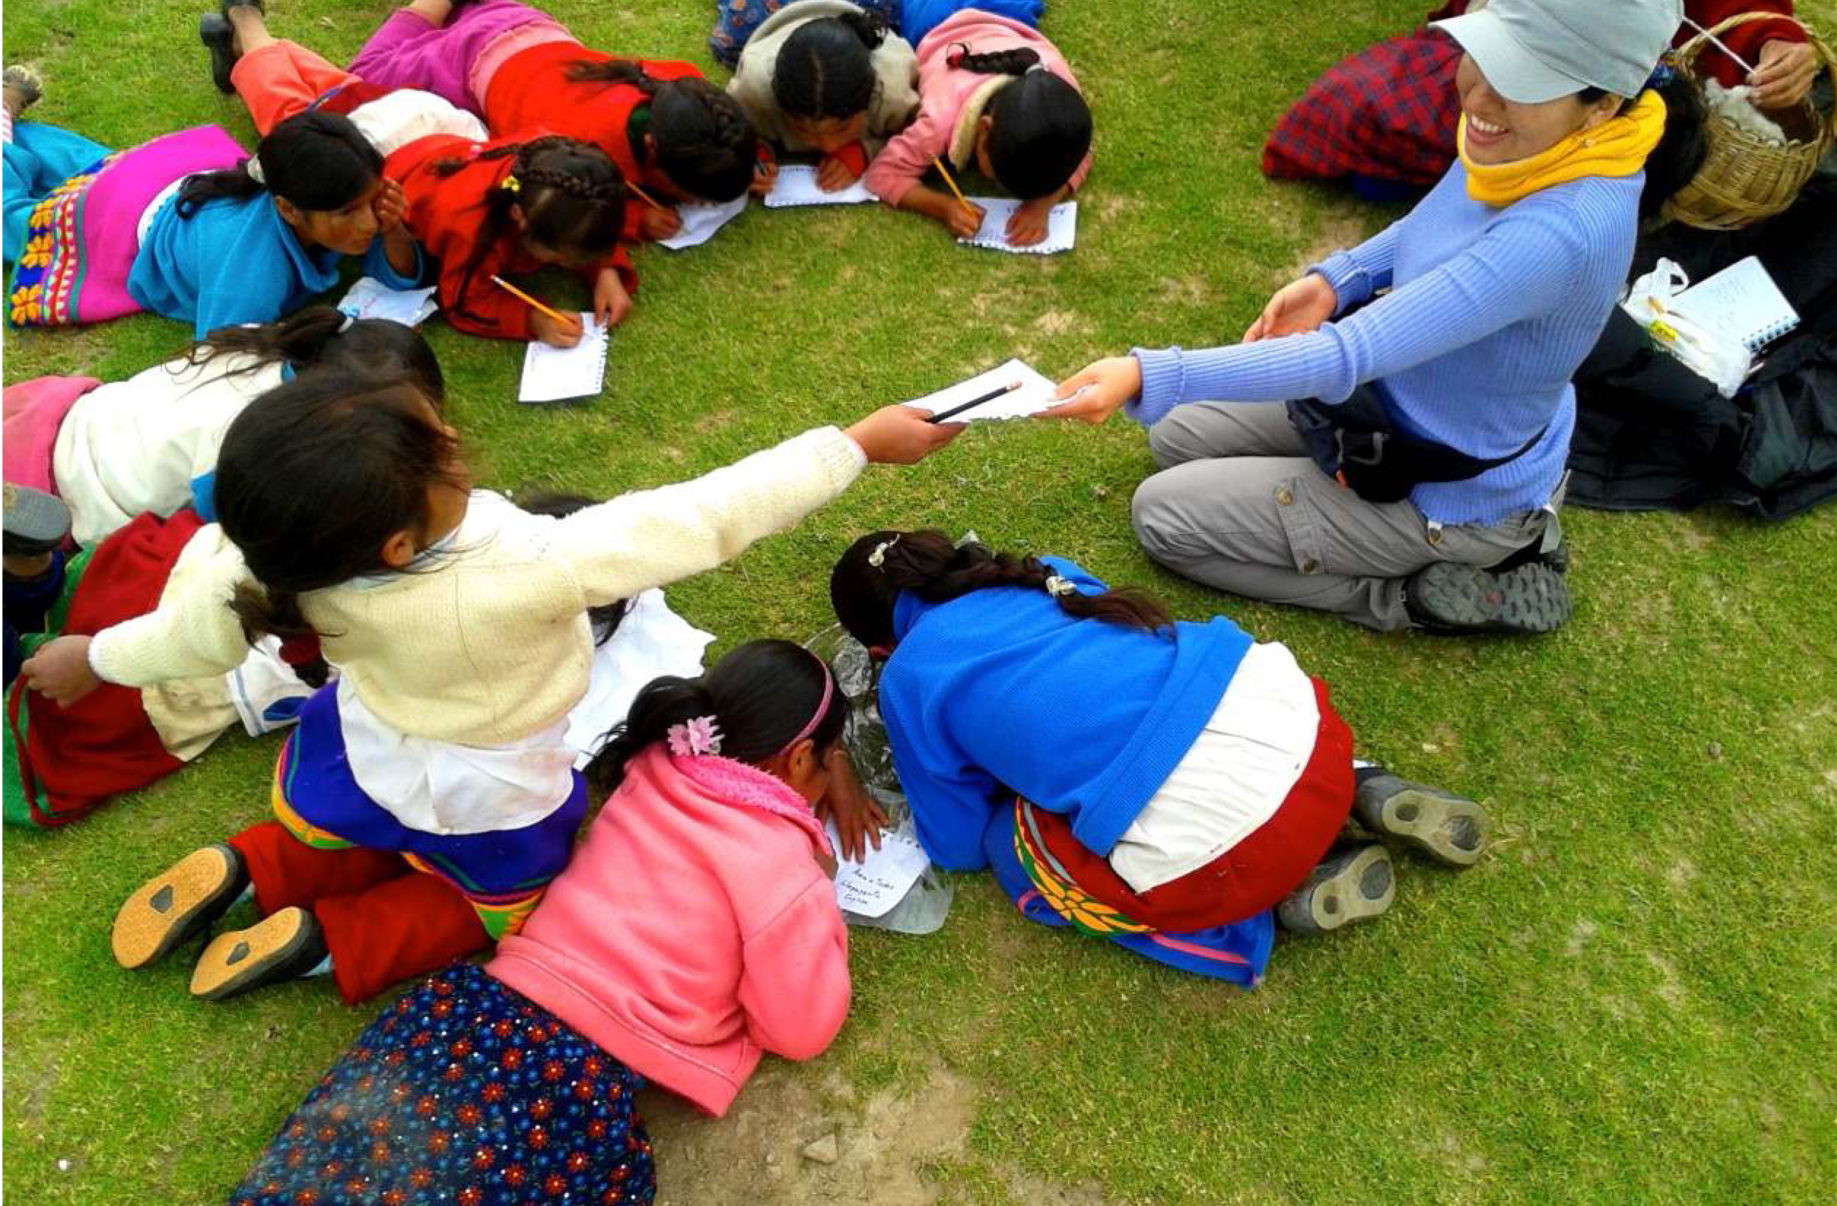
Human values activities in Cullcuy, high up in the Andes, Peru

Slide 8
Location of Dental Camp, Peru

Slide 9
Saint Francis Hill, Peru – Dental Camp, 2014

Slide 10
10th Anniversary of the Sathya Sai School of Minas Gerais, Brazil

Slide 11
Sathya Sai School, Asunción, Paraguay - Parenting

Slide 12
Human Values Workshop, Montevideo, Uruguay: Circle of Love

Slide 13
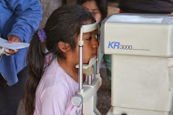
Vision Camp, Salta, Argentina

Slide 14
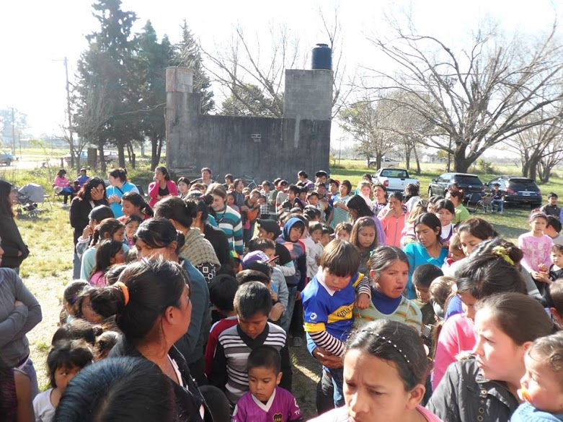
Service in Noccan Kani, Argentina

Slide 15
Sathya Sai Education
Seven Institutes of Sathya Sai Education: Argentina, Brazil, Bolivia, Peru, Ecuador, Colombia and Venezuela
Eleven Sathya Sai Schools: Argentina (1), Brazil (5), Paraguay (1), Ecuador (2), Colombia (1), and Venezuela (1)

Slide 16
Sathya Sai School in Buenos Aires, Argentina

Slide 17
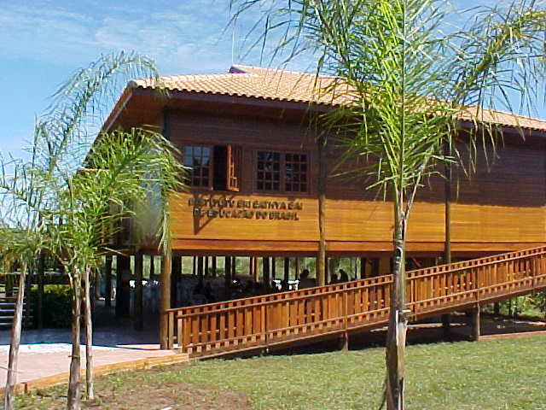
Sathya Sai School in Ribeirão Preto, Brazil

Slide 18
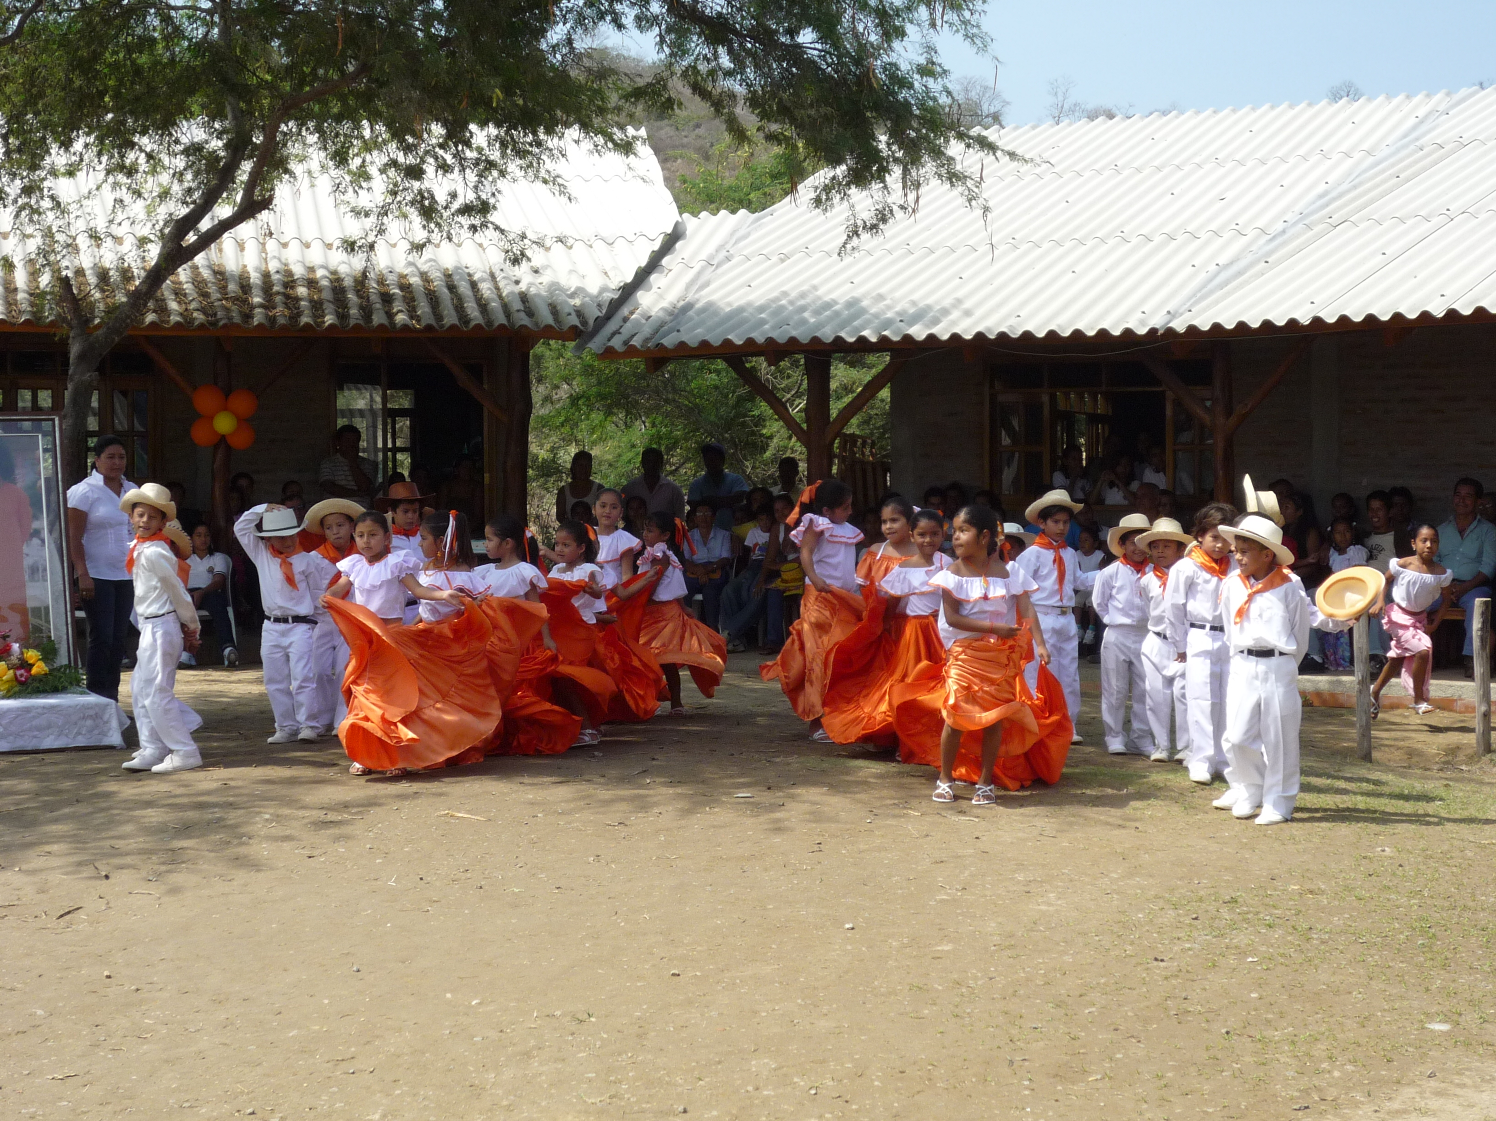
Sathya Sai School in Bahía de Caraquez, Ecuador

