Slide 1
Sathya Sai International Organisation
Zone 2 A

Slide 2
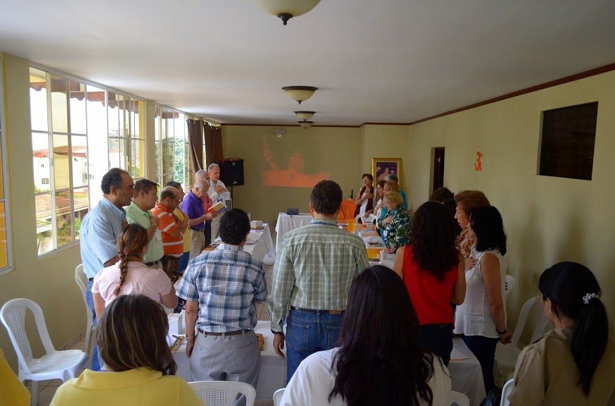
Meeting of the Central Council of Central America Sept. 2014, El Salvador
Sri Sathya Sai Organization
Zone 2 A
Love All,
Serve All

Slide 3
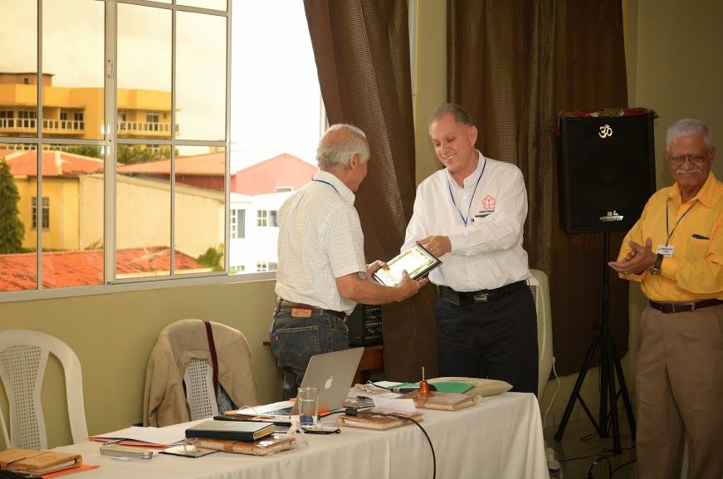
Dr. Castaneda being honored for many years of service as
Central Coordinator of Region 21
Sri Sathya Sai Organization
Zone 2 A
Love All,
Serve All

Slide 4
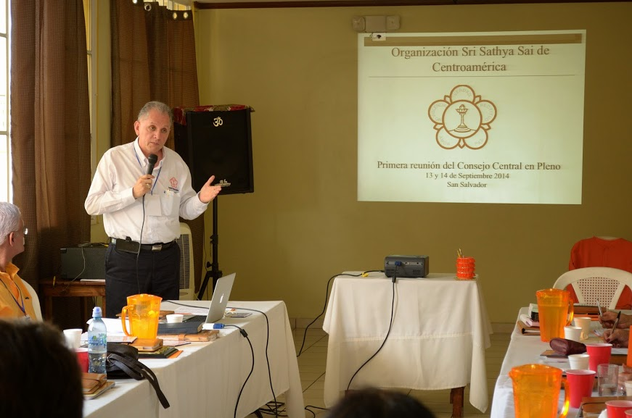
Meeting of the Central Council of Central America Sept. 2014, El Salvador
Sri Sathya Sai Organization
Zone 2 A
Love All,
Serve All

Slide 5
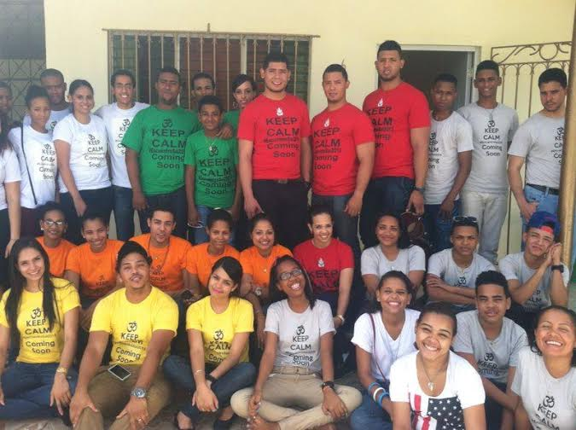
Preparation for the Pre World Youth Conference Dominican Republic
Sri Sathya Sai Organization
Zone 2 A
Love All,
Serve All

Slide 6
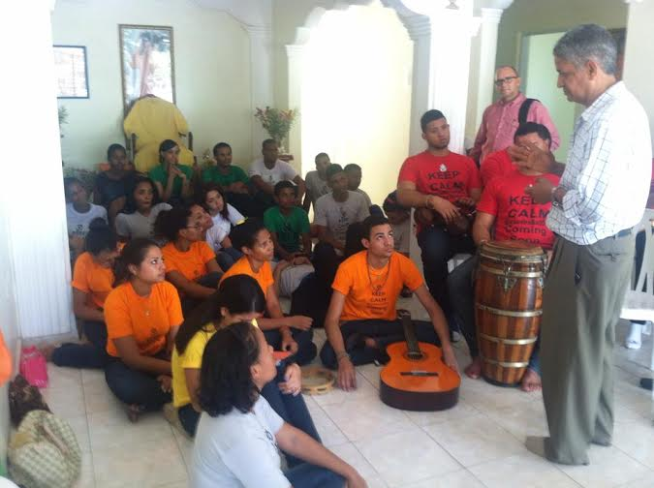
Preparation for the Pre World Youth Conference Dominican Republic
Sri Sathya Sai Organization
Zone 2 A
Love All,
Serve All

Slide 7
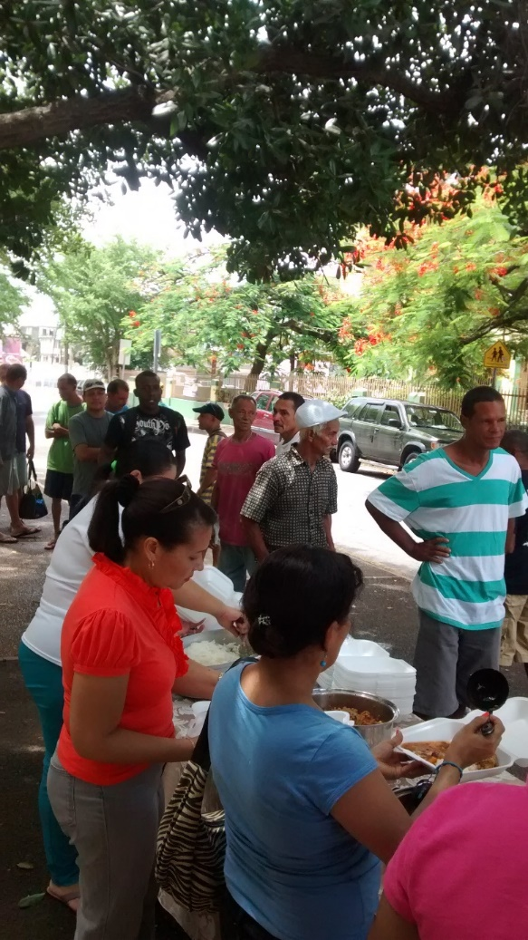
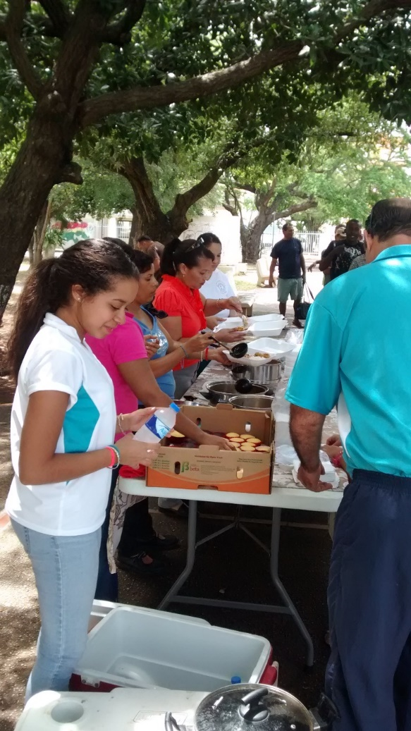
Weekly Narayana Seva in Puerto Rico 2014
Sri Sathya Sai Organization
Zone 2 A
Love All,
Serve All

Slide 8
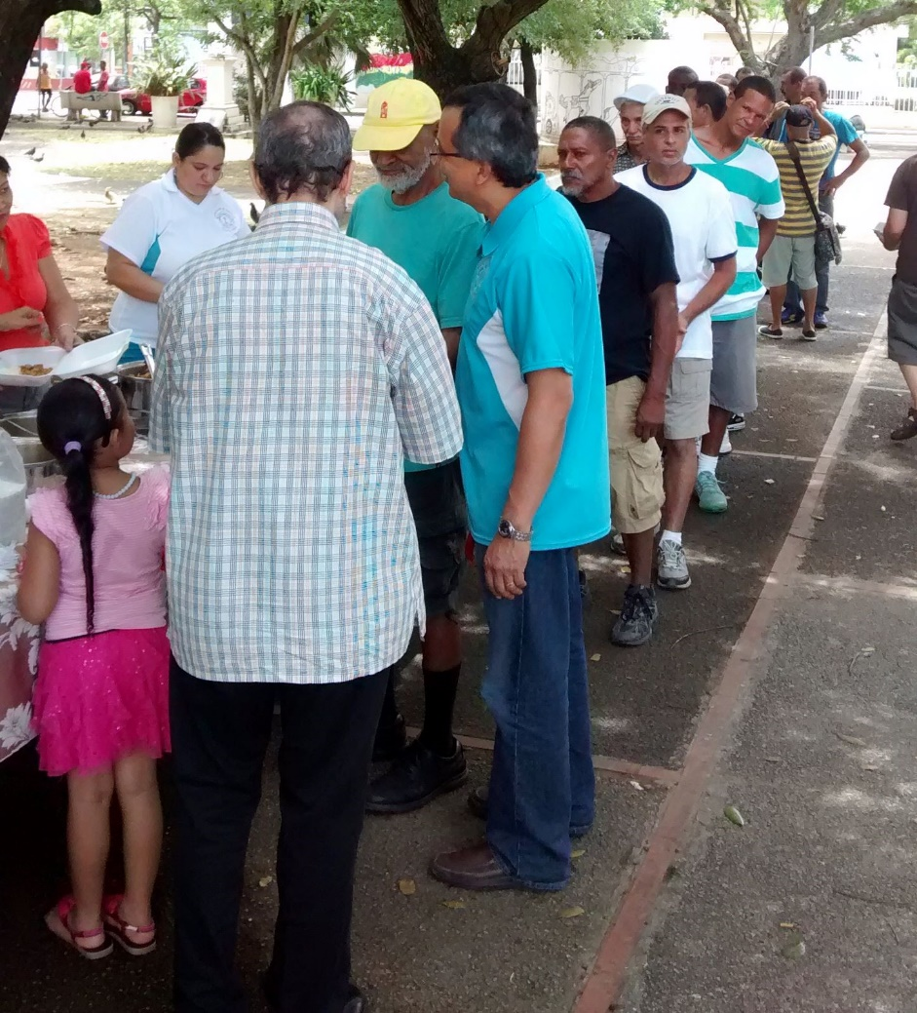
Weekly Narayana Seva in Puerto Rico 2014
Sri Sathya Sai Organization
Zone 2 A
Love All,
Serve All

Slide 9
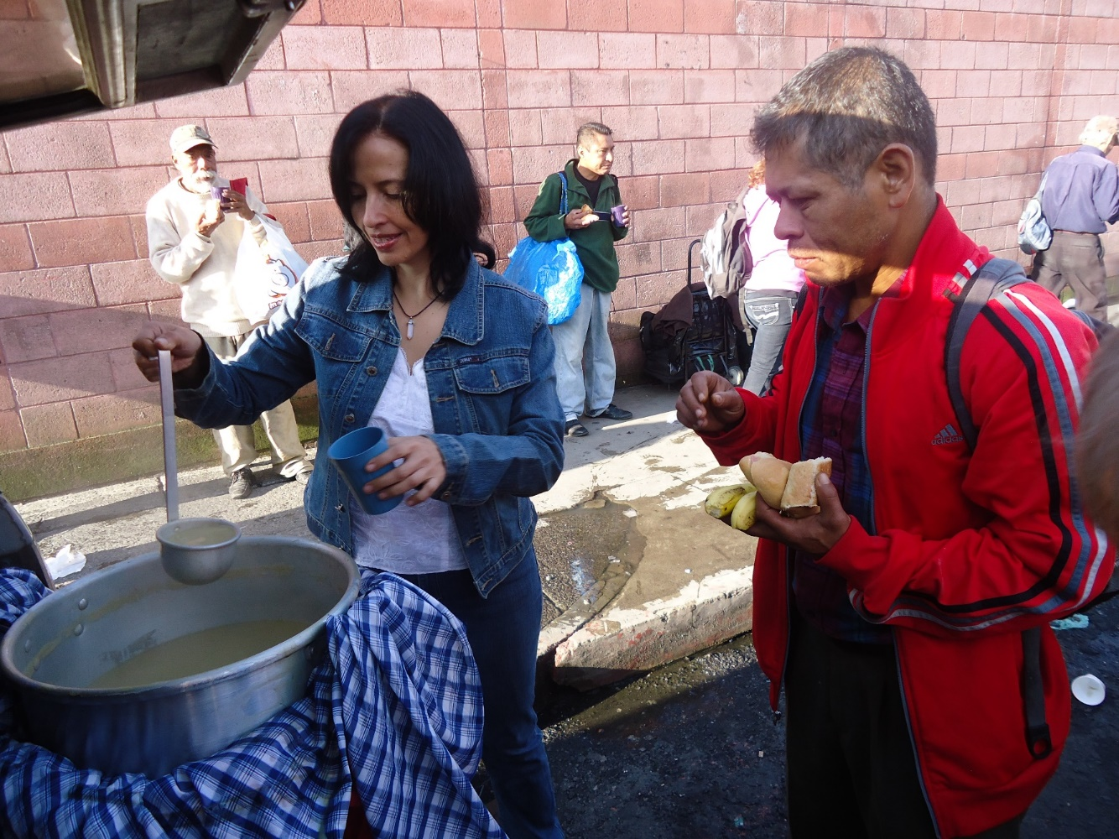
Weekly Narayana Seva in Guatemala 2014
Sri Sathya Sai Organization
Zone 2 A
Love All,
Serve All

Slide 10
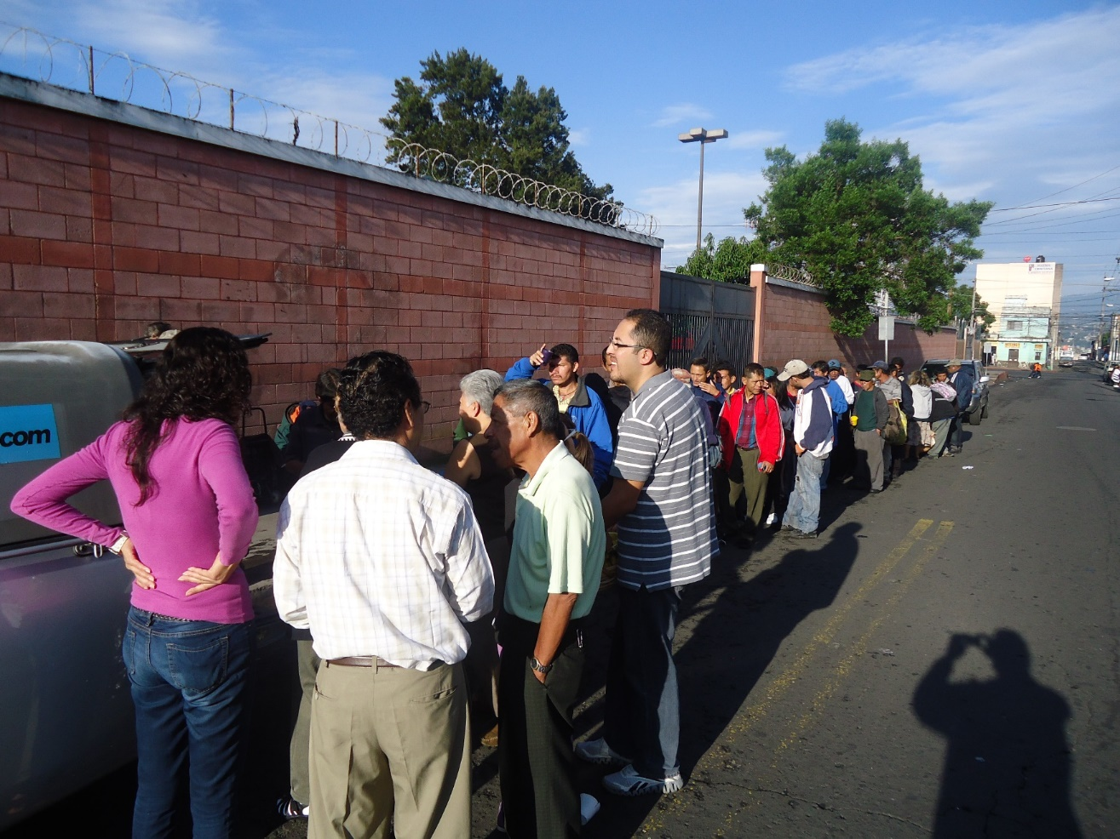
Weekly Narayana Seva in Guatemala 2014
Sri Sathya Sai Organization
Zone 2 A
Love All,
Serve All

Slide 11
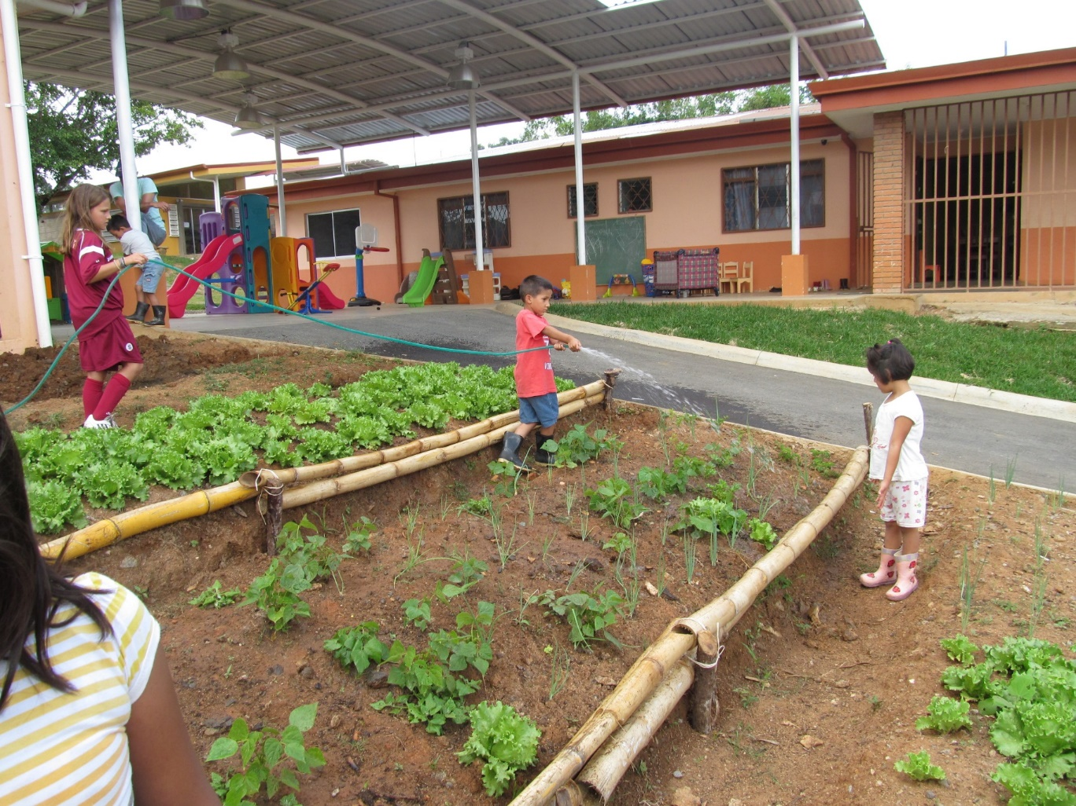
Organic Vegetable Garden for Orphans Home in Costa Rica
Sri Sathya Sai Organization
Zone 2 A
Love All,
Serve All

Slide 12
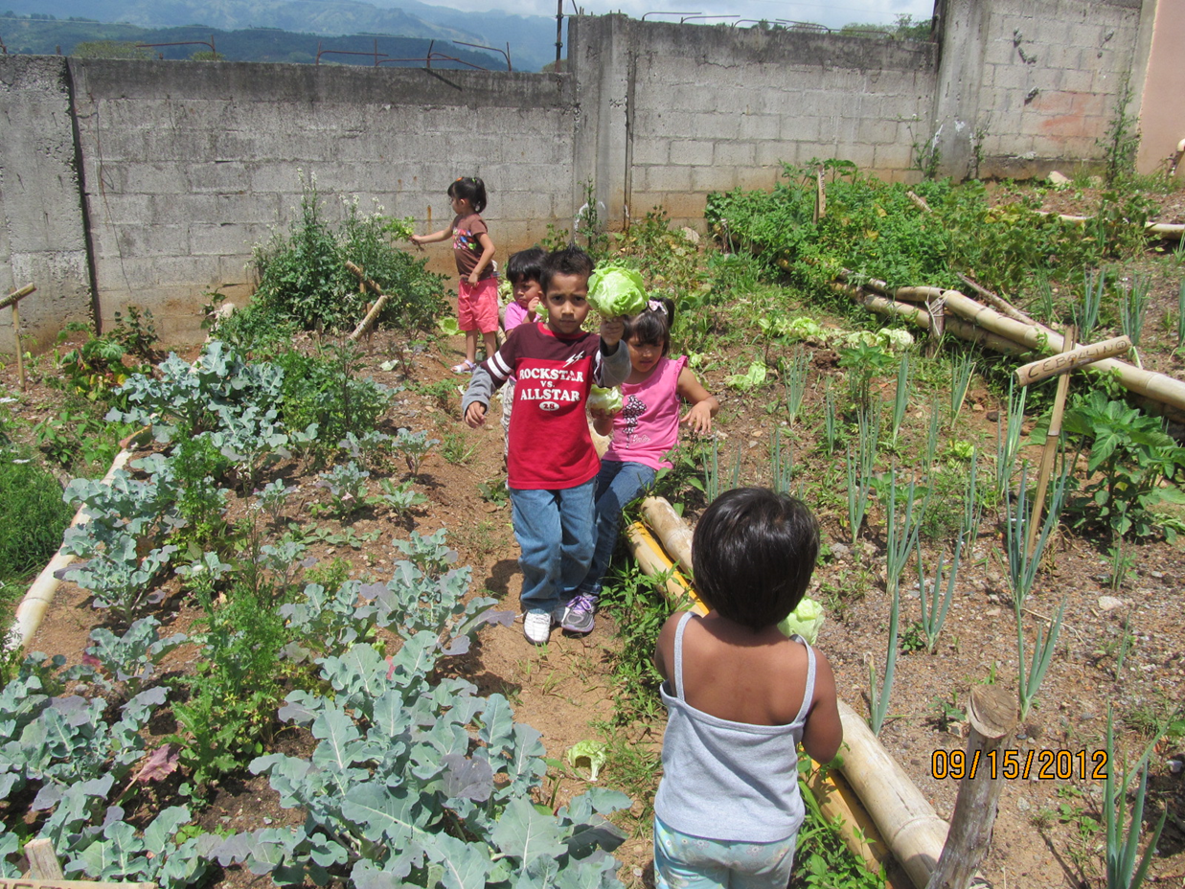
Organic Vegetable Garden for Orphans Home in Costa Rica
Sri Sathya Sai Organization
Zone 2 A
Love All,
Serve All

Slide 13
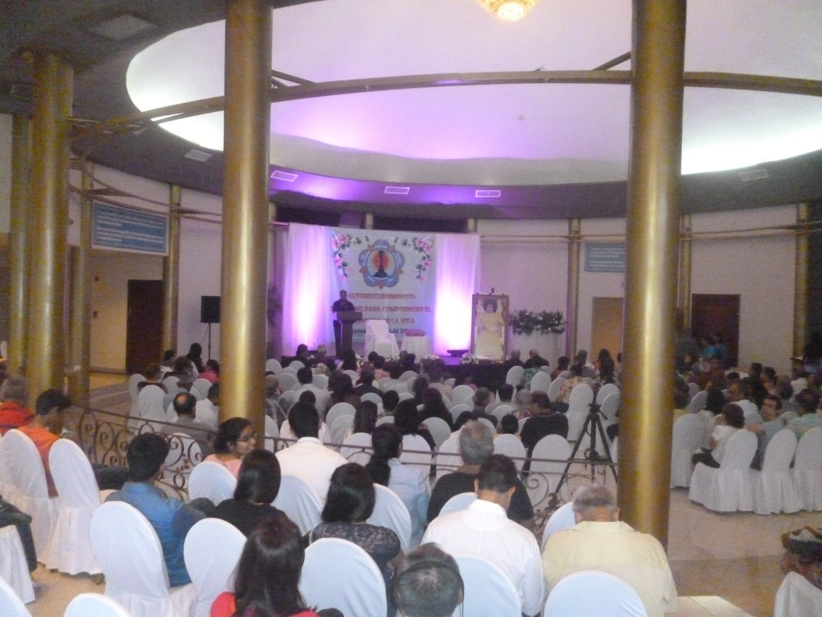
Anil Kumar at a Public Meeting in Panama, July 2014
Sri Sathya Sai Organization
Zone 2 A
Love All,
Serve All

Slide 14
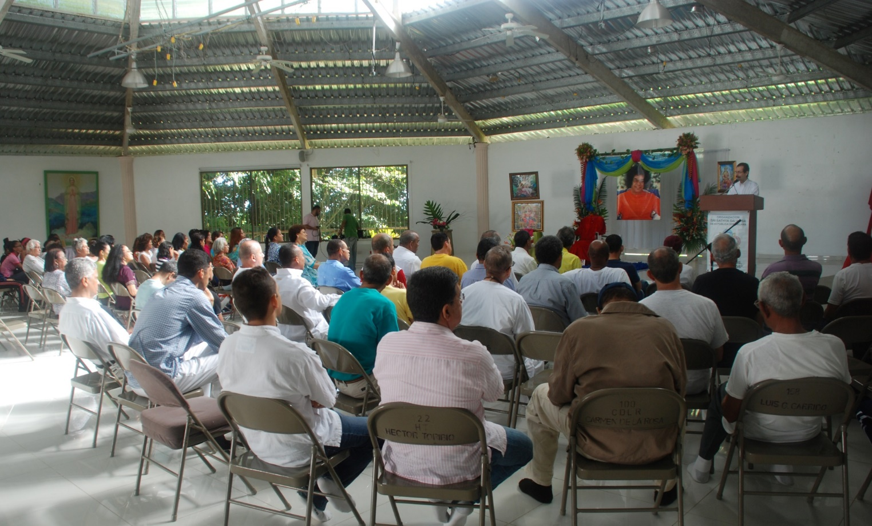
Sai Retreat in Dominican Republic September 2014
Sri Sathya Sai Organization
Zone 2 A
Love All,
Serve All

Slide 15
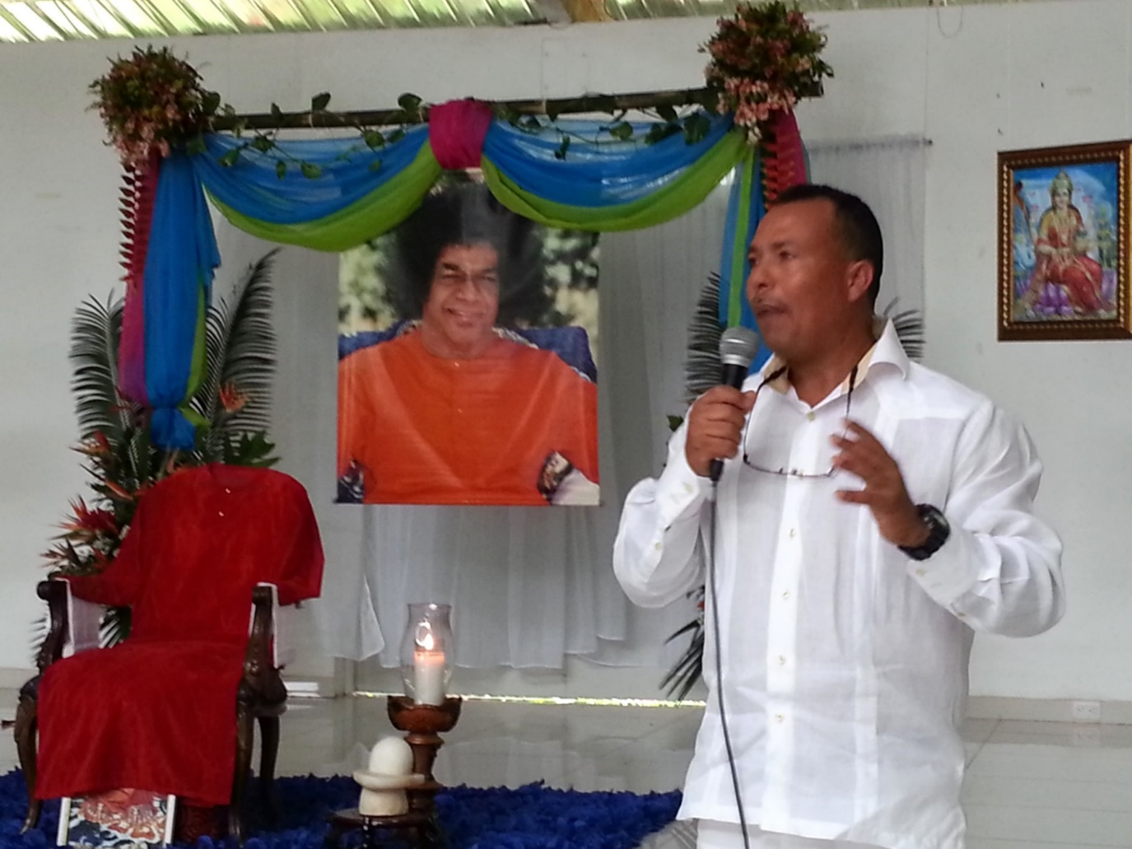
Sai Retreat in Dominican Republic September 2014
Sri Sathya Sai Organization
Zone 2 A
Love All,
Serve All

Slide 16
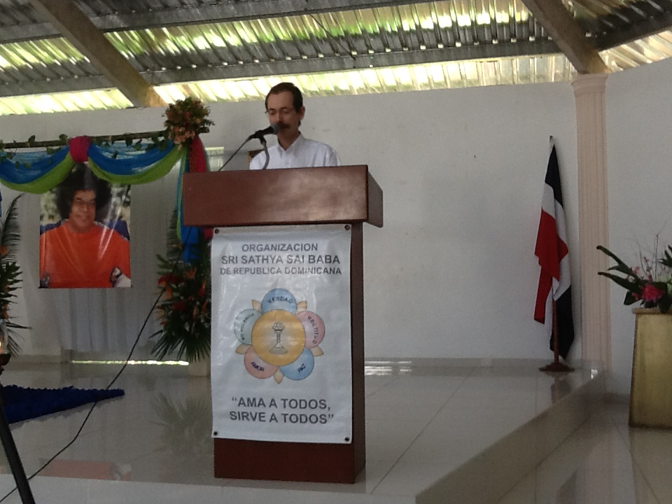
Sai Retreat in Dominican Republic September 2014
Sri Sathya Sai Organization
Zone 2 A
Love All,
Serve All

Slide 17
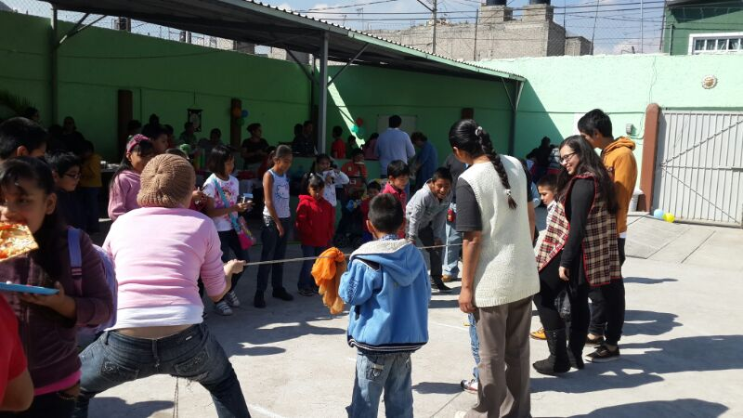
Activities at the Sai Community Center of Iztapalapa Mexico City, 2014
Sri Sathya Sai Organization
Zone 2 A
Love All,
Serve All

Slide 18
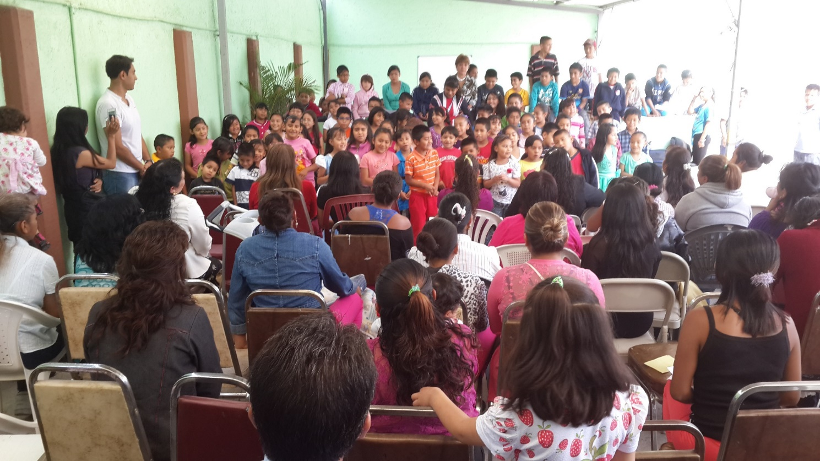
Activities at the Sai Community Center of Iztapalapa Mexico City, 2014
Sri Sathya Sai Organization
Zone 2 A
Love All,
Serve All

Slide 19
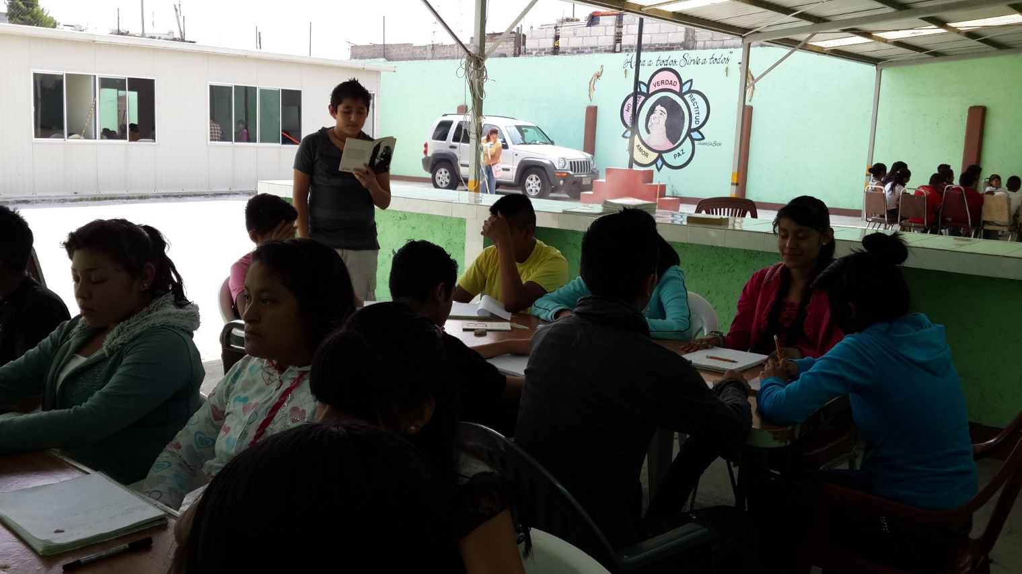
Activities at the Sai Community Center of Iztapalapa Mexico City, 2014
Sri Sathya Sai Organization
Zone 2 A
Love All,
Serve All

Slide 20
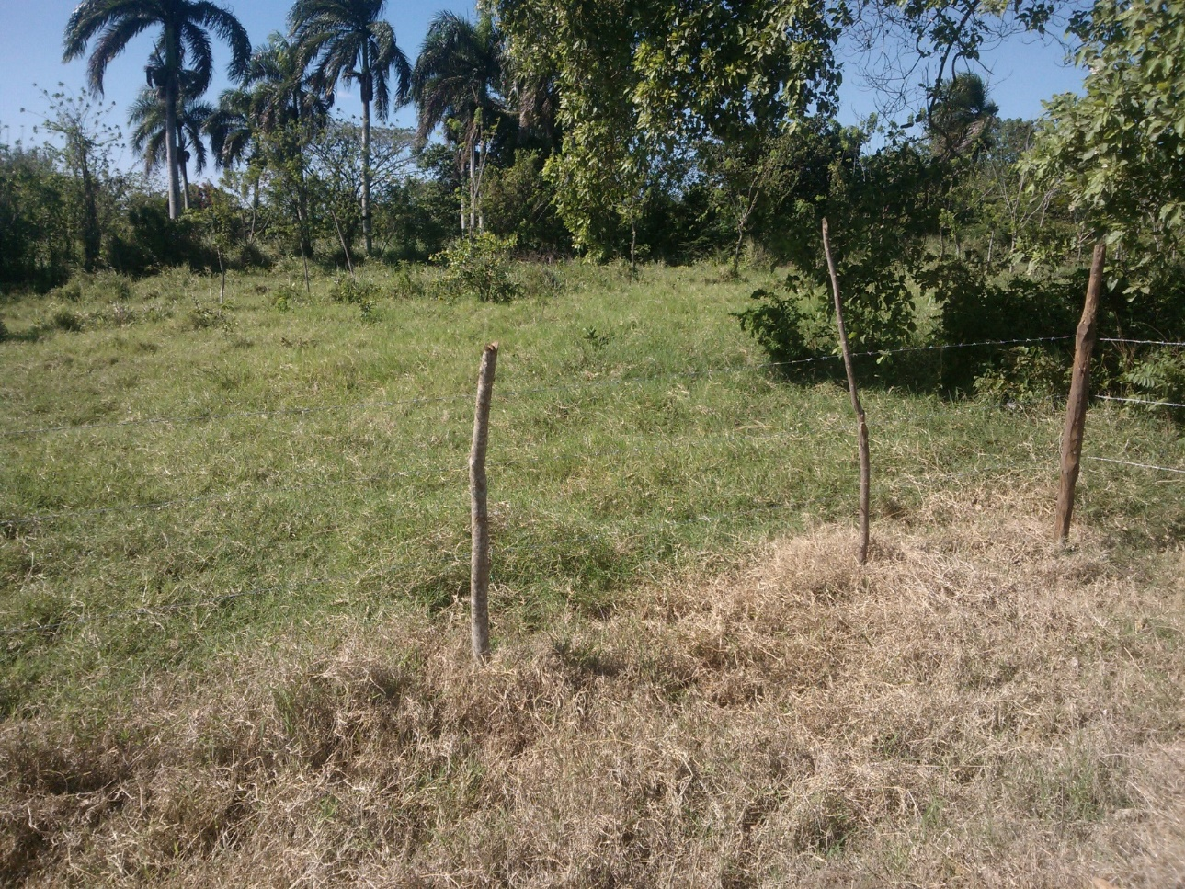
Land for the Sai School in Dominican Republic
Sri Sathya Sai Organization
Zone 2 A
Love All,
Serve All

Slide 21
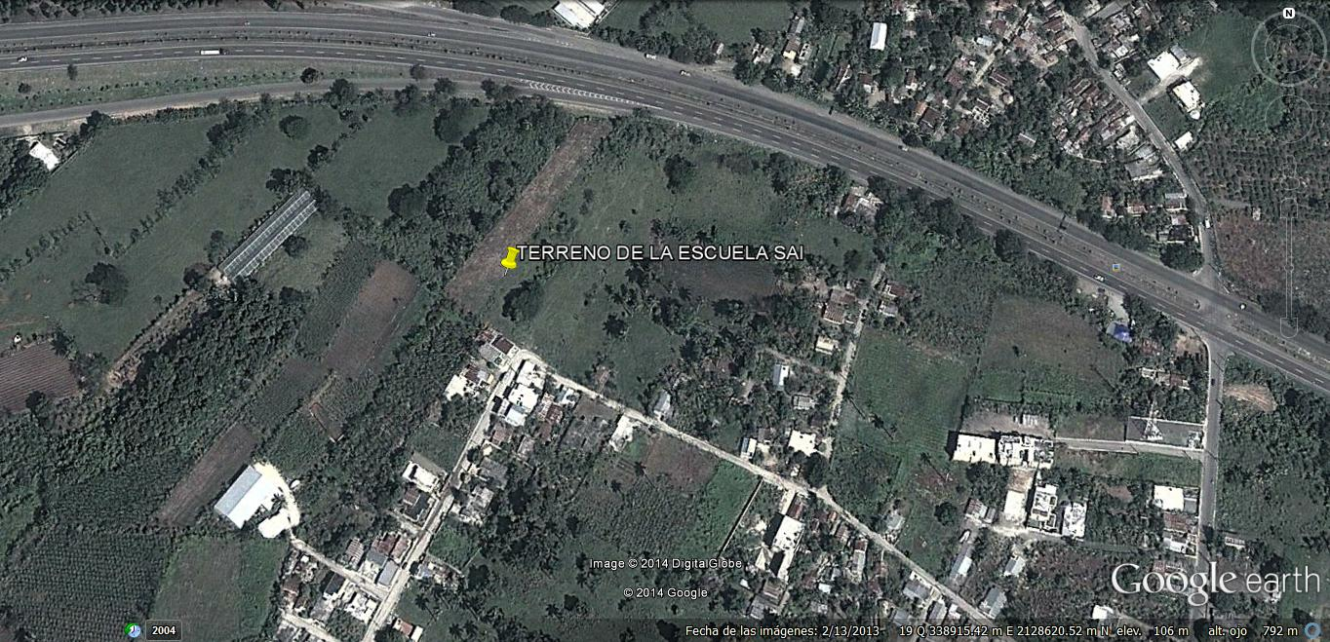
Land for the Sai School in Dominican Republic
Sri Sathya Sai Organization
Zone 2 A
Love All,
Serve All

