Slide 1

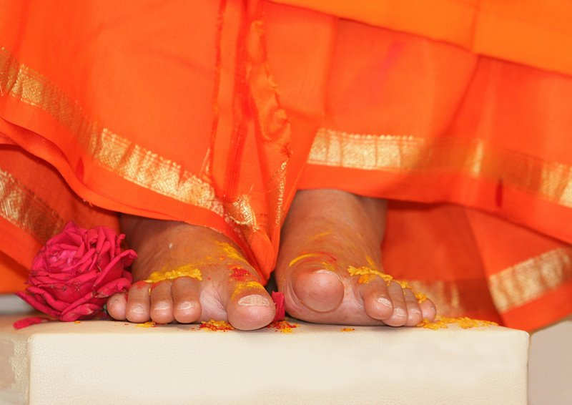
Sathya Sai International Organisation
Canada
November 2104

Slide 2
National Youth Conference
On August 22-24, 2014, the Canadian Sai Youth held their first ever National Youth Conference in Val-Morin, Quebec.
This conference had over 230+ youth attend from across Canada, representing over 4 time zones! The conference’s theme was: FOCUS (Faith, Openness, Consciousness, Unity, Spirituality).
The Conference took place over 3 days, with youth assembling in Val-Morin on Friday afternoon, and concluding Sunday afternoon.
The objectives of the conference were three-fold.
Inspire and Sai-motivate the youth across Canada to stay involved in the Organization.
Develop working relationships amongst Sai Youth across Canada and
Introduce/re-introduce Swami into the daily lives of Canadian Sai Youths.

Slide 3
“Walk for Values” and “PanAm Games 2015“
With the Grace and Blessings of Sri Sathya Sai Baba, ‘Walk for Values’ became an official partner with Pan Am Games 2015 !!
The Pan Am Games take place from July 10-26, 2015 and the Parapan Am Games from August 7-15, 2015.

Slide 4
These Games are now the world’s third largest international multi-sport Games.
The Games are a showcase—Toronto and the Golden Horseshoe Region will host close to 7,000 athletes, coaches and delegates from 41 countries, and up to 250,000 tourists who come to cheer them on.
The Sathya Sai International Organisation in Canada has chosen to partner with the Pan American Games because their organisation has demonstrated a high level of commitment to building stronger communities based upon values.
Thus, working together with them will allow members of the Sai Organisation to demonstrate the human values in a global context.

Slide 5
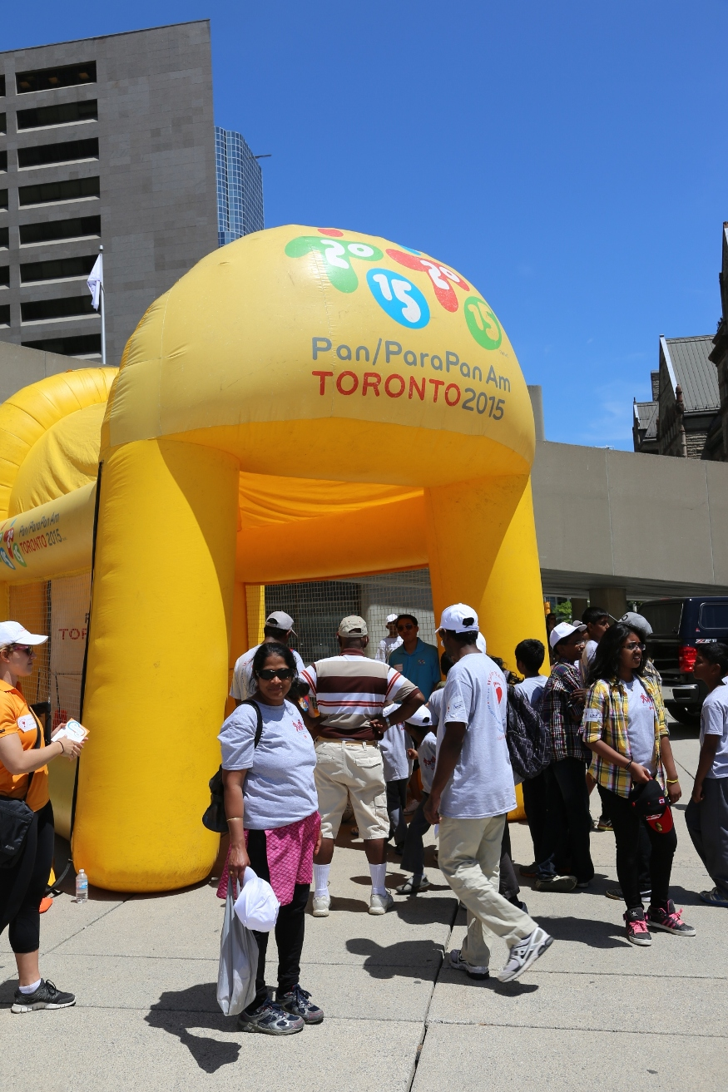
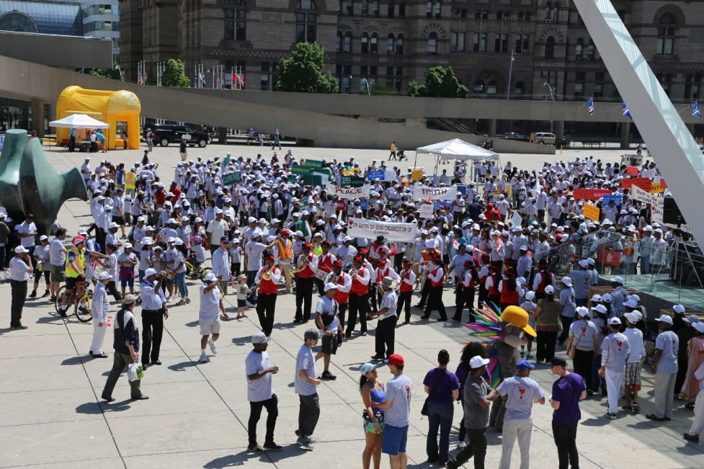

Slide 6
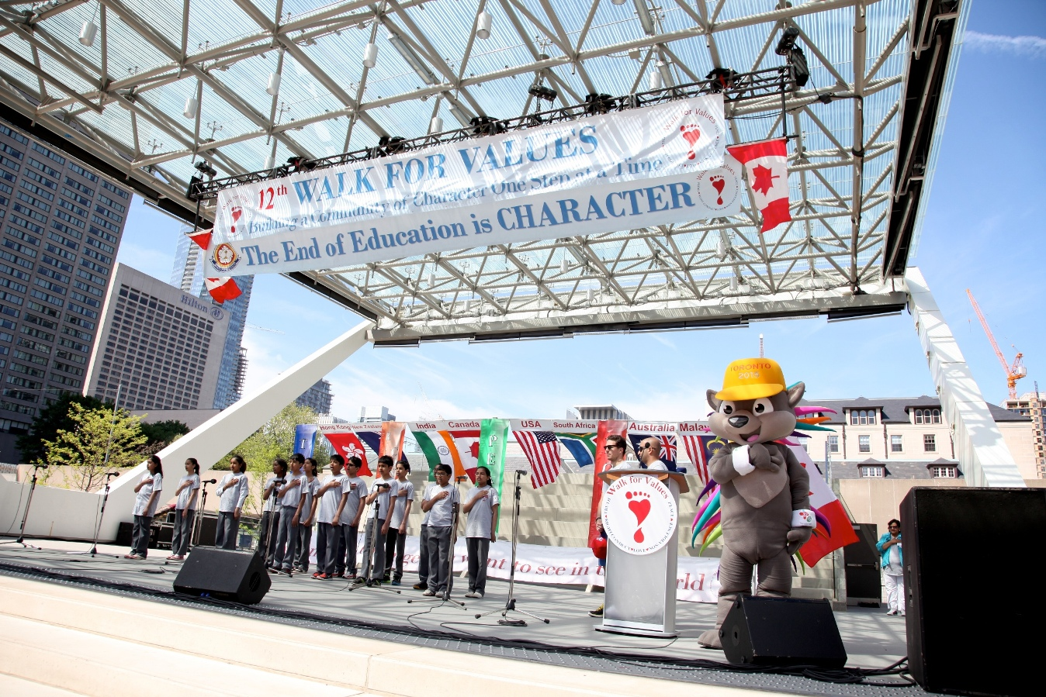

Slide 7
Edmonton's K-Days Parade
Edmonton Sai Center participated in the city’s K-Days Parade on July 18th, 2014 in order to propagate Swami's messages of the 5 Human Values to the Edmonton community with a specially built Walk for Values float.
The theme for the float was 'Garden of Values'. The float was decorated with close to 50 large flower pots.
The float depicted 5 human values, “Love all Serve All”; “Help Ever Hurt Never” and “End of Education is Character”.
The parade covered close to 10 blocks in downtown Edmonton and is the largest summer event. Thousands of spectators lined the sidewalks.
Out of 120 floats that participated in the parade, Edmonton Sai Centre’s float was chosen for the 'Most Creative Award'. Overall it was an exhilarating experience for the devotees and we thank Swami for His grace and love.

Slide 8
K-Days Media video clip

Slide 9
The “We Care We Share Service” - Ottawa
WE CARE WE SHARE “Mobile Food Service” is rendered to less fortunate across Ottawa, Canada. The Van, for this purpose, was inaugurated on April 24th , 2014.
The Mobile Van has a Sarva Dharma logo, “Love All Serve All”, “Help Ever Hurt Never” which in turn also spreads Swami's message around the city of Ottawa.
Food is prepared at the Ottawa Sai Centre with great care and love. It is then transported in the mobile van to be distributed to less fortunate people in Ottawa’s downtown area.
Devotees of Ottawa Sai Center volunteer to carry out this service all year on a monthly basis.
Approximately, “Mobile Food Service” served 10,000 less fortunate people so far.

Slide 10
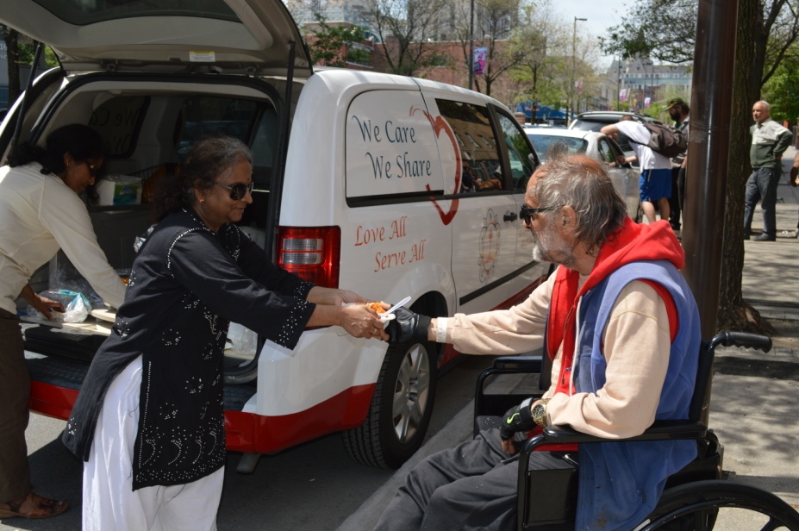
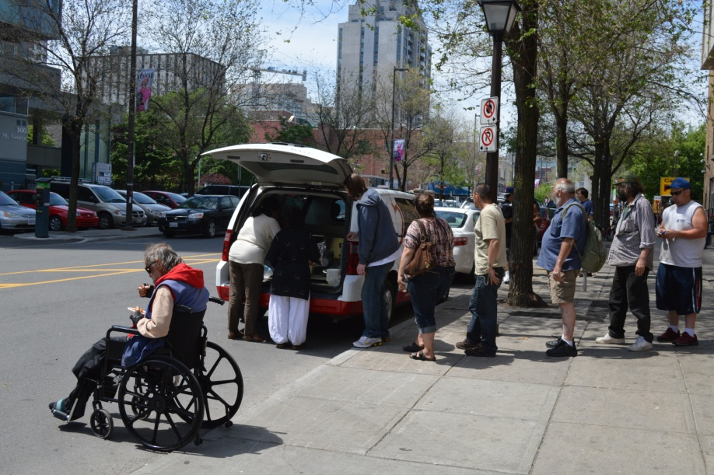
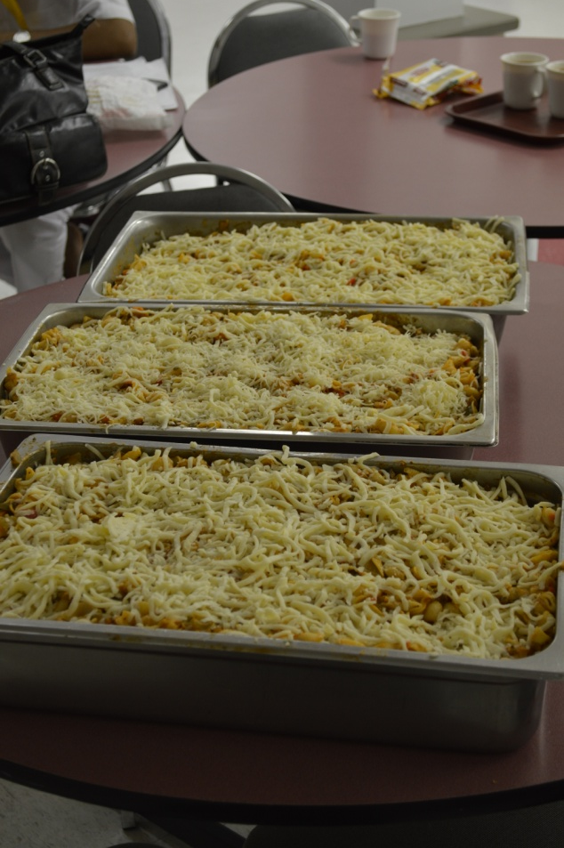

Slide 11
Feel the pain, Fill the plate
Feel the pain, Fill the plate goes one step beyond just donating the food items.
It requires participants to actually sacrifice a meal or two so they can feel the hunger that many around the world feel on a daily basis, and then donate food items from this sacrifice.
Not only our SSE children participated in this project, parents went the extra mile to sort the items and help out in the food bank. This project is now on it’s 4th year and has generated over 3500 lbs of non- perishable food items.
Officials at the food bank were so impressed with our SSE children and mentioned that they have never seen an organization so unique and to see the children take leadership roles, which really impressed them. It is a testament to our dedicated SSE gurus who instill these values.

Slide 12
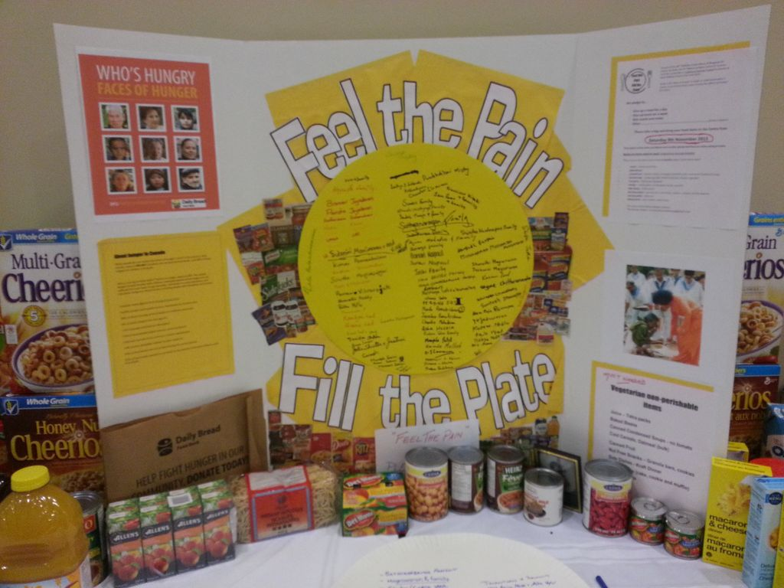

Slide 13
Siloam Mission - WORK CARRIED OUT BY SATHYA SAI CENTER OF WINNIPEG
Siloam Mission is a connecting point between the compassionate and Winnipeg’s less fortunate. Siloam Mission is a Christian humanitarian organization that serves the homeless.
‘Siloam Mission’s Sponsor the Meal program’ allows local businesses to partner with them in providing meals to Winnipeg’s less fortunate every day. Sathya Sai Center of Winnipeg is a partner in this program and implements cooking and serving duties once every month – around 350 people are served lunch.
At Siloam Mission`s Volunteer appreciation day on May 9th 2014, The Center of Winnipeg was presented with a Certificate for Most Meals donated by a volunteer group and a plaque was presented: “Partner for Hope” for 2013-2014.

Slide 14
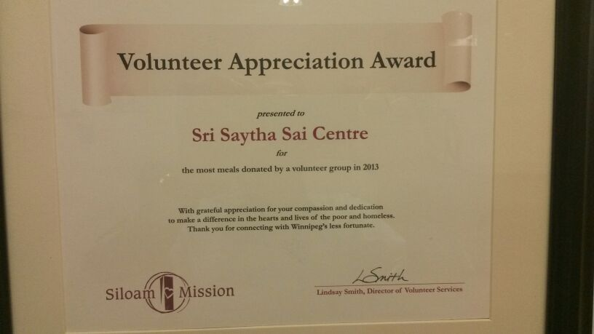
AWARD FOR DONATING MOST MEALS BY A VOLUNTARY GROUP – SSSB CENTER OF WINNIPEG

Slide 15
The Meals on Wheels program - Work Carried out by the Center of Saskatoon
Provides a hot, nutritious lunch to over 200 people in Saskatoon every day, but the Saskatchewan Health Region needs more volunteers to help deliver those meals.
Brenda Johnson, the volunteer coordinator for the program, says one hour of volunteer time greatly improves the quality of life of each client, “we always say to volunteers, Meals on Wheels delivers dignity to the doorstep.” It is delivering meals to those for whatever reason are unable to prepare themselves a well-balanced meal and this enhances their lives and keeps them at home longer.
SSSB Center of Saskatoon has been carrying out the Meals on Wheels Program Service for several years. Members of our Center are involved in delivering Food via Meals on Wheels to approximately 12 to 14 clients every Friday of the week. Hot meals are picked up from the City hospital and delivered to the clients in their residence. This service has been very successful.

Slide 16
Sandwich Drive
Centers across Canada prepare and distribute cheese, vegetarian sandwiches to the less fortunate and homeless.
Distributes well over 14,000 to 15,000 sandwiches across Canada each year. Along with sandwiches, juice, fruits, hot soup in winter months, socks, mittens and hats are also served.

Slide 17
Tree Planting
Tree planting is done in each municipality and is a very popular event around Earth day, across Canada.
Our members along with SSE children plant well over 1,200 trees this year.

Slide 18
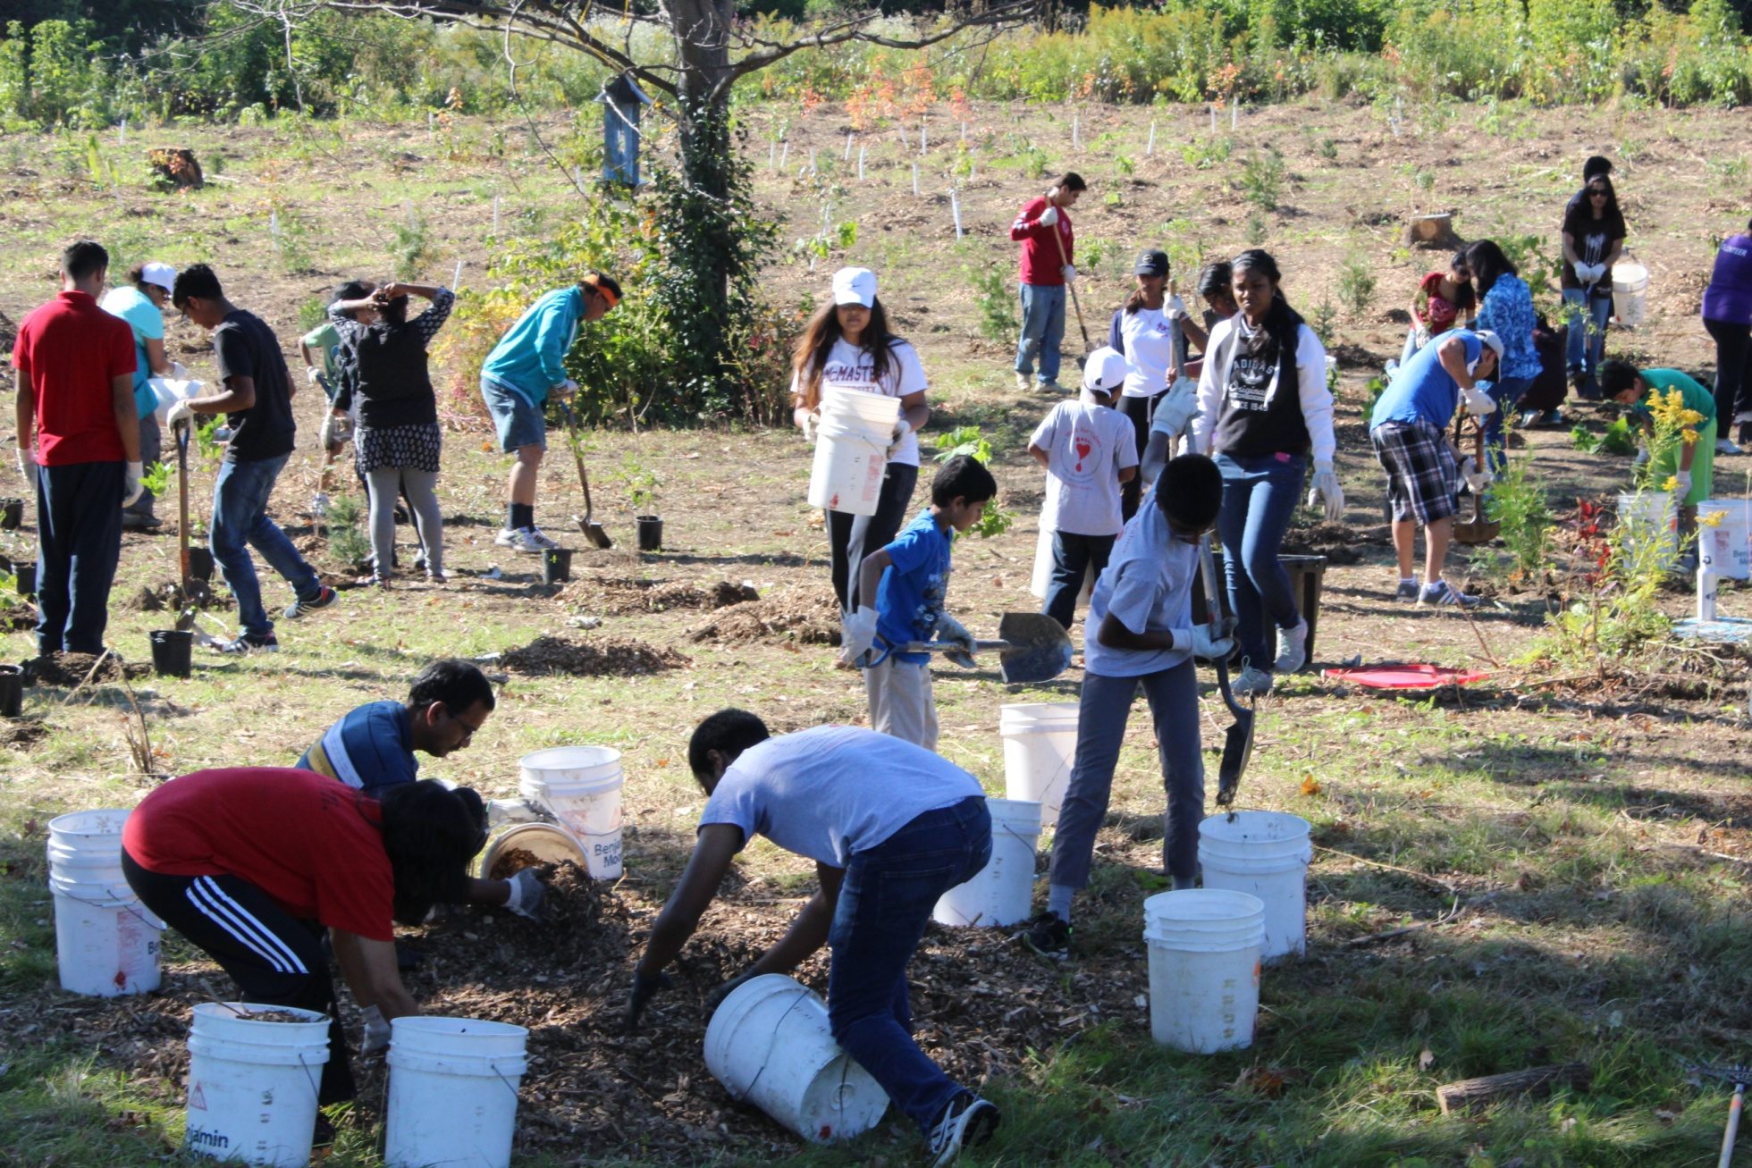

Slide 19
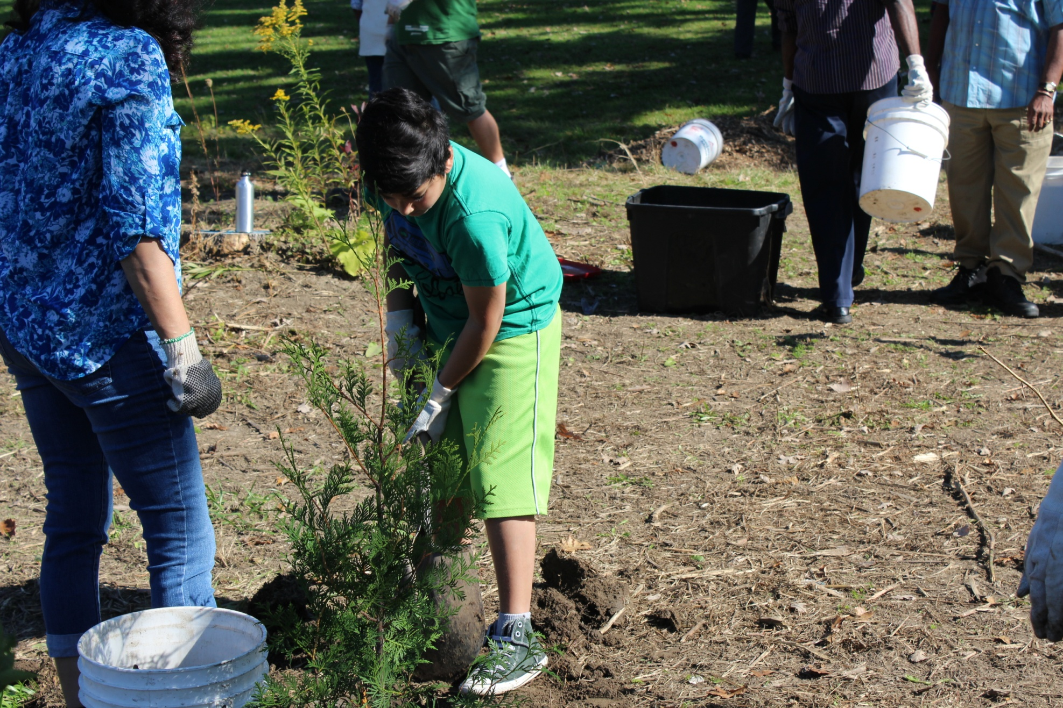

Slide 20
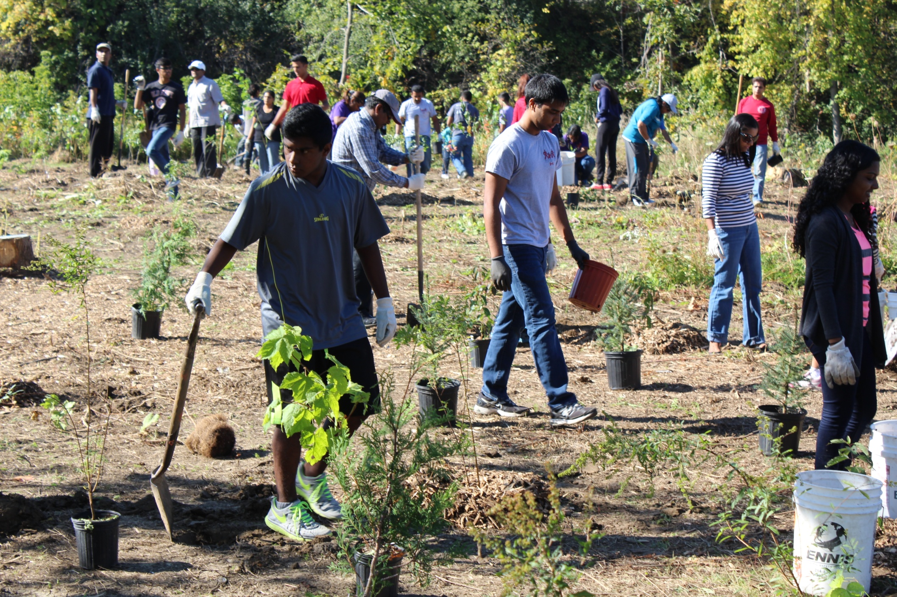

Slide 21
Habitat for Humanity
Youth from SSSB center of Edmonton volunteer their time and skills to build homes for the less fortunate at Habitat for Humanity. This service project had a remarkable, lasting impact on the youth.
They felt they had made a difference when they noticed the reaction of a needy family who plan to move into the home that was being built.

Slide 22
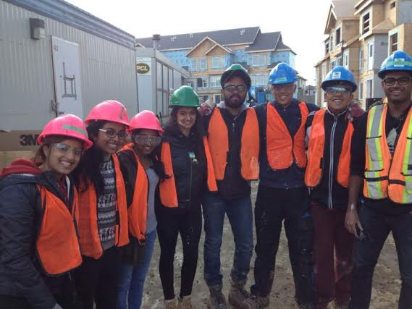
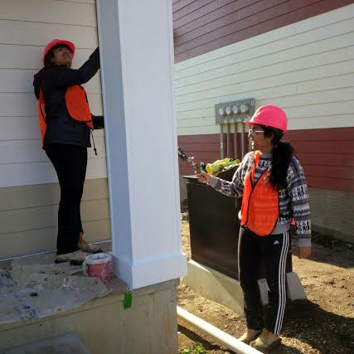

Slide 23
UNITY OF FAITH CONFERENCE
“Love All Serve All”
The Unity of Faith Conference was organized, at the Sathya Sai Centre of Toronto-York, on Saturday, 18 October 2014, for interfaith discussions on Christianity, Buddhism, Judaism, Islam, Zoroastrianism, Aboriginal spirituality, Sikhism and Hinduism.
The members from various centres and devotional groups in and around Toronto area participated in the Conference.

Slide 24
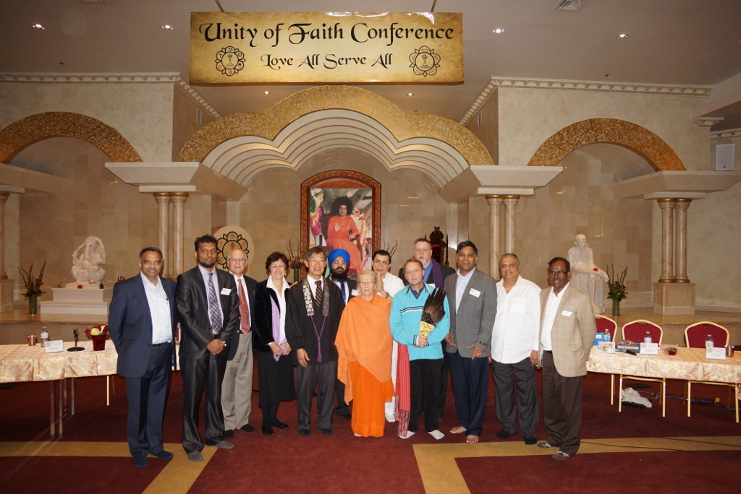
Multi-Faith

Slide 25
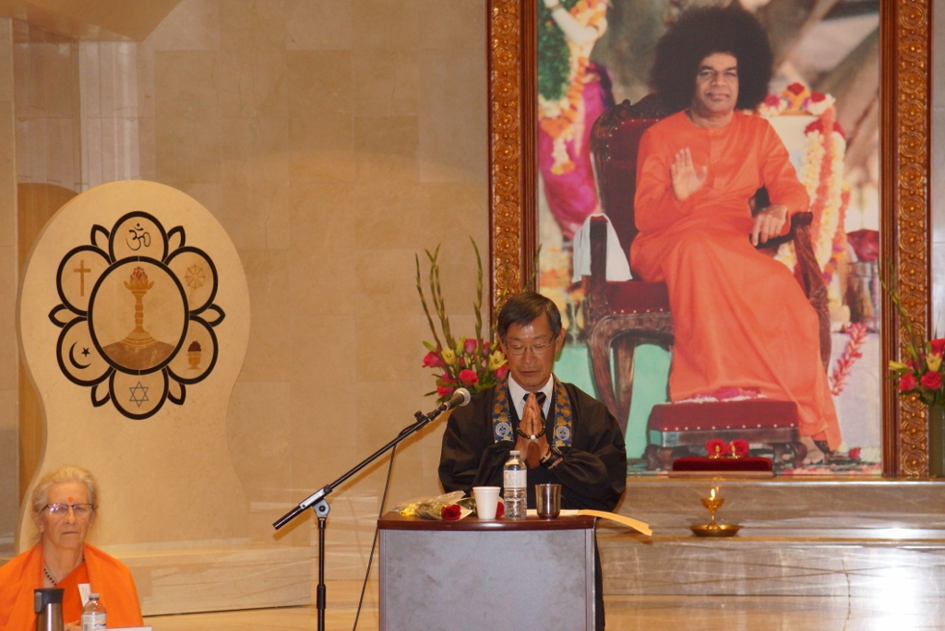
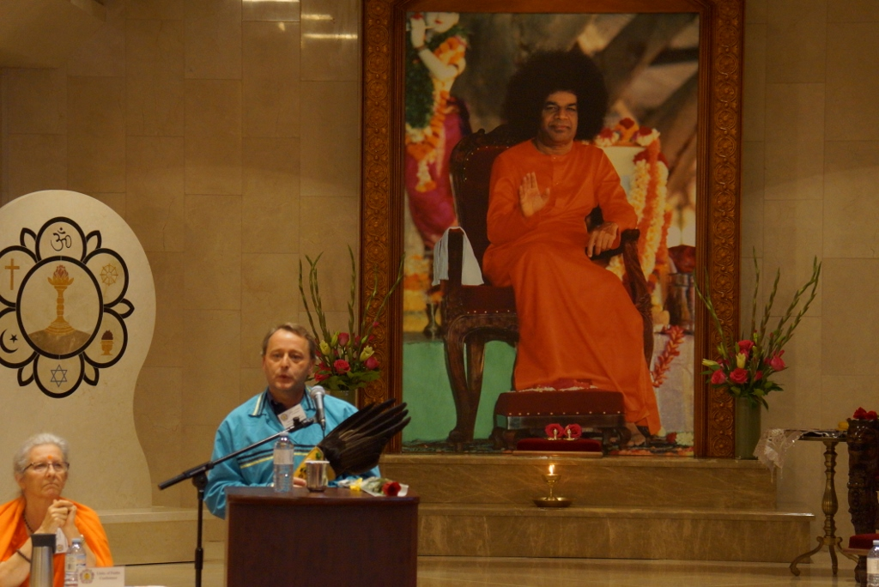
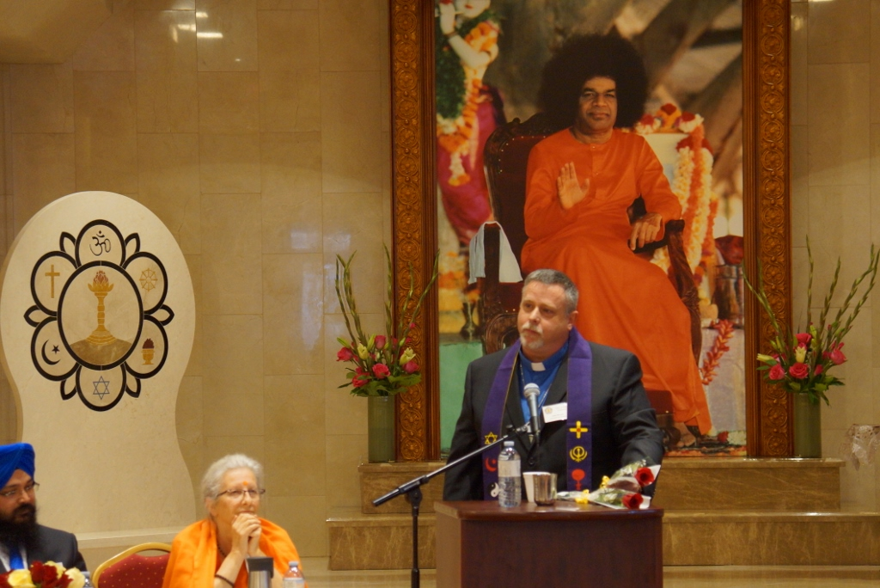
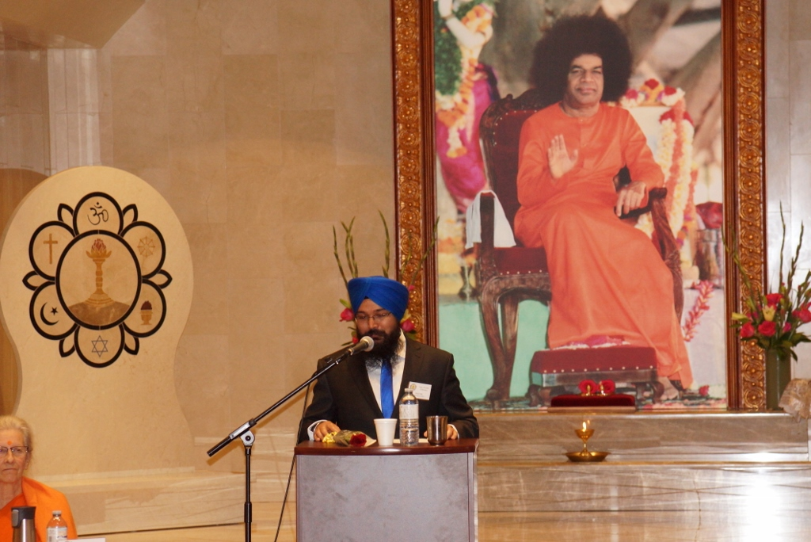
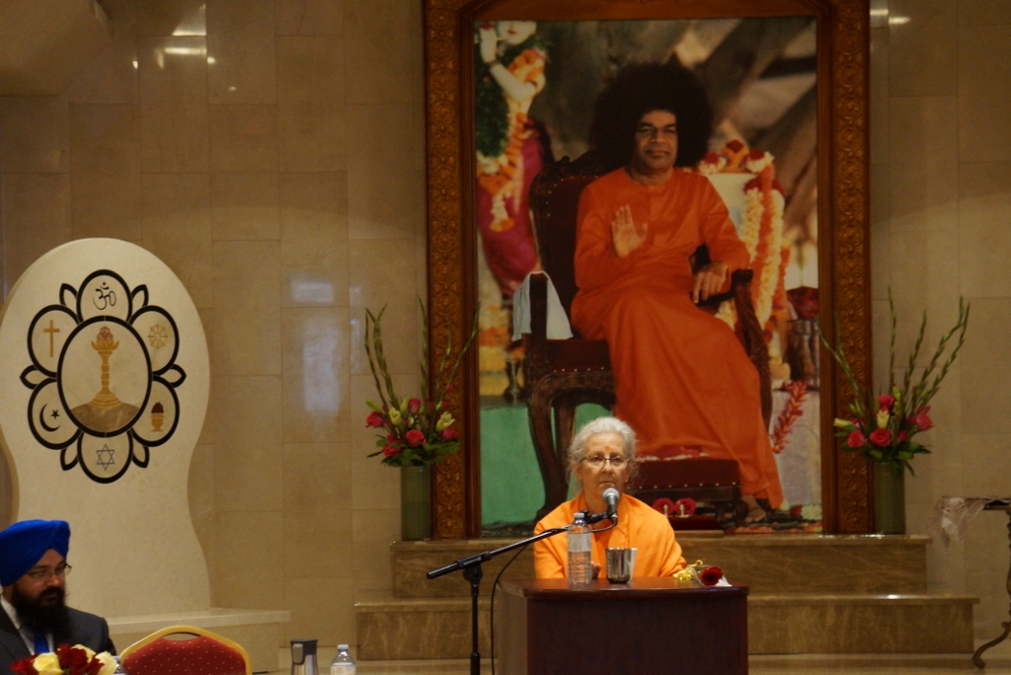
Buddhism
Aboriginal Spirituality
Christianity
Sikhism
Hinduism

Slide 26
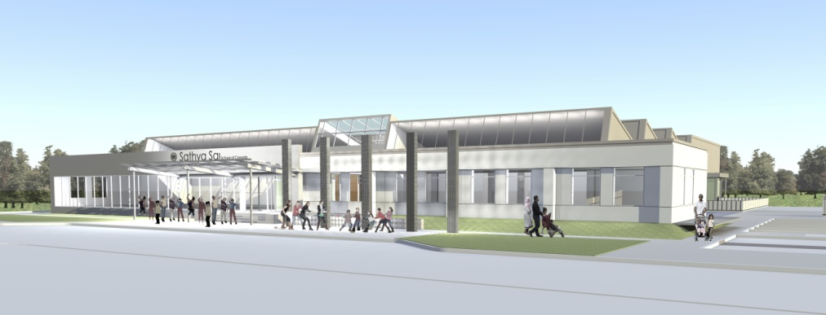
Sathya Sai School Building Project
451 Ellesmere Road, Toronto
Ontario, M1R 4E5, Canada
An offering at the
Divine Lotus Feet of
Bhagawan Sri Sathya Sai Baba

Slide 27
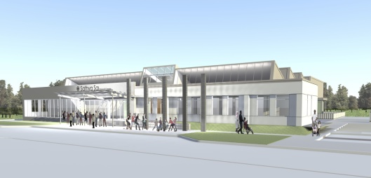
General Information
Date of Purchase: Jan 31, 2013
24,000 Sq. ft on 2.5 Acres
New extension of 6,000 Sq. ft
Construction Began: October 2013
Completion Date: December 2014

Slide 28
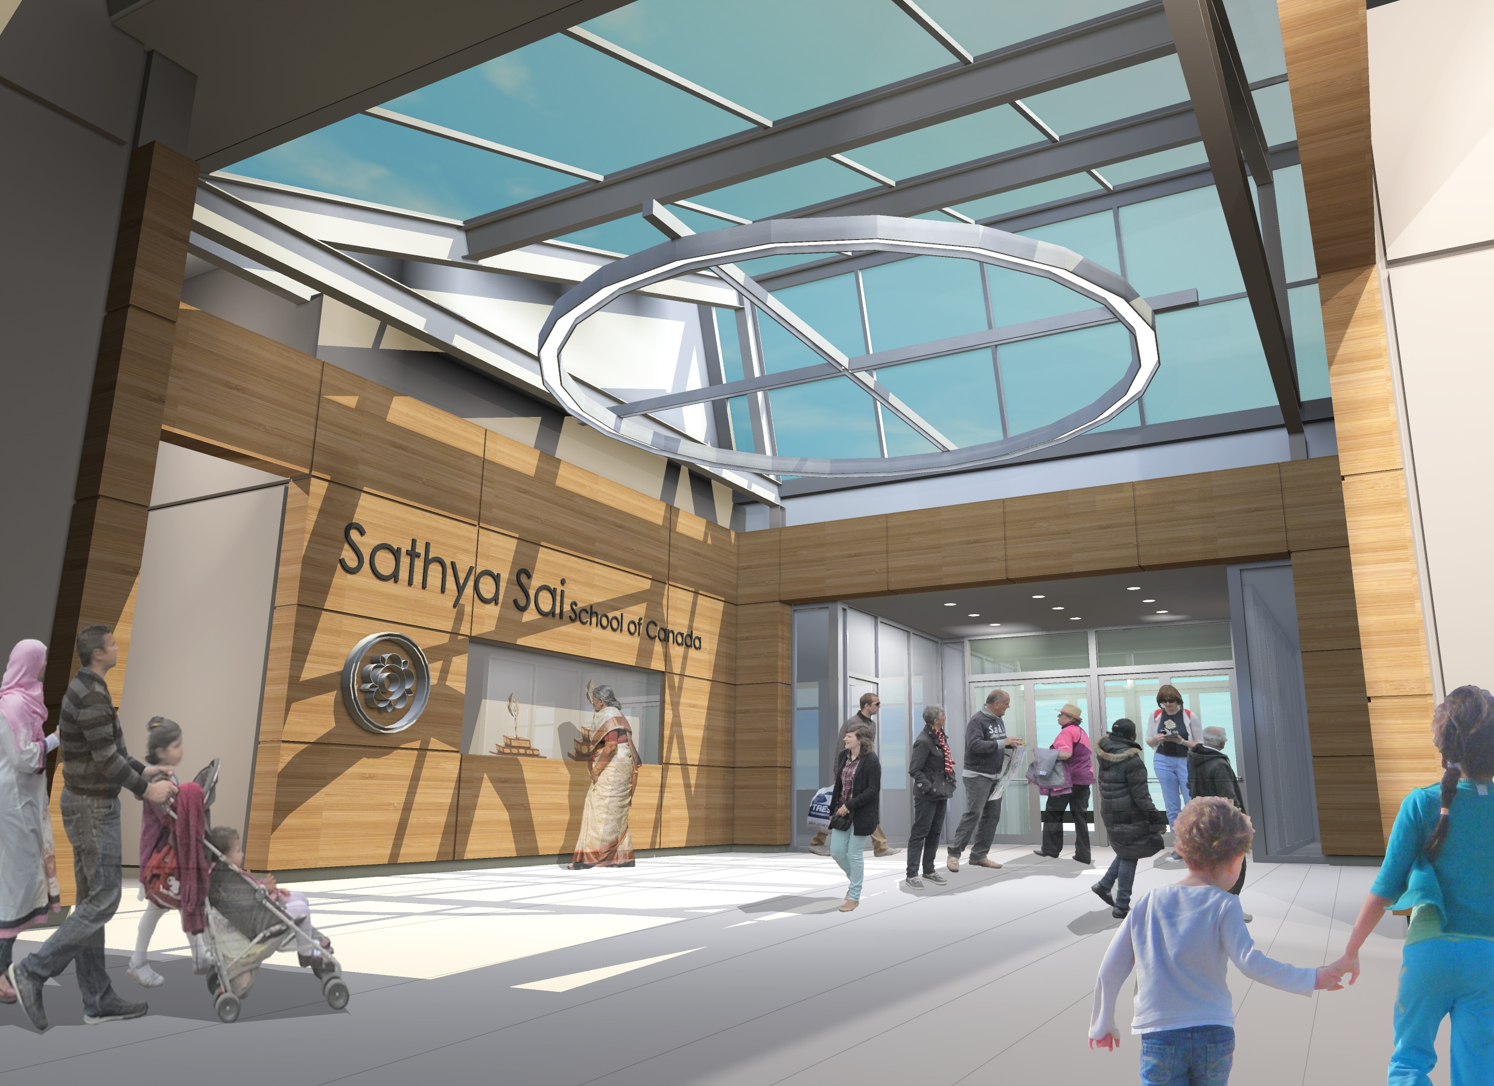

Slide 29
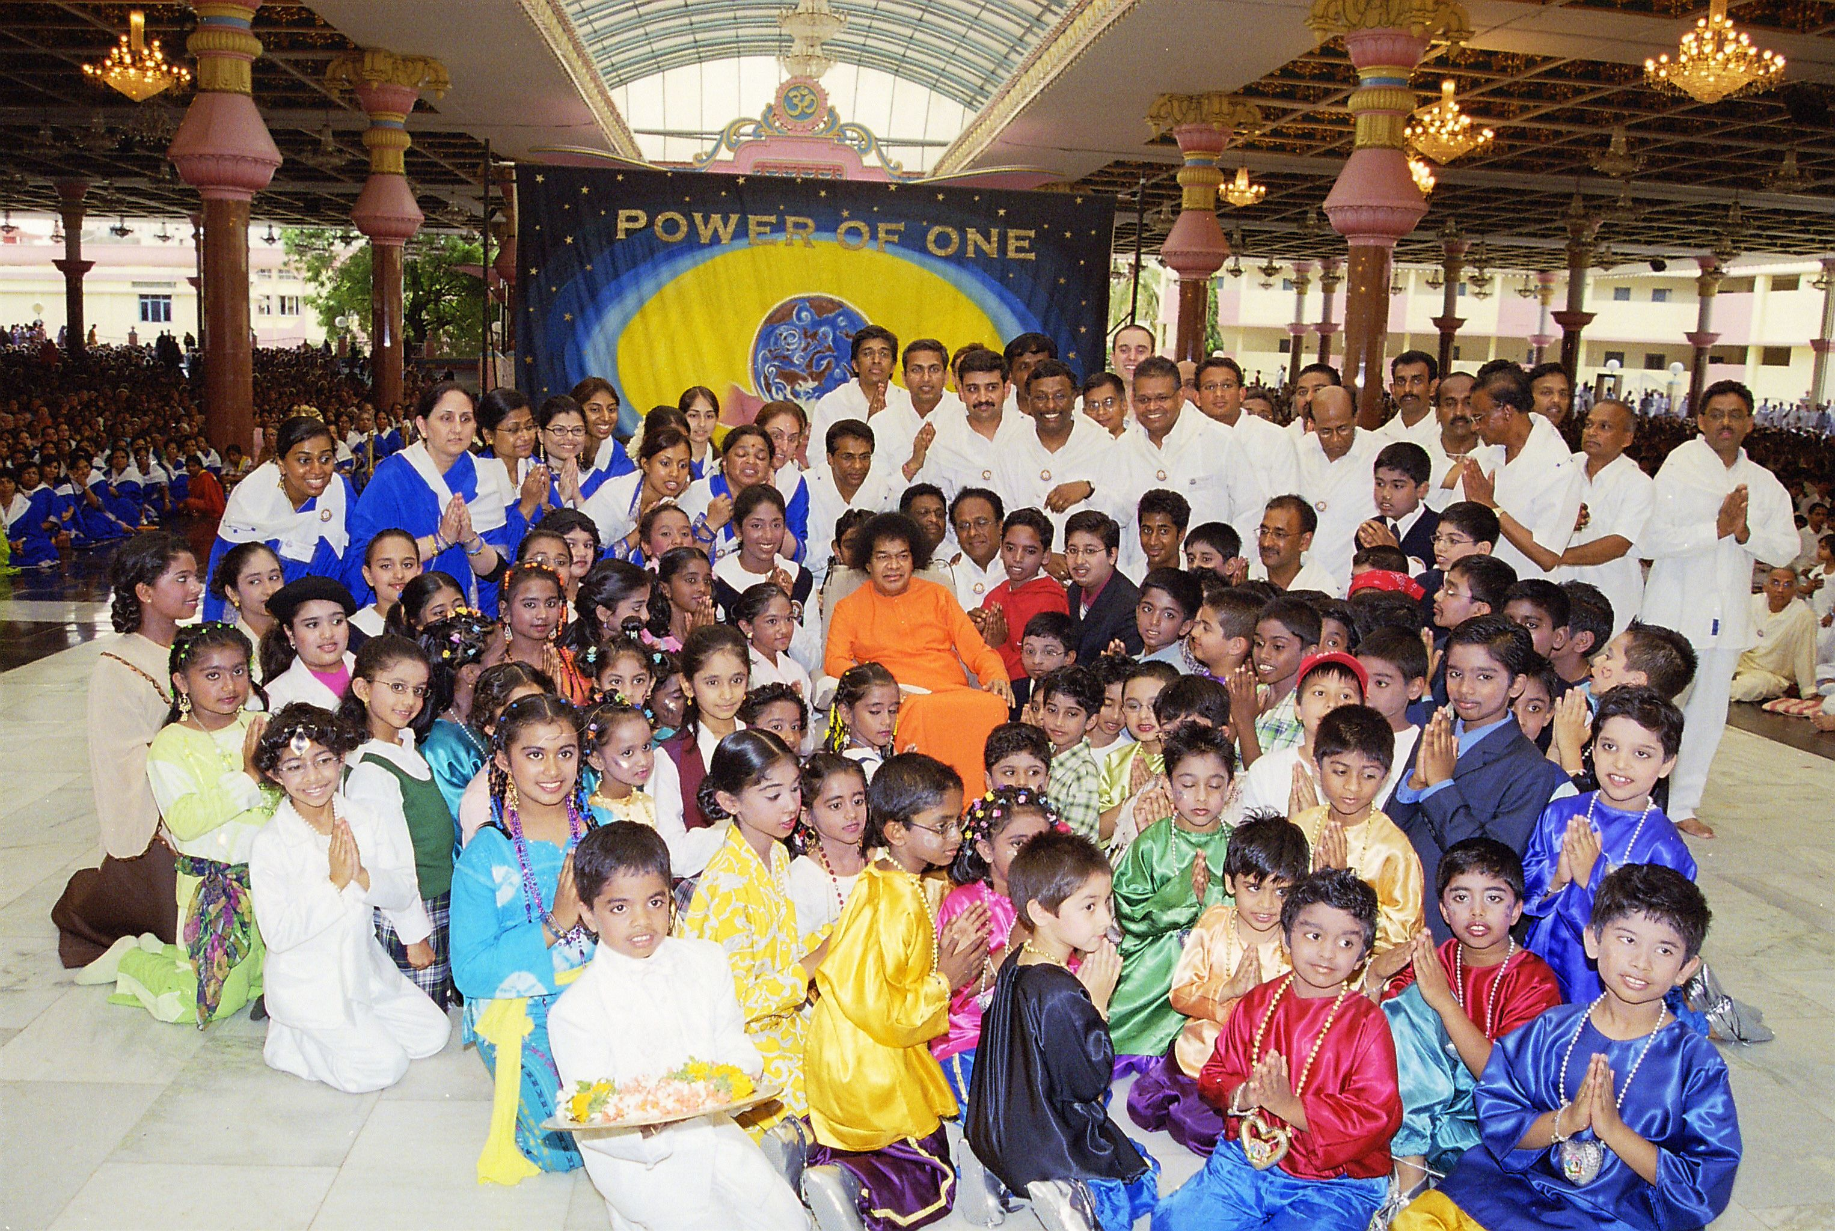
Swami blessed Sathya Sai School Children – July 2006

Slide 30
Canadian Pilgrimage to Prasanthi Nilayam in December 2014
The National theme for 2014 is, “All ARE ONE, ALL ARE LOVE, ALL ARE SAI”.
Christmas Carols led by the Canadian Devotees - Thursday, 25th Morning, December 2014.
Play by the Sathya Sai School of Canada – Thursday, 25th evening, December 2014.
Musical Performance by SSE/Youth/Sathya Sai school – Saturday, 27th evening, December 2014.
Devotees will be decorating Swami’s residence and his Abode the “Prasanthi Nilayam”

