Slide 1
Protecting Swami’s Name in a Digital World
Presented by the Sathya Sai International Organisation,
IT Committee

Slide 2
Purpose of Search Engine Optimization (“SEO”)
Ensure appropriate information about Swami & His Works is easier to find while also improving prioritization for our official websites within internet search engine results

Slide 3
Current Context of the Usage of the Internet
Summary
The Internet is Now the Primary Medium for Information & Research for both Devotees and Seekers
Search Engines Rely on Website Owners to Determine Appropriate Content
IT Committee is Developing Standards & Training for Organization Webmasters & Media Coordinators to Make SEO Easier

Slide 4
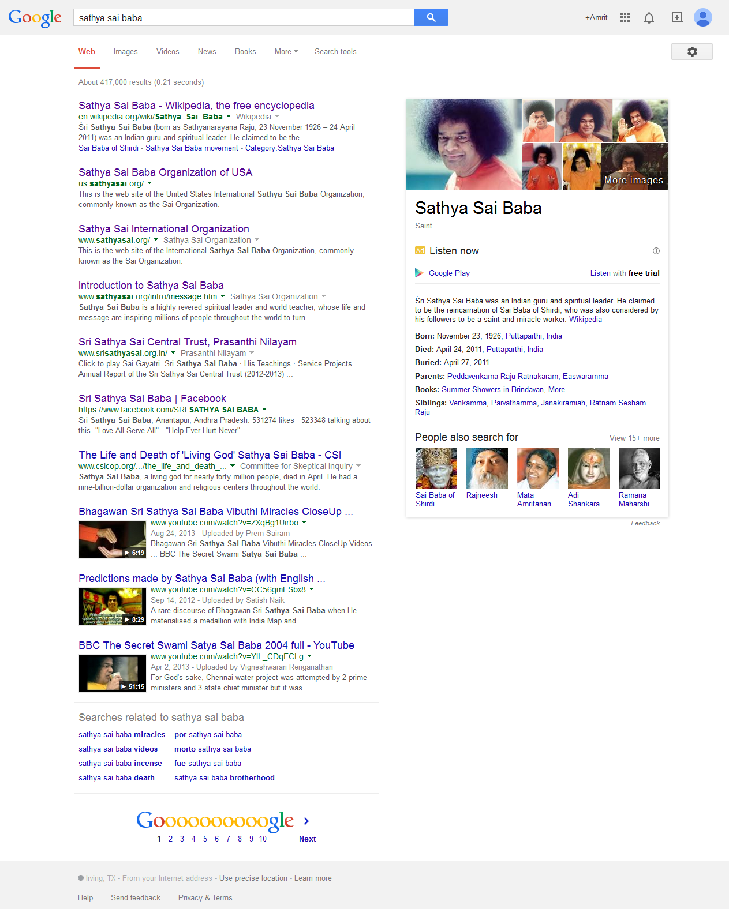
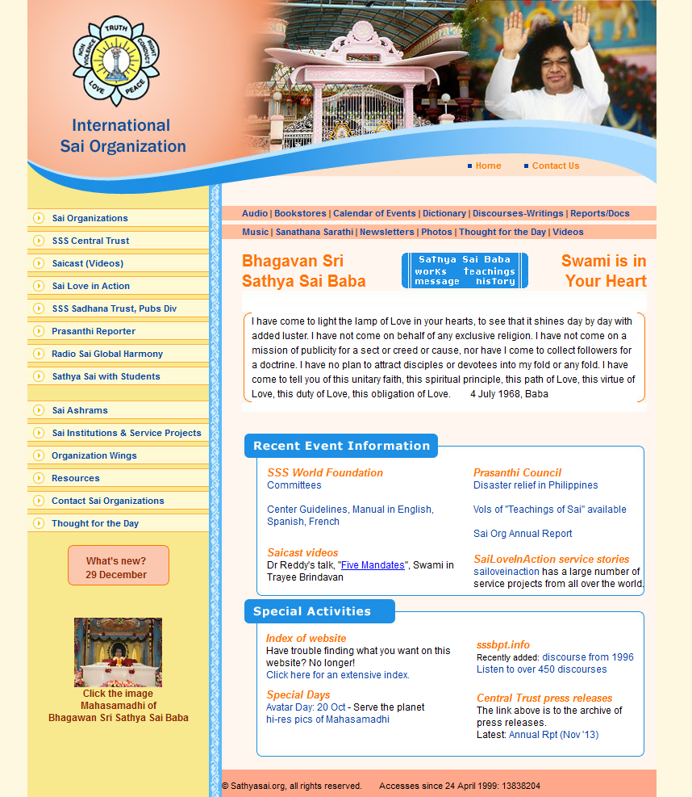
SEO Can Help Prioritize Relevant Content at the Top of Search Engine Results
Summary
Latest News by Recognized Sources Moves to the Top in Search Results
Search Engines Use ‘Internal Page Content’ to Determine Relevant Information
Image Names
Page Names
Page Descriptions
Much of this is in our control and is easy to do …
Search results as of November 18, 2014

Slide 5
The Key Building Blocks of SEO: Regular, Relevant Content is a Priority
SEO
Content
(Regular & Relevant)
Site Structure
(Keywords, Image Names, URLs, etc.)
Off-Page
(Third-Party Links & ‘Reputation’)
Key Point
Our largest needs are in the On-Page and Structure areas; SathyaSai.org has sufficient third-party sites with links to it

Slide 6
These Changes Need to be Made on All Official Websites …
While SEO work is taking place on SathyaSai.org, based on a review, most of our official websites need similar enhancements
We recognize not all Zones / Countries / Regions have SEO experience
IT Committee is holding a series of training sessions starting in early 2015

Slide 7
Preview of SEO Training Session Topics
Introduction to Search Engine Optimization (“SEO”)
SEO best practices
Determine descriptions, keywords and other SEO parameters
Keyword density
Naming images correctly (“Haiti Disaster Relief.jpg” vs “DSC_0123.jpg”)
Tools to utilize
Google Analytics & Google Webmasters
Others where Google may not be an option
Video and social media are growing search engine influencers
Why third-party, quality links matter
Quick SEO Checklist

Slide 8
To Participate, Please Have Your Webmasters Sign-Up
There are limited slots available for each training
Please have webmasters sign-up by writing to Dr. Venkat Sadanand via saiwork@gmail.com
We will also proactively contact the list of Webmasters we have already received from you

Slide 9
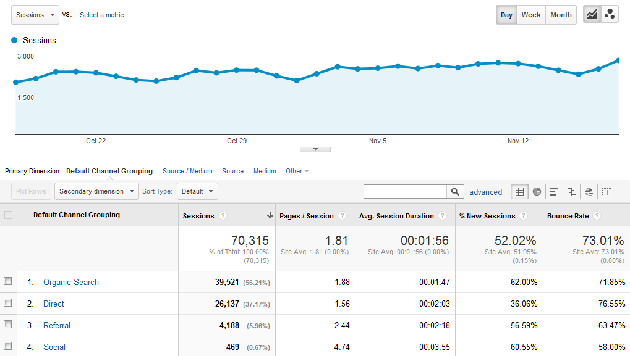
Information from Google Analytics shows that organic Search is by far the largest source of traffic … and this is likely the same in other Organization websites

Slide 10
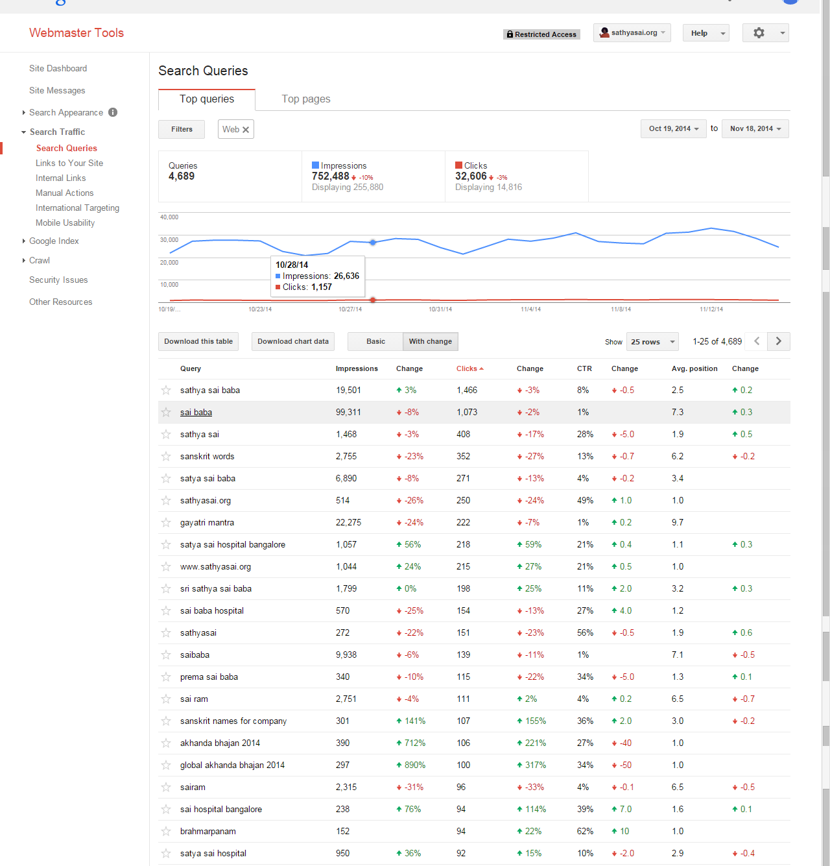
Snapshot of Google Webmasters
Shows detail of what searches visitors made and how those queries are performing

Slide 11
What You Can Do Tomorrow …
Have Google Analytics & Google Webmasters enabled for your site(s)
For countries where Google products may not be an option, we will recommend an alternate solution
Provide contact information for training session

Slide 12
Jai Sai Ram

