Slide 1
Information Technology Update
Sathya Sai International IT Committee

Slide 2
IT Team
IT Committee
Nilesh Patel
Venkatakrishnan Srinivasan
Adriano Bratovic
Tomas Bures
Amrit Kirpalani
David Gries
Venkatraman Sadanand

Slide 3
Progress Report
New SathyaSai.org
Current Status & Roadmap
Key Features & Functionality
Quick Demo
Global SEO Training Session
Update on Other IT Initiatives

Slide 4
Current Status - New SathyaSai.org
Technology
Implementing Platform
Site Content
Reviewed Existing Content & Editing
Notes:
Technology
> IT Committee is implementing the platform
> We have selected the DRUPAL Content Management System
> We faced a few technical delays with the design agency
Site Content
> Post Guru Poornima meeting we launched a SathyaSai.org specific content team
> Team has reviewed and cataloged 1000s of pages
> Editing content and also identifying appropriate images by page

Slide 5
New SathyaSai.Org Planned Timeline
2014
2015
AREA
Q1
Q2
Q3
Q4
Q1
Q2
Q3
Q4
Planning
Content Review & Editing
Core Content
Expanded
Technical Implementation
Expanded
Site Testing & Optimization
Beta version Launched
Maha Samadhi
Expanded Content Launched
Guru Poornima
Today

Slide 6
Appeal
Call for experts
Web development with experience in Drupal
Graphics design
Content editors
Content management
Search Engine Optimization

Slide 9
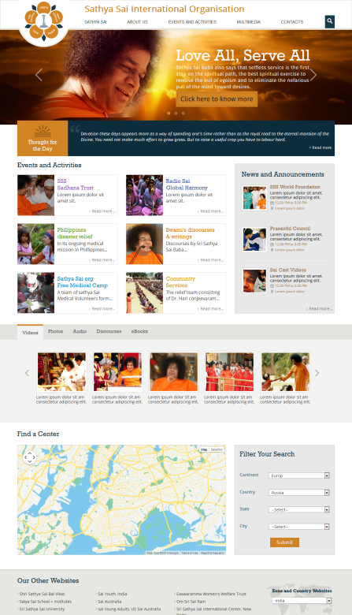
Key Features and Functionality
A
B
Features
C
A
Large, user-friendly navigation menu
D
B
Powerful content search options
C
Rotating graphic summarizing Swami’s teachings
E
F
D
Thought for the Day
E
Current event and activity summaries / reports
G
F
Organisational news & announcements
G
Links to multi-media content (video, photos, etc.)
H
Easily find a center anywhere in the world
H
I
Quick links to official Organisation sites
I

Slide 10
Demo of Current Site

Slide 11
SEO Global Training Session
What is SEO?
Search Engine Optimization or “SEO” is the process of ensuring website content is optimally setup (descriptions, image names, tags, etc.)
Why does SEO matter?
Search engines utilize SEO information to prioritize web search results
The IT Committee will be hosting a series of training sessions in Q1 2015 for webmasters and content producers

Slide 12
Preview of SEO Training Session Topics
Introduction to Search Engine Optimization (“SEO”)
SEO best practices
Determine descriptions, keywords and other SEO parameters
Keyword density
Naming images correctly (“Haiti Disaster Relief.jpg” vs “DSC_0123.jpg”)
Tools to consider
Google Analytics & Google Webmasters
Others where Google may not be an option
Video and social media are growing search engine influencers
Why third-party, quality links matter
Quick SEO Checklist

Slide 13
Creating Detailed Catalog of Existing Sathya Sai Websites
There are many Sathya Sai Websites, some are regularly updated and confirm to guidelines … while others need to
Please submit list of ALL existing Sathya Sai Websites in your Zone by December 31, 2014
Should include zonal, country, regional, city, etc.
Please note those as official
Send to: Venkat Sadanand via saiwork@gmail.com
This list will also be used to invite webmasters and content producers to the SEO training session

Slide 17
Jai Sai Ram

