Slide 1
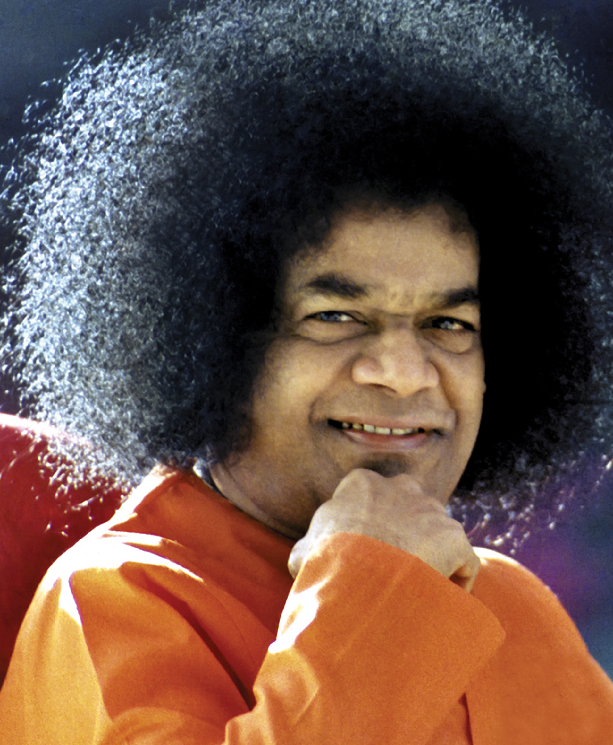
Sathya Sai International Organisation Media Committee Webinar January 2017

Slide 2
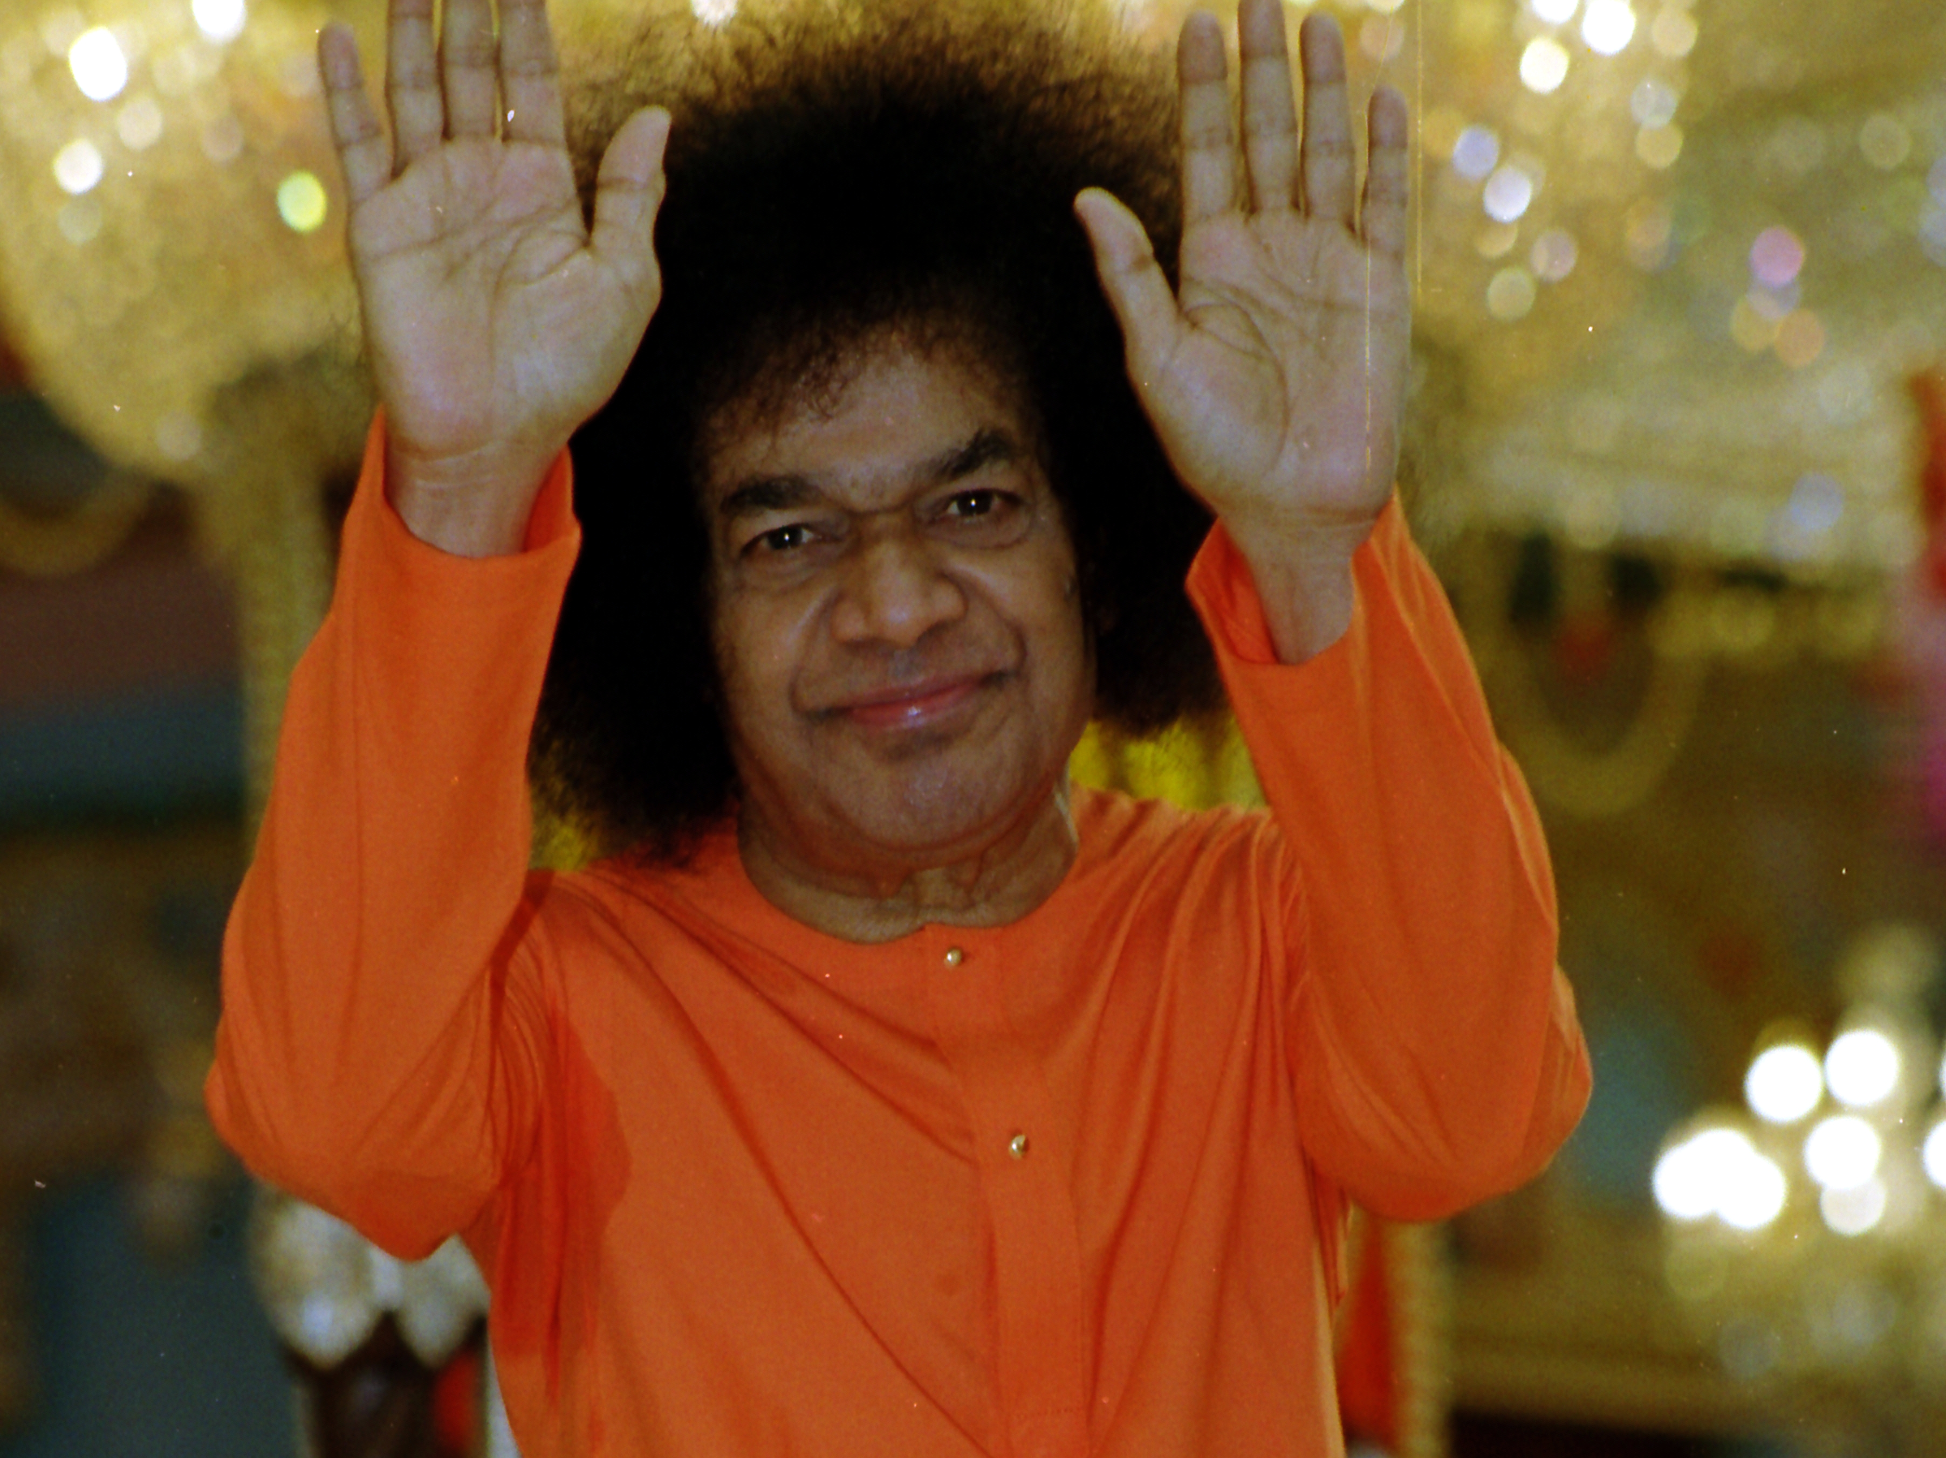

Slide 3
Function of Media Coordinators Interface with Senior SSIO Officers
Media Coordinators
Zone Chair
Central Coordinator
National Council President
MediaTeam@sssio.org

Slide 4
Sharing with Sathya Sai Devotees Worldwide
Media Coordinators: Send Report, Picture, Video to SSIO Media Team
Editorial/Web Team: Edit article, picture, video, and Publish on Websites
Diffusion Team: Distribute to Centers, Groups, Schools (Media Coordinators?)

Slide 5
Media Outlets
Sanathana Sarathi
SSIO Websites: Next slide
SSIO Annual Report: April 2016 – March 2017
SSIO Bulletins: Latest Update on Nepal Disaster Relief
Facebook, Tweeter, WhatsApp
Videos
Brochures
Conference Books, Brochures, Banners, Posters

Slide 6
Selected SSIO Websites
http://www.sathyasai.org/
http://saiuniverse.sathyasai.org/
http://sathyasaihumanitarianrelief.org/updates/

Slide 7
Best Practices and Recommendations
Order of Preference: SERVICE – EDUCATIONAL – DEVOTIONAL
Photographs are very important – tell the story, capture action (no posing), good quality, high resolution – please see Guidelines
Videos are very desirable – please see Guidelines
Longer Articles Preferred – No Word Limit (But content should be inspiring & motivating) – please see Guidelines
Article/Photo/Video Guidelines – On sathyasai.org
Local Teams: Writers, Videographers, Photographers – replicate at local level

Slide 8
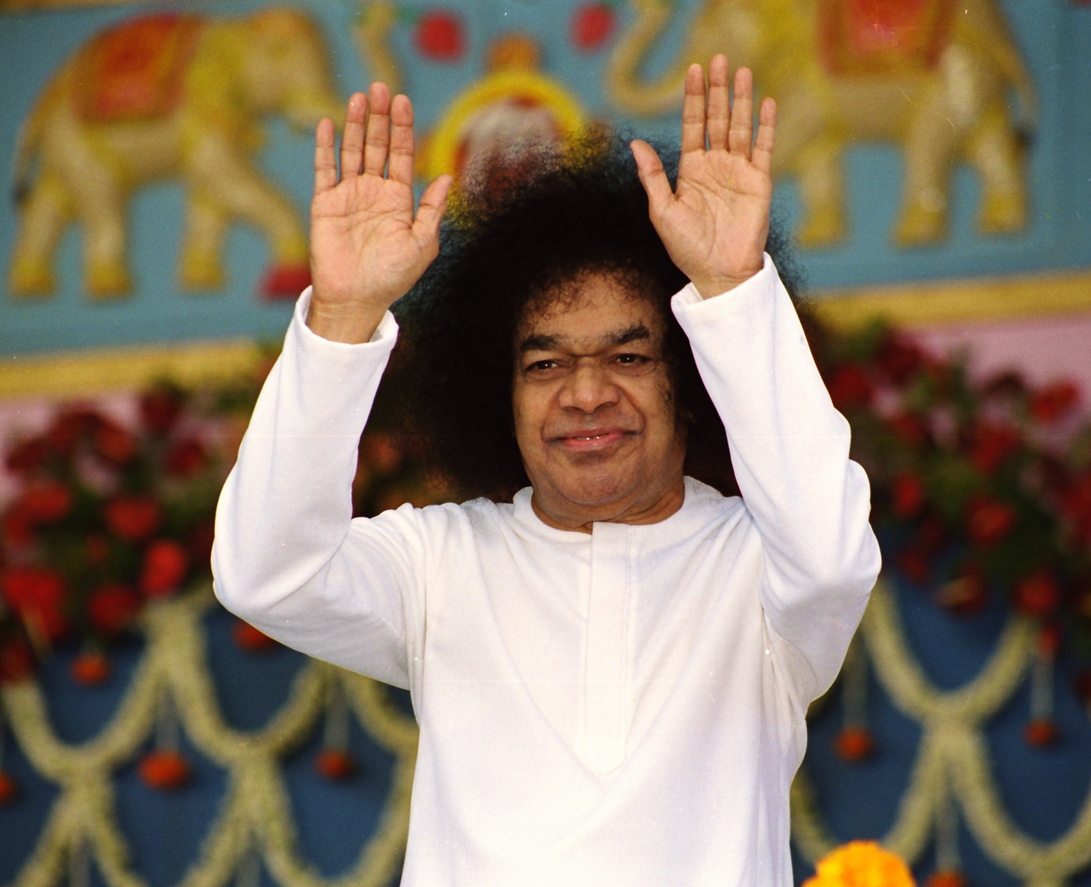
Om Sri Sai Ram

