Slide 1
Introduction to TeamViewer
A Tutorial

Slide 2
Objective
Understand the benefits of TeamViewer vs other similar technologies
How to allow others to get remote control
Learn how to attend and host a meeting

Slide 3
Benefits of TeamViewer
TeamViewer allows another person to remotely control your computer and to host online meetings with Audio, Video and Desktop Sharing
TeamViewer provides a very simple method to allow another person to remotely control your computer. This is very useful when you need assistance from someone else.
The person controlling your computer will be able to do everything they can do as if they are in physically sitting in front of the computer.
TeamViewer allows you to host Online meetings Similar to WebEx
TeamViewer is free for non-profit/personal use

Slide 4
When to Use Other Technologies
WebEx is better choice for re-occurring meetings
TeamViewer requires installing their application to host a meeting and to download and run their application to give remote control
For Audio only Conference calls for a small number of individuals Skype may be a better option
For more than 25 participants WebEx and other tools are better

Slide 5
Giving Remote Control
Download the TeamViewer Client from http://download.teamviewer.com/download/TeamViewer_Setup_en.exe
Run the TeamViewer Setup
Start TeamViewer
Give the individual assisting you Your ID and Password
Now they will be able to control you computer. Do not use the mouse and keyboard unless instructed by them.

Slide 6
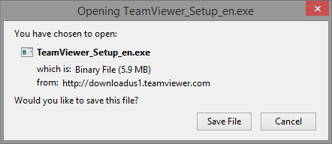
Downloading TeamViewer
Click Save
Once downloaded run the setup application
Click Ctrl-J to see downloaded files
Double click on TeamViewer Setup

Slide 7
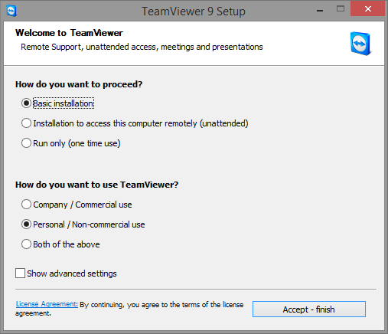
TeamViewer Setup

Slide 8
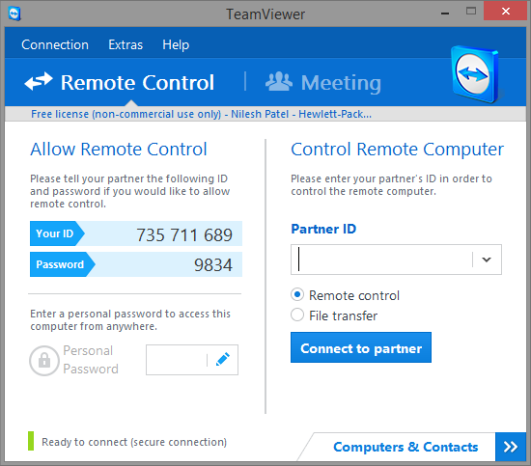
Start TeamViewer
Click Start
Click all Programs
Click TeamViewer 9
Provide the person assisting you Your ID and Password.

Slide 9
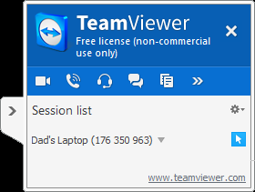
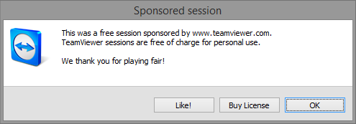
You will see this at the bottom of the Screen when someone is remotely controlling your laptop.
Click on the X when you want to stop the remote assistance.
You will see this screen when you exit TeamViewer. Click OK.

Slide 10
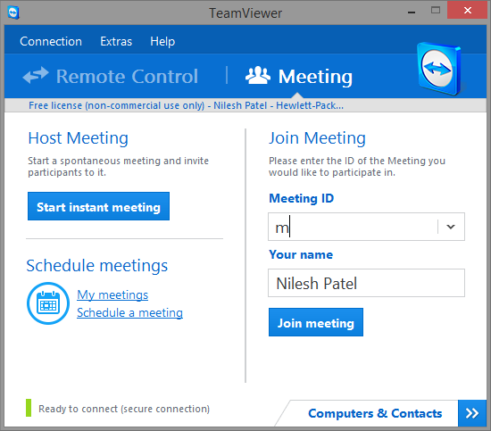
Hosting an Instant Meeting
Click on Meeting
Click on Start Instant Meeting

Slide 11
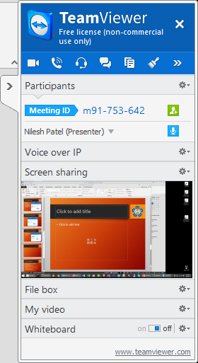
Meeting Panel
Provide Meeting ID to other participants. This can be done by email or phone
Host will automatically be sharing Desktop

Slide 12
Questions
?

